Slide 1
Analysis of Customer Satisfaction
Anika Hynönen | Ron Kosova • 28.09.2022

Slide 2
Overview of Survey
Survey of 102 customers of a store
Measuring satisfaction of prices and range of products

Slide 3
Variables
gender | 1 - female | 2 - male
age | year
family_size | persons
house | 1 - own apartment | 2 - rental | 3 - employ housing
education | 1 - primary | 2 - vocational | 3 - secondary | 4 - applied science university | 5 - other
net_h_income | €/month
h_spending | 1 - < 250| 2 - 250 - 499 | 3 - 500 - 749 | 4 - 750 - 999 | 5 - > 1000 €/month
range_sat | 1- 5 | 1 - very dissatisfied ~ 5 - very satisfied
price_sat | 1- 5 | 1 - very dissatisfied ~ 5 - very satisfied

Slide 4
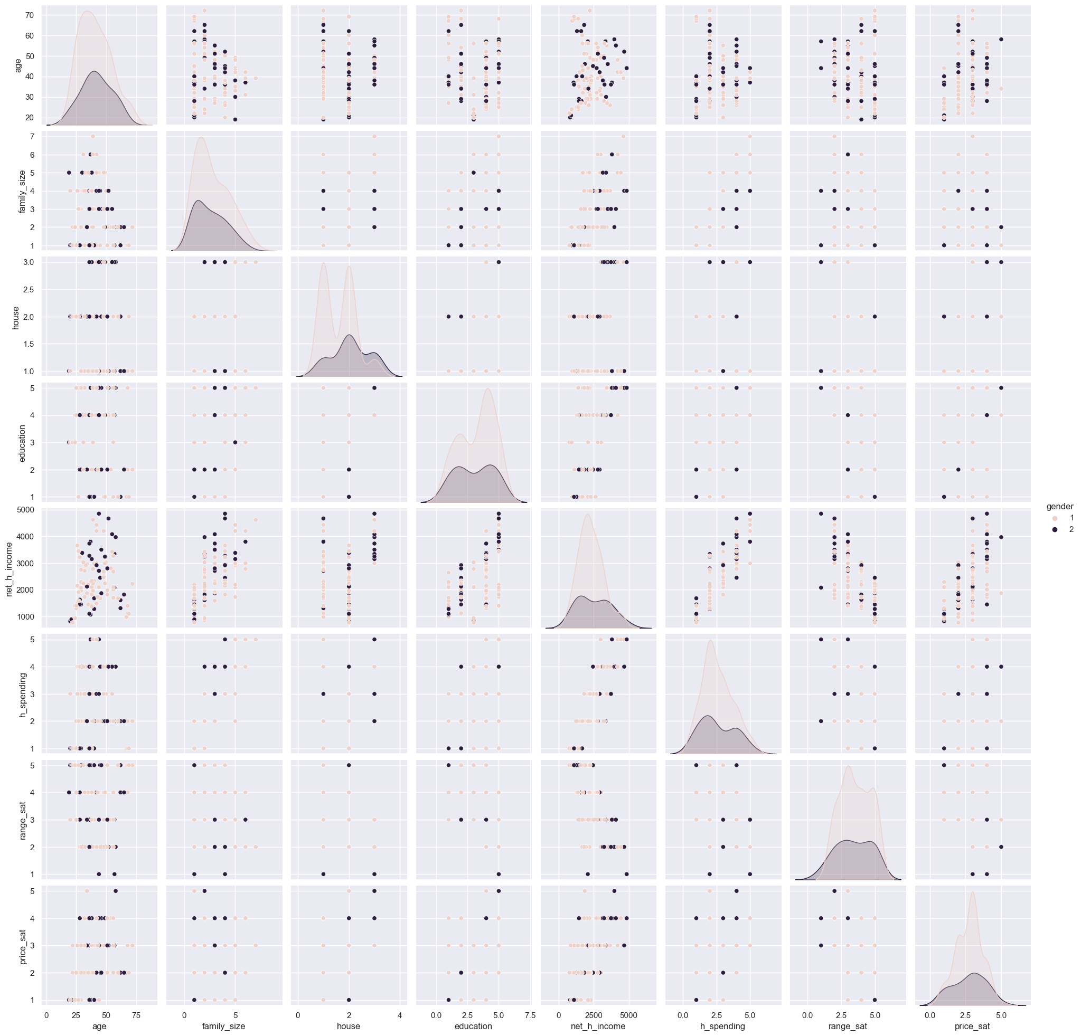
General look at data relations
Important step to find relations
Meant to present a generalized graphical view and not details
Provides a great look into potential correlations
Allows focus to be on correlations involving price satisfaction and range satisfaction
Important, easily noticeable correlation:
Net Household Income (net_h_income)
vs.
Price Satisfaction (price_sat)

Slide 5
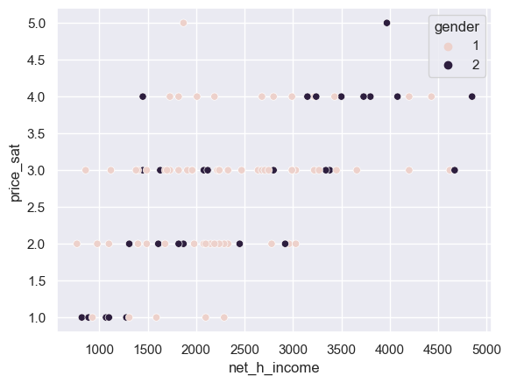
Net Household Income vs. Price Satisfaction
Noticeable density within the range of ~1500 to ~3000
Noticeable (rough) linear correlation

Slide 6
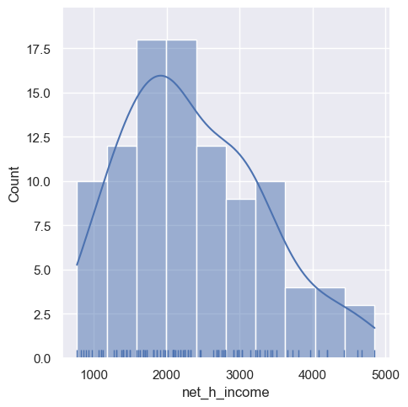
Net Household Income Distribution
Representation of income distribution
Average income: 2365.7 euro
Standard Deviation: 960.65 euro
Clear density between the ranges of ~1500 and ~3000; roughly within 1𝜎
Exactly 67% of all customers reside within one standard deviation
Mean: | 2365.7
STD: | 960.65
67% of customers earn between €1405 and €3326

Slide 7
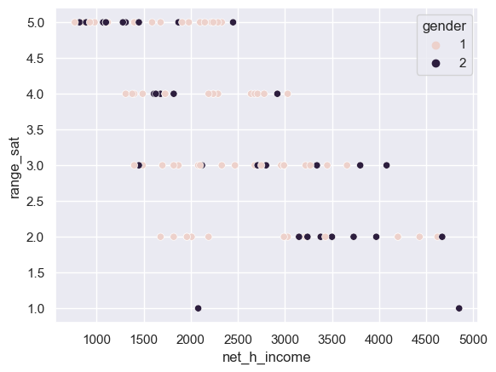
Net Household Income vs. Range Satisfaction
67% in a dense range is important when going for efficient solutions as it means the majority is being impacted.
Another interesting correlation:
Net Household Income vs. Range Satisfaction
Opposite direction of Net Household Income vs. Price Satisfaction

Slide 8
Equilibrium Solution Suggestion
Customers within the 67% range are more satisfied with the range than with the prices.
Customer on the lower end of net household income trend similarly but more extreme.
Customers on the higher end of net household income are quite dissatisfied with range but also quite satisfied with the prices.
Opportunity to bring satisfaction to an equilibrium or even higher average.
Average (67%) consumer price satisfaction is 2.836
Average (67%) consumer range satisfaction is 3.493

Slide 9
Equilibrium Solution Suggestion
Lowering the prices while also lowering the range can equalise or improve general satisfaction while keeping or improving current net revenue.
Items can be dropped and cause minimal damage to range satisfaction if dropped efficiency, i.e.:
Dropping items that aren’t purchased as often,
May even lead to profit increase.
Average (67%) consumer price satisfaction is 2.836
Average (67%) consumer range satisfaction is 3.493

Slide 10
THANK YOU
Anika Hynönen | Ron Kosova • 28.09.2022

