Slide 1
Url: https://vahan.parivahan.gov.in/puc/

Slide 2
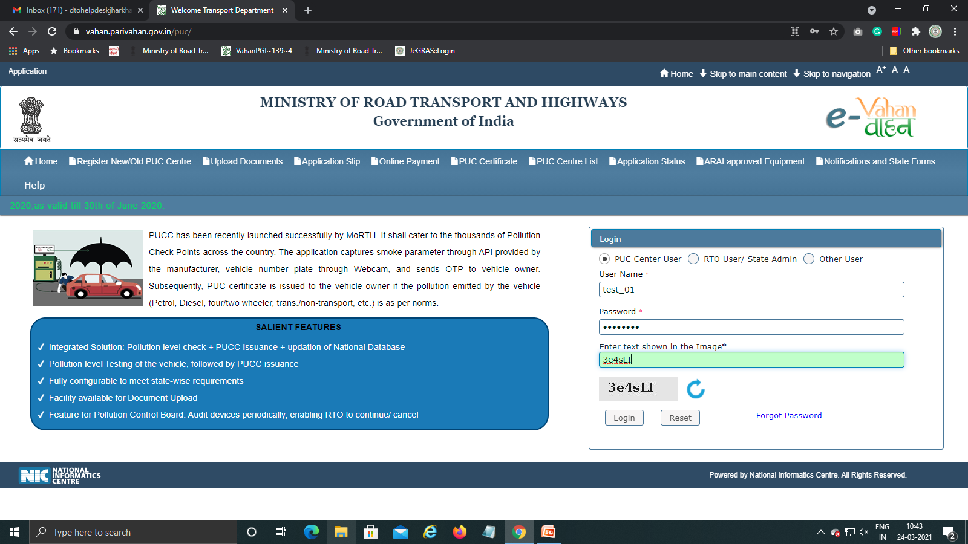
Step 1: Login With PUC Center User

Slide 3
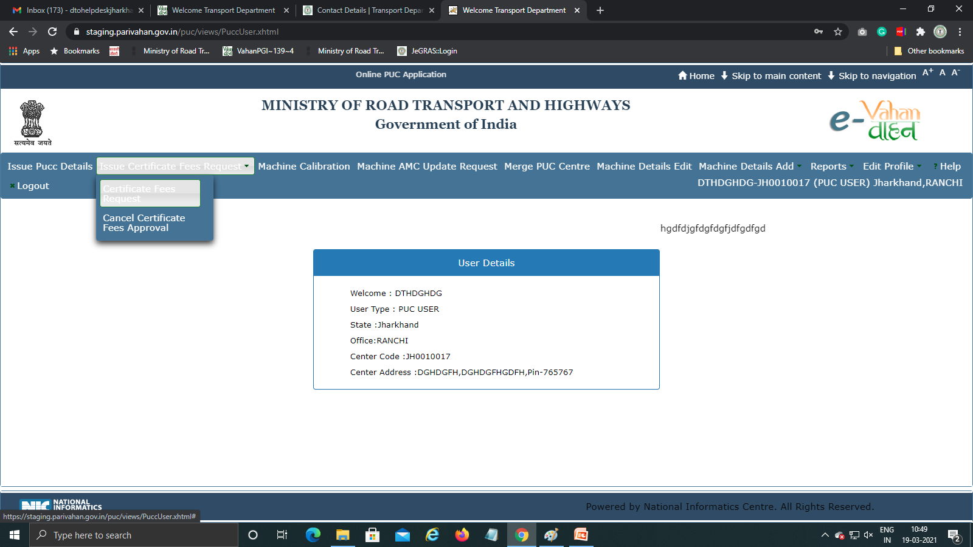
Step 2: Select Issue Certificate Fee Request→Certificate Fee Request

Slide 4
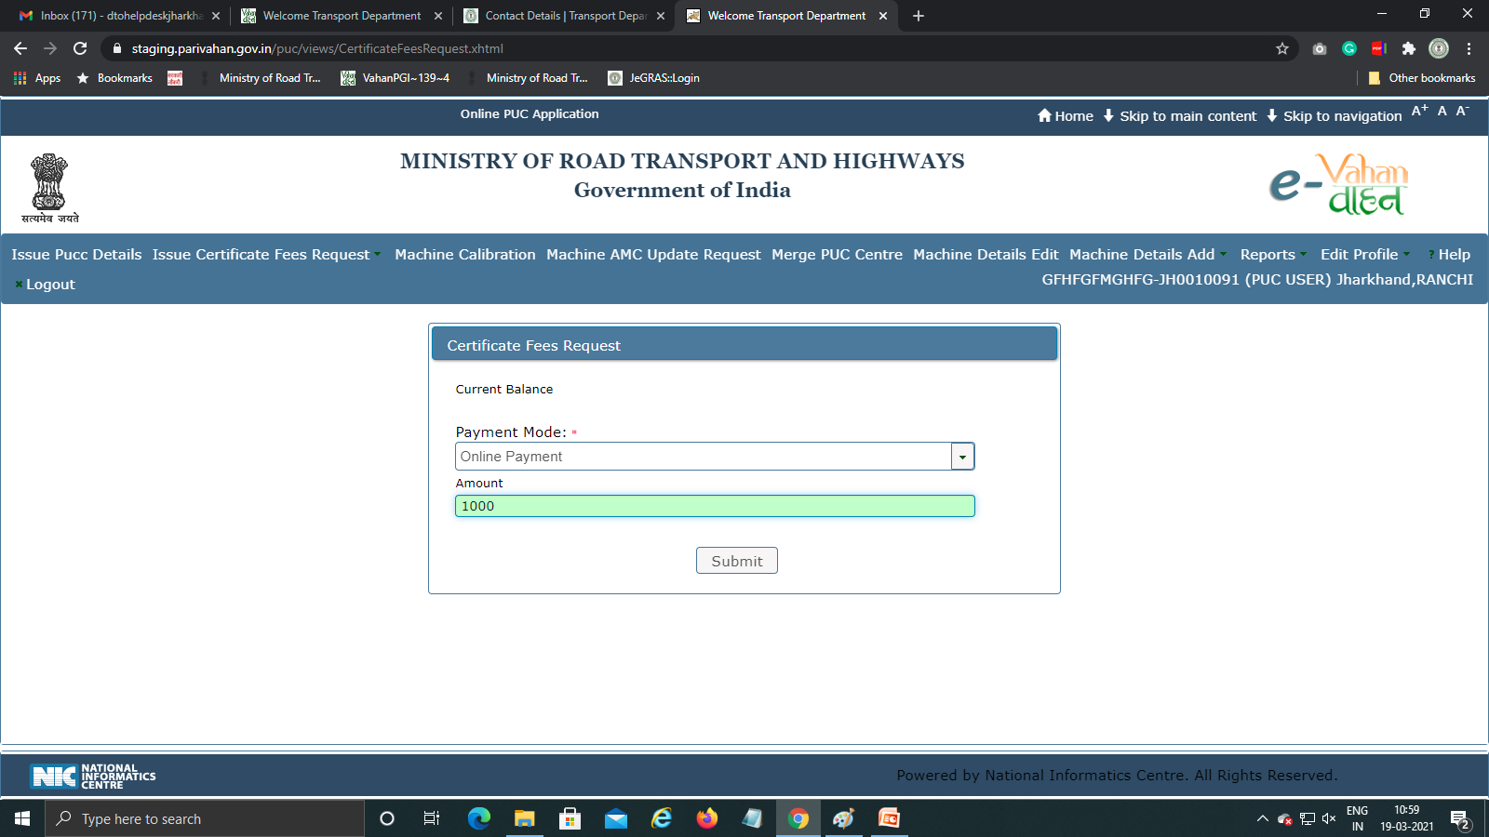
Step 3: Select Payment Mode(Online) And Enter Amount

Slide 5
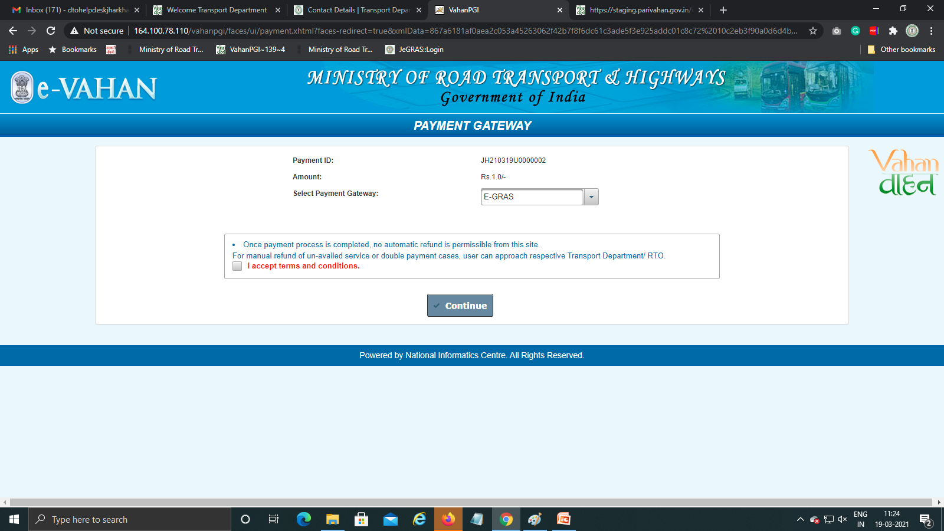
Step 4: Do Online Payment Through E-GRAS

Slide 6
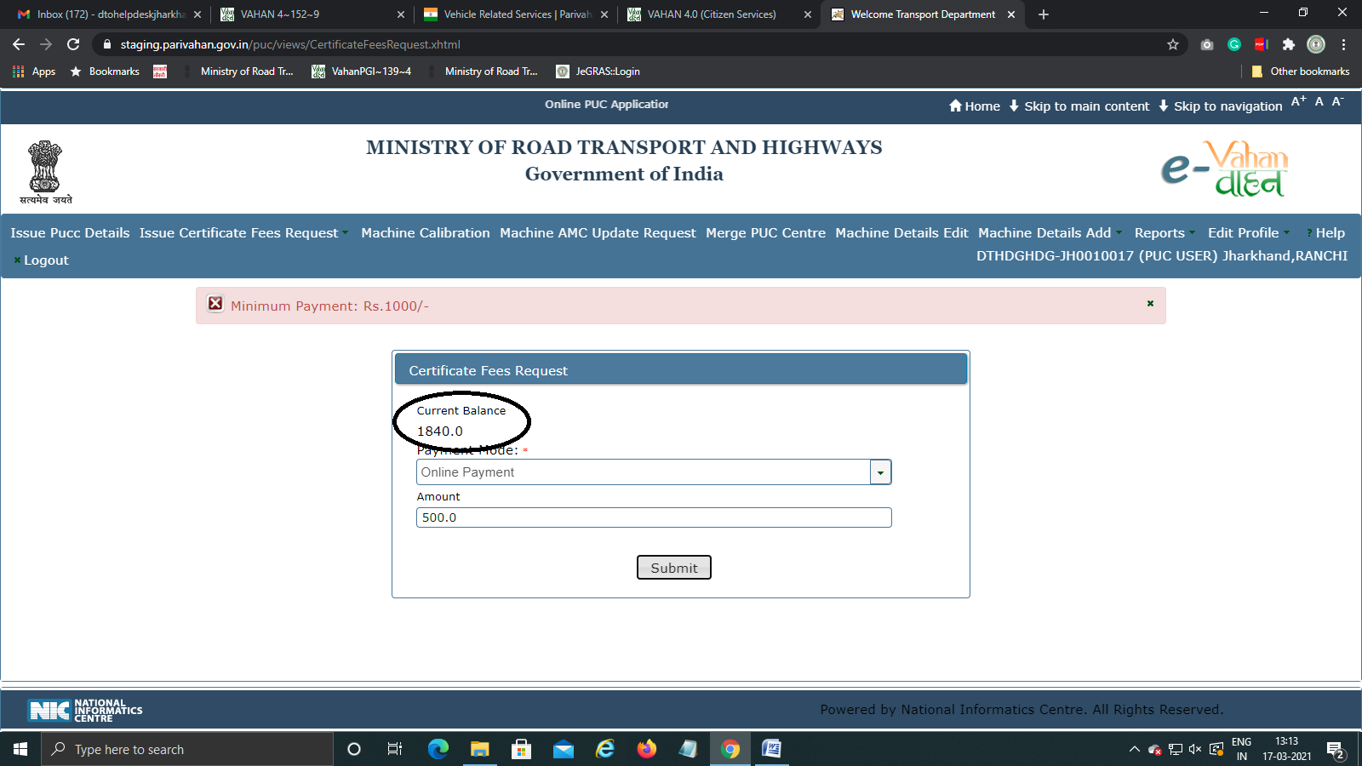
Step 5:After Online Payment Amount Will Be Added To Wallet (Minimum Payment →1000)

