Slide 1
Game Time: Project Week

Slide 2
Project Week Overview

Slide 3
You made it!!!

Slide 4

Project Week! (This Week)
Today’s Class:
Divide into groups
Begin researching APIs
Outline project ideas
Submit Project Proposal for Approval
Initial Design work
Next Class:
Hardcore Development
Instructor + TA Workshops
Saturday’s Class:
Hardcore Development

Slide 5
Project Week (Next Week)
Next Week (M/T):
Hardcore Development
Next Week (W/Th):
Hardcore Development
Presentation Prep
Saturday’s Class:
Presentations!

Slide 6
The Great Push
Be serious about project week!
Use this as an opportunity to push yourself and prove what you know.
Because you DO KNOW!.

Slide 7
Teams

Slide 8

Groups
When I was putting these teams together, I assigned you all team names of randomly generated Dungeons and Dragon/Forgotten Realms tavern names! You most definitely do not need to keep them, but I figured I would share since it's how I have you in my documentation now!
The Grinning Lion
• Isaac Motley
• Nathan Kloer
• Johnny King
• Nadine Hernandez
The Sharpening House
• Kevin Luu
• Phillip Grider
• Vita Chen
• Barbara Hernandez
The Dragon’s Den
• Alton Salmon
• Vicki Hope
• Jamie Rodriguez
• Daniel Valverde
The Shield and Keep
• Chris Human
• Carolyn Bernier
• Sam Bussey
The Roots of the Earth
• Tony Lockhart
• Mary Nguyen-Choi
• Komal Batra
• Shemika Williams

Slide 9
Task

Slide 10
Coding Requirements
Must use at least two APIs
Must use AJAX to pull data
Must utilize at least one new library or technology that we haven’t discussed
Must have a polished frontend / UI
Must meet good quality coding standards (indentation, scoping, naming)
Must NOT use alerts, confirms, or prompts (look into modals!)
Must have some sort of repeating element (table, columns, etc)
Must use Bootstrap or Alternative CSS Framework
Must be Deployed (Github Pages)
Must have User Input Validation

Slide 11
Coding – Nice To Haves
Utilize Firebase for Persistent Data Storage (Consider this basically a requirement).
Mobile Responsive
Use an alternative CSS framework like Materialize

Slide 12
Presentation Requirement
You will also be responsible for preparing a 10 minute presentation.
This will be a formal presentation.
One in which you explain in detail:
  Your overall application’s concept
  The motivation for its development
  Your design process
  The technologies you used (and briefly how they work)
  A demonstration of its functionality
  Directions for future development
Treat the presentation seriously!
Talking intelligently about tech > doing tech sometimes.

Slide 13
Metrics

Slide 14
Metrics
Concept
Design
Functionality
Collaboration
Presentation

Slide 15
Awards Yay!
Most Awe-Inspiring
Most Useful
Most Creative
Best Use of Tech
Best UI/UX
Most Hilarious
Most Disruptive
Most Socially Conscious

Slide 16
API Suggestions

Slide 17
API Suggestions
Stick to APIs that do all of the following:
Allows CORS
Simple or no authentication
JSON response returned
Well documented

Slide 18
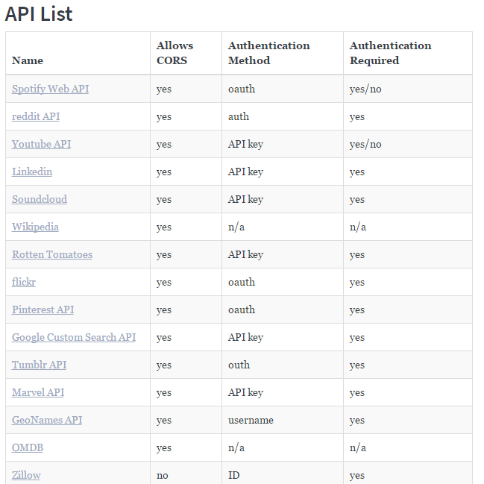
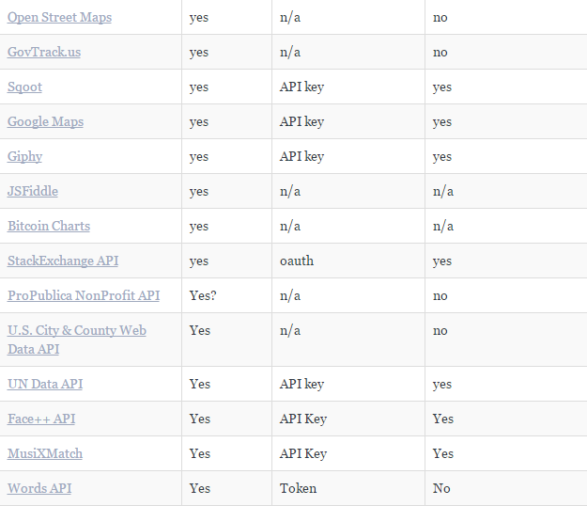
API Suggestions

Slide 19
Tools

Slide 20
Collaboration is Critical!
Steering a project with remote developers like this one can be challenging.
Consider using the following tools…

Slide 21
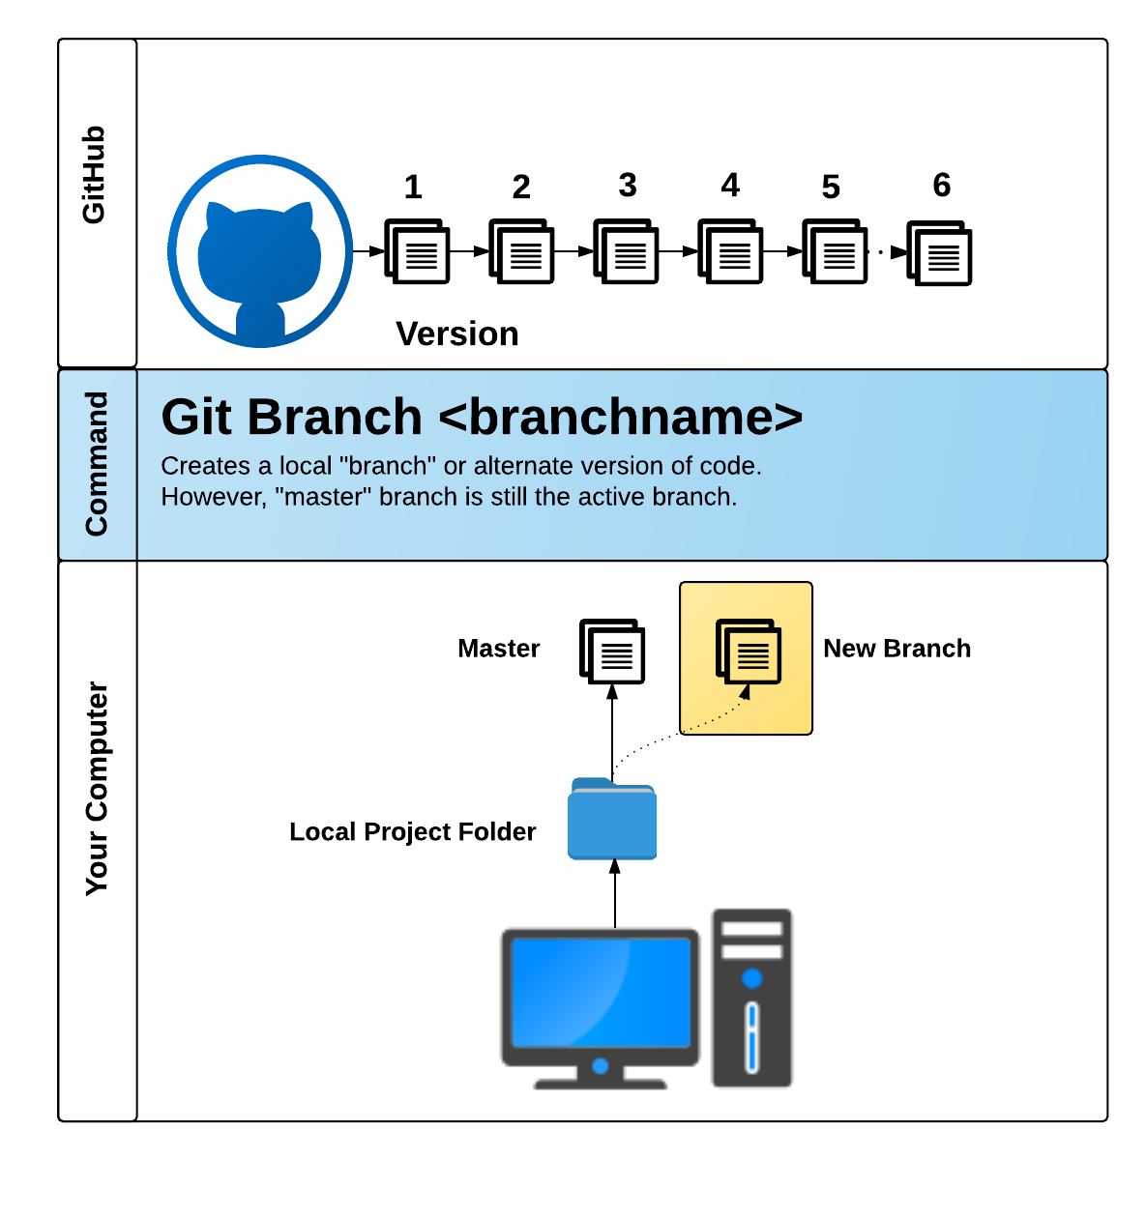
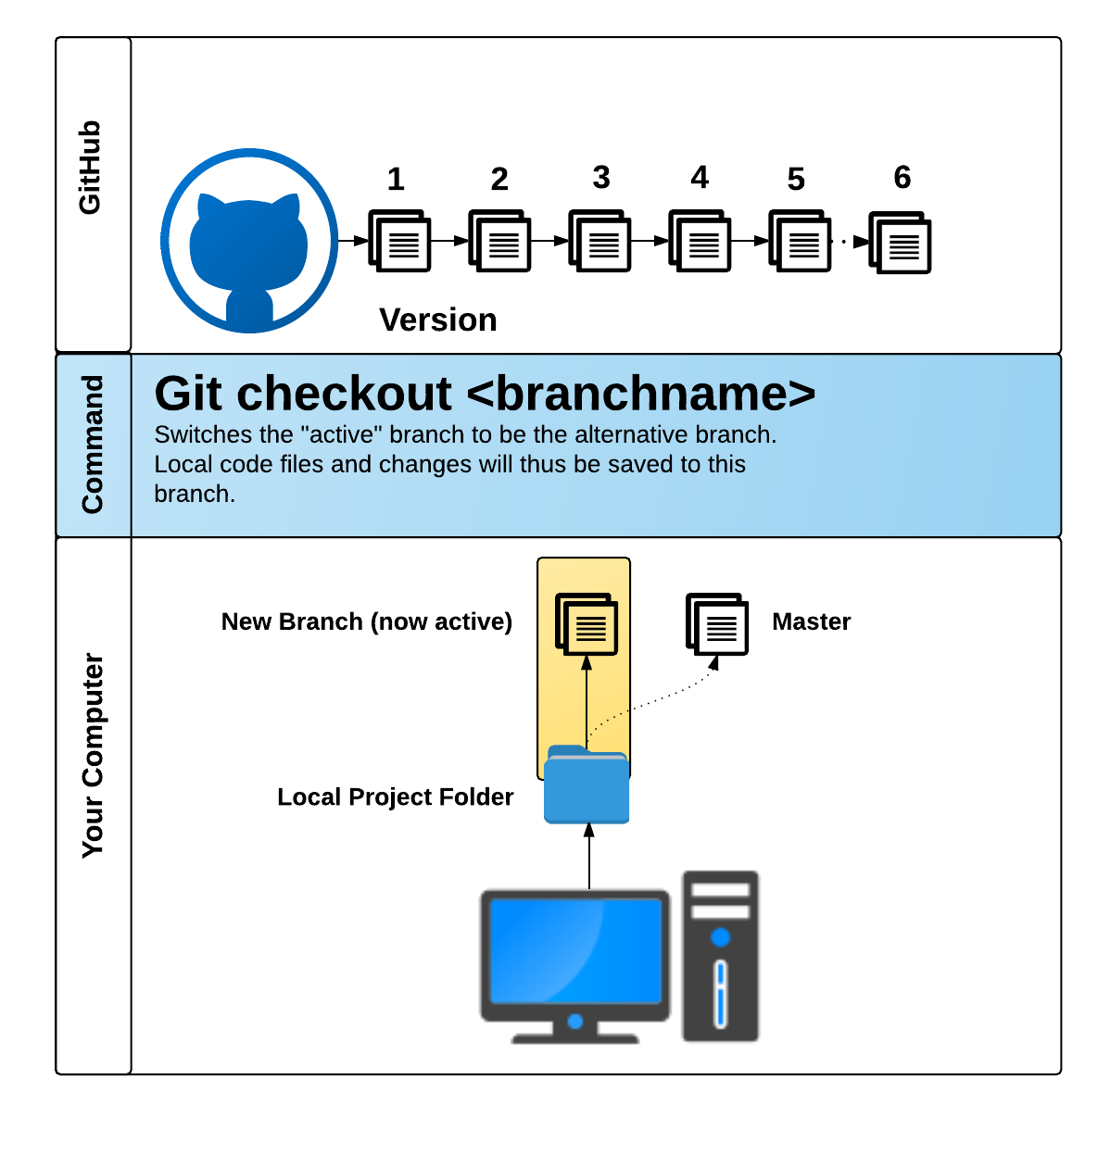
GitHub Pull Requests
GitHub Pull Requests are a great way to “combine” code when multiple users are working on the same files.
We’ll show you how to use this feature in the next class.

Slide 22
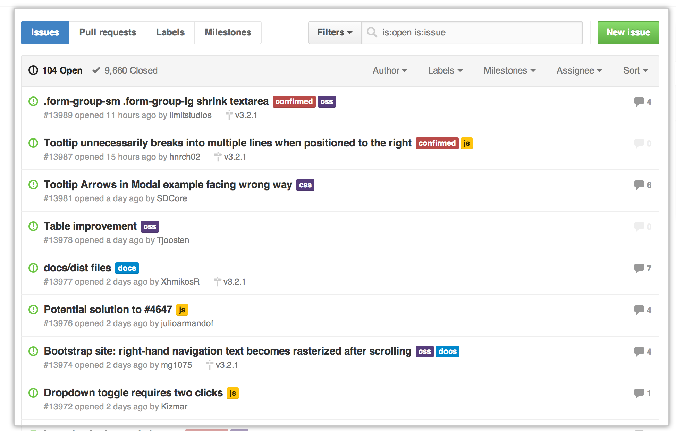
GitHub Issues
GitHub Issues are a great way to keep track of bugs, feature requests, etc.

Slide 23
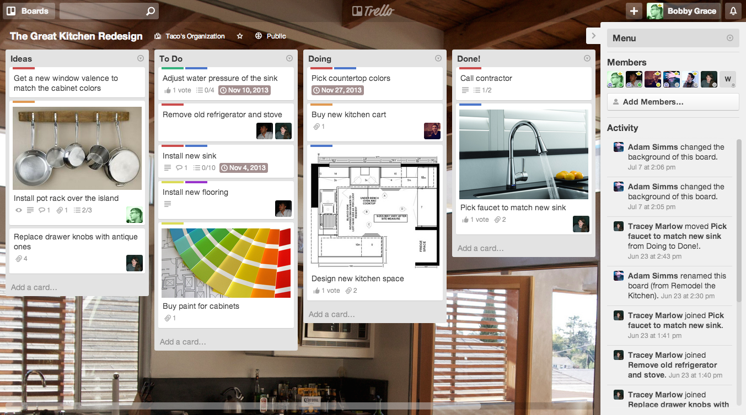
Trello
Trello is a great project management tool for creating to-do lists and communicating updates.

Slide 24
Example Project Ideas

Slide 25

Event Searcher
Users type in the name of their favorite sporting team.
Then using the SeatGeek API, your web application points them to the next game and location where the team is playing.
The web application also provides them a link to Ebay where they can purchase memorabilia associated with the team.

Slide 26

UN Data API
Use the Unofficial UN Data API to search a user specified country’s health records.
Then use a secondary data source (Google Maps, Flickr, YouTube, etc.) to provide additional context or data.
Examples: Per Capita Govt Expenditures on Health, # of Physicians, Deaths due to HIV, Malaria Cases etc, low birth weight newborns

Slide 27

Facial Recognition
Use the Face++ API
Allow users to provide a URL link to a facial image then provide viewers with information on the image’s gender, race, whether they are wearing glasses, and their age
Use Firebase to update ALL users of the site about the current search

Slide 28
Or…
Just do your own thing.
Be creative! Be ambitious!

Slide 29
Today’s Focus

Slide 30
By End of Day - Today
Brainstorm possible ideas
Begin API Research
Create an initial draft / sketch of the final design
Create a short 1 page proposal listing out each of the following:
  Project Title
  Team Members
  Project Description
  Sketch of Final Product
  APIs to be Used
  Rough Breakdown of Tasks

Slide 31
Questions

