Slide 1
Final Projects
Notes:
1

Slide 2
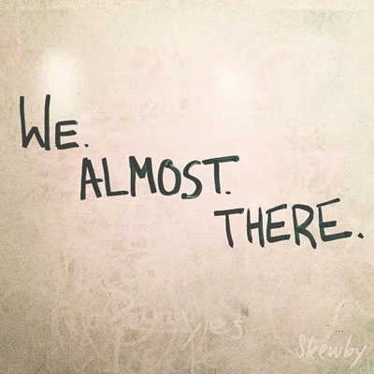
Notes:
1

Slide 3
Look at all you have learned!
The Browser
Dev Tools
Server Side
HTML
CSS
JavaScript
jQuery
Bootstrap
SEO
Heroku
Git
GitHub
Templating Engines
Sessions
Writing tests
Node.js
Express.js
Creating APIs
MVC
User Authentication
ORM (Sequelize)
Laravel
Databases
MySQL
MongoDB
API Interaction
APIs (Consuming)
JSON
AJAX
Real Time Cloud Database via Firebase
Algorithms
Design Patterns
CS Fundamentals
Cutting Edge Development
React.js
Notes:
1

Slide 4
Goals Re-Examined…
“To land a solid career.. and be able to support a family.”
“Hope to make something of myself one day…”
“An opportunity to be more creative in my day-to-day work.”
“…to get a better paying job.”
“I want nothing more in the entire world than to be a game designer.”
“Change careers and become a web developer.”
“…to build mastery. To learn a skill that I haven’t yet explored.”
“[a chapter] better than the last.”
Notes:
1

Slide 5
Nudge Forward
Didn’t quite make your target?
Let’s chat.
Notes:
1

Slide 6
Admin Items
Notes:
1

Slide 7
What’s Left
Final Projects
Remaining Topics
Computer Science Algorithms
Javascript Design Patterns
Lightning Talks:
TypeScript
React App from Scratch
Developer Tools In-depth
Suggestions?
Job Workshops
Demo Day!!!!
Notes:
1

Slide 8


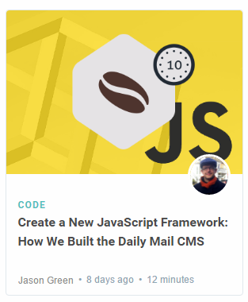
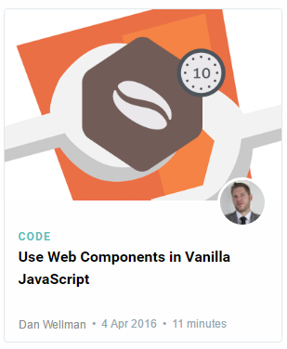
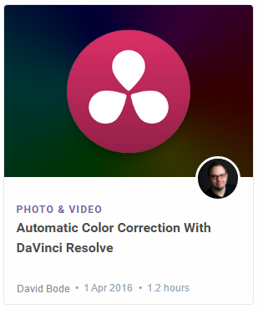
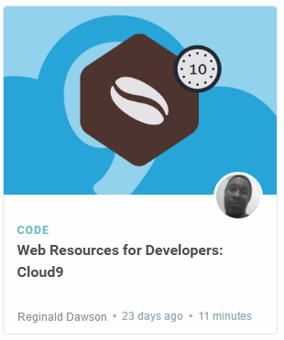

Lightning Talks!
Disclaimer: Not actual topics for Lightning Talks. I just liked the colors. Lolz.
Notes:
1

Slide 9

Never Stop Learning!
The key to hireability and relevance is to constantly be learning.
The field is always changing and there is never a point where you can call it quits.
Stick with it! It’s a craft that you continue to hone with time.
Notes:
1

Slide 10
Final Projects
Notes:
1

Slide 11
Your Challenge
Notes:
1

Slide 12
Your Challenge
Prove yourself.
Notes:
1

Slide 13
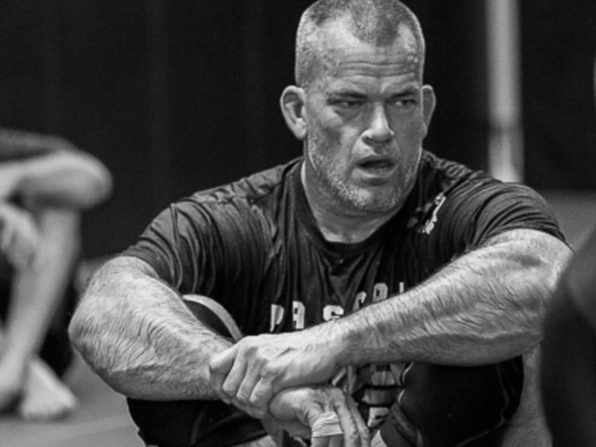
The Futility of Excuses
Your success, or lack of success, is your responsibility. Even when you have a chain of command that you don't like as well, its your responsibility to work with the up chain of command.
Jocko Willink
Notes:
1

Slide 14
Your Challenge
You have plenty of time to work on this.
You have ALL the skills you need.
You have a team of skilled developers.
You have experts willing to help.
No excuses. Time to prove yourself.
Notes:
1

Slide 15
Expectations
Notes:
1

Slide 16
Expectations
We expect whatever you build to have utility
We expect you to have market or real-world research that evidences your idea has REAL value to people.
We expect you to have done research on other web / mobile applications in your domain.
We expect you to put serious time and thought into this.
We expect you to report problems you are facing along the way.
We expect you to utilize some form of project management system.
We expect you to dig deep into documentation and external resources to learn what you need.
Notes:
1

Slide 17
Requirements
Notes:
1

Slide 18
Coding Requirements
Must use ReactJS in some way (even if minimal)
Must use a Node and Express Web Server
Must be backed by a MySQL or MongoDB Database with a Sequelize or Mongoose ORM
Must have both GET and POST routes for retrieving and adding new data
Must be deployed using Heroku (with Data)
Must utilize at least two libraries, packages, or technologies that we haven’t discussed
Must allow for or involve the authentication of users in some way
Must have a polished frontend / UI
Must have folder structure that meets MVC Paradigm
Must meet good quality coding standards (indentation, scoping, naming)
Notes:
1

Slide 19
But Honestly…
Do what you want. Talk to us first. Get our input.
But if you have an idea and want to run with it, we’re not going to stop you.
Remember:
No excuses. Time to prove yourself.
Notes:
1

Slide 20
Deliverables
Notes:
1

Slide 21
Project Updates
Instead of homework, you will be required to submit 4 Project Deliverables.
These will be due each Saturday from now until Presentation Day.
Deliverables #1 (Jan 24, 2019) – Plan, Design, and Research
Deliverables #2 (Jan 31, 2019) – Ready MVP (Working App!), Mini-Presentation
Deliverables #3 (Feb 7, 2019) – Project Polish, Functionality Push, Final Plan
Final Presentation (Feb 14, 2019) – Presentation Time!
Notes:
1

Slide 22
Deliverable #1
Notes:
1

Slide 23
Deliverable #1
By Jan 24, 2019 you must submit a detailed plan of action for your project.
In this plan, you will include:
An overview of the intended application and WHY you feel it’s valuable.
A set of DETAILED screen-by-screen design layouts with annotations describing all UI/UX components and all data relevant to the screen.
A breakdown of roles by group member.
A schedule for completion of various tasks.
A screenshot of your Jira, Trello, or Project Management Board that shows breakdown of tasks – assigned to group members with a schedule.
Notes:
1

Slide 24
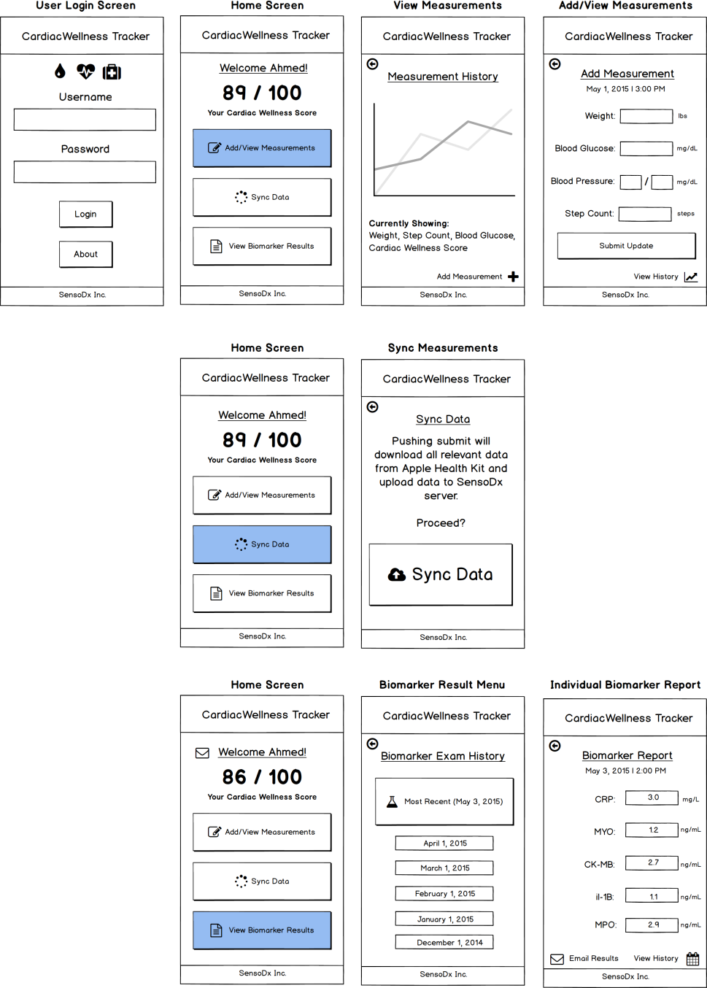
Example UI/UX Flow
Screen Map
This is intended to show you the order in which users would see screens. The three branches correlates with the three button options from the main menu.
Notes:
<number>

Slide 25
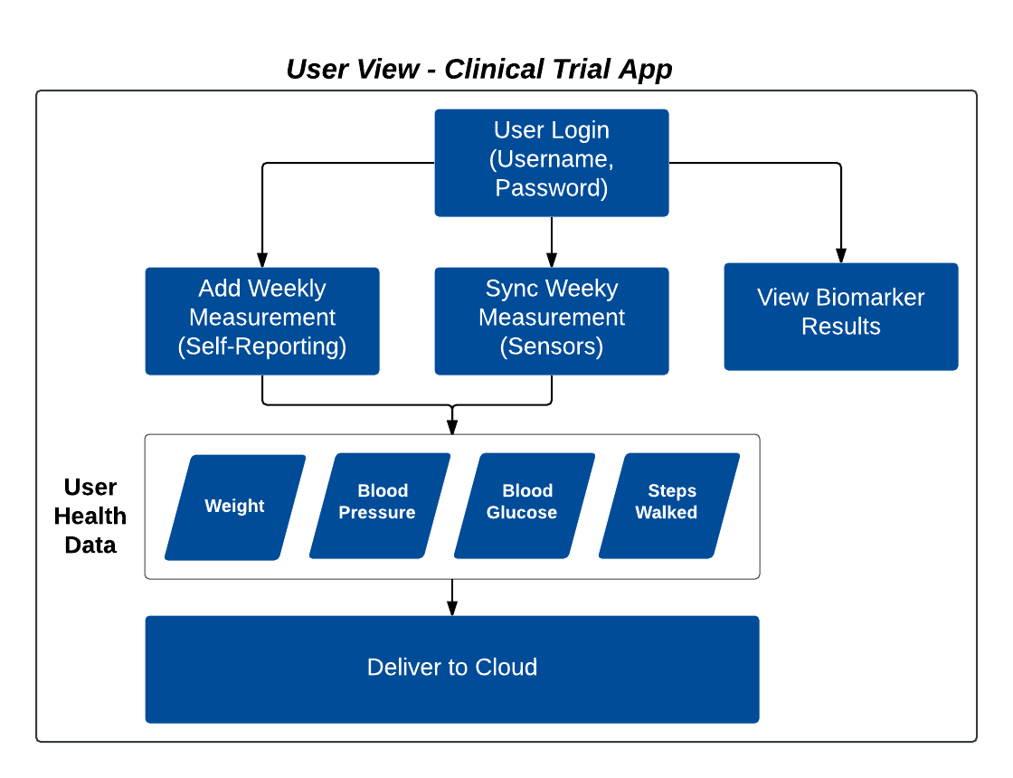
Example Data Flow
Notes:
<number>

Slide 26
Questions
Notes:
<number>

