Slide 1

KBE Knowledge Acquisition
Tomáš Kukučka (4542703) & Erik Peeters (4547322)

Slide 2
High lift devices sizing
Methods from Airplane Design – Part II – Preliminary Configuration Design and Integration of the Propulsion System by dr. Jan Roskam, 1985, Roskam Aviation and Engineering Corporation

Slide 3
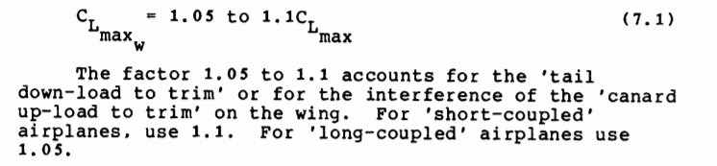
Step 1.1 : calculate the Clmax in trim
Because this application is intended for transport aircraft, a factor of 1.1 is used

Slide 4
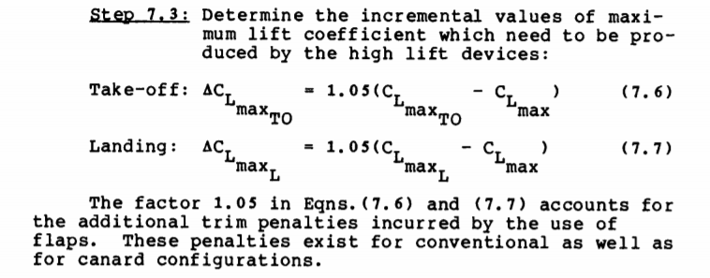
Step 1.2 : calculate ΔCLmax, corrected for trim
No distinction was made between take-off and landing. The user provides the clean wing
geometry from which CLmax follows. The user also specifies CLmax_flapped, which is the
maximum lift coefficient the plane should be able to achieve, either at landing or take-off,
whichever condition is more critical.

Slide 5
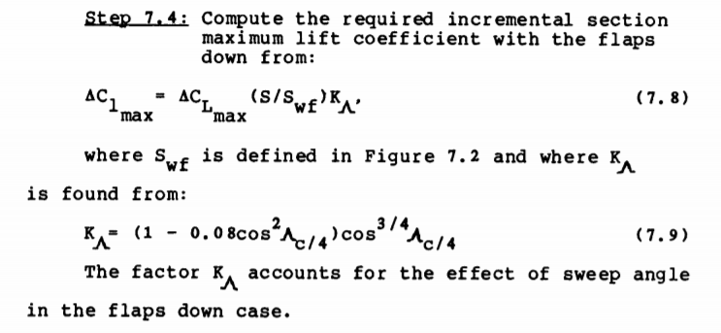
Step 1.3 : calculate the ΔCLmax required by the flapped section
Swf is defined in the next slide

Slide 6
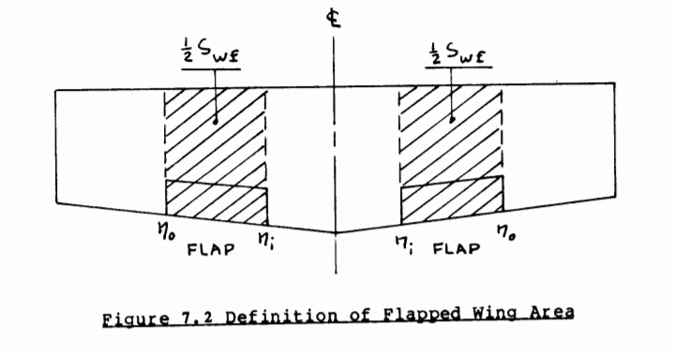
Step 1.3b : Flapped area Swf from book

Slide 7
Step 1.3c : Flapped area Swf in our design
= Flapped area
= Flaps

Slide 8
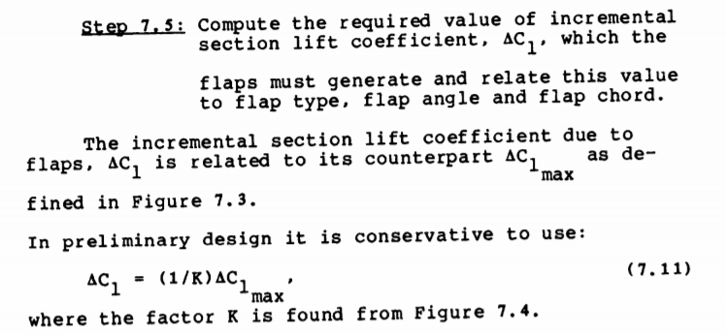
Step 1.4 : calculate the ΔCL the flaps have to create
Factor K is dependent on the type of flap used, the flap chord and the deflection angle. The graph used is shown on the next slide.

Slide 9
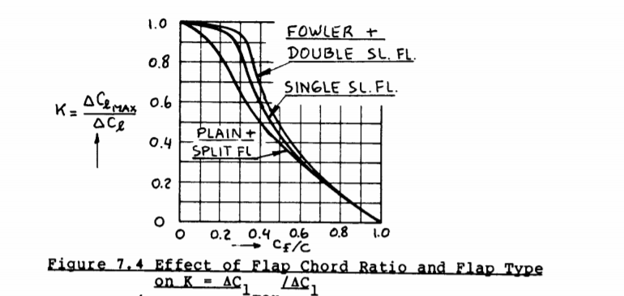
Step 1.4a : graph to determine K-factor

Slide 10
Step 2 : calculate the actual ΔCL that the different flap types can attain
The following three flap types are considered:
Plain flap
Single slotted flap
Fowler flap

Slide 11
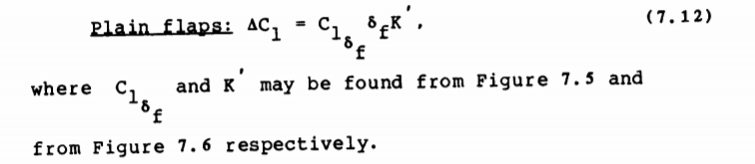
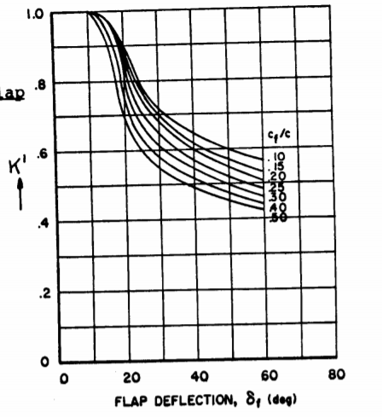
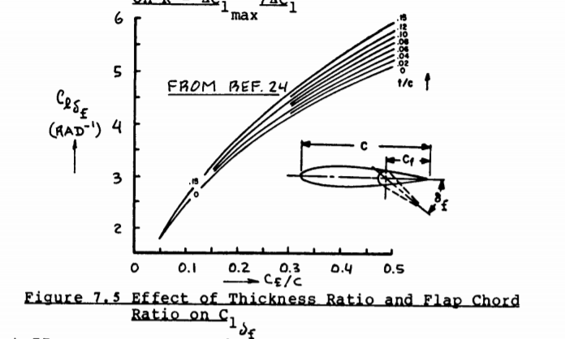
Step 2.1 : The plain flap

Slide 12
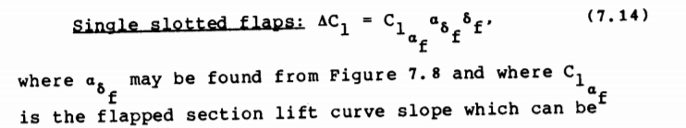
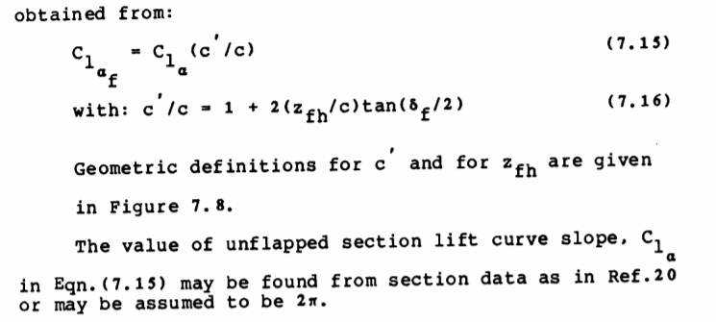
Step 2.2 : Single slotted flap
The lift curve slope was assumed to be 2π, the graphs used in the calculations can be
found on the next slide.

Slide 13
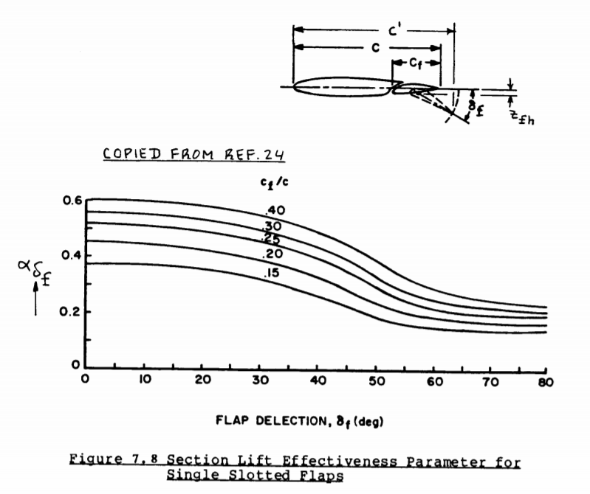
Step 2.2a : Single slotted flap

Slide 14

Step 2.2 : Fowler flap

Slide 15
Step 3 : Compare results from step 1 and step 2
For a design that can attain the maximum flapped lift coefficient as specified by the user, the value resulting from step 2 should be higher than the value resulting from step 1.
If it is not, either the flap chord has to be increased, the deflection angle has to be increased or a different flap type should be chosen.

