Slide 1
Data Cleaning Assessment
Robert Kraemer
COMP 4448

Slide 2
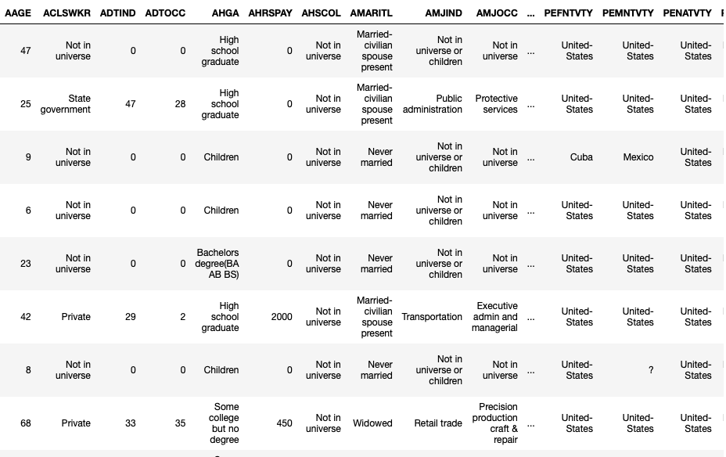
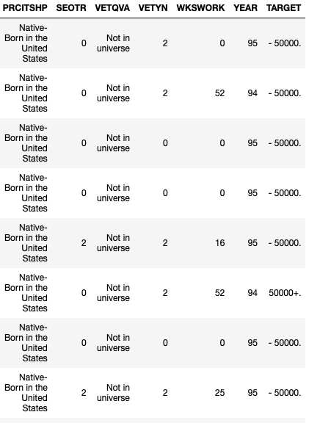
Goal
Prepare and explore US Census data for later use in identifying characteristics associated with a person making more or less than $50,000 per year

Slide 3
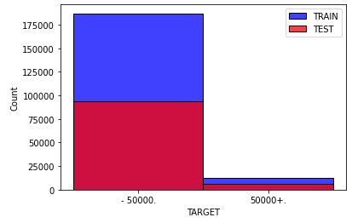
Description of the Data
Input Variables:
Continuous
Age, Wage per hour, Capital gains, Capital losses, Dividends from stocks, Num persons worked for employer, Weeks worked in year
Nominal
Class of worker, Detailed industry recode, Detailed occupation recode, Education, Enroll in edu inst last wk, Marital stat, Major industry code, Major Occupation code, Race, Hispanic origin, Sex, Member of labor union, Reason for unemployment, Full or part time employment stat, Tax filer stat, Region of previous residence, State of previous residence, Household and family stat, Household summary in household, Migration code-change in msa, Migration code-change in reg, Migration cod-move within reg, Live in this house 1 year ago, Migration prev res in sunbelt, Family members under 18, Country of birth father, Country of birth mother, Country of birth self, Citizenship, Own business or self employed, Fill inc questionnaire for veteran’s admin, Veterans benefits, year
Output Variable:
Target
- 50,000.
50,000+.

Slide 4
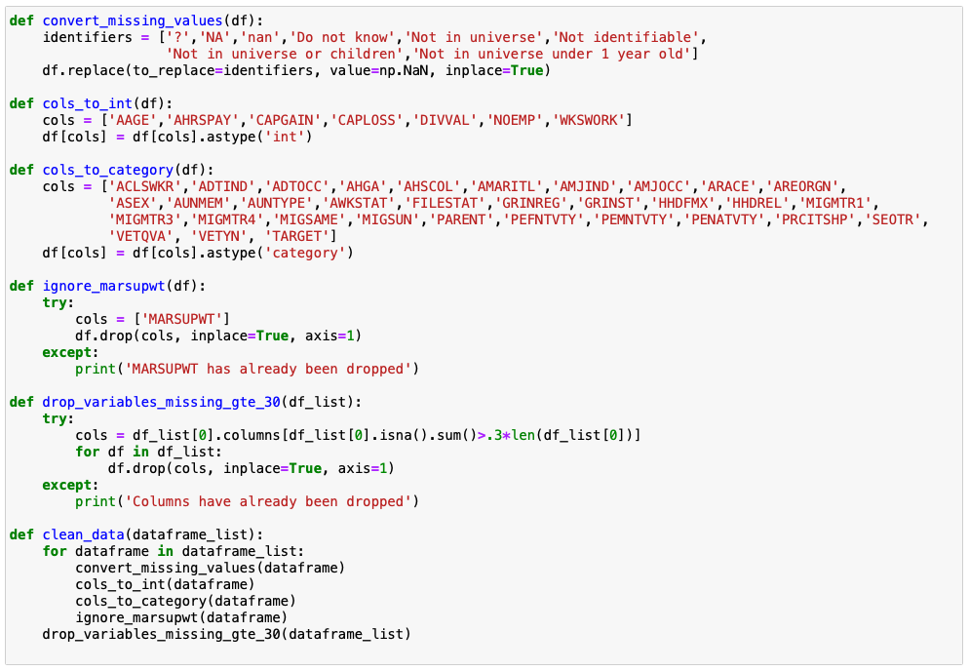
Data Cleaning
Process
Clean text values, normalize the text; remove white spaces
Inspect unique values to all variables to ensure values are not in the data
Convert missing values to np.NaN
Make certain variable types are set correctly for each variable
Handle missing values and drop variables with that are missing more than 30% of the data
Drop/ignore instance weight, as indicated in census_income_metadata.txt

Slide 5
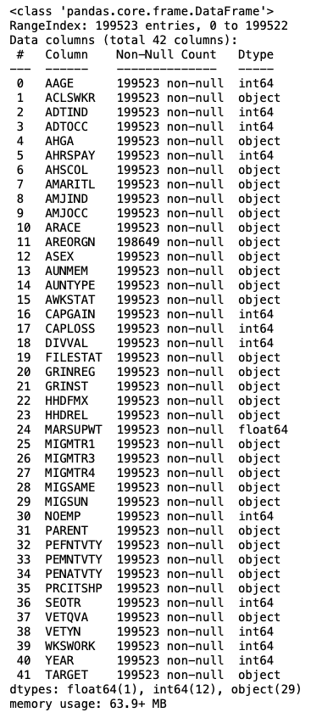
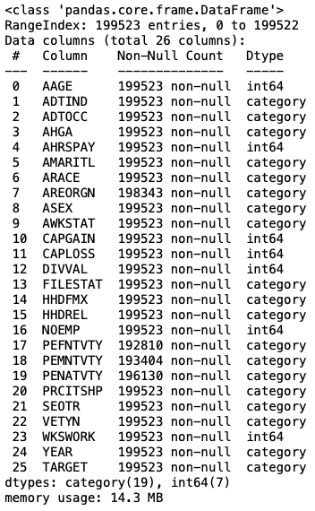
Data Cleaning
Summary
Missing Values (converted to np.NaN):
'?', 'NA','nan', 'Do not know', 'Not in universe', 'Not identifiable', 'Not in universe or children', 'Not in universe under 1 year old'
25 input variables are missing less than 30% of the data
28% continuous, 72% nominal

Slide 6
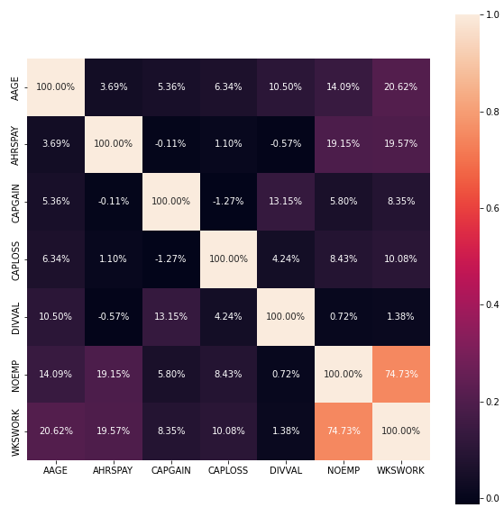
Exploratory Analysis
Observe the distribution of the output (TARGET) variable (slide 3)
Descriptive statistics for numerical values (slide 7)
Observe correlation between continuous variables
Explore distributions of continuous variables of TRAIN and TEST datasets

Slide 7
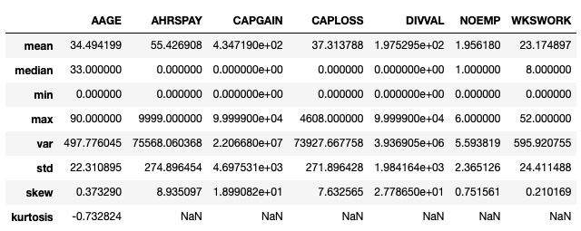
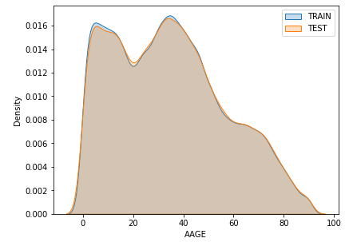
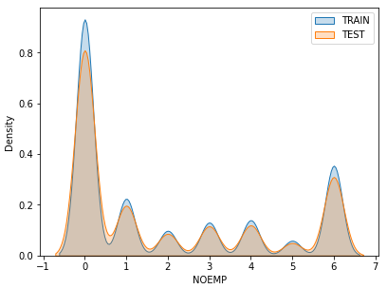
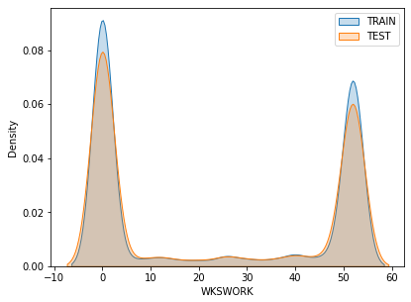
Exploratory Analysis
We see that the age distribution looks fairly normal, with some outliers, while several of the other variables are trending towards two peaks.

