Slide 1
SEIS 603 Foundations of Software Development - Python
Damodar Chetty

Slide 2
The Python Interpreter
2 modes
Shell mode
type Python expressions into the shell, and interpreter immediately shows results
Program mode
write a program in a file (.py) and have the interpreter execute its contents
Additional modes
Interactive Python (shell)
enhanced, and cosmetically different, version of the standard interpreter
Jupyter Notebooks
web based notebook originally created within the IPython project

Slide 3
The Python Interpreter
2 modes
Shell mode
type Python expressions into the shell, and interpreter immediately shows results
Program mode
write a program in a file (.py) and have the interpreter execute its contents
Additional modes
Interactive Python (shell)
enhanced, and cosmetically different, version of the standard interpreter
Jupyter Notebooks
web based notebook originally created within the IPython project

Slide 4
IPython enhancements
automatically pretty-prints Python objects for readability
better than print()
Tab completion, as an interactive dropdown rather than as a list
search the interactive namespace for variables (objects, functions, etc.), keywords, and built-in functions
enter a few characters<TAB>
complete object or module attributes
import a module (turtle) or create a list, b=[1,2,3]
enter a “.”<TAB>
File path completion
path/to/folder<TAB> or path=‘path/to/folder<TAB>

Slide 5
IPython enhancements
Introspection
<variableName>? displays general information about an object
<functionName>? displays the docstring
Wildcard matching using * to show matching names
import numpy as np np.*load*?
Keyboard Shortcuts for navigation and interacting with command history
up and down arrow to locate commands starting with the currently entered text
CTRL-R for reverse history search using partial matching
CTRL-C interrupt currently executing code
CTRL-A, CTRL-E move to beginning or end of line
CTRL-U discard text on current line
CTRL-L clear screen

Slide 6
IPython enhancements
Command History
IPython maintains an on-disk database of commands executed and their results
Previous History
Up and Down arrows
Reverse History search:
CTRL-R and enter text for searching
Press CTRL-R to cycle through history
Input and Output
References to input commands and output objects are stored in special variables
input commands are stored in _i<#> and output results are in _<#>
where # is the command’s sequence number
to reexecute a prior command use: exec(_i<#>)

Slide 7
IPython enhancements
Magic Commands
special commands built into IPython shell, are prefixed by %
%run <scriptName>
runs any file as a Python program inside the environment of your IPython session
script is run in an empty namespace so behavior is same as if running it on command line
after script is run, variables (imports, functions, globals) in script are available in the shell
Other commands
%hist prints command history
%time and %timeit report execution times
%pwd returns current directory
%matplotlib sets up integration with matplotlib

Slide 8
Jupyter Notebook
Interactive document for code, text (with markup), data visualizations, etc.
interacts with the underlying IPython system for its behavior
In a terminal, type “jupyter notebook”
navigate to http://localhost:8888
To create a new Notebook, click New > Python 3
In a cell, enter Python code and press Shift-Enter to execute it
save file using File > Save and Checkpoint
creates .ipynb file with all content in notebook (incl. evaluated code output)
can be loaded and edited by other Jupyter users
to load a notebook
put the file within the directory where you started the Notebook process
select the file by navigating to it from the landing page
OR, use %load <file>.py from a cell

Slide 9
PyCharm IDE
Combines an intelligent editor, debugger, and runtime
Create a new project, and point it at the runtime
Create a new Python file and run it

Slide 10
Turtle Graphics
A simple way to introduce programming
developed in 1966 as part of the Logo programming language
metaphor:
imagine a robotic turtle
starts at (0,0) facing East (+ve x-axis)
accepts simple movement commands
move in a line
change orientation by an angle
as it moves, its tail drags along, leaving a trail
if you tell it to lift up its tail, it moves without leaving a trail
has state in terms of colors and shapes
complex shapes can be drawn by moving the turtle and setting its state

Slide 11
Turtle Graphics
Relies on a Python module (turtle)
Python.org > Documentation > Module Index > Global Module Index
A module is a Python library
contains Python elements that can be reused in your programs
must be imported before the elements can be used
elements are accessed using dot notation
import turtle # allow us to use the turtles library
wn = turtle.Screen() # create instances of Python classes
alex = turtle.Turtle()
alex.forward(150) # call methods on these instances
alex.left(90)
alex.forward(75)
wn.exitonclick()

Slide 12
Turtle Graphics - Instances
Instances can have
methods - things it can do
attributes
collectively, defines the current state of the object E.g., a Turtle instance has a color, a pen width, current position, heading, etc.
can have many different instances of a class in the same program
import turtle
wn = turtle.Screen()
wn.bgcolor("lightgreen") # set the window background color
tess = turtle.Turtle()
tess.color("blue") # make tess blue
tess.pensize(3) # set the width of her pen
tess.forward(50)
tess.left(120)
tess.forward(50)
wn.exitonclick() # wait for a user click on the canvas

Slide 13
Turtle Graphics - Instances
can have many different instances of a class in the same program
each instance is an independent object, an instance of that type (class)
each instance has its own state (attributes)
import turtle
wn = turtle.Screen() # Set up the window and its attributes
wn.bgcolor("lightgreen")
tess = turtle.Turtle() # create tess and set some attributes
tess.color("hotpink")
tess.pensize(5)
alex = turtle.Turtle() # create alex
tess.forward(80) # Let tess draw an equilateral triangle
tess.left(120)
tess.forward(80)
tess.left(120)
tess.forward(80)
tess.left(120) # complete the triangle
tess.right(180) # turn tess around
tess.forward(80) # move her away from the origin
alex.forward(50) # make alex draw a square
alex.left(90)
alex.forward(50)
alex.left(90)
alex.forward(50)
alex.left(90)
alex.forward(50)
alex.left(90)
wn.exitonclick()

Slide 14
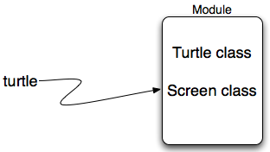
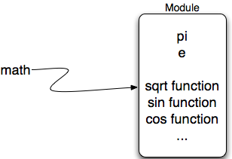
Types of Modules
Data Modules
an object of a Python class must first be initiated – an instance
each instance has
associated state (data members)
methods that can be invoked (behaviors)
Utility Modules
instance need not be constructed before methods are invoked
but no individual state is possible
import turtle
wn = turtle.Screen() # construct instances
alex = turtle.Turtle()
alex.forward(150) # call methods on instances
import math
print(math.pi)
print(math.sqrt(2.0))

Slide 15
Turtle Graphics - Methods
Turtle Behaviors
forward / backward (distance)
right / left (angle)
setposition(x,y)
setx(x)/sety(y)
setheading(to_angle)
home()
circle(radius, extent, steps)
dot (size, color)
stamp()
clearstamp(stampid)
clearstamps(n)
undo()
speed(0-10)
reset()
clear()
Turtle State
position()
xcor() / ycor()
heading()
distance(x,y)
fillcolor()
color(*args)
Turtle Pen Behavior
pendown()
penup()
Turtle Pen State
pensize(width)
isdown()
pencolor(*args)

Slide 16
Types of Values
Two Types of Values
Scalars
int, float, bool, etc. that are associated with only a single value
Collections
value is made up of smaller components
str is made up of individual characters: 1-character strings
sequential order from left to right
a collection data type can be treated as a single entity OR
we can access its component parts using
index operator [ ]
and an integer index
name = "John Hancock"
print(name[0]
print(name[-1]

Slide 17
Collection Types - Lists
Lists
sequential ordered collection of values
Allow you to store sets of information in one place
elements
can be of different types
do not have to be related in any way
Naming convention – plurals (digits, names, items, etc.)
comma-separated sequence of values, enclosed in [ ]
elements are accessed using index operator with an integer index
numbers = [0, 1, 2, 3 ]
print(numbers)
friends = ["Joe", "Amy", "Brad", Angie"]
print(friends)
new_list = [mixed_list, numbers, friends]
print(new_list)
numbers[2]
numbers[-1]

Slide 18
Ranges
range() delivers a sequence of values
1-parameter version: range (5)
produces 5 values, 0 through 4
2-parameter version: range(1, 5)
produces 4 values, 1 through 4
3-parameter version: range(0, 6, 2)
produces 3 values, 0, 2, and 4
BUT
it is lazy – produces the next element only when asked
to immediately calculate all elements, wrap it in a list()
conversion function iterates over all elements in the range
returns a list of those elements

Slide 19
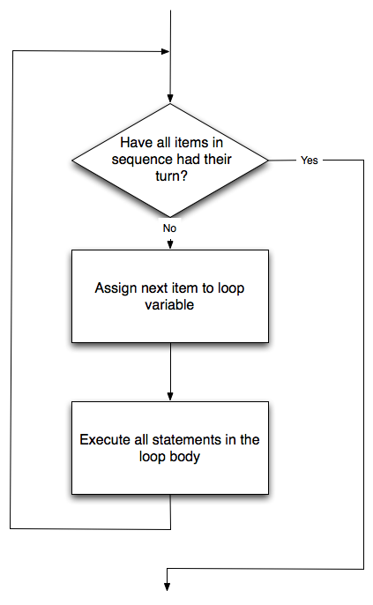
Repetition / Iteration
Repeated execution of a sequence of statements
computers excel at repeating similar tasks
finding a “repeating pattern” of statements is a key skill
can be used to process each item in a list
is a compound statement that consists of
header line with
the for keyword
a loop variable
the in keyword
a colon
body of 1+ indented statements (a block)
executed for each iteration
friends = ["Joe", "Amy", "Brad", Angie"]
for friend in friends:
print("Hello ", friend, "!")

Slide 20
Putting it all together
import turtle # set up alex
wn = turtle.Screen()
alex = turtle.Turtle()
for i in [0, 1, 2, 3]: # repeat four times
alex.forward(50)
alex.left(90)
for i in range(4): # sets i to each of [0, 1, 2, 3]
alex.forward(50)
alex.left(90)
wn.exitonclick()

