Slide 1
SEIS 603 Foundations of Software Development - Selection and Iteration
Damodar Chetty

Slide 2
Boolean data types
only 2 boolean values:
data type bool
only two values: True and False (capitalization is important)
are not strings
Conditional test (aka Boolean expression)
evaluates to True or False based on expression on either side of an operator
operator can be either relational or logical
>>> True
>>> type(True)
>>> type("True)

Slide 3
Operators - Comparison
equality comparison operator ==
produces a boolean value based on whether two values are equal
test is case sensitive
note the difference with the assignment operator (=)
equality test is symmetric: if a == 7, then 7 == a
assignment is not symmetric: a = 7 is legal; 7 = a is not
>>> age = 5
>>> print(age == 5)
>>> print(age == 6)
>>> car = 'BMW'
>>> car == 'bmw'
>>> car.lower() == 'bmw'

Slide 4
Operators - Comparison
other comparison (relational) operators
produces a boolean value based on the relationship between the two values
x != y # x is not equal to y
x > y # x is greater than y
x < y # x is less than y
x >= y # x is greater than or equal to y
x <= y # x is less than or equal to y
>>> age = 28
>>> age >= 17
>>> age <= 65
>>> age != 28

Slide 5
Operators - Logical
logical operators
semantics (meanings) of these operators is similar to their meaning in English
used to check multiple conditions (not just one)
and
both conditions must evaluate to True for the entire expression to be True
or
either condition must evaluate to True for the entire expression to be True
not
negates a condition
>>> x = 5
>>> x > 0 and x < 10
>>> n = 25
>>> n % 2 == 0 or n % 3 == 0
>>> not x > n

Slide 6
Operator Precedence
Precedence rules
evaluates arithmetic operators first
relational operators next
logical operators are last
Level Category Operators
------ -------- ---------
7(high) exponent **
6 multiply, divide *,/,//,%
5 add, subtract +,-
4 relational ==,!=,<=,>=,>,<
3 logical not
2 logical and
1(low) logical or
>>> x = 2
>>> y = 10
>>> x * 5 >= 10 and y - 6 <= 20

Slide 7
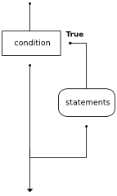
If statement: unary selection
allows you to examine the current statement of a program and respond appropriately to that state
compound statement that consists of:
header line
if
conditional test that evaluates to True or False
colon (:)
true body
1+ indented statements to be executed iff expression is True
When condition evaluates to True, body is executed
Else, flow of execution continues to statement after body of if
x = -10
if x < 0:
print("The negative number ", x, " is not valid here.")
print("This is always printed")

Slide 8
Styling If statements
use a single space around comparison operators
if x >= 0:
print('Non-negative')

Slide 9
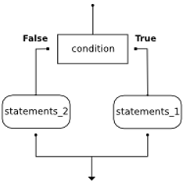
If statement: binary selection
binary: two possible paths of execution
compound statement that consists of:
if-header with True body
else-header with False body
statements to be executed iff expression is False
Flow of execution
if condition is true, executes the True block
if condition is false, executes the False block
after block executes continue with the statement after the if
x = 15
if x % 2 == 0:
print(x, " is even")
else:
print(x, " is odd")

Slide 10
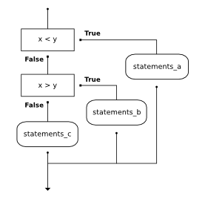
If statement: Chained Mutually Exclusive Conditions
multiple possible paths of execution
compound statement that consists of:
if-header with one possible True body
elif-header with another possible True body
else-header with False body
statements to be executed iff expression is False
no limit on the number of elif statements
BUT only one final else statement (optional)
if else is present, must be last branch in the statement
x = y = 15
if x < y:
print("x is less than y")
elif x > y:
print("x is greater than y")
else:
print("x is equal to y")

Slide 11
If statement: Chained Mutually Exclusive Conditions
Conditional tests
each condition is checked in order
If one is true, its branch executes
even if more than one condition is true, only the first true branch executes the rest of the tests are skipped
Flow of execution
if condition1 is true, execute its True block
else if condition 1 is False but condition2 is True, executes its True block
else, execute the final False block
after block executes continue with the statement after the if
x = y = 15
if x < y:
print("x is less than y")
elif x > y:
print("x is greater than y")
else:
print("x is equal to y")

Slide 12
If statement: Non Mutually Exclusive Conditions
With mutually exclusive conditions
If one condition is true, its branch executes
the rest of the tests are skipped – even if they may be true
With non mutually exclusive conditions
many conditions may match, and we want all their blocks to run
a sequence of simple unary if-statements with no elif or else blocks
Flow of execution
if condition1 is true, execute its True block
if condition2 is True, executes its True block
x = -15.0
if type(x) == 'float':
print("x a floating point number")
if x < 0:
print("x is a negative number")

Slide 13
Advanced conditionals - Ternary Expressions
expresses a simple if-else compound statement in one line
can impact readability so avoid unless the condition is very simple
if condition:
value = true_expr
else:
value = false_expr
value = true_expr if condition else false_expr
x = 5
if x >= 0:
print('Non-negative')
else:
print('Negative')
x=5
print('Non-negative' if x >= 0 else 'Negative')

Slide 14
Advanced conditionals - None
None data type
the Python null value – it is nothing and has no value
data type is NoneType
there is only one instance of this type
Uses
check the success of some action later
check if a reference variable points to an object or not
f = None
try:
f = open("file") # replace with a text file that exists in same folder
except:
pass
if f == None:
print("unable to open file")
else:
print(f.readlines())

Slide 15
Advanced conditionals – no-op
pass statement
no-op statement
can be used in blocks where no action is to be taken or as a placeholder where future action will be added
only required because Python uses indentation to delimit blocks
x = y = 15
if x < y:
print("x is less than y")
elif x > y:
pass
else:
print("x is equal to y")

Slide 16
Advanced conditionals – checking a list
useful to check whether a list is empty or not
an empty list [] evaluates to False
friends = []
# friends = ["Joe", "Amy", "Brad", "Angie"]
if friends:
for friend in friends:
print("Hello ", friend, "!")
else:
print("Alas, you have no friends")

Slide 17
Iteration
Iteration == repeated execution of a sequence of statements
computers do this much better than humans
computers do not get bored
most common way that a computer automates repetitive tasks
Loops and iterations
a loop refers to all the times that a computer repeats a sequence of statements
an iteration refers to a single pass through that loop
All forms of iteration have some common features
a compound statement comprised of
a keyword that summons iteration
a condition that indicates how long iteration should continue
a way for making that condition occur (else would iterate indefinitely)
a block of statements that need to be executed in each iteration
Two popular keywords: for and while

Slide 18
for statement - revisited
if we had a list of names, and wanted to print out each name in the list
Naïve implementation
retrieve each name individually and process it
BUT
have to change our code every time a new entry is added to our list
violates the DRY principle … every time code in the code block changes
Beter approach – let Python manage this internally
process each item in a list – no matter how many items it contains
each item in turn is assigned to the loop variable and loop's body is executed
friends = ["Joe", "Amy", "Brad", "Angie"]
friend = friends[0]
print("Hello ", friend, "!")
friend = friends[1]
print("Hello ", friend, "!")
friend = friends[1]
print("Hello ", friend, "!")
friend = friends[3]
print("Hello ", friend, "!")
friends = ["Joe", "Amy", "Brad", "Angie"]
for friend in friends:
print("Hello ", friend, "!")

Slide 19
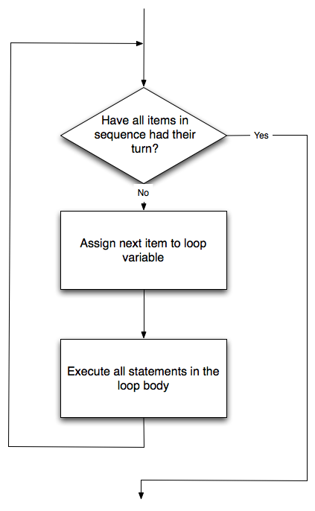
for statement - revisited
a compound statement that consists of
header line with
for <loop variable> in <collection variable> :
body of 1+ indented statements (a block)
executed for each iteration
convention
choose meaningful name for the loop variable
represent a single item from the list
use plural name for the list, singular name for the loop variable
sets up a definite iteration
we know how many times we are going to iterate
executes a block once for each item in collection
friends = ["Joe", "Amy", "Brad", Angie"]
for friend in friends:
print("Hello ", friend, "!")

Slide 20
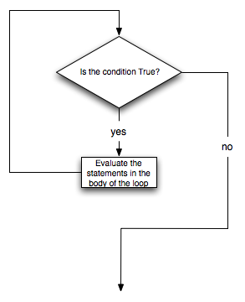
while statement
more general mechanism for looping
indefinite iteration: runs as long as a certain condition is True (or False)
don't know how many times it will repeat before condition triggers and loop exits
much more common in the real world:
when selling tickets to an event … keep selling as long as people arrive and seats available
when unloading baggage … keep unloading while there are bags in the cargo hold
when at the checkout line … keep scanning as long as there are items in the cart
Construction
like if statement, uses a Boolean expression to control flow of execution
body is repeated while controlling expression evaluates to True

Slide 21
while statement
Flow of execution
evaluate the condition – yielding True or False
if condition is False, exit while statement and continue execution after block
if condition is True, execute code block and go back to evaluating condition
if condition is False first time around, code block is never executed!
when using a while loop
you have to control the loop variable yourself
give it an initial value
test for completion
change something in the body so that loop terminates at some point

Slide 22
Indefinite iteration – infinite looping
fix the above loop
x = 1
while x <= 5:
print(x)

Slide 23
Indefinite iteration – with an exit condition
every loop needs a way to stop running, else it will run forever
def sumTo(aBound):
""" Return the sum of 1+2+3 ... n """
theSum = 0
aNumber = 1
while aNumber <= aBound:
theSum = theSum + aNumber
aNumber = aNumber + 1
return theSum
print(sumTo(4))
print(sumTo(1000))

Slide 24
Using a sentinel or flag
a sentinel is
a special value that flags the termination of a loop
e.g., a word such as 'quit' or 'exit', or a price of 0 to indicate the last iem
a flag is
a Boolean value that controls loop execution
the while statement only checks the flag
other statements in the block test to see if the flag can be set based on different events that may cause the loop to exit
easy to add more tests for events that can cause this flag to change state
prompt = "Tell me something to echo: (enter quit to end)"
message = ""
while message != 'quit':
message = input(prompt)
print('echo ' + message)
print('done')
prompt="Tell me something to echo: (enter quit to end)"
active = True
while active:
message = input(prompt)
if message == 'quit':
active = False
else:
print(message)

Slide 25
Controlling a loop or iteration
Loop need not be exited only from the condition test
can be aborted from anywhere within the code block
abort the entire loop (break statement)
flow of execution starts at first statement after the loop compound statement
abort the current iteration (continue statement)
flow of execution returns to the beginning of the loop where the condition is tested again
Loop control statements work with either while or for statements
prompt = "Tell me something to echo: (enter quit to end)"
while True:
message = input(prompt)
if message == 'quit':
break
else:
print(message)
current_number = 0
while current_number < 10:
current_number += 1
if current_number % 2 == 0:
continue
print(current_number)

