Slide 1
NGRX : State management

Slide 2
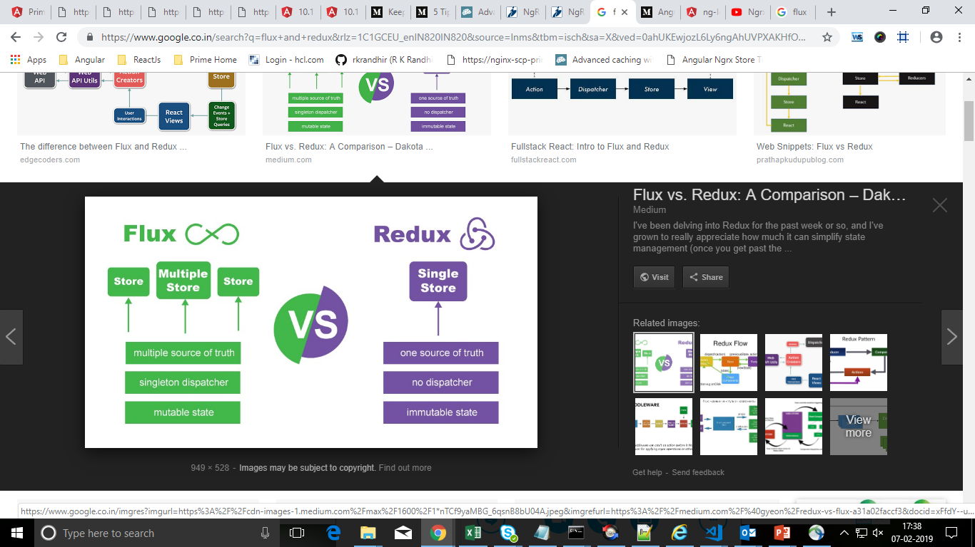
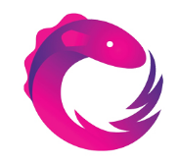
What is NgRx?
NGRX is a group of libraries for state management.
NGRX is an angular/rxjs version of the REDUX pattern which was a simplified version of the FLUX pattern.
It keeps your application scalable.
NgRx is a framework for building reactive applications in Angular. NgRx provides state management, isolation of side effects, entity collection management and developer tools that enhance developers experience when building many different types of applications.

Slide 3
NgRx Packages
Store - RxJS powered state management for Angular apps, inspired by Redux.
Store Devtools - Instrumentation for @ngrx/store enabling time-travel debugging.
Effects - Side effect model for @ngrx/store.
Router Store - Bindings to connect the Angular Router to @ngrx/store.
Entity - Entity State adapter for managing record collections.
Schematics - Scaffolding library for Angular applications using NgRx libraries.

Slide 4
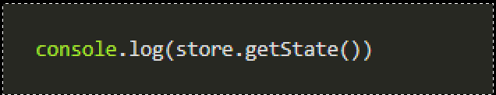
What is STATE?
State is a single, immutable data structure.
It usually refers to the single state value that is managed by the store and returned by getState() . It represents the entire state of an application, which is often a deeply nested object.

Slide 5
What is STORE?
A store is an object that holds the application's state tree.
They have the responsibility of holding the state and applying changes to it when they are told to do so (when an action is dispatched)

Slide 6
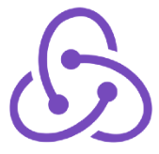
Benefits
Since we have a single source of truth and you can’t directly change the state (state is read only), applications are going to behave more consistently.
Using the redux pattern gives us a lot of cool features to make debugging easier.
Easier to test because we are handling changes using pure functions in the state.

Slide 7
The Core Principles
Since we have a SINGLE SOURCE OF TRUTH and you can’t directly change the state (STATE IS READ-ONLY), applications are going to behave more consistently.
Using the redux pattern gives us a lot of cool features to make debugging easier.
Easier to test because we are HANDLING CHANGES USING PURE FUNCTIONS in the state.

Slide 8
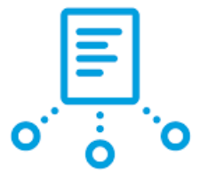
Principles – Single source of Truth
The state of your whole application is stored in an object tree within a single store.
BENEFITS
This makes it easy to create universal apps, as the state from your server can be serialized and hydrated into the client with no extra coding effort.
Easier to debug or inspect an application.
Persist your app's state in development.
Easy to implement some of the functionality which were traditionally difficult to implement.

Slide 9
Principles – State is Read-Only
You can not directly change the state. The only way to change the state is to emit an action, an object describing what happened.
BENEFITS
All changes are centralized and happen one by one in a strict order, there are no subtle race conditions to watch out for.
Any change to the state is going to happen only in one place. This has a great impact on debugging and testing.
If a particular action is dispatched, the operation in the state is always the same. It also helps in debugging and testing.

Slide 10
Principles – Handling changes using pure functions
The operation triggered by dispatching an action is going to be a pure function called, within the redux architecture, reducers. Reducers are just pure functions that take the previous state and an action, and return the next state. They aren’t really changing state but making a copy of existing state and changing one or more properties on the new state.
BENEFITS
Immediately testable.
Navigate between different instances of state and debug for the changes.

Slide 11
Why NGRX?
TBD

Slide 12
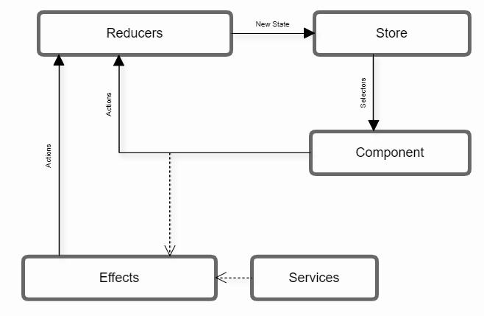
NGRX Architecture

Slide 13
NGRX Architecture: Action

Slide 14
NGRX Architecture: Reducers

Slide 15
NGRX Architecture: Selectors

Slide 16
NGRX Architecture: Store

Slide 17
NGRX Architecture: Effects

Slide 18
NGRX : LINKS/URLs
https://github.com/ngrx/platform

Slide 19
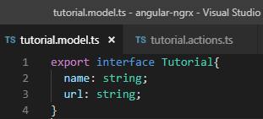
NGRX Architecture: Example
CREATING MODEL

Slide 20
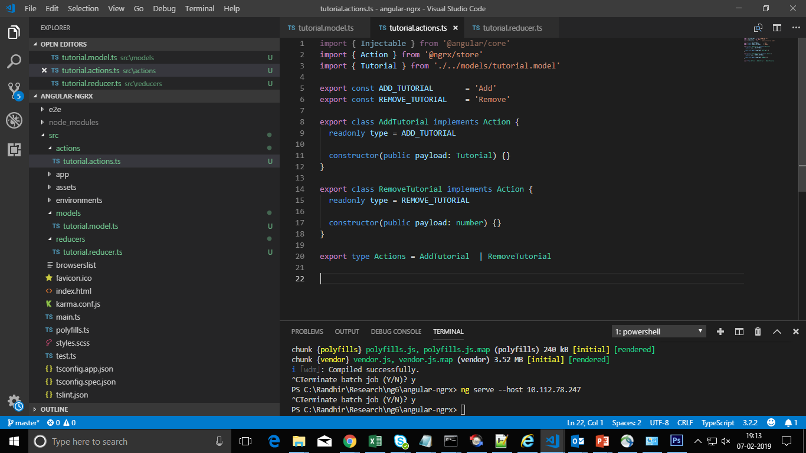
NGRX Architecture: Example
CREATING AN ACTION
An action in Ngrx/store is two things:
A type in the form of a string. It describes what's happening.
It contains an optional payload of data.

Slide 21
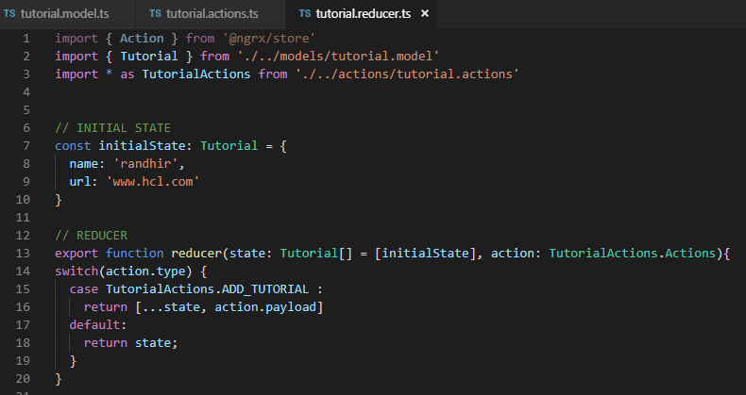
NGRX Architecture: Example
CREATING A REDUCER
A reducer is what takes the incoming action and decides what to do with it.
It takes the previous state and returns a new state based on the given action.

Slide 22
NGRX Architecture: Example
CREATING AN APP STATE

Slide 23
NGRX Architecture: Example
UPDATE APP.MODULE

Slide 24
NGRX Architecture: Example
READING FROM STORE

Slide 25
NGRX Architecture: Example
WRITING TO STORE

Slide 26
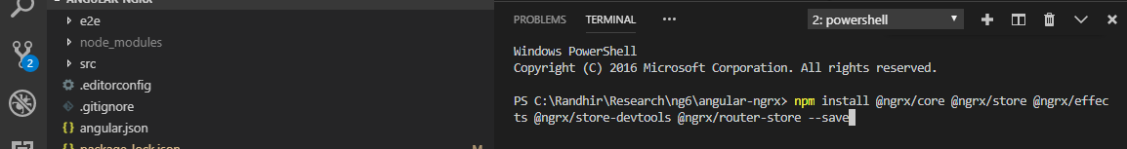
Rewards
TBD

Slide 27
https://www.intertech.com/Blog/ngrx-tutorial-actions-reducers-and-effects/
https://www.intertech.com/Blog/ngrx-tutorial-quickly-adding-ngrx-to-your-angular-6-project/
https://medium.com/frontend-fun/angular-ngrx-a-clean-and-clear-introduction-4ed61c89c1fc
https://stackoverflow.com/questions/52471796/what-is-state-management-in-angular-and-why-should-i-use-it
https://itnext.io/ngrx-best-practices-for-enterprise-angular-applications-6f00bcdf36d7

Slide 28
Thank You!

