Slide 1
CANCER DETECTION USING CONVOLUTION NEURAL NETWORKS
Guide:
D.SARITHA ASST.PROFESSOR NECN
Project Team:
K.RADHAKRISHNA REDDY - 17711A0567
H.MOHAMMED NAUMAN - 17711A0565
P.VENKATA NITHISH - 17711A0589
K.VISHNU VARDHAN - 17711A0569
SK.SUHAIL BASHA - 17711A05A1

Slide 2
ABSRACT
Cancer has been characterized as a heterogeneous disease consisting of many different subtypes.
Machine learning is frequently used in cancer diagnosis and detection.
In addition, the ability of ML tools to detect key features from complex datasets reveals their importance.
Here we are using Convolution neural networks to predict the cancer qualities. It is an algorithm to analyzing visual imagery
Keywords: Cancer, Machine learning, CNN

Slide 3
EXISTING SYSTEM
1. Image denoising via combination anisotropic diffusion and bilateral filtering M. Zeinali, S. Saryazdi, and H. Rafsanjani
This system uses mammogram images. It uses smoothening filters.
The system which can assist and help the doctor or specialist nurse to speed diagnosed the mammograms, to cover shortage of specialist or time handling diagnosed.
Disadvantages:
The excessive smoothing affects the isotropic diffusion procedures.

Slide 4
EXISTING SYSTEM (Contd)
2. Molecular characterization of Soft Tissue Tumors: A Gene Expression Study Tororsten O Nielsen, Rob B West, Sabine C Linn, Orly Alter, Margaret A Knowling, John X O'Connel
A new method for classification of soft-tissue tumours, which could improve on the method based on histological findings.
Singular value decomposition analysis can be used to overcome bias introduced by use of different batches of arrays.
Disadvantages:
The classification is complicated by the fact that there are few reliable immune histochemical markers to aid in tumor subclassification or to help predict a patient’s outcome.

Slide 5
EXISTING SYSTEM (Contd)
3. Early Detection of Cancer: Past, Present, and Future by Joshua D Schiffman, Paul G Fisher, Peter Gibbs
The early diagnosis of a particular cancer type does not necessarily lead to higher rates of cure, and potential risks.
It is presumed that for each primary cancer there will be a typical window from the point at which ctDNA is initially detectable to when the lesion is incurable, a window that may be only a few months or may be several years, and potentially may vary widely within a particular cancer type.
Disadvantages:
A multitude of blood-based biomarkers have been proposed as cancer screening tests, but none have yet proven to be clinically.
ctDNA provides a more sensitive marker since it is present in over 80% of advanced cancers, including in many patients in whom CTCs are not detectable

Slide 6
DISADVANTAGES IN EXISTING SYSTEM
False cancer detection is present while predicting the cancer.
Linked to a natural anxiety of specialists to avoid overlooking cancer images at earlier stages.
Some algorithms are not suitable for large data sets.

Slide 7
PROPOSED SYSTEM
Aim: The main aim of this project is to provide an automatic method for cancer prediction with accurate results.
Objectives:
To get the results of the diagnosis without any false predictions. It can predict the presence of the tumor in the body correctly.
The level of accuracy in the proposed system will be higher. All operation would be done correctly and it provide us the accurate results in the detection of the tumor.
We can detect the presence of the tumor in the body automatically just by providing and training the data to the system.
It does not require any experts help in predicting the cancer.

Slide 8
PROPOSED SYSTEM (Contd)
In this project, CNN architecture that take high dimension cancer scanned image inputs and perform cancer type prediction while considering their tissue of origin.
Our model achieved high accuracy comparing to earlier published studies.
CNN is very dependent on the size and quality of the training data. Given a well prepared dataset, CNNs are capable of surpassing humans in at visual recognition tasks.

Slide 9
ALGORITHM USED
CNN:
A Convolutional Neural Network (CNN) is the foundation of most computer vision technologies.
Unlike traditional multilayer perceptron architectures, it uses two operations called ‘convolution’ and ‘pooling’ to reduce an image into its essential features, and uses those features to understand and classify the image
Convolutional Neural Networks are a bit different. First of all, the layers are organized in 3 dimensions: width, height and depth.
Further, the neurons in one layer do not connect to all the neurons in the next layer but only to a small region of it.
Lastly, the final output will be reduced to a single vector of probability scores, organized along the depth dimension.

Slide 10
PROPOSED METHODS
There are mainly 2 methods. They are as follows.
Feature Extraction:
In this part, the network will perform a series of convolutions and pooling operations during which the features are detected.
If you had a picture of a zebra, this is the part where the network would recognize its stripes, two ears, and four legs.

Slide 11
PROPOSED METHODS (Contd)
Classification:
Here, the fully connected layers will serve as a classifier on top of these extracted features.
They will assign a probability for the object on the image being what the algorithm predicts it is.

Slide 12
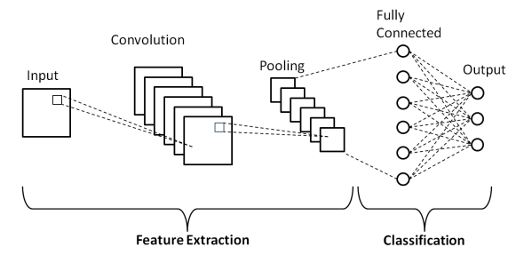
CNN ARCHITECTURE

Slide 13
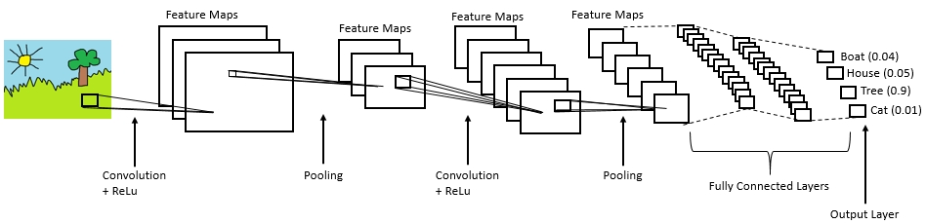
Example:

