Slide 1

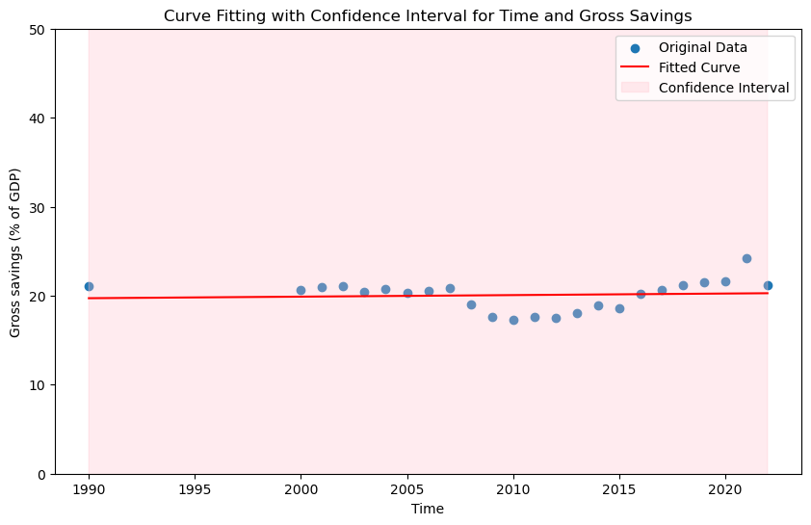
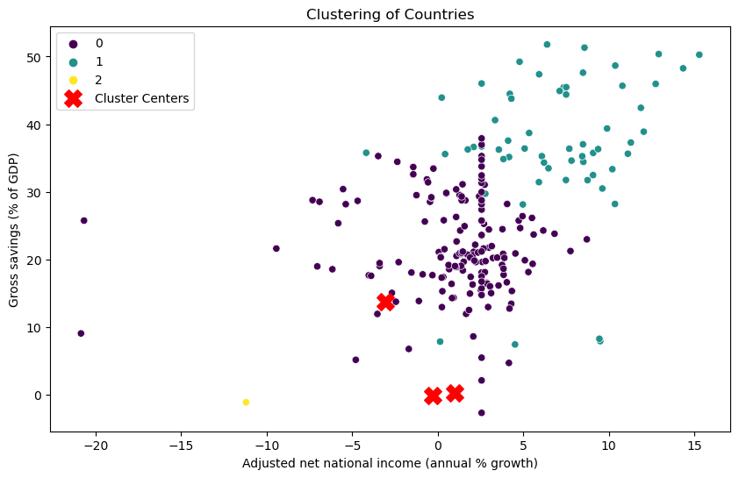
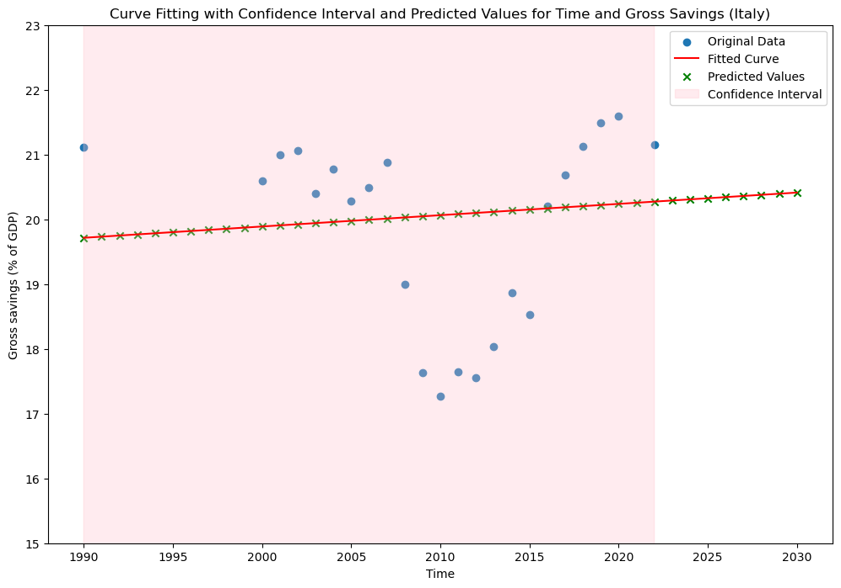
"Economic Insights: Clustering and Time Series Analysis of Gross Savings in Italy and Global Trends"
Name : Rohith Konda
Student ID : 22071628
OBJECTIVE
The goal of this analysis is to examine economic indicators across different countries, perform clustering based on selected features, and create a predictive model for future gross savings (% of GDP).
INTRODUCTION
This analysis delves into the economic landscape of Italy, focusing on the trends in gross savings over the past decades. Utilizing clustering techniques and curve fitting, we explore patterns in the country's economic data. The study further extends to predicting future trends, offering valuable insights into Italy's economic trajectory. Through these analytical methods, we aim to provide a comprehensive overview of Italy's economic scenario and draw global implications from the observed patterns.
ABSTRACT
This study investigates Italy's economic trajectory by employing clustering and curve fitting techniques on key economic indicators, with a specific focus on gross savings. The analysis reveals distinct clusters within Italy's economic data, shedding light on nuanced trends. Furthermore, the curve fitting model allows for predictions of future gross savings values. The findings contribute to a comprehensive understanding of Italy's economic dynamics and hold broader implications for economic forecasting.
ANALYSIS AND INSIGHTS
Clustering of Countries based on Economic Indicators
The clustering analysis was performed on countries using economic indicators such as Adjusted Net National Income growth, Adjusted Net National Income per capita growth, Adjusted Net Savings (excluding and including particulate emission damage), and Gross Savings as a percentage of GDP. The K-means algorithm with three clusters was applied, resulting in distinct groups.
Silhouette Score: The Silhouette Score, a measure of how well-defined the clusters are, was found to be Silhouette Score Value = 0.5148. A higher Silhouette Score indicates better-defined clusters.
Cluster Centers: The identified cluster centers provide a summary of the characteristics of each group.
Data Pre-processing
Curve Fitting
The dataset is loaded from a CSV file.
Missing values denoted as '..' are replaced with NaN.
Columns are converted to numeric values.
NaN values are imputed with the mean of their respective columns.
Time and gross savings (% of GDP) data are extracted for curve fitting.
A linear model is defined for curve fitting.
Curve fitting is performed using the curve fit function from SciPy.
Fitted values and confidence intervals are calculated and plotted.
Clustering
Time Series Analysis for Italy's Gross Savings (% of GDP)
A time series analysis was conducted for Italy, focusing on Gross Savings as a percentage of GDP. The original data was fitted using a linear model, and a confidence interval was established to capture the variability in the data.
Fitted Curve and Confidence Interval:
The fitted curve represents the trend in Italy's Gross Savings over time. The confidence interval indicates the range of values within which the true values are likely to fall.
K-means clustering is applied to relevant economic indicators, grouping countries into three clusters.
The data is normalized before clustering.
Cluster centres are printed for interpretation.
Future Predictions
Extended Analysis and Predictions
To gain a broader perspective, the time range was extended from 1990 to 2030. The fitted curve was plotted along with predicted values.
Fitted Curve and Extended Predictions:
The extended analysis provides a comprehensive view of Italy's Gross Savings trajectory, offering insights into potential future trends.
Predictions for gross savings (% of GDP) are made for the years 2024 and 2034.
Predictions are generated for specific countries: Italy
Country | Year 2024 | Year 2034
Italy | 20.31% | 20.48%
Conclusion
In conclusion, the clustering analysis highlights distinct economic groups among countries. The time series analysis for Italy's Gross Savings reveals historical trends, and the predicted values offer insights into future economic scenarios. The extended analysis provides a comprehensive understanding of Italy's economic trajectory. This information can assist policymakers, economists, and stakeholders in making informed decisions and understanding the economic landscape.
Datasource : https://databank.worldbank.org/reports.aspx?source=2&series=AG.LND.FRST.ZS&country=
GitHub Link : https://github.com/rkrohith23/ADS1-Assignment-3.git

