Slide 1
Coupon Recommendation

Slide 2
Architecture
User
Coupon ranking
algorithm
Coupon

Slide 3
What are the information available
User
Registration date
Gender
Age
Residential Prefecture
Coupon viewing : browsed coupons, referer
Coupon purchase: purchase data, small area name

Slide 4
What are the information available
Coupon
Genre
Price: Discount Rate, List Price, Discount Price
Location: Large area, ken, small area
Validity: Start date, end date, Validity period, availability day (Sunday, Monday..)

Slide 5
Hypothesis
Users buy coupons from shops that are located close to their residential area. Prefecture matching
Users buy coupons only during the coupon availability time

Slide 6
Relationship to check
Gender influence on coupon genre
Age group influence on coupon genre

Slide 7
Hierarchy of Japanese location
Large area
Prefecture (Ken)
Small area

Slide 8
User Demographics

Slide 9
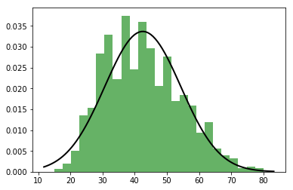
Age distribution
Mean = 42.49
sd = 11.84

Slide 10
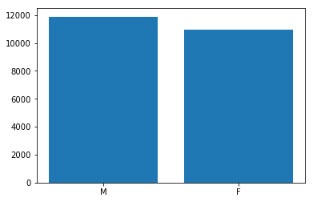
Gender distribution

Slide 11
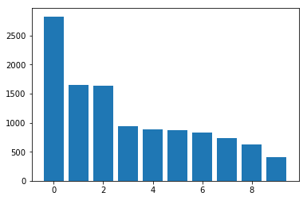
Residence distribution
1. 東京都
2. 神奈川県
3. 大阪府
4. 愛知県
5. 兵庫県
6. 埼玉県
7. 千葉県
8. 福岡県
9. 北海道
10. 静岡県

Slide 12
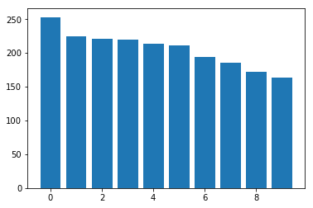
Registration date distribution
2010-11-16 253
2011-05-19 224
2010-11-12 221
2010-11-11 220
2011-05-18 214
2010-11-15 211
2010-11-17 194
2011-05-17 186
2010-11-13 172
2011-05-20 164

Slide 13
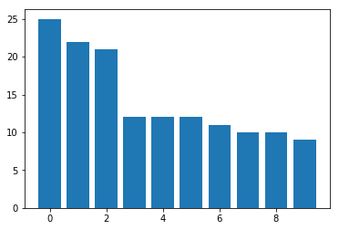
Withdrawal date distribution
2012-05-10
2011-12-19
2012-01-18
2011-08-13
2011-11-15
2011-09-15
2011-12-22
2011-09-20
2011-10-13
2011-12-02

Slide 14
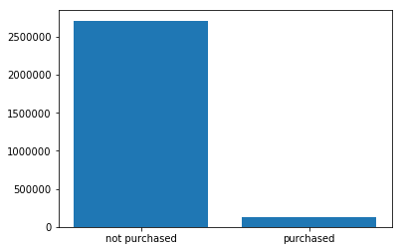
Purchase count
0 (only viewed) 2710791
1 (purchased) 122389
122389*100/(2710791+122389)
4.32 (% purchase)

Slide 15
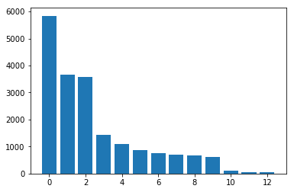
Coupon Genre
宅配 5841
グルメ 3658
ホテル・旅館 3570
ヘアサロン 1436
リラクゼーション 1089
その他のクーポン 873
エステ 758
レッスン 696
レジャー 664
ネイル・アイ 626
ギフトカード 104
健康・医療 55
ビューティー 43

Slide 16
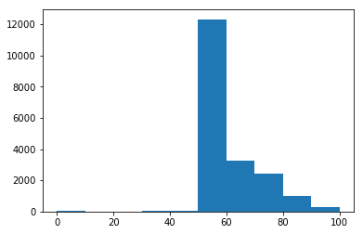
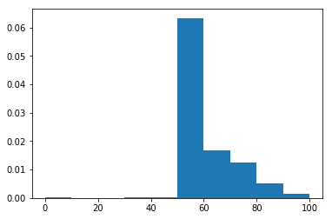
Coupon Price rate

Slide 17
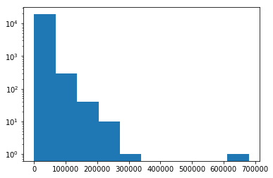
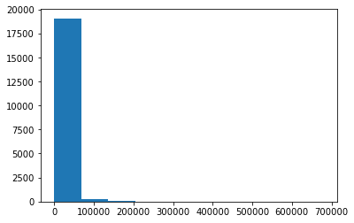
Coupon catalogue price

Slide 18
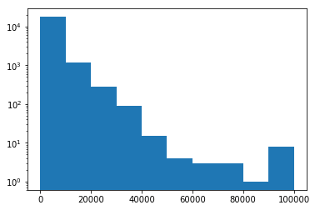
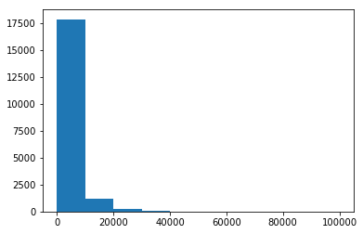
Coupon discount price

Slide 19
Bayesian approach
p(coupon|person) : Quantity to be found
coupon = (genre, discount rate, location)
person = (gender, age, residence)
p(coupon) = p(genre)*p(discount rate)*p(location)
p(person) = p(gender)*p(age)*p(residence)
For continuous variable either use distribution or divide it into discrete groups

Slide 20
Bayesian approach
Step 1:
p(coupon|person) = p(genre|person)*p(discount rate|person)*p(location|person)
Step 2a:
p(genre|person) = p(genre)*p(person|genre)/p(person)
Step 2b:
p(discount rate|person) = p(discount rate)*p(person|discount rate)/p(person)
.
.
.
Step 3a:
p(person|genre) = p(sex|genre)*p(residential location|genre)*p(age|genre)
Step 3b:
p(person|discount rate) = p(sex|discount rate)*p(residential location|discount rate)*p(age|discount rate)
.
.
.

Slide 21
Bayesian approach
Step 4:
p(person) = p(sex)*p(residential location)*p(age)
Now we have all the variable we can go for it. ☺
Let’s try and see where I end up ☺

Slide 22
Bayesian approach: Final formula
p(genre)*p(sex|genre)*p(residential|genre)*p(age|genre)*
p(location)*p(sex|location)*p(residential|location)*p(age|location)*
p(discount rate)*p(sex|discount rate)*p(residential|discount rate)*p(age|discount rate)*
….
….
….
p(coupon price)*p(sex|coupon price)*p(residential|coupon price)*p(age|coupon price)

Slide 23

Formal notations
$$u=\left(u_{1}, u_{2},….,u_{n−1}, u_{n}\right)$$
$$c=(c_{1}, c_{2},…, c_{m−1}, c_{m})$$
$p\left(c|u\right)=p\left(c_{1}|u\right)∗p\left(c_{2}|u\right)$*$….∗p\left(c_{m−1}|u\right)$*$p\left(c_{m}|u\right)$
$$p(c_{1}|u)=p\left(c_{1}\right)∗p(u|c_{1})/p(u)$$
$$p\left(u|c_{1}\right)=p\left(u_{1} | c_{1}\right)∗p\left(u_{2} | c_{1}\right)∗p\left(u_{3} | c_{1}\right)…p(u_{n}|c_{1})$$

Slide 24
Python implementation
Person = [age, gender, residential area]
Coupon = {genre: “ ” , discount Price: 20 , location: ‘’ “}
Coupons = [Coupon1, Coupon2, …. Couponm]
For Coupon in Coupons:
p(genre == Coupon.genre)
p(discount price == Coupon.discount)
p(location == Coupon.location)

Slide 25
Content vector calculation

Slide 26
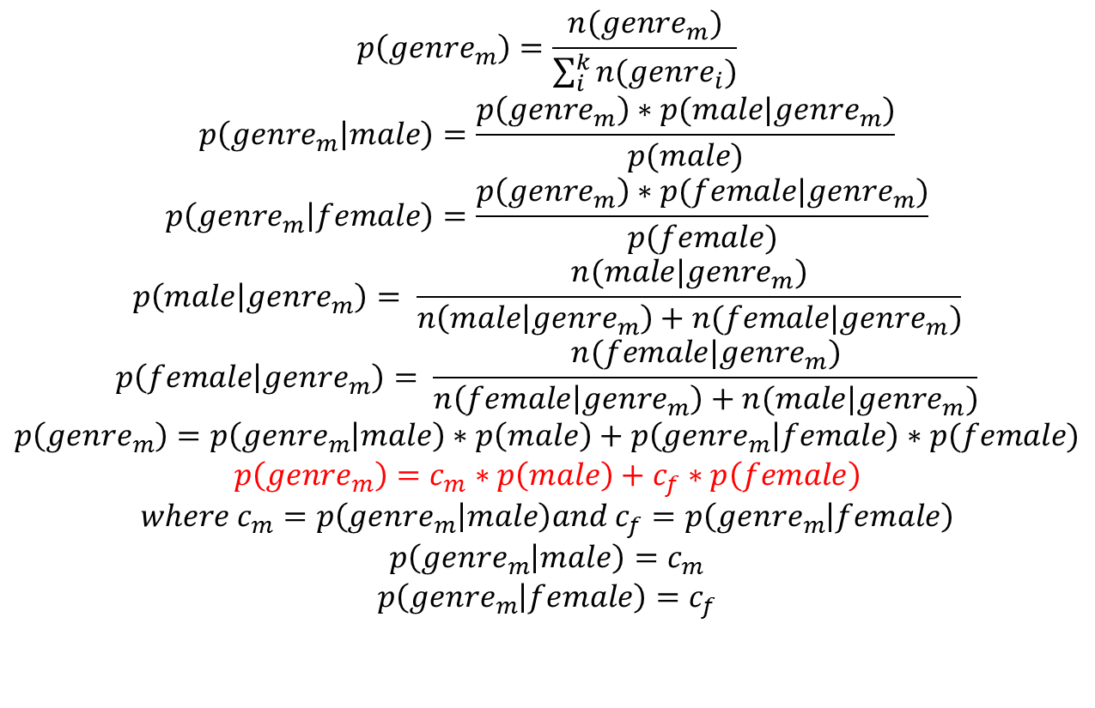
How to implement it
$$p\left(genre_{m}\right)=\frac{n(genre_{m})}{\sum_{i}^{k}{n(genre_{i})}}$$
$$p\left(genre_{m} | male\right)=\frac{p\left(genre_{m}\right)∗p(male|genre_{m})}{p(male)}$$
$$p\left(genre_{m} | female\right)=\frac{p\left(genre_{m}\right)∗p(female|genre_{m})}{p(female)}$$
$$p\left(male | genre_{m}\right)= \frac{n(male|genre_{m})}{n\left(male | genre_{m}\right)+n(female|genre_{m})}$$
$$p\left(female | genre_{m}\right)= \frac{n(female|genre_{m})}{n\left(female | genre_{m}\right)+n(male|genre_{m})}$$
$$p\left(genre_{m}\right)=p\left(genre_{m} | male\right)∗p\left(male\right)+p\left(genre_{m} | female\right)∗p(female)$$
$$p\left(genre_{m}\right)=c_{m}∗p\left(male\right)+c_{f}∗p\left(female\right)$$
$$where c_{m}=p\left(genre_{m} | male\right)and c_{f}=p\left(genre_{m} | female\right)$$
$$p\left(genre_{m} | male\right)=c_{m}$$
$$p\left(genre_{m} | female\right)=c_{f}$$

Slide 27
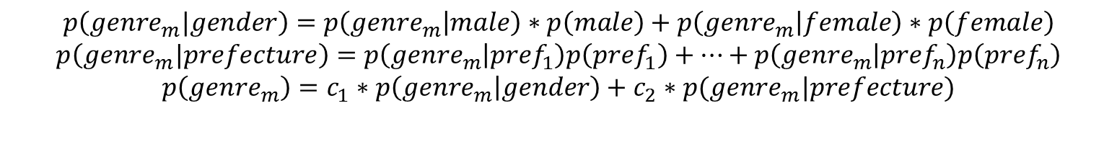
How to implement it
$$p\left(genre_{m}|gender\right)=p\left(genre_{m} | male\right)∗p\left(male\right)+p\left(genre_{m} | female\right)∗p\left(female\right)$$
$$p\left(genre_{m}|prefecture\right)=p\left(genre_{m} | pref_{1}\right)p\left(pref_{1}\right)+…+p\left(genre_{m} | pref_{n}\right)p\left(pref_{n}\right)$$
$$p\left(genre_{m}\right)=c_{1}∗p\left(genre_{m} | gender\right)+c_{2}∗p(genre_{m}|prefecture)$$
Calculate the value of $c_{1}$ and $c_{2}$ using cross validation

Slide 28
Joint probability
その他のクーポン m 0.446086888331
その他のクーポン f 0.553913111669
ギフトカード m 0.461165970376
ギフトカード f 0.538834029624
ホテル・旅館 m 0.594041450777
ホテル・旅館 f 0.405958549223
ビューティー m 0.136363636364
ビューティー f 0.863636363636
エステ m 0.108949416342
エステ f 0.891050583658
ヘアサロン m 0.142930856553
ヘアサロン f 0.857069143447
健康・医療 m 0.313131313131
健康・医療 f 0.686868686869

