Slide 1

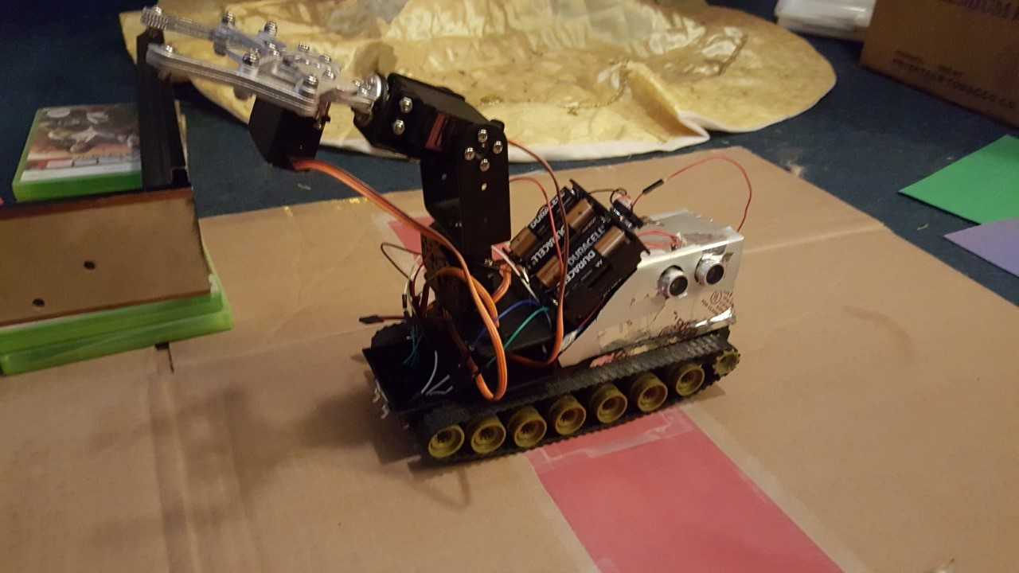
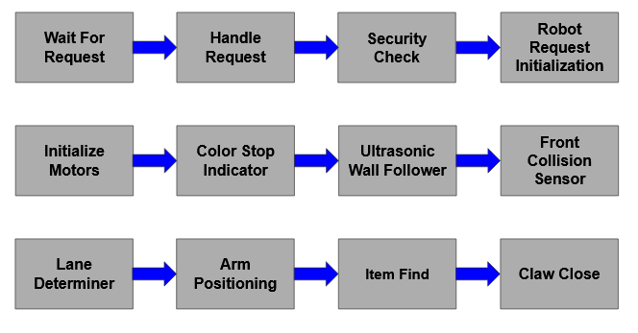
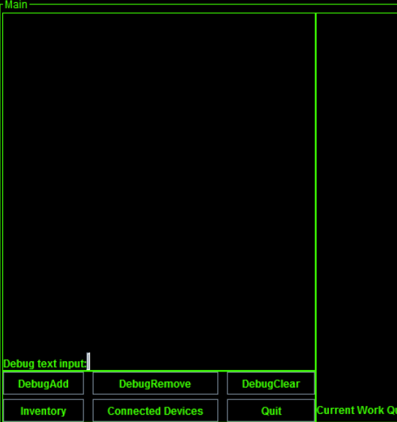
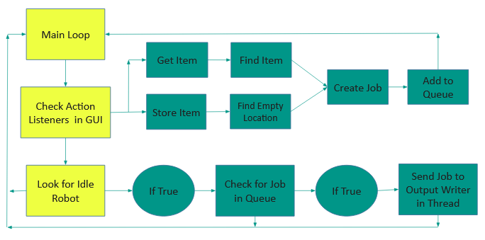
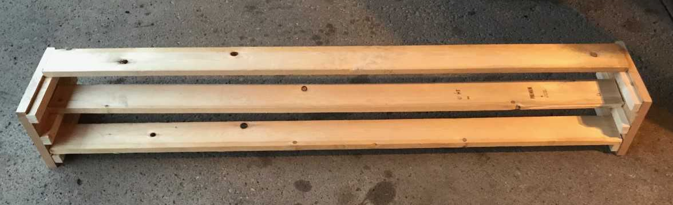
ECE Department
College of Engineering
ECE 4600: Capstone Design I Fall-2017
Robotic Warehouse Management System
Instructor: Dr. Syed M. Mahmud
Mentor: Dr. Syed M. Mahmud
Fadi Satto, Jacob Mijal, Robert Kruzel
Objective: The objective of our project is to design a robot to navigate a warehouse and return with an item from a specific position. In addition to the robot itself, we have a Java server to control the tasks of the robot, as well as adding potential scalability of multiple units working simultaneously.
Theory of Operations: The main function of the robot are to navigate an area containing custom shelves designed to simulate a warehouse environment. The robot will receive a task from the server, containing x, y, and z coordinates, which correspond to the aisle, row, and shelf location of the desired item. To navigate, each intersection is given a color code on the floor, which the robot uses to determine if they need to turn or continue. After reaching the item, the robot will pick up the item with the claw arm, and return to the starting location. Ultra-sonic sensors are used on the sides of the robot to prevent running in to a wall, as well as in front for safety purposes.
Connection management is multi-threaded, allowing many clients connected to the server, as well as asynchronous message execution and reducing bottlenecks caused by multiple instructions. In addition to distributing jobs to the robot, the server maintains a unique instance of inventory objects. These objects are all children of the static InventoryManager class, and are assigned their location value on creation, which will never change. Other data fields include a flag for determining occupancy, and the item’s part number and name. This allows us to skip empty locations while searching for an item. Once a successful match has been found, the items location data and the instruction type are encoded as prescribed by our TCP protocol. Then it is added to a work queue. When a robot tells the server it is idle, the queue is polled and the instruction is sent to the robot. When a robot is sent out on a job, the inventory for that items position is set to default (unoccupied).
Design Alternatives: We considered different schemes for navigation and job assignment, such as non-persistent connections to the robot. This would reduce network chatter, and would not change the idle to get job structure, however this would not allow management of the robots by the server in real time for diagnostic or logistical purposes. Regarding navigation, we considered simpler implementations such as line following or a fixed system such as like a vending machine. They were determined to not fit the scope of our project and were dismissed.
Key Points for Selecting Your Design: There are two main reasons we chose our design: centralization of control, and improved efficiency. Control centralization prevents many problems, keeping decision-making and inventory data in one location prevents inconsistent data or overlapping instructions. It also improves efficiency, with the server’s ability to find an item taking much less time then for a human to search the same set of items. Additionally, the user does not need to consider the position of the item in storage, and problems such as item being placed in a new location do not negatively effect work efficiency.
Constraints from Regulating Bodies on the Project: The constraints of our project primarily came from navigation, and the hardware systems needed to implement navigation. Additionally there are various safety concerns that needed to be considered, such as prevention of electrical shock and collision. Additionally we had to abide by FCC guidelines regarding wireless communication standards. Since we are using public WiFi frequencies, we must adhere to use standards. Specifically the operational radius of a WiFi switch, which for a large warehouse would mean multiple nodes, and the ability to hand off connections smoothly between nodes.
Pictures of the Prototype and Testing Materials.
Three tier shelving unit built for testing.
(use this space for more picture
Design of the robot, showing tread based moving systems and multi-jointed item retrieval arm. Control Logic housed at rear of device with ultrasonic sensors on side. Batteries contained between Arm and logic boards.
Screen-shot of Server GUI – Early debug version, this version had many foundational problems that it was scrapped late into development. New GUI is in development but was not complete at the time of this posters submission. It is aimed to be complete for demo at the showing.
Discussions of the Experimental Results: Through the design process, we had a couple difficulties with components. Due to the Arduino board’s low max current output, we went through a few power distribution models as we had systems that we thought should be sufficiently powered from data sheet specs, but in high-power or max-power scenarios the batteries were not able to deliver sufficient power. Another problem that we faced was that changing the battery type resulted in changes of expected values from our sensors. In operation we don’t suspect this will be a problem as nominal voltage and current output under load are fairly constant through lithium based battery technologies.
Conclusions: Our group faced many difficulties in the short time we have been working on this project, and we were able to find reasonable solutions to not only the scope of the project in general, but also identify and overcome unknown design challenges identified in testing. The complexity of the project as well as the number of systems integrated together provided a high work load as well as logistical and labor intensive design and testing environment. We likely would have had stronger results starting with a simpler framework and adding complexity further into design.
Robot General Behavior and Task Execution
Server Main Loop and Task Execution

