Slide 1







POPULAR TOOLS & TECHNOLOGY AMONG DEVELOPERS
Ranjeet Singh
12/03/2024

Slide 2



OUTLINE
Executive Summary
Introduction
Methodology
Results
Visualization – Charts
Dashboard
Discussion
Findings & Implications
Conclusion
Appendix

Slide 3

EXECUTIVE SUMMARY
JavaScript, Python and HTML/CSS remain highly in demand for their versatility
MySQL, PostgreSQL and Microsoft SQL Server are most popular database.
AWS, Linux, and Windows are the top platforms
React and Angular are the most commonly used frameworks
Developer Demographics:
Majority identify as male
Largest age group is 20-30
The U.S. has the highest number of developers

Slide 4

INTRODUCTION
Analyze the current trends in the developer community using insights from Stack Overflow’s annual survey.
These insights shed light on the evolving landscape of programming languages, web frameworks, and the demographics of professional developers
The findings may not reflect the entire developer population
Highlight the more widely used tools among developers

Slide 5

METHODOLOGY
Data Collection
Web Scrapping
APIs
Data Pre-Processing
Data Cleaning
Exploratory Data Analysis
Analyzing data distribution
Handling outliers
Checking Correlation
Data Visualization
Highlight data distributions, relationships and correlations
Building Dashboard

Slide 6
RESULTS

Slide 7
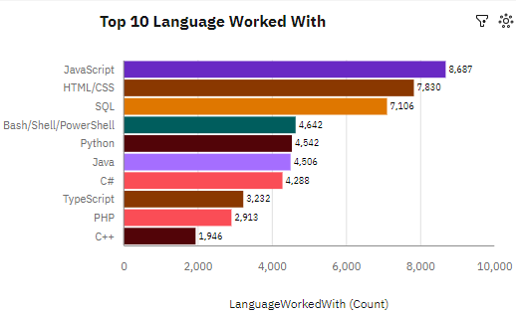
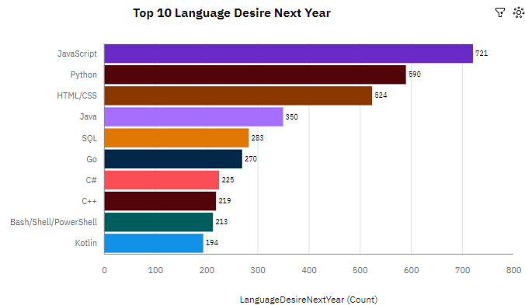
PROGRAMMING LANGUAGE TRENDS
Current Year
Next Year

Slide 8
PROGRAMMING LANGUAGE TRENDS - FINDINGS & IMPLICATIONS
Findings
JavaScript is most popular language
HTML/CSS & SQL are the important tools
Python is gaining popularity
Implications
Typescript language is gaining popularity and more people are shifting towards it.

Slide 9
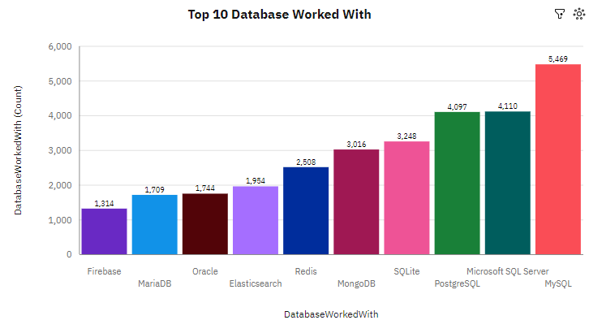
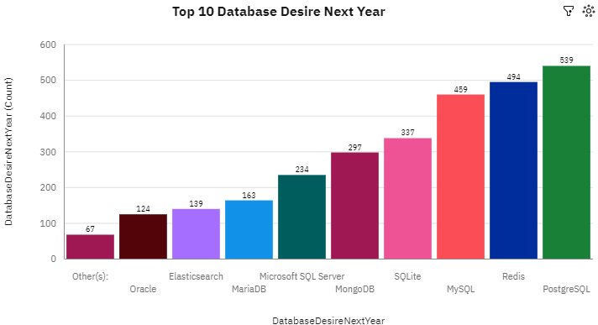
DATABASE TRENDS
Current Year
Next Year

Slide 10
DATABASE TRENDS - FINDINGS & IMPLICATIONS
Findings
MySQL is the most commonly used database
PostgreSQL & Redis is gaining popularity
Implications
PostgreSQL is most desired language to learn due to its advance features and scalability

Slide 11

DASHBOARD
https://github.com/rksin8/IBM-Data-Analyst-Capstone-Project/blob/main/dashboard/Task%206.pdf

Slide 12
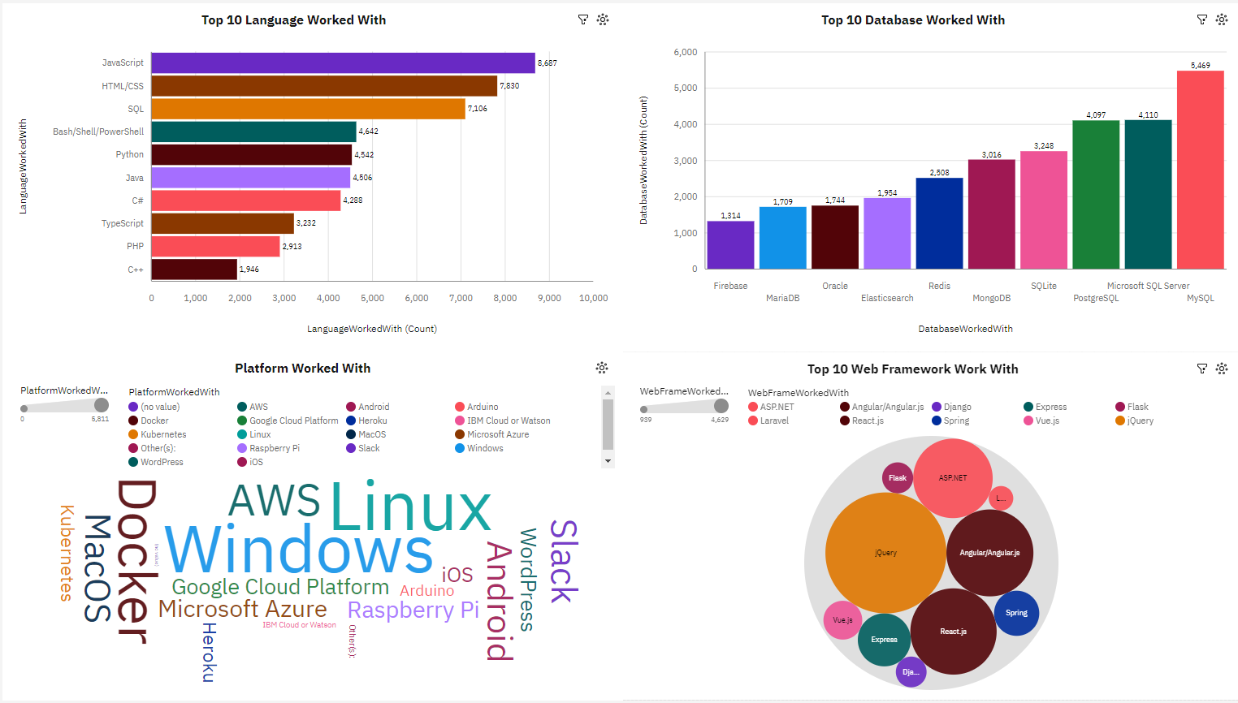
CURRENT TECHNOLOGY USAGE

Slide 13
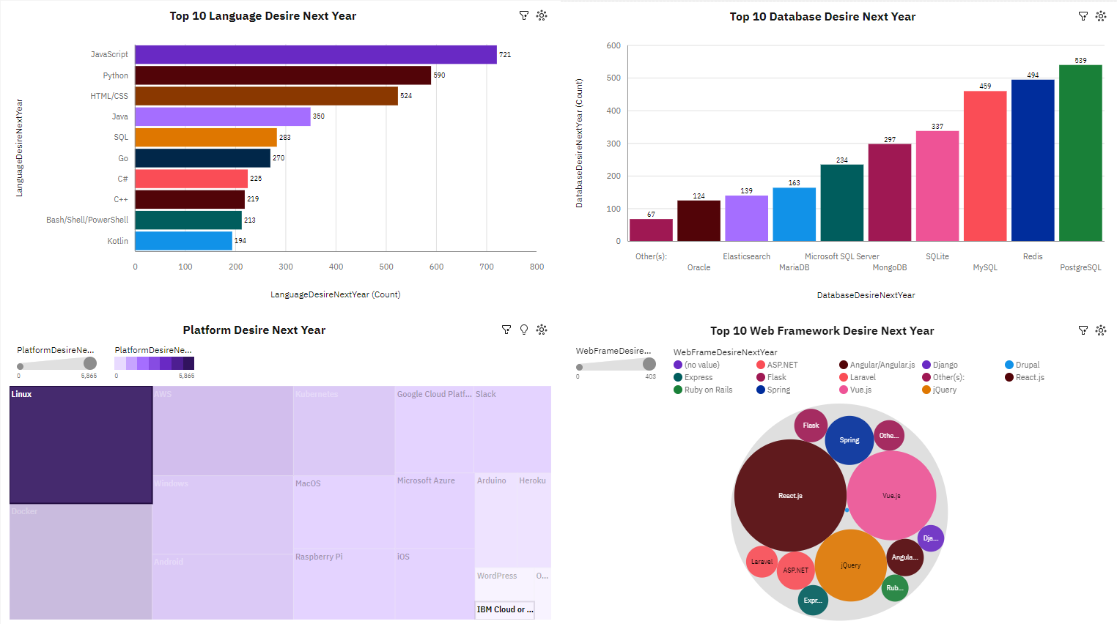
FUTURE TECHNOLOGY TREND

Slide 14
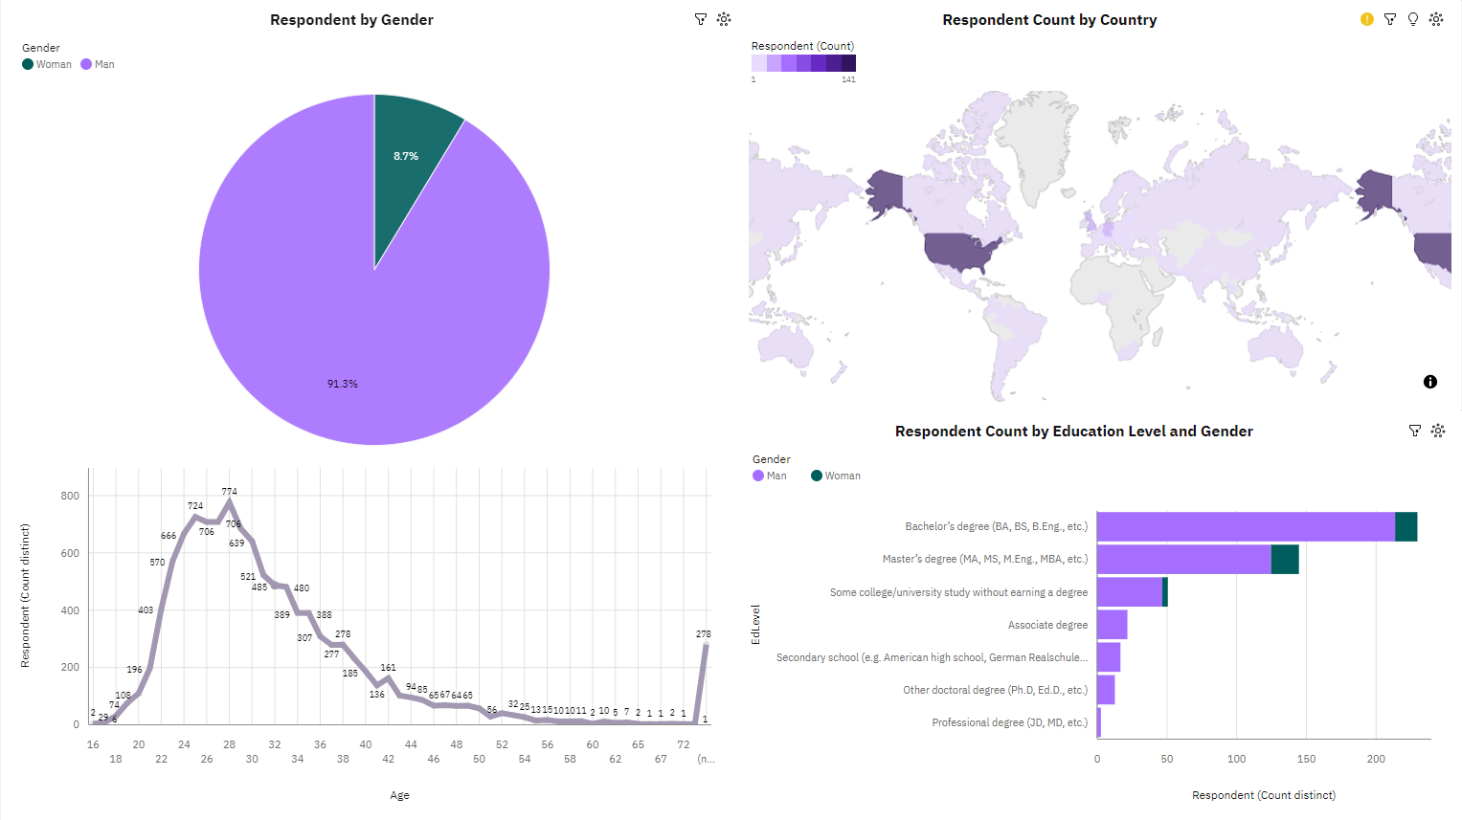
DEMOGRAPHICS

Slide 15
DISCUSSION

Slide 16
OVERALL FINDINGS & IMPLICATIONS
Findings
Python & JavaScript is gaining popularity among developers
Over 90% developers are male and age between 20-30
Majority of developers have formal college or university education
Implications
Technology is shifting towards more typescript language like JavaScript, Python.
Formal education is not mandatory for developers

Slide 17

CONCLUSION
Developers from diverse regions and backgrounds reflect the global technology trends
Programming languages and technologies change rapidly
Keeping up with trends in programming languages, platforms, and tools is essential.

Slide 18

APPENDIX
Job postings.
Popular Languages

Slide 19
JOB POSTINGS

Slide 20
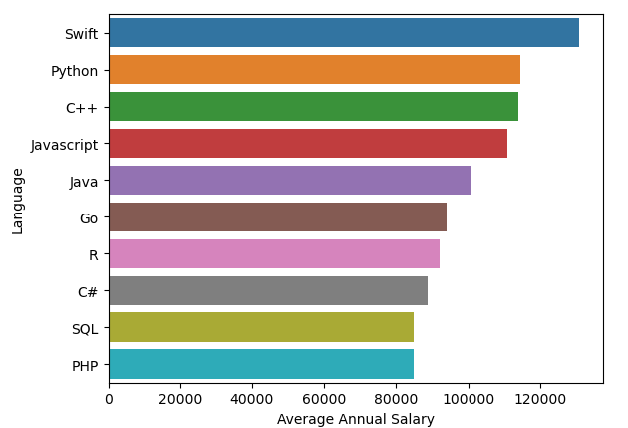
POPULAR LANGUAGES

