Slide 1



IT SERVICES & TECHNOLOGY SOLUTIONS

Slide 2

IT SERVICES & TECHNOLOGY SOLUTIONS

Slide 3
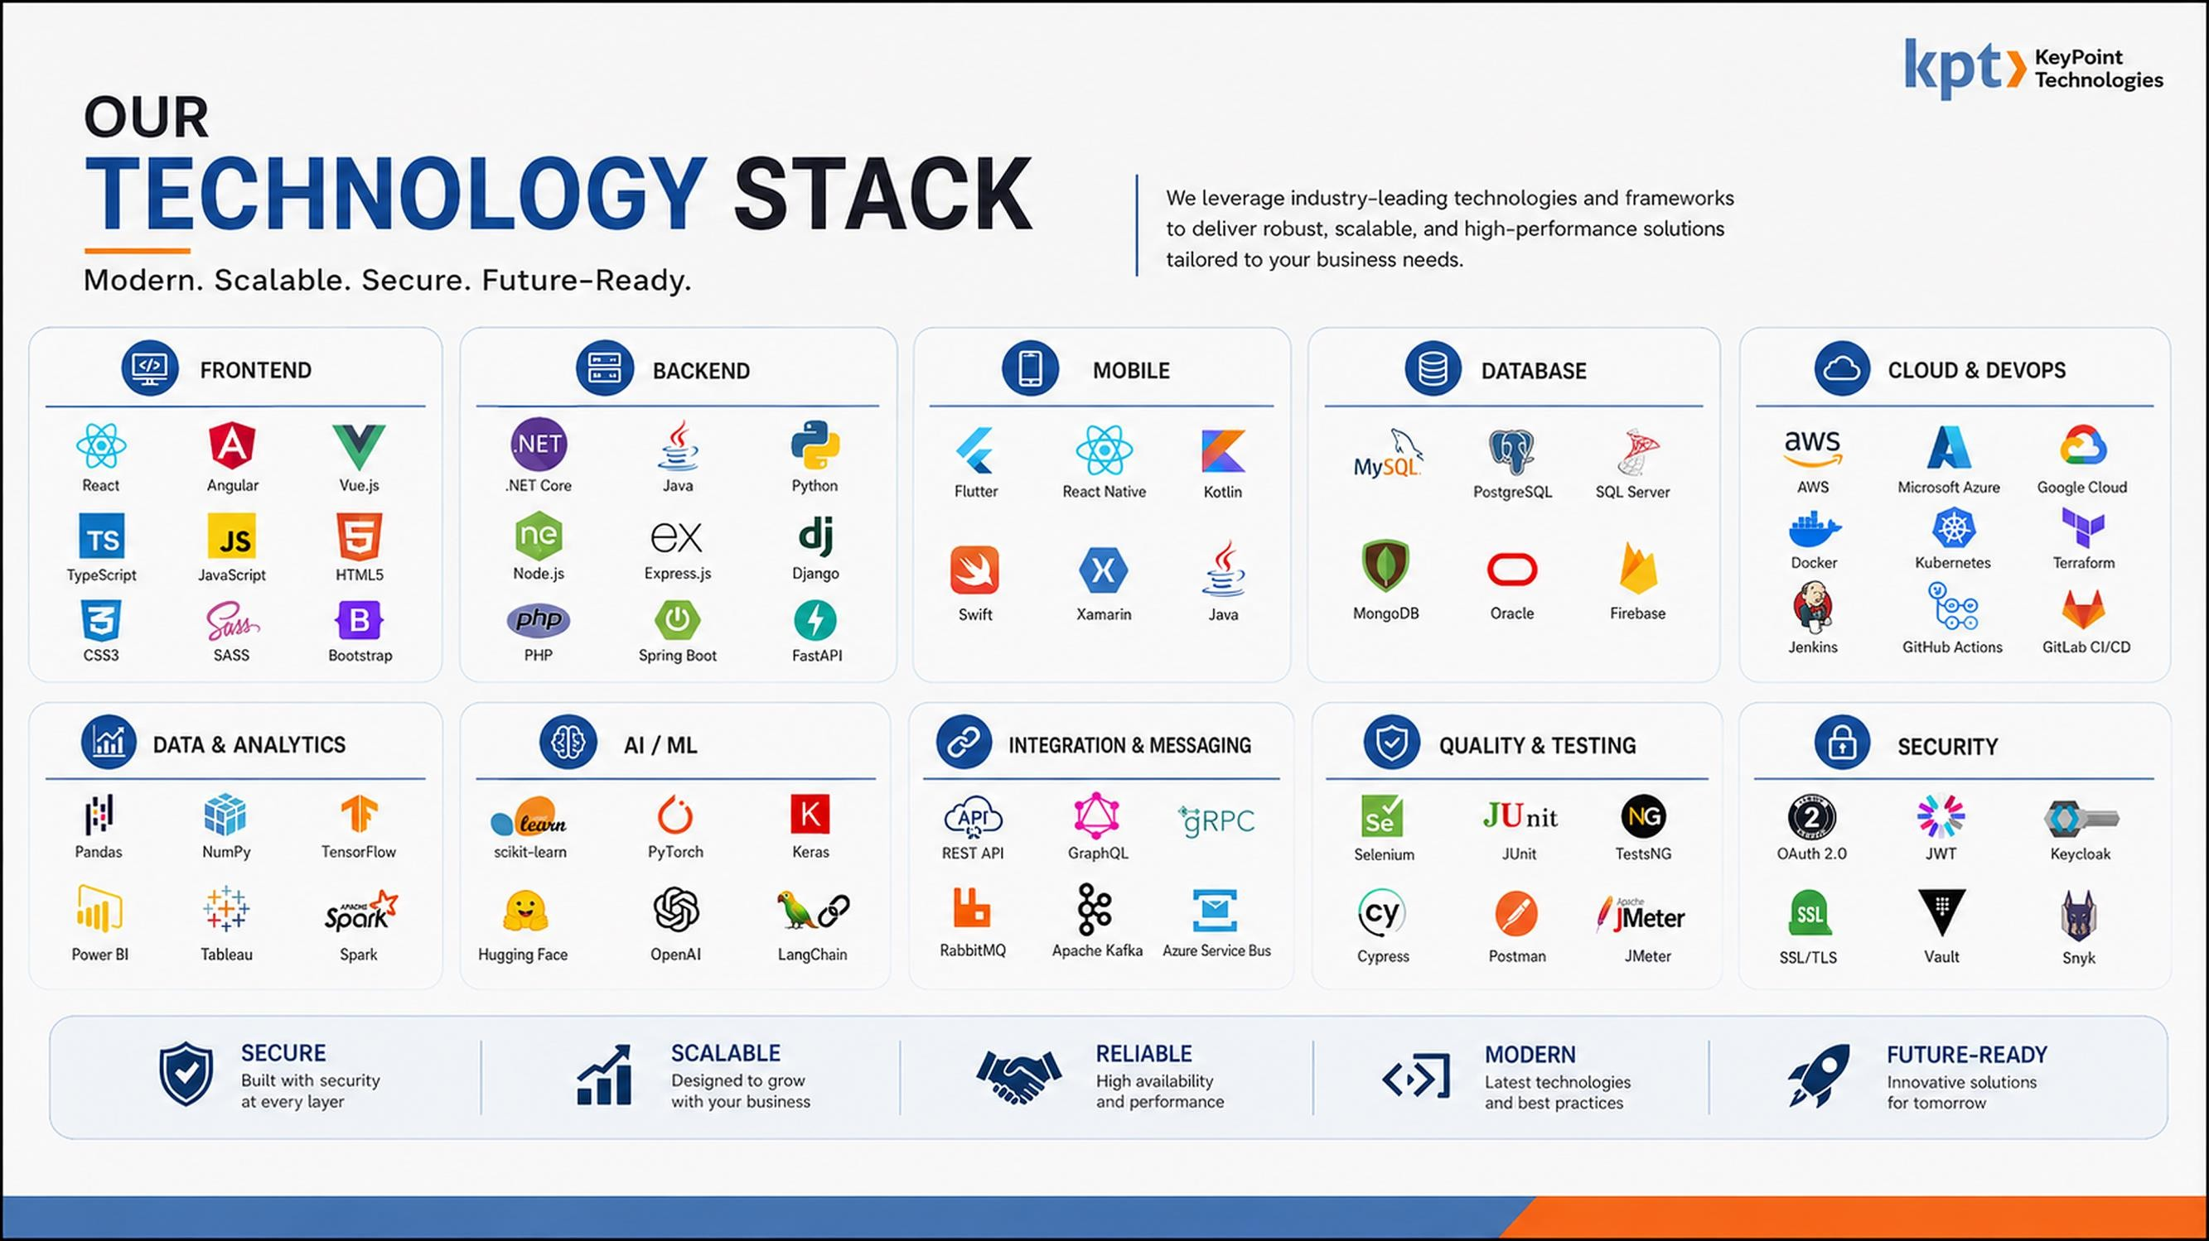
OUR TECHNOLOGY STACK

Slide 4
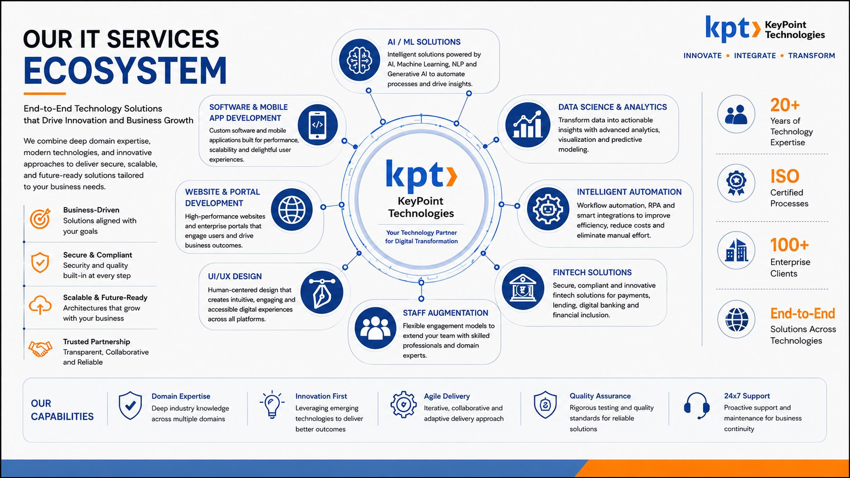
OUR IT SERVICES ECOSYSTEM

Slide 5
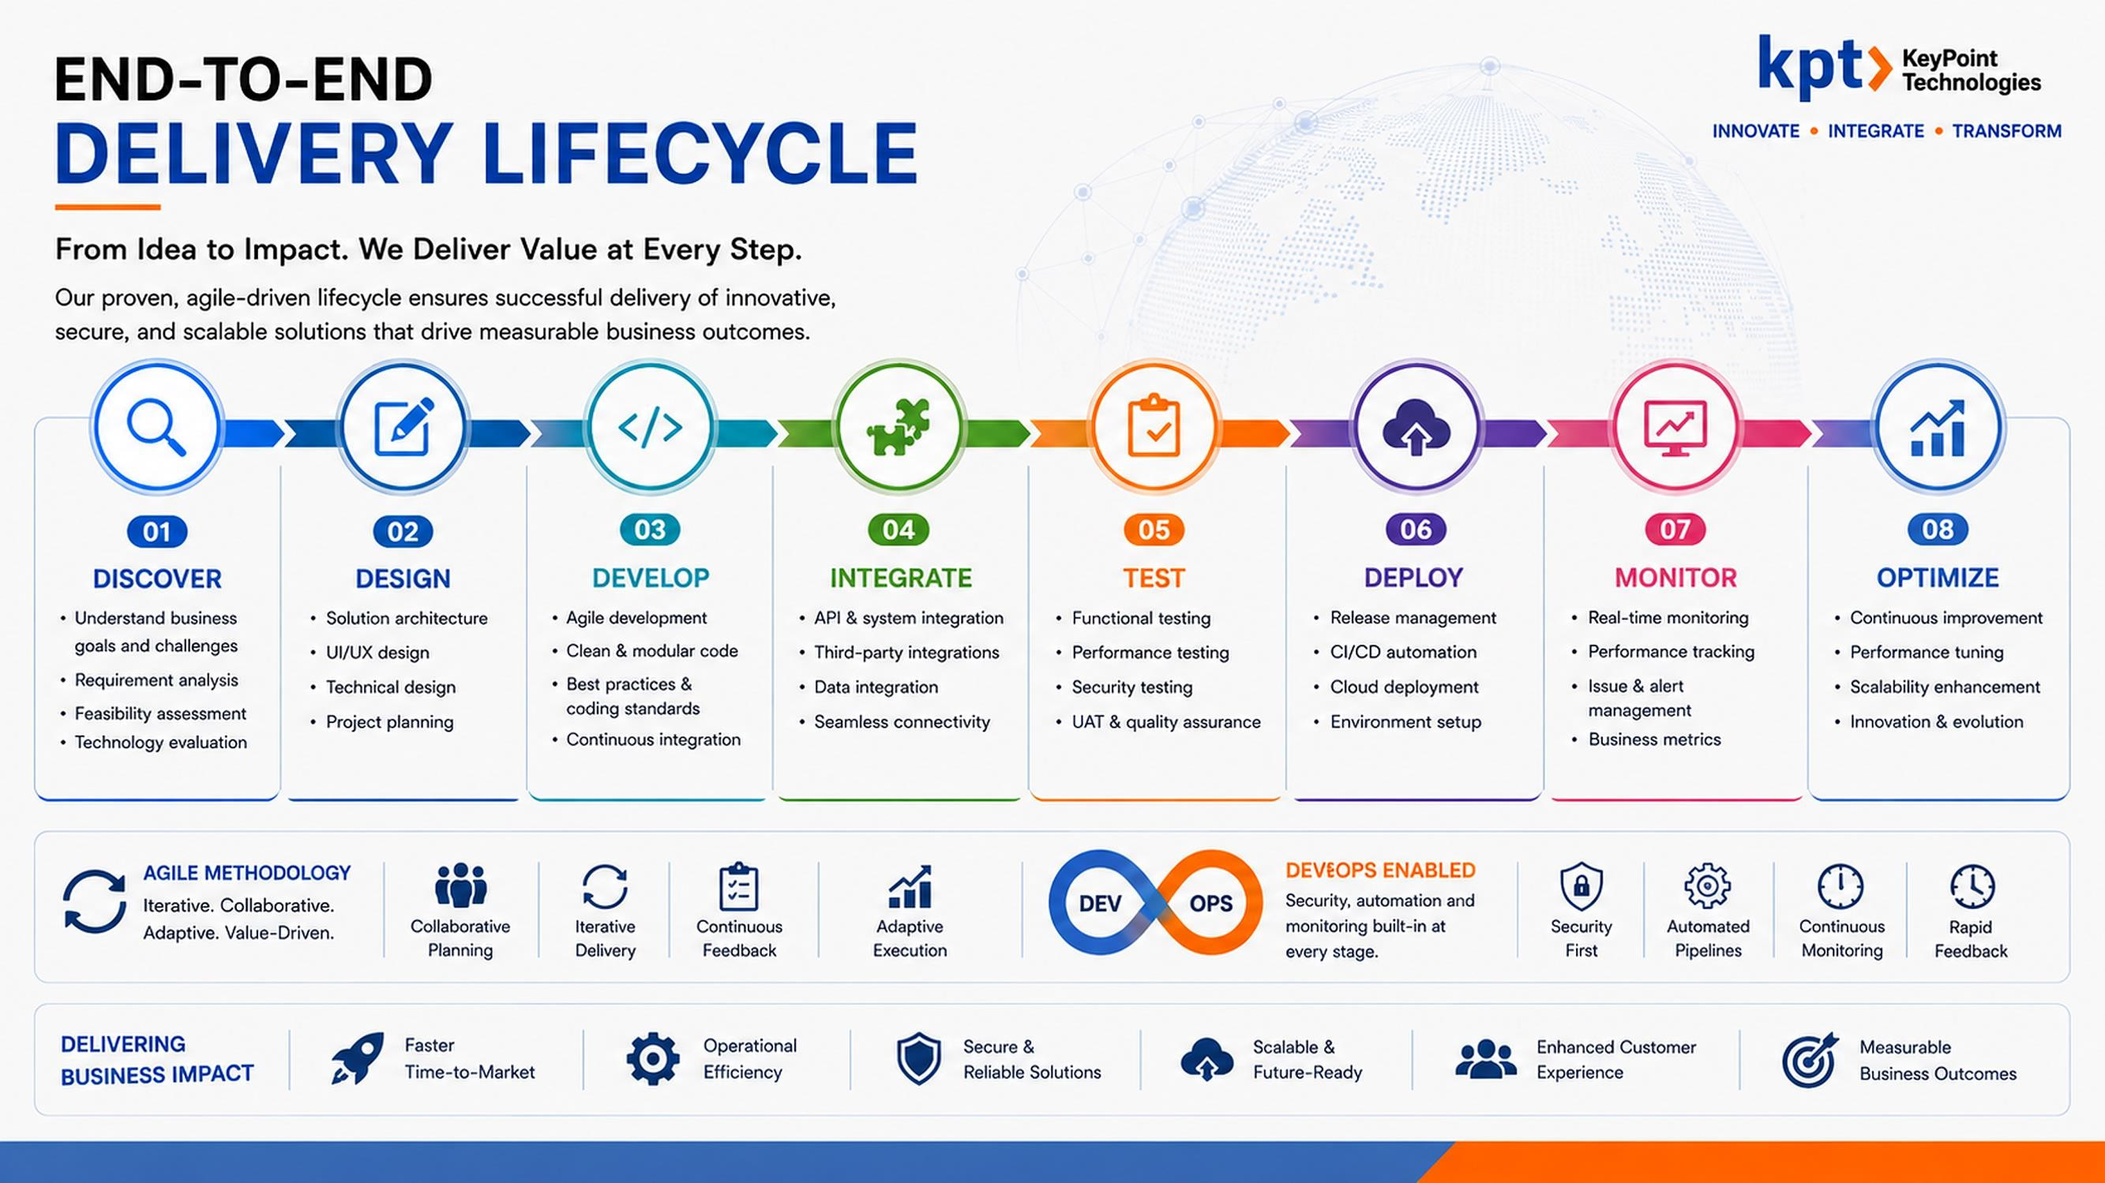

Slide 6
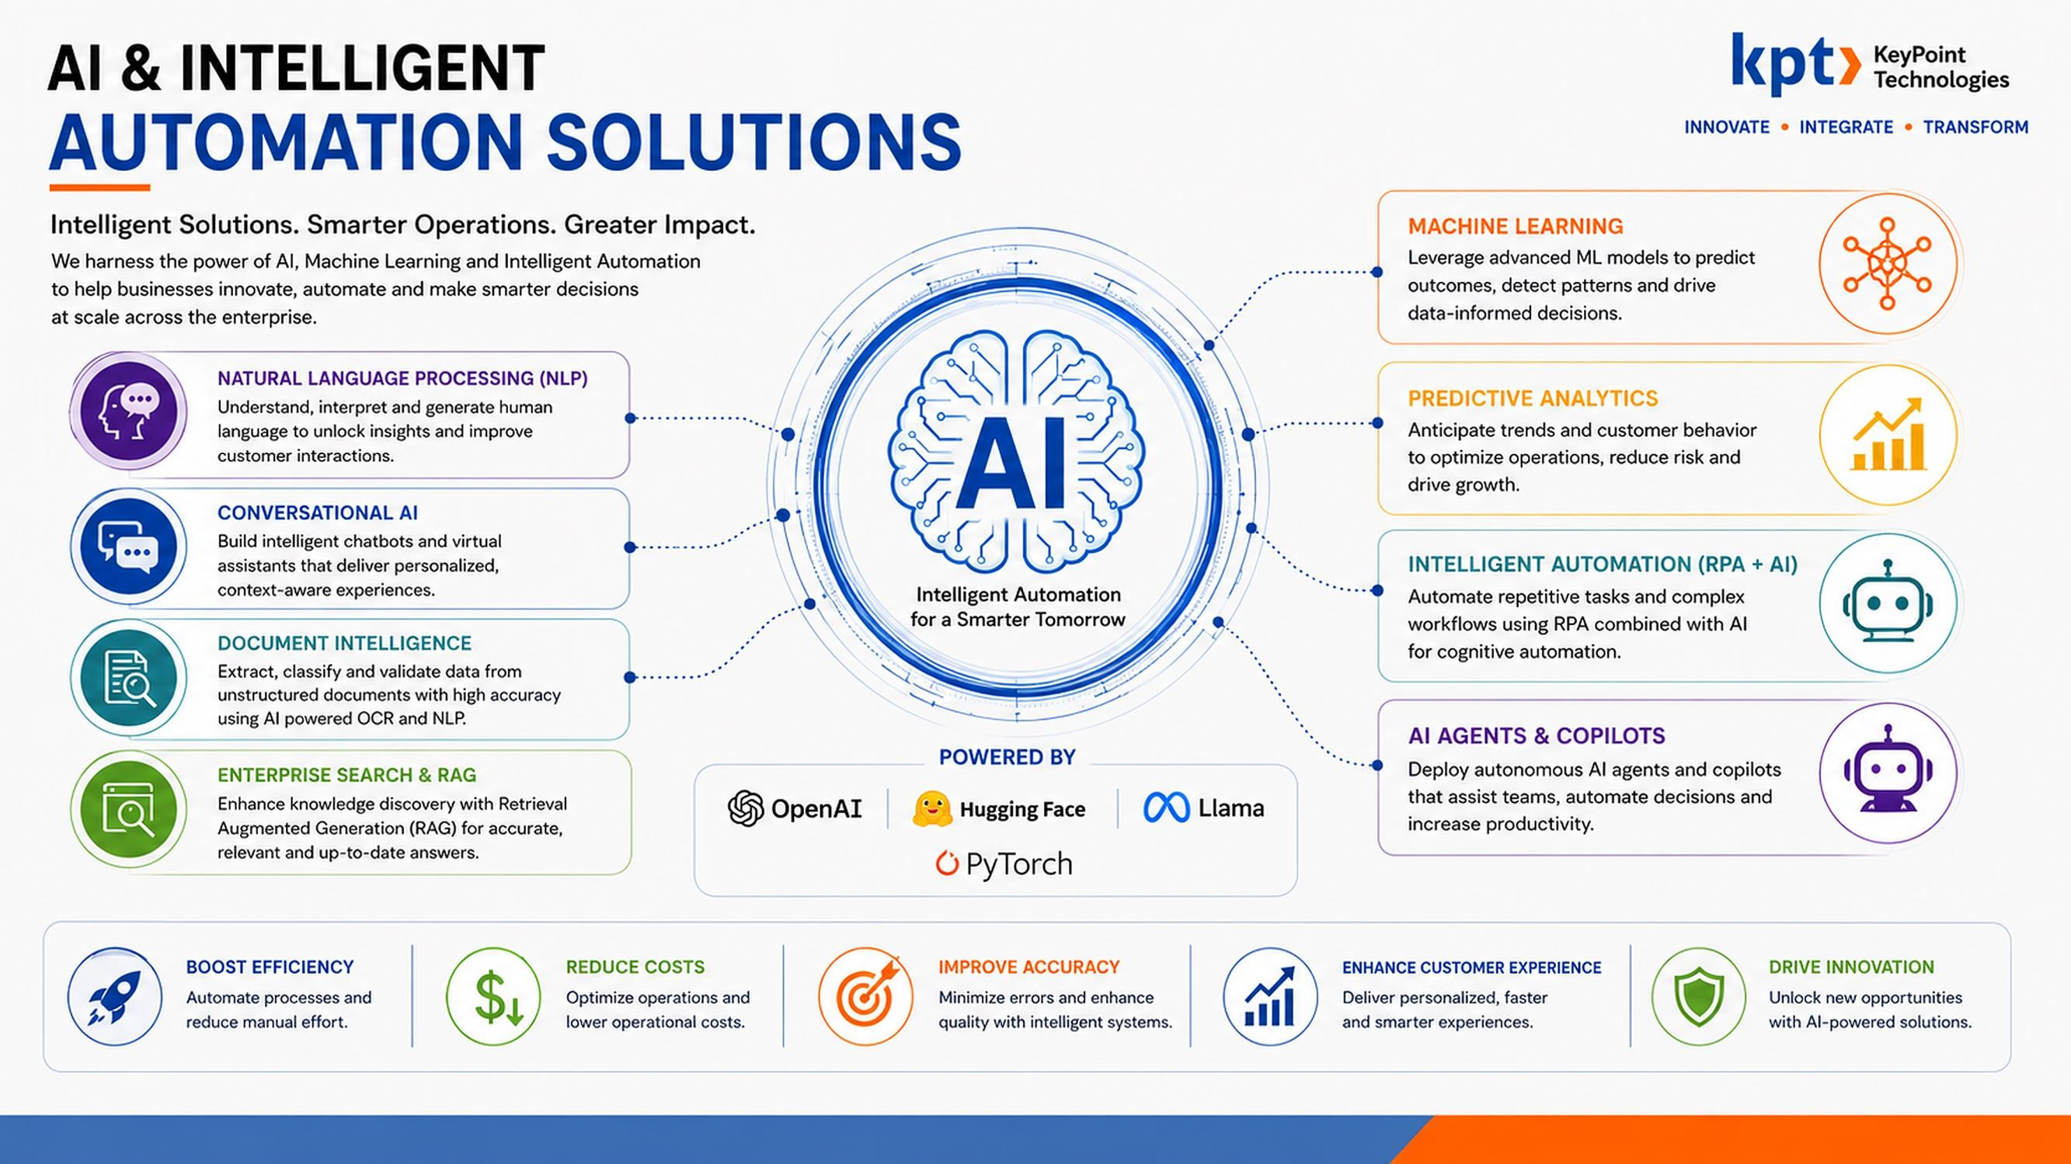

Slide 7
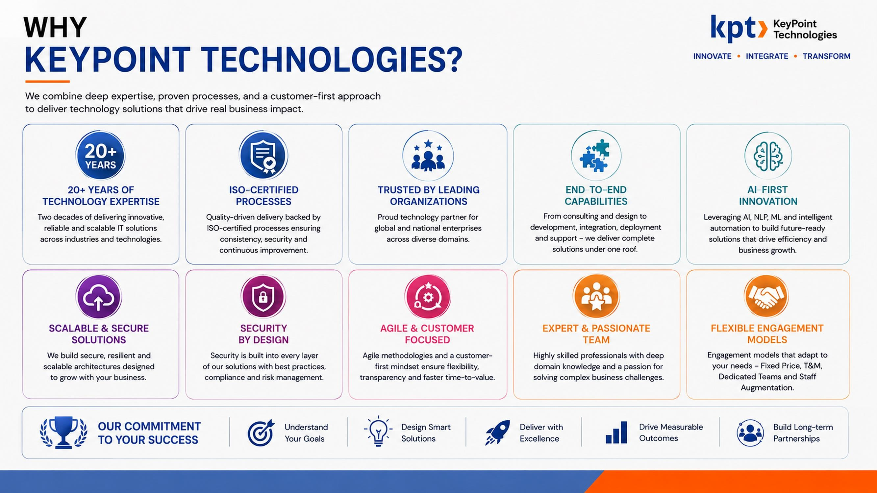

Slide 8













TruMed Leading C\ienH
Delivering technology solutions to global brands across industries
Metis-LI
Reliable Insights
IIT
LG
Aerospace & Defence Pu'°’••’ s u
DRDO
ITI LIMITED .
CRIS
OAIL (Indlaj Lbnflad
SPMCIL
BBSERYE BAI¥K OF IN0âA
PIONEERS IH PRDERESS

Slide 9
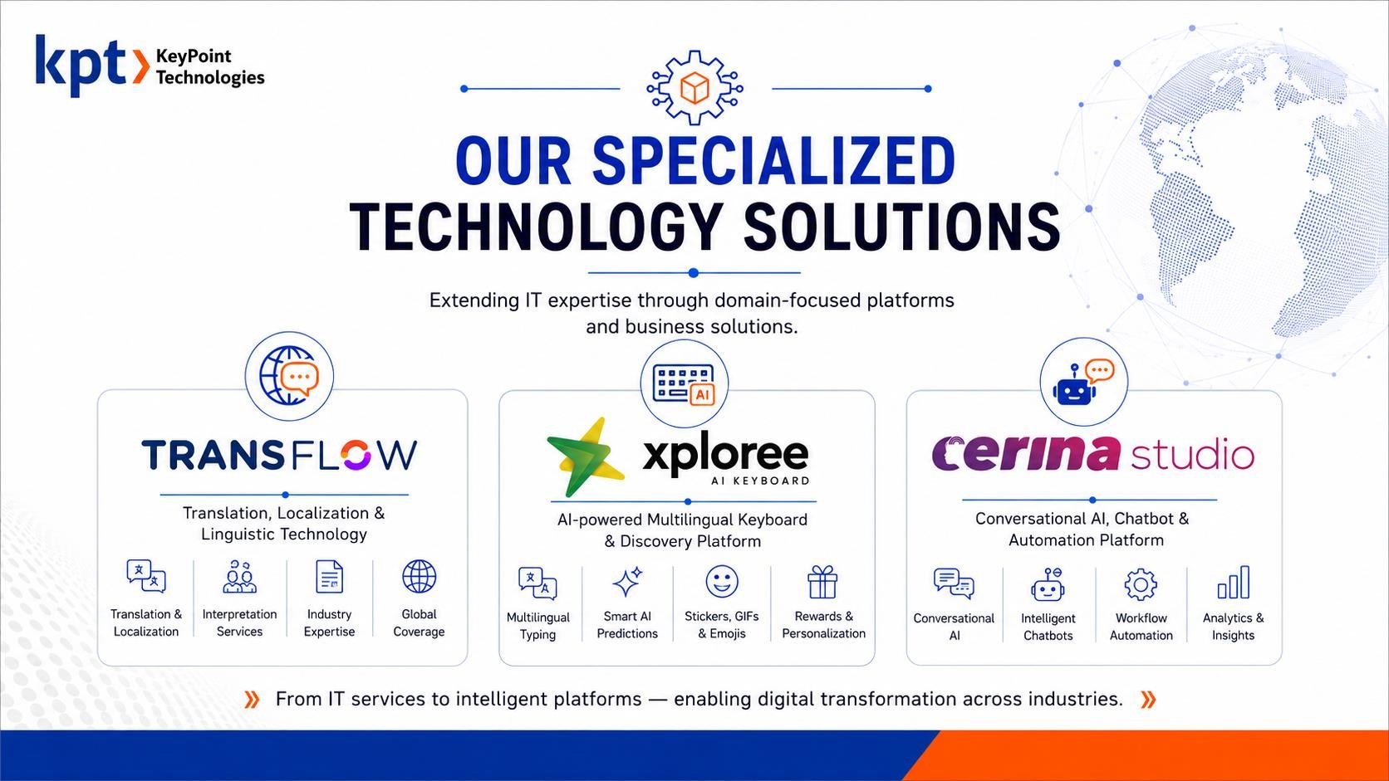

Slide 10
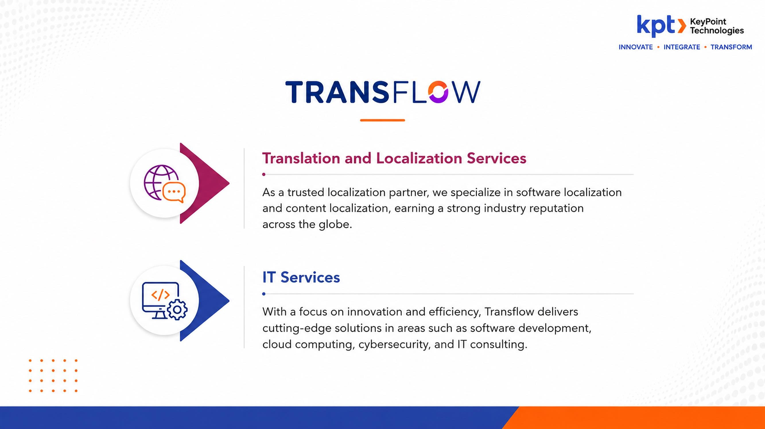


Slide 11
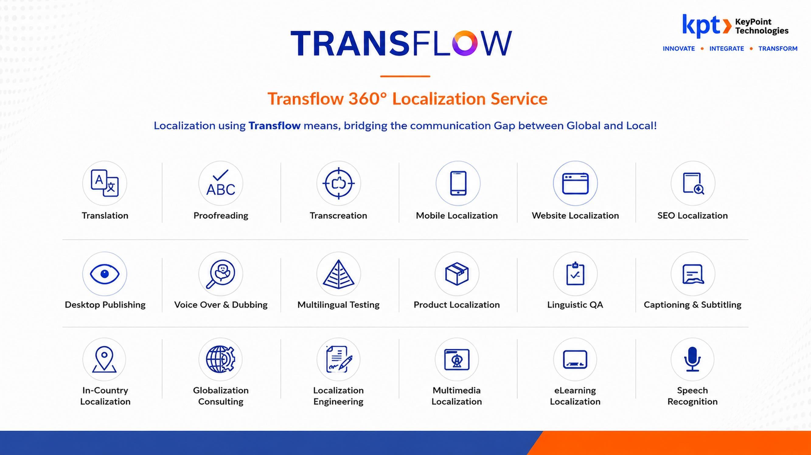

Slide 12
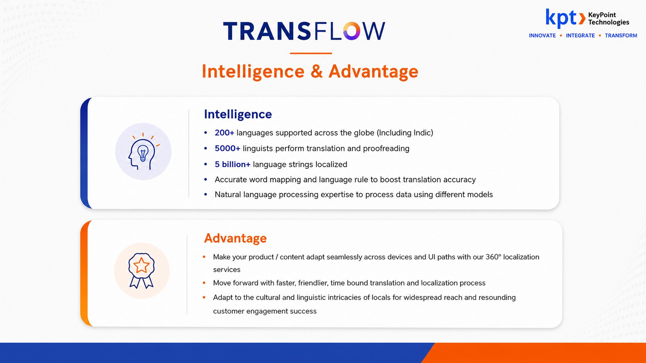

Slide 13
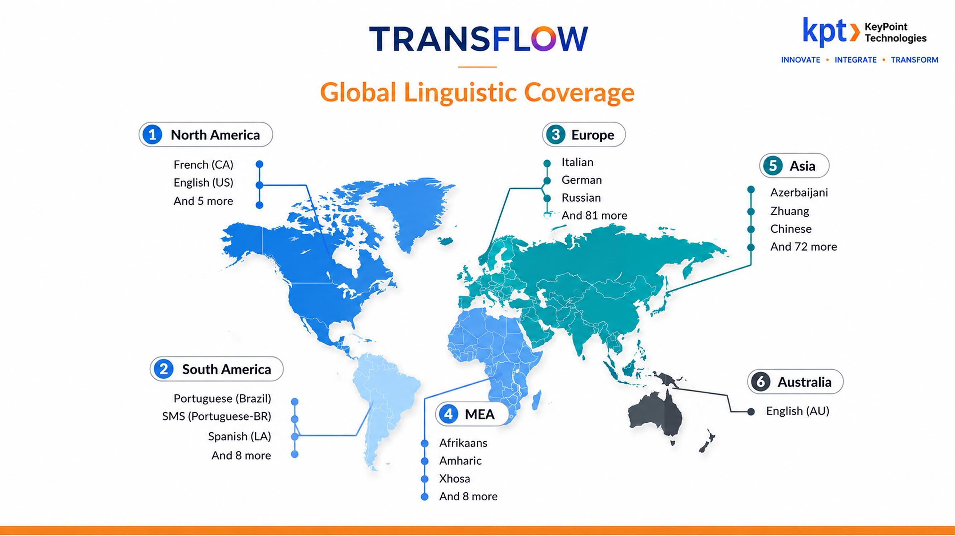

Slide 14
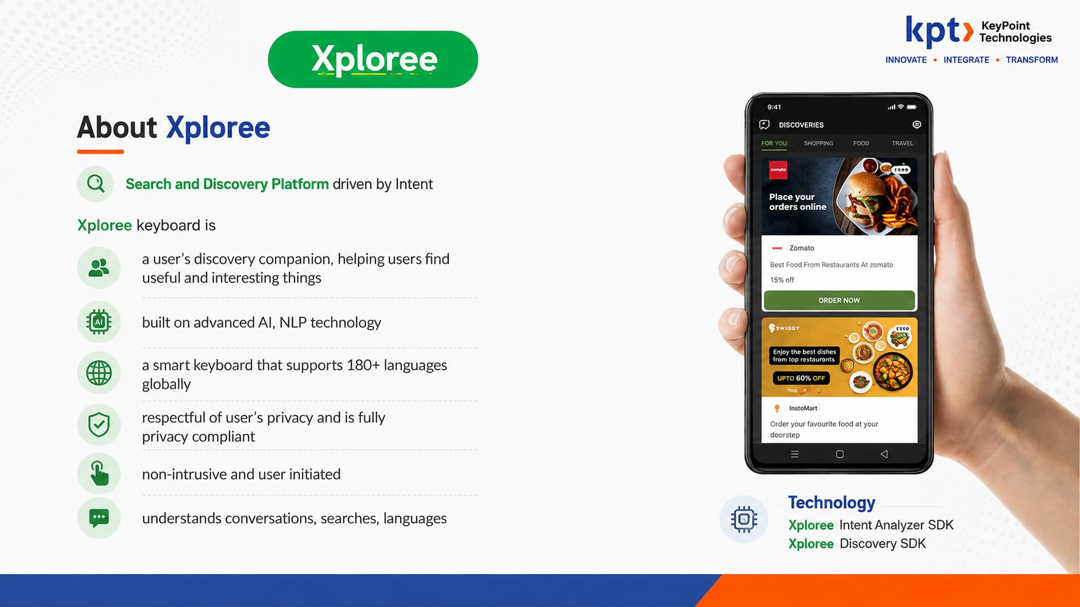


Slide 15



Slide 16
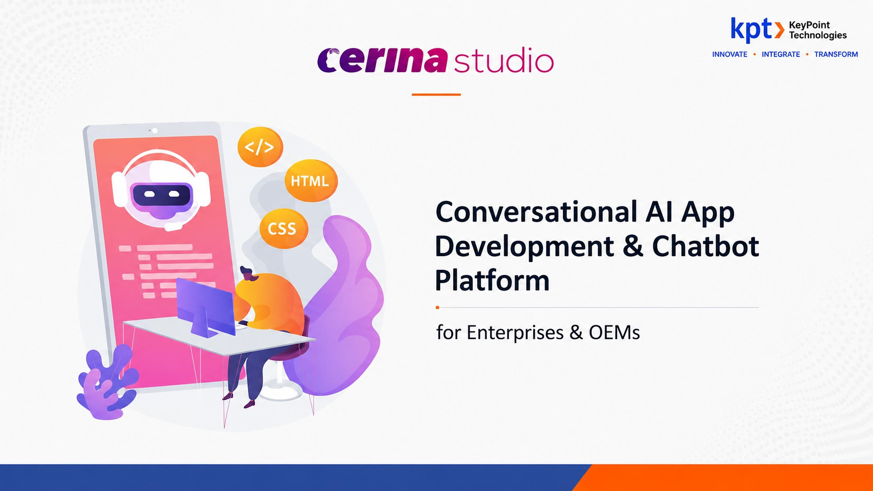

Slide 17
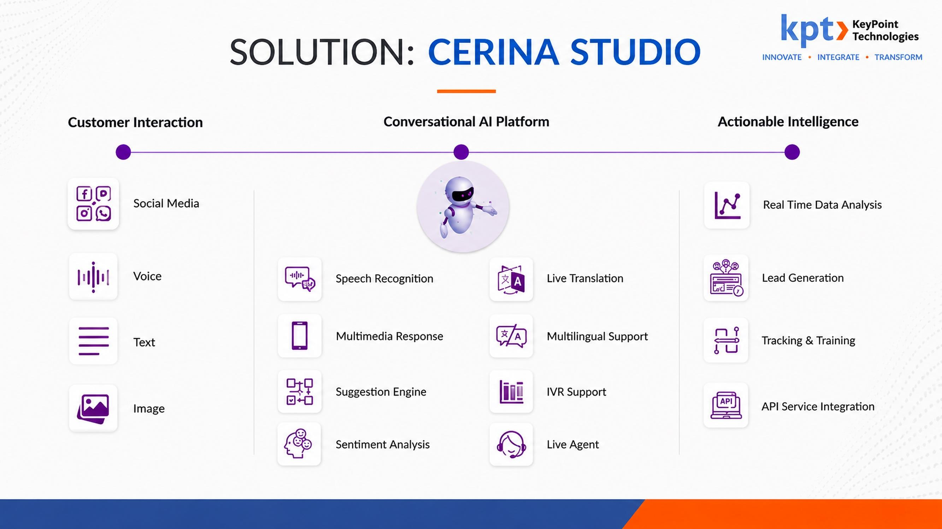

Slide 18

Web-GIS Mine Monitoring Platform & Decision Support System
Technical Presentation | RFP for Selection of System Integrator
Department of Mines & Geology, Government of Telangana
Tender issued by Telangana Technology Services Ltd (TGTS) on behalf of TGMDC
Presented by: [Bidder name] | October 2026
Notes:
Introduce the team and the purpose: this presentation covers the technical understanding, methodology, resource deployment, training, O&M with helpdesk and escalation, and exit management, as required under evaluation criterion 7. The live prototype demonstration follows separately.

Slide 19
What this presentation covers
AGENDA
1
Understanding of the requirement
Context, objective, scope of the 11 modules
EVALUATION CRITERION 7
2
Solution and data security
Technical Demonstration of Project
Open-source architecture; RBAC, encryption, audit, CERT-In
3
Methodology and timeline
35 marks
Delivery approach and Go-Live at T+90 days
4
Resource deployment plan
This presentation: understanding, methodology, resources, training, O&M, helpdesk, escalation, exit
Separate live demo: Web-GIS visualisation, dashboards, web prototype
Development team and O&M team
5
Training plan
Role-wise, in English and Telugu
6
O&M, helpdesk and escalation
Support model, SLAs, escalation matrix
7
Exit management plan
Handover, parallel run, data deletion
Notes:
Each item maps to the wording of evaluation criterion 7 in the RFP. Data security is included because the RFP scores it separately (criterion 6, 10 marks).

Slide 20




Understanding of the requirement
01 · UNDERSTANDING OF THE REQUIREMENT
Fragmented records
Lease deeds, mine plans, survey sheets, returns and royalty sit in separate files and systems.
OBJECTIVE
One lease-centric, spatially enabled source of truth for the State’s mineral sector
Limited spatial visibility
Lease boundaries are not routinely seen against forest, water, eco-sensitive and revenue layers.
Late detection of violations
Monitor
Day-to-day visibility for district and field officers
Mining beyond boundaries and unauthorised extraction are found through field visits, not monitoring.
Enforce
Compliance checks and early detection of violations
Revenue tracking effort
Royalty, dues and penalties are reconciled manually, which delays follow-up.
Decide
Consolidated dashboards and forecasts for senior officers
Notes:
Explain the current challenges in the Department's own terms: records are scattered, boundaries are not seen against regulatory layers, illegal mining is detected late, and revenue is tracked manually. Then state the objective from RFP section 1: one lease-centric, spatially enabled source of truth.

Slide 21
Scope: 11 modules on one platform
01 · UNDERSTANDING OF THE REQUIREMENT
M1
M2
M3
M4
Web-GIS visualisation & monitoring
Lease master data & repository
Operational & financial information
Dashboards, MIS & decision support
Imagery, layers, search, spatial analysis
Lease records, spatial versions, documents
Production, dispatch, royalty, anomaly detection
Executive views, forecasts, early warnings
M5
M6
M7
M8
Governance, users & audit
Open source & cloud compliance
Training & knowledge transfer
Operations & maintenance
RBAC, SSO, MFA, tamper-proof audit trail
OSS only, OGC services, MeitY cloud, DR
Role-wise, English and Telugu
24x7 helpdesk, 99.5% uptime, hypercare
M9
M10
M11
T + 90 days
Testing & quality assurance
Integration & interoperability
Revenue information management
to Go-Live, then 33 months of O&M
SIT, load, security, UAT
REST APIs, payment, SMS, WhatsApp, imagery
Royalty, levies, penalties, outstanding dues
Notes:
Summarise the 11 modules from RFP section 2.3. Emphasise that they share one GIS interface and one lease-centric data model rather than being separate applications.

Slide 22
Solution architecture
02 · SOLUTION
Executives
District officers
Field officers (mobile)
Revenue staff
Leaseholder portal
Admin & audit
USERS
ReactJS web app
OpenLayers map UI
Apache Superset dashboards
English + Telugu UI
PRESENTATION
Keycloak SSO, MFA, RBAC
API gateway
TLS in transit, AES-256 at rest
Tamper-evident audit log
SECURITY
Lease master
Spatial & survey
Documents
Operations
Revenue
Analytics & ML
Notifications
SERVICES
PostgreSQL + PostGIS
GeoServer: WMS, WFS, WCS
GeoNetwork: CSW
MinIO object store
Kafka message queue
GEO & DATA
Payment gateway
SMS, e-mail, WhatsApp
Satellite imagery providers
Department applications
INTEGRATIONS
MeitY-empanelled cloud
Kubernetes, HA, load balancing
DR site, backups, PITR
Prometheus, Grafana, OpenSearch
PLATFORM
Notes:
Walk the layers from top to bottom: users and channels, the React and OpenLayers front end, the security layer, the microservices, the geospatial data layer with GeoServer and PostGIS, external integrations, and the cloud platform underneath.

Slide 23






Security, data protection and compliance
02 · DATA SECURITY & COMPLIANCE
Identity & access
Encryption
Audit trail
Keycloak SSO and multi-factor authentication. Role-based access down to module, district and field level.
TLS for all data in transit and AES-256 at rest. Secure session management and timeout.
Tamper-evident logs of every user action. Hash recorded for each uploaded document.
Compliance
Backup & recovery
Data ownership
CERT-In empanelled security audit before Go-Live. Government IT security guidelines followed.
Daily incremental and weekly full backups, point-in-time recovery and DR replication.
All data, backups and code belong to the Department. No reuse of project data for any other purpose.
Notes:
Cover RFP Module 5 and section 5.1.15 to 5.1.16. Stress that the Department owns all data and that project data is never used for any other purpose, including AI model training, as the RFP requires.

Slide 24
Methodology: five delivery phases
03 · METHODOLOGY
Discover
Data readiness
Build & integrate
Assure
Go-Live & hypercare
T to T+15
T+10 to T+70
T+15 to T+80
T+60 to T+90
T+90 onward
Workshops at HQ and districts
Inventory of lease files and systems
SRS with traceability matrix
Digitise lease boundaries
Validate DGPS and ETS data
Load reference layers
Five two-week sprints
OGC services from GeoServer
Payment, SMS, imagery APIs
SIT, load and security tests
UAT with district officers
Training and sign-off
Production cut-over
60 days of hypercare
Hand over to O&M
Working rhythm: fortnightly sprint demo to the Department · weekly status report · monthly steering review · every change through the RFP change-request process
Notes:
The five phases overlap. We demo working software to the Department every two weeks, and build high-priority items first, as RFP 2.3.15 allows.

Slide 25
Timeline: Go-Live at T+90 days
03 · METHODOLOGY
T
T+15
T+30
T+45
T+60
T+75
T+90
T1+30
T1+60
Cloud infrastructure set-up
Requirement study and SRS
GIS data preparation
Design and build: 5 sprints
Integrations
SIT, load and security testing
UAT, training and sign-off
Hypercare (60 days)
Payment milestones
Then O&M for 33 months, paid in 11 equal quarterly instalments
SRS approval
15% of application cost
Beta Go-Live
50% of application cost
Go-Live (T1)
35% of application cost
Notes:
Read the milestones and the payment schedule from RFP sections 2.3.15 and the payment terms: SRS approval releases 15%, Beta Go-Live 50%, Go-Live 35%, then 11 equal quarterly O&M instalments.

Slide 26
Resource deployment plan
04 · RESOURCE DEPLOYMENT PLAN
Development and implementation phase
Role | No. | Experience | Key responsibility
Project Manager | 1 | 10+ yrs | Delivery, single point of contact
GIS Solution Architect | 1 | 8+ yrs | Spatial data model, GeoServer, PostGIS
GIS Developer | 2 | 5+ yrs | Layers, map interface, spatial tools
Backend Developer | 2 | 5+ yrs | APIs, business logic
Frontend Developer | 2 | 4+ yrs | Web interface, dashboards
Database Administrator | 1 | 6+ yrs | PostgreSQL / PostGIS, backup
Cloud & DevOps Engineer | 1 | 5+ yrs | Cloud, CI/CD, DR
AI/ML Engineer | 1 | 5+ yrs | Anomaly detection, forecasting
Integration Specialist | 1 | 5+ yrs | Payment, SMS, WhatsApp, imagery
QA & Testing Engineer | 2 | 4+ yrs | Functional, load, security testing
GIS Data Specialist | 1 | 5+ yrs | Digitisation, DGPS / ETS validation
Technical Documentation | 1 | 4+ yrs | Manuals, SOPs (English, Telugu)
Total | 16
O&M phase · 33 months
1 × Technical Support Lead
7+ yrs
1 × GIS Support Engineer
4+ yrs
1 × Application Support Engineer
4+ yrs
1 × Database Administrator
5+ yrs
1 × Cloud Support Engineer
5+ yrs
1 × Helpdesk Support Executive
3+ yrs
Helpdesk staffed 24x7 on shifts
Support team on site at the Department
Development bench on call for L3 fixes
Notes:
Development roles and numbers meet the minimum manpower in RFP 2.3.17.2 (16 people). The O&M team meets 2.3.17.3 (6 people). Key staff are not replaced without Department approval, and any replacement has equal or better qualifications.

Slide 27



Training plan
05 · TRAINING PLAN
Audience | Content | Mode | Duration | Language | When
Senior officers | Executive dashboards, MIS reports | Briefing and demo | Half day | English / Telugu | T+80
District Mines Officers, ADs | GIS portal, lease records, compliance, approvals | Hands-on lab | 2 days | English / Telugu | T+76 to T+86
Field officers, inspectors | Mobile map, field verification | At district clusters | 1 day | Telugu first | T+80 to T+90
Data entry operators | Monthly returns, bulk upload, documents | Hands-on lab | 1 day | Telugu / English | T+78
Revenue and accounts | Royalty, collections, reminders, reports | Hands-on lab | 1 day | English / Telugu | T+82
System administrators | Users, roles, audit logs, backups | Workshop | 2 days | English | T+84
Technical team (KT) | Architecture, deployment, troubleshooting, source code | Workshop and shadowing | 5 days | English | T+85 and at exit
Bilingual materials
Train the trainer
During O&M
Manuals, SOPs and videos in English and Telugu
2 certified master trainers per district
Monthly onboarding, quarterly refreshers
Notes:
Training runs in the last three weeks before Go-Live, on the UAT environment loaded with each district's own leases. Languages follow RFP Module 7: English and Telugu, with bilingual materials.

Slide 28






O&M strategy and helpdesk setup
06 · O&M STRATEGY & HELPDESK SETUP
What O&M covers for 33 months
Helpdesk
Application maintenance
Bug fixes, approved change requests
Channels: phone (24x7), e-mail, web portal, WhatsApp, in-app button
Infrastructure & cloud
Capacity, scaling, patching
Ticketing: open-source ITSM (GLPI), ticket ID sent to the user, SLA timer by severity
Security monitoring
Ticket lifecycle
Critical patches in 7 days; incidents reported in 24 h
Log
Classify
Assign
Resolve
Close
Backup & DR
Daily incremental, weekly full, PITR, DR drills
Performance
99.5%
60 days
Monthly
Monthly health checks and tuning
monthly uptime
hypercare after Go-Live
SLA and availability report
User support
24x7 helpdesk, new-user training
Notes:
Cover RFP Module 8: six areas of O&M work measured against 99.5% monthly uptime, and a helpdesk with an ITSM ticketing system on phone, e-mail and web portal as required. We add WhatsApp and an in-app button.

Slide 29
Incident SLAs and escalation matrix
06 · ESCALATION MECHANISM
Severity | Description | Response | Resolution
Critical | Complete outage or major function unavailable | 30 minutes | 4 hours
High | Major feature failure affecting operations | 1 hour | 8 hours
Medium | Partial loss of functionality | 4 hours | 2 working days
Low | Minor defect or cosmetic issue | 1 working day | 5 working days
Escalation for a critical incident
L1
Helpdesk executive
0 min
Logs, triages, applies known fixes
L2
Application & GIS engineers
+30 min
Functional, data and service faults
L3
Developers, DBA, cloud engineer
Where the RFP gives two figures for critical incidents, we commit to the stricter one.
+1 hour
Code fix, recovery, failover
L4
Support Lead & Project Manager
+2 hours
Department nodal officer informed; RCA in 48 h
Notes:
Read the SLA table from the RFP incident management section. Note the RFP also states 1 hour response and 8 hours resolution for critical incidents in Module 8; we commit to the stricter figures shown. Then walk the escalation ladder.

Slide 30
Exit management plan
07 · EXIT MANAGEMENT PLAN
1
2
3
4
5
Go-Live + 3 months
Contract end − 6 months
Within 15 days
3 months
Within 30 days
Exit plan submitted
Readiness review
Full handover
Parallel run
Data deletion
Asset register, environments, credentials vault, runbooks. Updated every year.
Joint review with the Department and TGTS. Incoming provider identified.
Source code, database, GIS datasets, backups, documentation, credentials.
Shadowing, then reverse-shadowing, with the new provider until sign-off.
Department data removed from our systems. Deletion certificate issued.
Ownership: the Department owns all data, source code and configuration. These rights survive completion, termination and exit, and remain enforceable indefinitely.
Notes:
The 15-day handover, 3-month parallel run, 30-day data deletion and deletion certificate all come from RFP sections 5.1.14 and 5.1.16.9. The exit plan at Go-Live plus 3 months and the readiness review are our additions.

Slide 31
Summary
Understands the need
Delivers on time
Supports and hands over
One lease-centric GIS platform covering all 11 modules
Go-Live at T+90 days with a proven open-source stack
24x7 helpdesk, 99.5% uptime, clean exit with no lock-in
Next: live demonstration of the Web-GIS prototype
Notes:
Close with the three commitments, thank the committee, and move to the live prototype demonstration.

Slide 32


