Slide 1
OpenGL Essentials Image Credits
Notes:
This concludes OpenGL Essentials LiveLessons.

Slide 2
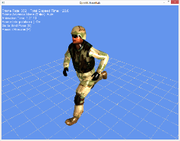
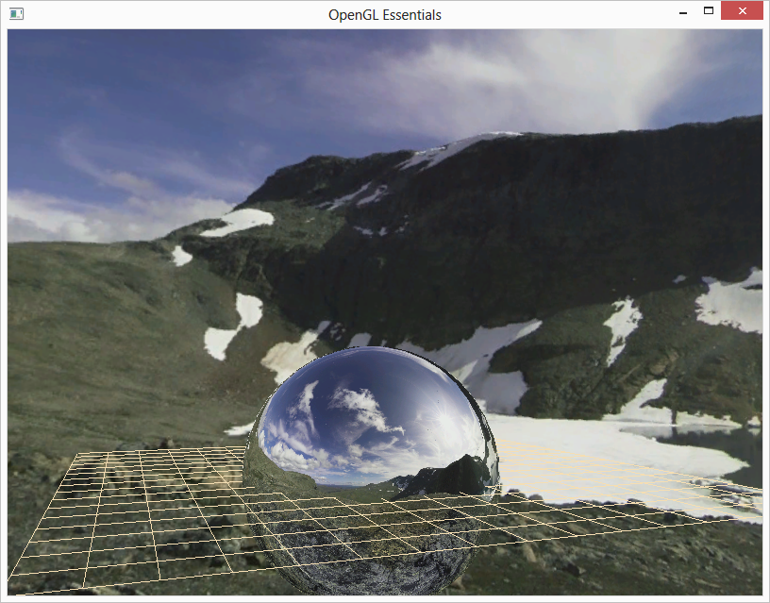
Image Credits
Animated model by Brian Salisbury, Florida Interactive Entertainment Academy.
Skybox texture by Emil Persson, aka Humus.
Creative Commons 3.0 (http://creativecommons.org/licenses/by/3.0/)
Notes:
surveyed a number of additional rendering topics including post processing, shadow mapping, skeletal animation, geometry and tessellation shaders, deferred rendering, global illumination, and compute shaders.

Slide 3
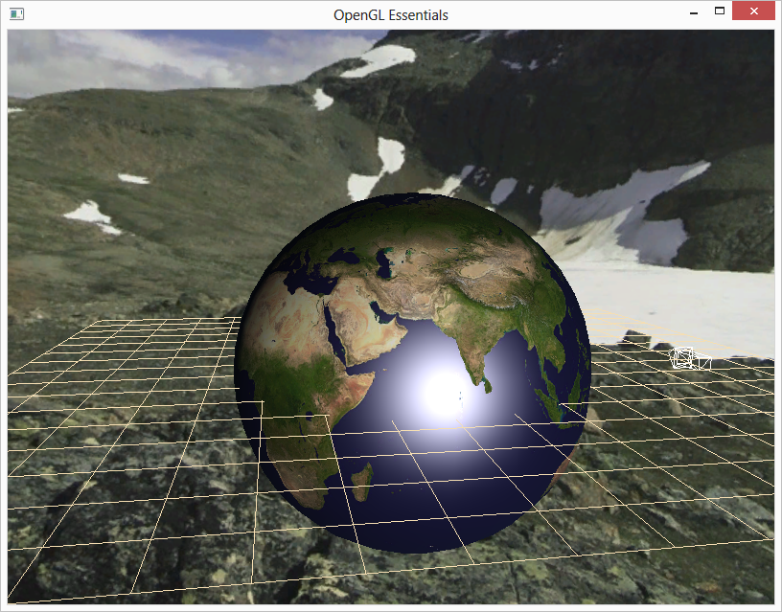
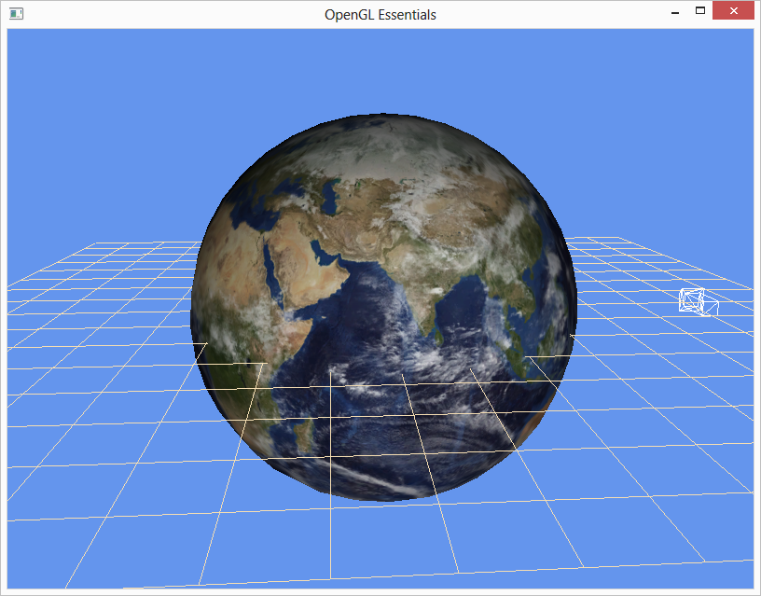
Image Credits
Earth texture by Reto Stöckli, NASA Earth Observatory.
Original earth texture by Reto Stöckli, NASA Earth Observatory. Additional texturing by Nick Zuccarello, Florida Interactive Entertainment Academy.
Notes:
surveyed a number of additional rendering topics including post processing, shadow mapping, skeletal animation, geometry and tessellation shaders, deferred rendering, global illumination, and compute shaders.

Slide 4
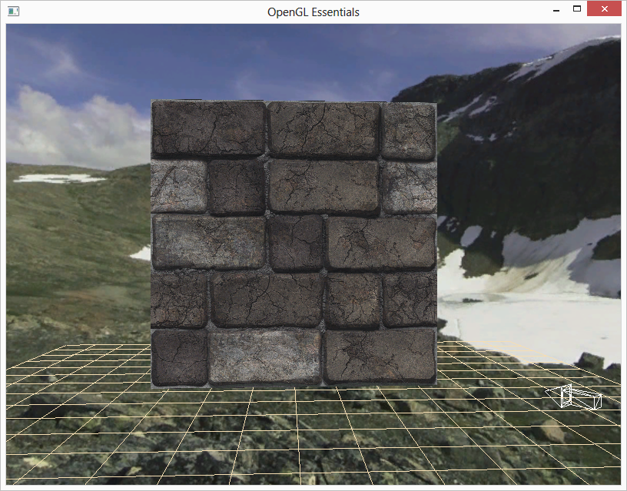
Image Credits
Stone wall texture and normal map by Nick Zuccarello, Florida Interactive Entertainment Academy.
Notes:
surveyed a number of additional rendering topics including post processing, shadow mapping, skeletal animation, geometry and tessellation shaders, deferred rendering, global illumination, and compute shaders.

