Slide 1
HEALing Communities/Opioid Databook
Review of Salient Opioid Databook
Opioid DB collection clarifying questions discussion
May 2023

Slide 2
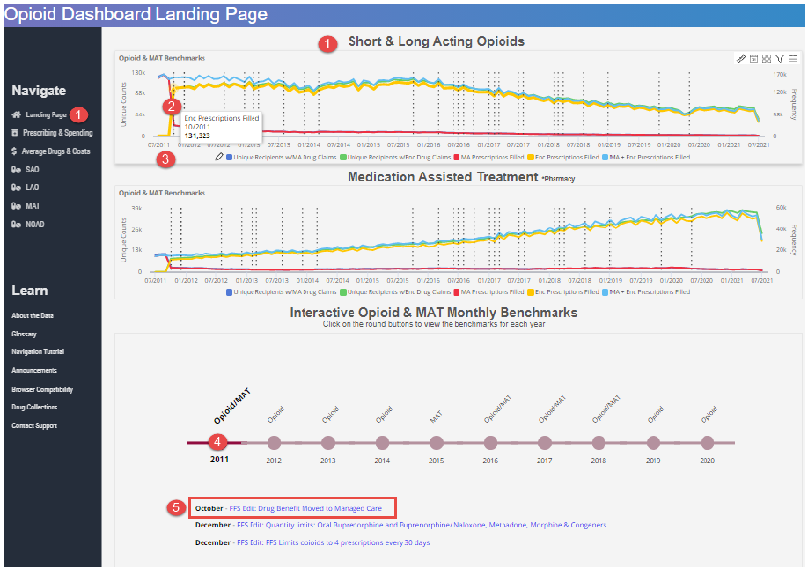
Salient Opioid Dashboard Landing Page View
May 2023

Slide 3
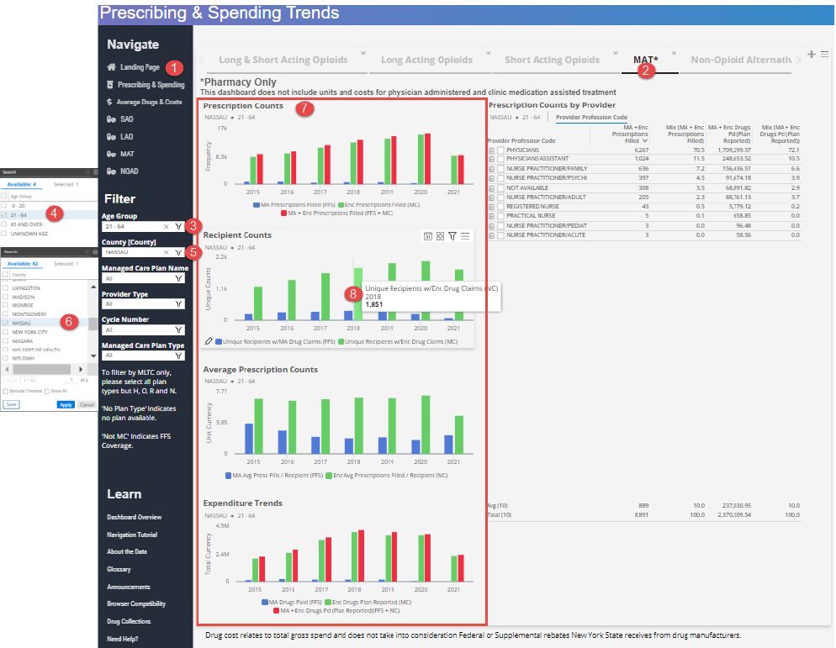
Prescribing & Spending Trends View
May 2023

Slide 4
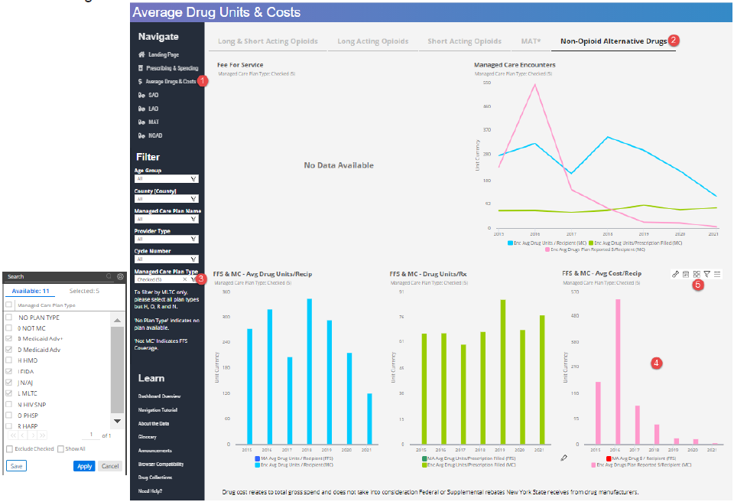
Average Drug Units & Costs View
May 2023

Slide 5
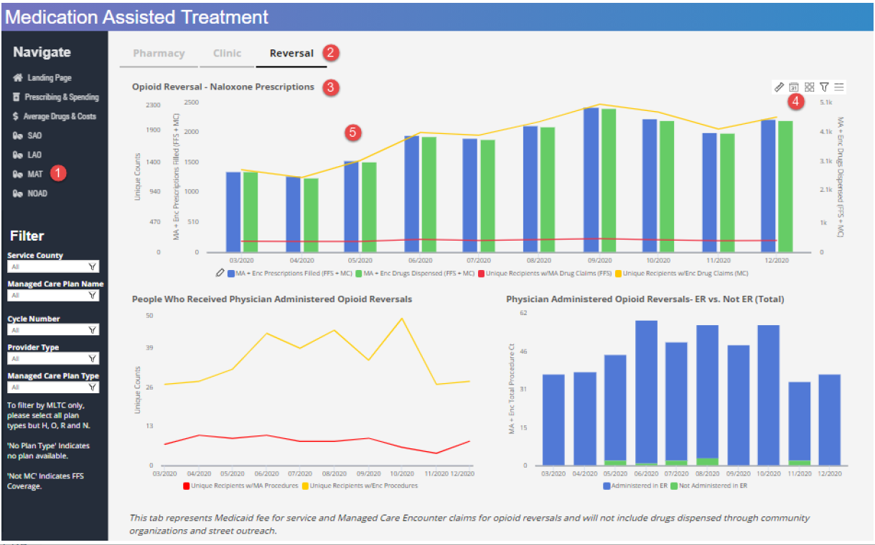
Medication Assisted Treatment View
May 2023

