Slide 1
Family First Prevention Services Act:
Qualified Residential Treatment Programs (QRTPs), Qualified Individuals (QIs) and the State Prevention Plan

Slide 2
Agenda
Introductions
Background
Qualified Residential Treatment Program (QRTPs)
Qualified Individuals (QIs)
State Prevention Plan
Question and Answer

Slide 3
Background

Slide 4

Background – Overview
The Family First Prevention Services Act (FFPSA) was enacted as part of the federal Bipartisan Budget Act of 2018 (P.L. 115-123) on February 9, 2018
Reforms federal financing to prioritize family-based foster care over residential care by limiting federal reimbursement for certain residential placements
Aimed at providing higher quality care in congregate settings with focus on entire family
Goal is to reduce lengths of stay and prevent recurrence of placement

Slide 5

Background – Overview
FFPSA has two major components:
Prevention Services – new Title IV-E reimbursement available, at state option, for evidence-based programs
NY must comply with congregate care provisions before it can access
Congregate Care – Reforms federal financing to prioritize family-based foster care and places limits on reimbursements for congregate care
Notes:
Discussion regarding scope of what was in state legislation, does not encompass all of Family First; much more to Family First; this presentation will focus only on the state legisaltion for Family First.

Slide 6
Qualified Residential Treatment Programs (QRTPs)

Slide 7

What is a QRTP?
Federal Requirements for a QRTP:
Trauma-informed treatment model
Licensed nursing and clinical staff on-site during business hours and on-call after hours
Family participation in treatment and family-based aftercare support for at least 6 months post-discharge
Nationally accredited
This Photo by Unknown Author is licensed under CC BY-NC

Slide 8
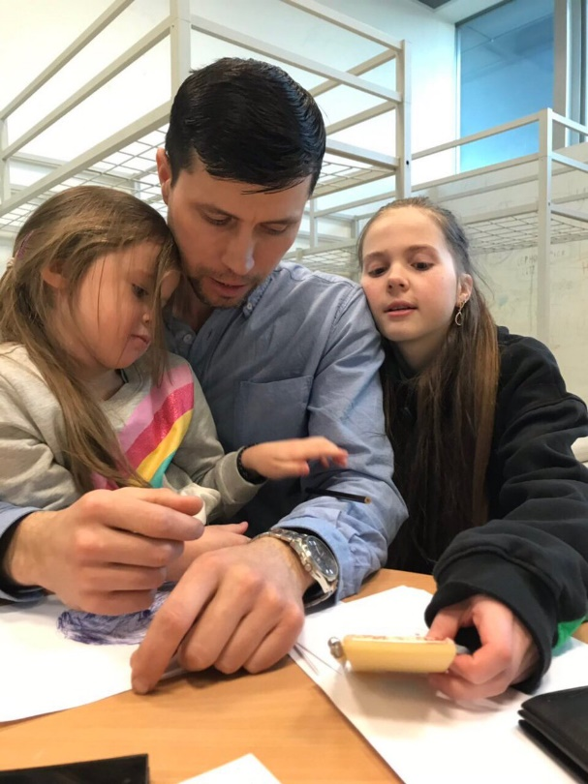
What’s not a QRTP? – Other Settings
Foster Family Homes
FFPSA emphasis on placement in family-based settings
No new limits on Title IV-E reimbursement
“Non-Specified” Settings
Any other setting that is not a foster family home, a QRTP or a QRTP Exception - Title IV-E limited to first 14 days of placement

Slide 9

What’s not a QRTP – QRTP exceptions
Specialized congregate care programs that are eligible for ongoing Title IV-E reimbursement:
Specialized settings providing prenatal, post-partum or parenting supports
“Supervised settings” where a child 18 years or older may live independently [defined in SSL §371(22)]
Settings providing high-quality residential and supportive services to children who are survivors of, or at risk of being victims of, human trafficking
Notes:
Note no substance abuse mother child programs. Maybe each gets their own slide

Slide 10

QRTP/QRTP-Exception Designation
The 29-I database opened on 6/1/21
As of 7/21/21, 55 agencies have submitted
their QRTP application
Encompasses a total of 212 programs
OCFS is actively reviewing applications
Applications received and approved during this open submission will have an effective date of 10/1/21

Slide 11

QRTP/QRTP-Exception Designation
Due to Systems Implications:
Effective start dates for all QRTPs will be the first of the
month (10/1, 11/1, 12/1, etc.)
Effective end dates will be the last day of the month
QRTP will be reflected on the operating certificate (OC)
The process for programs to receive their IROC includes agencies providing the original program description for the facility, the new program description for the facility and QRTP accreditation, which will allow for agencies to keep existing RID and VID

Slide 12

QRTP – Diagnostic Centers
A diagnostic center applying to be a QRTP will
need to meet all the QRTP standards, including the following requirements:
Trauma-informed treatment model
Licensed nursing and clinical staff on-site during business hours and on-call after hours
Family participation in treatment and family-based aftercare support for at least 6 months post-discharge
Nationally accredited

Slide 13
QRTP – Diagnostic Centers
A child residing in a diagnostic center that is not a QRTP or a QRTP-exception will likely not be eligible for Title IV-E foster care maintenance payments for all the time spent in the center. For diagnostic centers that are not QRTPs or QRTP-exceptions, the Title IV-E foster care maintenance payments are available for a maximum of 14 days of residence in the program.
If a diagnostic center considered taking on the role and function of the QI and the center became a QRTP, the center could not act as QI for the youth in the QRTP program, meaning: the center acting as QI could not conduct assessments for any child placed in that agency’s QRTP program. The QI must be independent.
Example: The Center for Children and Hope has a licensed QRTP program. The agency also operates a diagnostic center. Within the diagnostic center, there are people who meet the criteria and have been established to facilitate the role of the QI. The QI could not conduct an assessment for a child placed at the Center for Hope.

Slide 14

Long Stayers Review (LSR)
Long Stayer Review is required when:
A child in foster care age 13 or older is in a QRTP for more than 12 consecutive months or 18 non-consecutive months
A child in foster care younger than 13 is in a QRTP for more than 6 consecutive months or 12 non-consecutive months
Purpose:
Assess whether there is a treatment need warranting the continued placement in a QRTP beyond the identified time frames

Slide 15
LSR Thresholds
Following 60-day court review, approved QRTP stays that are IV-E-eligible are authorized to claim for limited number of days based on child’s age and federal long-stayer thresholds:
Any child younger than 13 who is placed in a QRTP for more than 6 consecutive months or 12 non-consecutive months
Any child 13 or older who is placed in a QRTP for more than 12 consecutive months or 18 non-consecutive months
Youth meeting the above thresholds must have their most recent status review/ permanency hearing reports reviewed by head of the state agency (OCFS) for approval for continued placement in that setting.
If county anticipates keeping a child in a QRTP beyond threshold, must submit case and supporting documentation to designated “review team” no later than 60 days before threshold date
If stay is not approved, state cannot claim IV-E for continued stay
Earliest date for LSR is 4/1/22 for a child younger than 13 placed in a
QRTP on or after 9/29/21; would need to commence by 2/1/22

Slide 16

LSR Process – Two-Tiered Approach
First Tier – Local Level Review
May be done by:
Qualified Individual (QI)
Local Multi Disciplinary Team (e.g., Hard to Place Committee, SPOA, Cross-systems team)
Local review team evaluates progress on achieving goals as stated in the treatment/support plan as well as barriers to achieving goals and any other pertinent information
If local review team does not approve extension, process ends; IV-E funding stops; LDSS should place in appropriate level of care
If local review team recommends continued treatment stay, summary of why extension is needed along with most recent PHR, treatment/support plan and other relevant information is forwarded for state review team

Slide 17

LSR Process – Two-Tiered Approach
Second Tier – State Level Review
State review team will consist of OCFS and other relevant state Agency partners, depending on the case circumstances
State review team may request additional information as needed
If state review team does not approve, then denial is sent to LDSS; Title IV-E is ended; LDSS should place in appropriate level of care
If state review team approves continued treatment stay, recommendation is presented to OCFS commissioner for final decision
OCFS is developing a guidance document that defines time frames and documentation requirements

Slide 18

Aftercare
Per FFPSA, programs must provide family-based aftercare support for at least six months post-discharge from the QRTP
This requirement is in effect if a child is discharged from care or if the child is stepped down from the QRTP to a family-based FC setting
21-OCFS-ADM-04, Qualified Residential Treatment Programs (QRTPs) and QRTP Exceptions in New York State, issued March 12, 2021, provides minimum standard contacts for QRTP aftercare support
Further guidance forthcoming regarding circumstances when a family declines services and diligence of efforts
An aftercare rate is being developed; once established, information will be shared with the field

Slide 19
Qualified Individual

Slide 20

Qualified Individual (QI)
FFPSA requires:
In the case of any child who is placed in a qualified residential treatment program, within 30 days of the start of each placement, the child must be assessed to determine the appropriate level of care by a QI
OCFS has identified the following requirements for the QI:
Licensed clinician
Minimum of two years child welfare experience
Notes:
Physician, Psychiatrist, Psychologist, Nurse Practitioner, Psychoanalyst, Registered Nurse, Clinical Social Worker, Marriage and Family Therapist, Mental Health Counselor, Master Social Worker, Licensed Creative Arts Therapist; within their scope of practice under their licensure.

Slide 21

Qualified Individual – Objectivity
QI Objectivity
QI cannot be employed by or associated with the QRTP where youth is referred
QI must not be the child’s case manager or case planner as defined in 18 NYCRR 428.2
OCFS regulations define “case management” and “case planning” to include, respectively, the ability to authorize and coordinate the provision of services (see 18 NYCRR 428.2)
While the QI may evaluate and recommend services for children in foster care in NYS, the QI would not authorize or coordinate the direct provision of any services
However, the QI would conduct case assessment activities that are required in the context of case planning as per SSA §471(a)(16)

Slide 22

Functional Behavioral Assessment Tool
FFPSA requires that the QI use an age-appropriate, evidence-based, validated, functional, federally approved assessment tool.
OCFS has approved the following two assessments for the QI:
Child and Adolescent Needs and Strengths (CANS)
Child and Adolescent Services Intensity Instrument (CASII)
Notes:
Physician, Psychiatrist, Psychologist, Nurse Practitioner, Psychoanalyst, Registered Nurse, Clinical Social Worker, Marriage and Family Therapist, Mental Health Counselor, Master Social Worker, Licensed Creative Arts Therapist; within their scope of practice under their licensure.

Slide 23

30-Day Assessment
Conduct interviews with family and youth to obtain or clarify any information needed to complete functional assessments and formulate child-specific short- and long-term mental and behavioral health goals
Collaborate with the local department of social services (LDSS), QRTP and permanency team to gather information to make determination
Provide recommendations regarding whether the child’s needs can be met by family members and/or through placement in a foster family home

Slide 24

QI Determination and Documentation
Where the QI determines that the placement of the child in a QRTP is not appropriate after the assessment, the child’s placement must:
Continue until the court has an opportunity to hold a hearing to consider the QI assessment and make an independent determination
as required by SSL section 393, or Family Court Act (FCA)
sections 353.7, or 756-b, 1055-c, 1091-a or 1097, as applicable.
If the QI determines that the child’s needs cannot be met with family members and/or through placement in a family-based setting, the QI must:
Document the reasons why the child’s needs cannot be met by the parents/caregivers in the home, or with a relative or fictive kin caregiver in a foster home or in a non-relative foster family home setting and why such a placement is not the most effective and appropriate level of care for the child
A shortage or lack of foster family homes may not constitute circumstances warranting a determination that the child’s needs cannot be met in a foster family home.

Slide 25

QI Determination and Documentation
If the QI determines that the child’s needs cannot be met with family members and/or through placement in a foster family home, the QI must also:
Document which congregate residential setting would provide the most effective and appropriate level of care for the child in the least restrictive environment and be consistent with the short-term and long-term goals specified in the permanency plan
Document why the recommended placement in a QRTP is the setting that will provide the most effective and appropriate level of care for the child in the least restrictive environment
Document how that placement is consistent with the short-term and long-term mental and behavioral goals as specified in the permanency plan
Provide written reports with recommendations within 30 days of the child’s placement in the QRTP
Document in child’s case plan as required

Slide 26

QI Determination and Documentation
The QI (or their designee) is required to promptly, but no later than five days following the completion of the assessment, provide the assessment, determination
and documentation to:
The court
The child’s parent or guardian
The child’s attorney and the parent’s attorney, if applicable
A written summary detailing the assessment findings must be provided to the LDSS or OCFS with care and custody or custody and guardianship of the child and to the parties to the proceeding redacting information necessary to comply with federal and NYS confidentiality laws [SSL §409-h(2)]
This documentation must be maintained in the Title IV-E Eligibility Documentation File (OCFS-2125) as it is required for the federal Title IV-E Foster Care Eligibility Reviews as well as the monitoring conducted by the Title IV-E Unit in the OCFS Bureau of Financial Operations; the OCFS-2125 will be updated to reflect the
documentation requirements.

Slide 27

Record Keeping
OCFS uses the CONNECTIONS database to collect and store information and assessments facilitated by the QI; the CONNECTIONS uploads feature will be utilized as a mechanism to capture needed documentation related to the QI’s role and function
The QI decision will need to be recorded in CONNECTIONS Activities; additional guidance on Activities entries will be provided at a later date.
Forms will be stored in the Health Services tab and only people with a role in the case or whose business functions require maintaining or viewing health data can access this information

Slide 28

Qualified Individual (QI) – Potential Funding Options
Medicaid
Activities that are within the scope of practice of the licensed health care
practitioner, also functioning in the role of a QI, may be reimbursable by NYS Medicaid
It is anticipated that the licensed health care practitioners are knowledgeable of which activities are within their scope of practice and are familiar with Medicaid billing opportunities
There are variables that impact Medicaid reimbursement, including the type of licensure and whether the individual is employed by an agency that is licensed/certified/designated by NYS to provide Medicaid services

Slide 29

Qualified Individual (QI) – Potential
Funding Options
Child Welfare Funding
There are activities that fall outside the licensed health care practitioner’s scope of practice that would be considered non-Medicaid-eligible and could be considered child welfare case assessment activities that fall under case planning
Examples include:
Activities associated with reviewing evaluations and assessments that were previously conducted on child and/or family
Activities associated with meeting with child’s permanency team to gather information to formulate determination
Activities associated with interviewing family and youth to obtain or clarify any information needed to complete functional assessments and formulate child-specific, short-term and long-term mental and behavioral health goals
Activities associated with preparing for court or making a court appearance
(review of documents, etc., aligned with assessment)

Slide 30
Qualified Individual (QI) – Guidance & Resources
QI ADM guidance document will be issued shortly, which will provide specific guidance regarding the role and function of the QI
For QIs who LDSS contracts with who are not on the LOI, DSS will need to attest that QIs meet minimum qualifications
Model contract for QI will be issued shortly
Draft CANS algorithm is being piloted
Structured QI decision template has been developed and is being piloted
Report template for QI being developed
Training is being developed and will consist of a child welfare foundational training and an assessment tool focused component

Slide 31
Title IV-E

Slide 32

Title IV-E Reimbursement- Key Decision Points
Child is placed in a QRTP
If the assessment by the QI is not completed 30 days before or within 30 days after the placement in the QRTP, there will be no federal reimbursement for any portion of that placement in the QRTP for Title IV-E maintenance costs
Assessment is completed within 30 days of placement
If the QI determines placement in a QRTP is not appropriate, the LDSS may claim Title IV-E foster care maintenance payments from the date of placement in the QRTP up to 30 days after assessment determination is completed; please note per the enacted NYS legislation, the child must remain in the QRTP until the 60-day court review and hearing has occurred
If the QI determines placement in a QRTP is appropriate, the LDSS may claim Title IV-E reimbursement from the date of placement in the QRTP until 60 days from the date of placement in the QRTP, pending outcome of 60-day court review

Slide 33
Title IV-E Reimbursement – Key Decision Points
60-Day Court Review:
If the QI determines placement in the QRTP is appropriate and the judicial review is not completed within 60 days of the placement in the QRTP, the LDSS may only claim Title IV-E maintenance costs for the first 60 days of the placement
If the QI determines that placement in the QRTP is not appropriate and the court orders that the child remain in that placement, the LDSS may only claim Title IV-E foster care maintenance payments up to 30 days after the QI completes the assessment determination
If the QI determines that placement in the QRTP is appropriate and the court approves the determination within the required 60-day time frame, the LDSS may continue to claim Title IV-E reimbursement, as long as the approval for long-term placement in the QRTP has been documented in the child’s case record; please note that if this approval is not documented in the child’s case record, the LDSS may no longer
claim Title IV-E reimbursement
Notes:
If the QI says no and the court requires the child to stay, the LDSS is still going to have to pay foster care maintenance and they will be reimbursed with non-title iv-e dollars.

Slide 34

FFPSA: Prevention

Slide 35
Reimagining Child Welfare: Moving Toward a System of Family Well-being
Our Goals:
Build a truly family-centered, equitable well-being framework
Reimagining “front door” that comes before a call to the SCR
Develop a public health approach to child abuse and maltreatment prevention through the lens of social determinants
Invest in New York’s families through robust primary prevention, thereby reducing, if not eliminating, unnecessary calls to SCR

Slide 36
Reimagining Child Welfare: Moving Toward a System of Child and Family Well-being
Challenge federal government to grant flexibility to allow New York to improve outcomes by leveraging funding opportunities
Imbed race equity and social justice throughout the continuum of our work
Partner with families and community stakeholders, including those with lived experience
Deepen collaborations with sister state agencies to strengthen communities through service integration
Notes:
Child abuse and maltreatment prevention requires a public health approach – next slide…
https://pubmed.ncbi.nlm.nih.gov/11081354/

Slide 37

FFPSA Provisions: Prevention
To draw down prevention funds, states must:
Be implementing FFPSA congregate care provisions
Have an approved 5-year state prevention plan, including state’s definition of “candidates for foster care”
Use programs rated and approved by the Title IV-E Prevention Services Clearinghouse
Notes:
State must meet these requirements to draw down Title IV-E funding for prevention services, including…
We will discuss each of these in the following

Slide 38

NYS’s Proposed Definition of Candidacy
Any child in a non-mandated or mandated preventive services case where the child or their caregiver(s) would benefit from receiving an
evidence-base parenting, mental health or substance use program, including:
Parents
Adoptive parents
Kinship caregivers
Notes:
We will discuss each of these in the following

Slide 39
New York’s Child Welfare Vision: Pathways to Transformation and Modernization
Race Equity
CURRENT SYSTEM TRANSFORMATION EFFORTS
Warm line, Differential Response/FAR,
Foster Care Block Grant, Child Welfare Financing Reform,
COPS Funding, Blind Removals, Kin-First Firewall Policy,
Parent and Youth Advisory Boards,
Therapeutic Foster Home,
QRTPs
PUBLIC
HEALTH MODEL
NYS FAMILY FIRST
TITLE IV-E
PREVENTION PLAN
• Investment and Reinvestment
in Primary Prevention and Services
for “No Track” Families (Home
Visiting, Family Resource
Centers)
• Provision of Economic & Concrete
Supports (Minimum Wage, UBI, Paid
Family Leave)
• Access to high quality and affordable
Child Care, Health Services, Housing,
Education
Child and Family
Well-Being System
Child and Family
Well-Being System
• Expansion and Establishment of Evidence-Based Programs
• Building Pathways to Candidacy
for Child Welfare and Light-Touch Families
• Creation of Cross-Sector Partnerships
with Sister State Agencies and
Community Providers
• Regional Collaboratives
Centers for Excellence
CQI
Social/Economic Well-Being
Family/Youth Voice
Opportunities for Future State/Federal Partnerships to Strengthen Child and Family Well-Being

Slide 40
NYS Family First Prevention
Services Plan
Race Equity
NYS FAMILY FIRST
TITLE IV-E
PREVENTION PLAN
Child and Family
Well-Being System
• Expansion and Establishment of Evidence-Based Programs
• Building Pathways to Candidacy
for Child Welfare and Light-Touch Families
• Creation of Cross-Sector Partnerships
with Sister State Agencies and
Community Providers
• Regional Collaboratives
Centers for Excellence
CQI
Family/Youth Voice
Social/Economic Well-Being

Slide 41
SECONDARY PREVENTIVE SERVICES:
“Light Touch”
Families at imminent risk of CPS/foster care involvement identified early and served by partnering state agencies and community providers
NYS Preventive Services Continuum Vision
FFPSA: Wave 1
TERTIARY
PREVENTIVE SERVICES:
Families referred due to CPS/
foster care involvement
FFPSA: Wave 2
EARLY/PRIMARY PREVENTIVE SERVICES:
“NO TRACK FAMILIES”
Families with economic, concrete and/or emerging needs served by federal/state-supported programs monitored at program level; no open child welfare services case
Public Health Model

Slide 42
COMMUNITY PATHWAY: “LIGHT TOUCH”
Families at imminent risk are identified early by sister state agencies, community partners or self-referral and provided with FFPSA-approved, evidence-based services and case management through community-based agencies
Target Populations for Family First Candidacy
CHILD
WELFARE INVOLVED
Families receive preventive
services following involvement with CPS, foster care, family court or through self- referral and are connected to FFPSA-approved, evidence-based services via LDSS case managers
Wave 1
Wave 2

Slide 43
Wave 1: Building Infrastructure and Well-Supported EBP Implementation
Wave 2: Expansion and Evaluation
Claim for existing well-supported EBPs provided to families known to child welfare
Apply to HFA to receive approval to use Child Welfare Protocol
State procurement for a subset of EBPs
Train child welfare workforce in Motivational Interviewing (MI)
Partner with sister agencies and community-based providers to create service pathways that will be used by light-touch families to access Family First EBPs
Form regional collaboratives and Statewide Center for Excellence to guide implementation and evaluation priorities and investments
Obtain real-time implementation feedback from SIT, PAB and YAB
Expand EBP infrastructure to meet caseload demands and underserved areas – through regional implementation approach and Center for Excellence
Enroll and claim for services to “light-touch” families
Expand EBP service array to include supported and promising programs endorsed by regional collaboratives; revise/resubmit prevention plan as needed
Use findings from state-facilitated evaluation and CQI to inform targeted investment in the most promising EBPs
Obtain real-time implementation feedback from SIT, PAB and YAB, and incorporate lessons learned

Slide 44
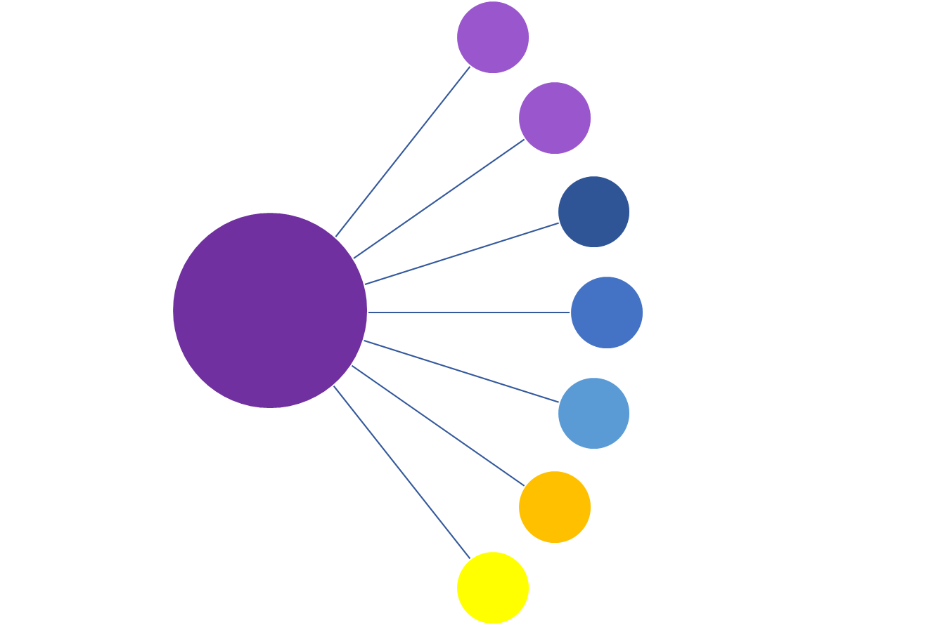
Existing Candidacy Pathways
Children named in CPS/FAR report
Children with prior foster care stay
Children living in adoptive/kin homes at risk of disruption
Candidates for Foster Care
Children involved in PINS or JD case
Children whose caregivers voluntarily seek LDSS services
Candidacy Pathways to be Developed
Children whose caregivers voluntarily seek service from partnering state agencies (e.g., OTDA, OASIS, OMH, SED)
Children whose caregivers voluntarily seek service from community providers

Slide 45

Questions?

