Slide 1
HW#2 problem 6
You are to compute the averages of the following, averaged over the three classes:
true positive rate
false positive rate
error rate
the accuracy
the precision
That is, compute each one for class A, each for class B, and each one for class C, then average all three
E.g., TPR = (TPR_{A} + TPR_{B} + TPR_{C})/3
FPR = (FPR_{A} + FPR_{B} + FPR_{C})/3
…
But how to compute these for a three-class problem?

Slide 2

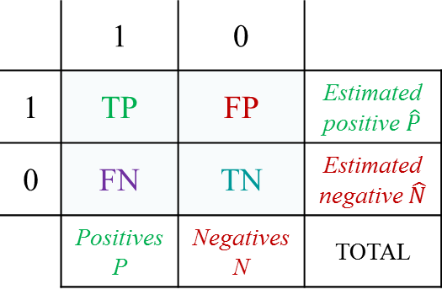



Two-class:
Three-class, for class A:
Actual class
Actual class
$$c$$
$$c$$
 | 1 | 0
1 | TP | FP | Estimated positive $\hat{P}$
0 | FN | TN | Estimated negative $\hat{N}$
 | Positives P | Negatives N | TOTAL
 | A | B | C
A | TP
B
C
Predicted class
Predicted class
FP
$$\hat{c}$$
$$\hat{c}$$
FN
TN
True positives in white entry
False negatives – sum the orange entries
False positives – sum the blue entries
True negatives – sum the pink entries

Slide 3

Three-class, for class B:
Three-class, for class C:
Actual class
Actual class
$$c$$
$$c$$
 | A | B | C
A
B |  | TP
C
 | A | B | C
A
B
C |  |  | TP
Predicted class
Predicted class
TN
FN
TN
$$\hat{c}$$
$$\hat{c}$$
TN
FN
FP
FP
TN
FN
TN
FP
True positives in white entry
False negatives – sum the orange entries
False positives – sum the blue entries
True negatives – sum the pink entries

