Slide 1
AZ-400.00 Module 2: Getting Started with Source Control

Slide 2
Lesson 01: Module overview

Slide 3
Module overview
Lesson 1: Module Overview
Lesson 6: Introduction to GitHub
Lesson 2: What is source control?
Lesson 7: Migrating from Team Foundation Version Control (TFVC) to Git in Azure Repos
Lesson 3: Benefits of source control
Lesson 8: Lab
Lesson 4: Types of source control systems
Lesson 9: Module review and takeaways
Lesson 5: Introduction to Azure Repos

Slide 4
Learning objectives
After completing this module, students will be able to:
Describe the benefits of using Source Control
Describe Azure Repos and GitHub
Migrate from TFVC to Git

Slide 5

Lesson 02: What is source control?

Slide 6
Introduction to source control
When it was introduced, DevOps was a revolutionary way to release software quickly and efficiently while maintaining a high level of security.
Source control (version control) is a critical part of DevOps.

Slide 7
Foundational practices of DevOps
Foundational practices and the stages of DevOps evolution: stages 0 to 2
 | Defining practices and associated practices | Practices that contribute to success
Stage 0 | Monitoring and alerting are configurable by the team operating the service Deployment patterns for building applications or services are reused Testing patterns for building applications or services are reused Teams contribute improvements to tooling provided by other teams Configurations are managed by a configuration management tool
Stage 1 | Application development teams use version control Teams deploy on a standard set of operating systems | Build on a standard set of technology Put application configurations in version control Test infrastructure changes before deploying to production Source code is available to other teams
Stage 2 | Build on a standard set of technologies Teams deploy on a single standard operating system | Deployment patterns for building applications and services are reused Rearchitect applications based on business needs Put system configurations in version control
* The practices that define each stage are highlighted in bold font
Notes:
State of DevOps report - https://puppet.com/resources/report/state-of-devops-report

Slide 8
Foundational practices of DevOps
Foundational practices and the stages of DevOps evolution: stages 3 to 5
 | Defining practices and associated practices | Practices that contribute to success
Stage 3 | Individuals can do work without manual approval from outside the team Deployment patterns for building applications and services are reused Infrastructure changes are tested before deploying to production | Individuals can make changes without significant wait times Service changes can be made during business hours Post-incident reviews and results are shared Teams build on a standard set of technologies Teams use continuous integration Infrastructure teams use version control
Stage 4 | System configurations are automated Provisioning is automated Application configurations are in version control Infrastructure teams use version control | Security policy configurations are automated Resources made available via self-service
Stage 5 | Incident responses are automated Resources available via self-service Rearchitect applications based on business needs Security teams are involved in technology design and deployment | Security policy configurations are automated Application developers deploy testing environments on their own Success metrics for projects are visible Provisioning is automated
* The practices that define each stage are highlighted in bold font
Notes:
State of DevOps report - https://puppet.com/resources/report/state-of-devops-report

Slide 9
What is source control?
A source control system allows developers to collaborate on code and track changes.
Source Control Management (SCM) systems provide a running history of code development and resolve conflicts when merging contributions from multiple sources.
Source control protects source code from both catastrophe and the casual degradation of human error and unintended consequences.

Slide 10
Lesson 03: Benefits of source control

Slide 11
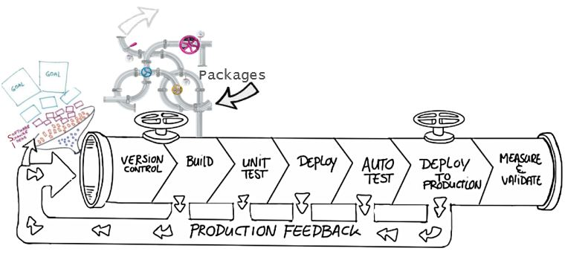
Benefits of source control
Create workflows
Work with versions
Collaboration
Maintains history of changes
Automate tasks
Notes:
Benefits include: Reusability, traceability, manageability, efficiency, collaboration, and learning

Slide 12
Best practices for source control
Make small changes
Don’t commit personal files
Update often and right before pushing to avoid merge conflicts
Verify your code change before pushing it to a repository; ensure it compiles and tests are passing
Pay close attention to commit messages as these will tell you why a change was made
Link code changes to work items
No matter your background or preferences, be a team player and follow agreed conventions and workflows

Slide 13
Lesson 04: Types of source control systems

Slide 14
Centralized source control
Strengths | Best Used for
Easily scales for very large codebases Granular permission control Permits monitoring of usage Allows exclusive file locking | Large integrated codebases Audit and access control down to the file level Hard to merge file types
Centralized
There is a single central copy of your project, and programmers commit their changes to this central copy.
Common centralized source control systems are TFVC, CVS, Subversion (or SVN), and Perforce.

Slide 15
Distributed source control
Strengths | Best Used for
Cross platform support An open-source friendly code review model via pull requests Complete offline support Portable history An enthusiastic growing user based | Smaller size (in bytes) and modular codebases Evolving through open-source Highly distributed teams Teams working across platforms Greenfield codebases
Distributed
Every developer clones a copy of a repository and has the full history of the project.
Common distributed source control systems are Mercurial, Git, and Bazaar.
Notes:
A greenfield project is one that lacks constraints imposed by prior work.

Slide 16
Git and TFVC
Git:
Distributed Source Control system
Each developer has a copy of the source repository on their development system
TFVC:
Centralized Source Control system
Team members have only one version of each file on their dev machines.
In the server workspaces model, before making changes, team members publicly check out files.
In the local workspaces model, each team member takes a copy of the latest version of the codebase with them and works offline as needed.

Slide 17
Why Git?
Feature branches
Distributed development
Pull requests
Community
Release cycles

Slide 18
Objections to using Git
Overwriting History – If used incorrectly, it can lead to conflicts
Large Files – Git works best with repos that are small and that do not contain large files (or binaries); consider using Git LFS support
Learning Curve – Some training and instruction will be needed. Existing developers might need to be retrained.
Discussion – What objections do you have?

Slide 19
Working with Git locally
DEMO
Notes:
Take a moment to complete the demonstration, as defined in the student manual.

Slide 20
Lesson 05: Introduction to Azure Repos

Slide 21
Azure Repos
Set of version control tools to manage your code:
Tightly integrated with other Azure DevOps features
Can connect from common development environments
Policy based management to protect branches
Offers two styles of version control:
Git: Distributed version control
Team Foundation Version Control (TFVC): Centralized version control

Slide 22
Lesson 06: Introduction to GitHub

Slide 23
What is GitHub ?
Largest open-source community
Features of GitHub:
Automate from code to cloud
Securing software, together
Seamless code review
Code and documentation in one place
Coordinate
Manage teams

Slide 24
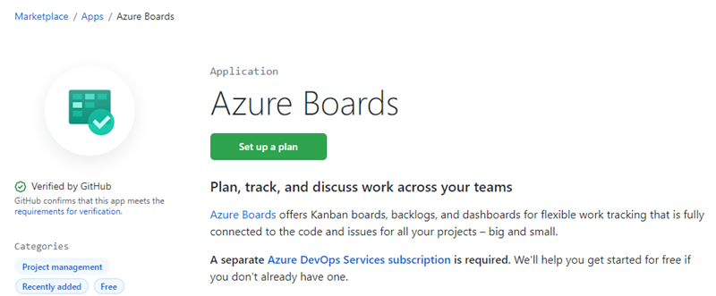
Linking GitHub to Azure Boards
Azure Boards App links commits, pull requests, and issues, directly to work items
Authenticate to GitHub using a username/password or a personal access token (PAT)

Slide 25
Lesson 07: Migrating from Team Foundation Version Control (TFVC) to Git in Azure Repos

Slide 26
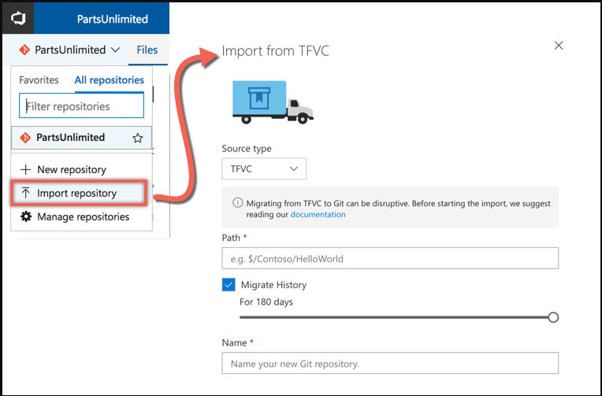
Migrating from TFVC to Git
Single branch import
Full synchronization (git-tfs)

Slide 27
Migrating from TFVC to Git
Migrating the tip:
Only the latest version of the code
History remains on the old server
Migrating with history:
Tries to mimic the history in Git
Recommend to migrate the tip, because:
History is stored differently – TFVC stores change sets, Git stores snapshots of the repository
Branches are stored differently – TFVC branches folders, Git branches the entire repository
Notes:
Video: https://www.youtube.com/watch?v=QsJdFkMKLN0

Slide 28
Lesson 09: Lab

Slide 29
Lab: Version controlling with Git in Azure Repos
Lab overview:
In this lab you will establish and work with a local Git repository.
Objectives:
Clone an existing repository
Save work with commits
Review history of changes
Work with branches by using Visual Studio Code
Duration:
Notes:
The labs are updated on a regular basis. For the latest information please visit:
https://microsoftlearning.github.io/AZ400-DesigningandImplementingMicrosoftDevOpsSolutions/

Slide 30
Lesson 10: Module review and takeaways

Slide 31
What did you learn?
Describe the benefits of using source control
Describe Azure Repos and GitHub
Migrate from TFVC to Git

Slide 32
Module 2 review questions
What are some of the benefits of source control?
1
2
What are the benefits of using distributed version control?
3
What are the benefits of using centralized version control?
4
What is source control?
Notes:
Q1 Answer: Benefits include: reusability, traceability, manageability, efficiency, collaboration, learning, create workflows, work with versions, collaboration, maintains history of changes, and automate tasks.
Q2 Answer: complete offline support and cross platform support
Q3 Answer: easily scales for very large codebases, granular permission control
Q4 Answer: Source control is the practice of tracking and managing changes to code.

