Slide 1
AZ-400.00 Module 03: Managing Technical Debt

Slide 2
Lesson 01: Module overview

Slide 3
Module overview
Lesson 1: Module overview
Lesson 2: Identifying technical debt
Lesson 3: Knowledge sharing within teams
Lesson 4: Lab
Lesson 5: Module review and takeaways

Slide 4
Learning objectives
After completing this module, students will be able to:
Identify technical debt
Build organizational knowledge on code quality

Slide 5
Lesson 02: Identifying technical debt

Slide 6
Code quality defined
Short deadlines, a lack of coding standards, and poor technical skills can lead to code that is NOT:
Clear and readable
Maintainable
Documented
Extensible
Efficient
Secure

Slide 7
Complexity metrics
A few of the most important complexity-related metrics:
Program vocabulary
Calculated program length
Volume
Difficulty
Effort

Slide 8


Measuring and managing quality metrics
Failed builds percentage
Failed deployments percentage
Ticket volume
Bug bounce percentage
Unplanned work percentage

Slide 9
Technical debt defined
Technical Debt describes the future penalty that you incur today by making easy or quick choices in software development practices.

Slide 10
Sources and impacts of technical debt
Common sources of technical debt are:
Lack of coding style and standards
Over-engineering code
Lack of or poor design of unit test cases
Insufficient comments and documentation
Ignoring or not understanding object orient design principles
Not writing self-documenting code
Monolithic classes and code libraries
Taking shortcuts to meet deadlines
Poorly envisioned use of technology, architecture and approach
Leaving dead code in place

Slide 11



Using automated testing to measure technical debt
Technical debt:
Adds problems during development that makes it more difficult to add customer value
Saps productivity and frustrates development teams
Makes code both hard to understand and fragile
Increases the time to make changes, and to validate those changes
Starts small and grows over time
One way to minimize the accumulation of technical debt, is to use automated testing and assessment
Notes:
For more information, you can see:
SonarCloud - https://sonarcloud.io/about

Slide 12
Discussion: Code quality tooling
Azure DevOps can be integrated with a wide range of existing tooling that is used for checking code quality during builds
Which code quality tools do you currently use (if any)?
What do you or don't you like about the tools?

Slide 13
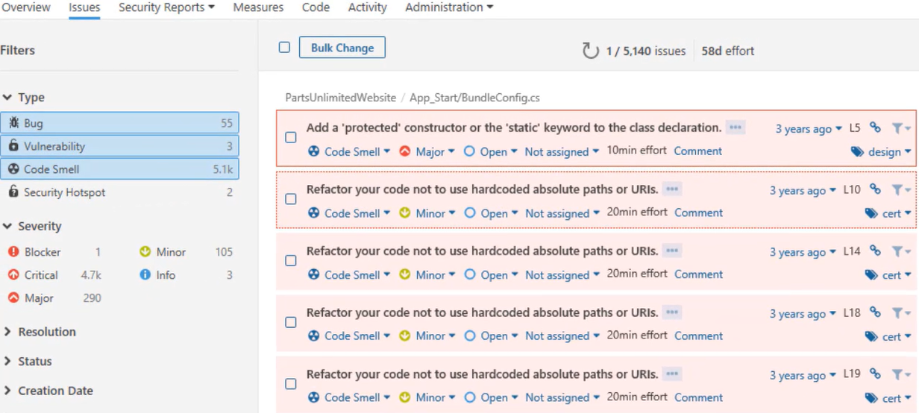
Measuring and managing technical debt

Slide 14
Integrating other code quality tools
NDepend is a Visual Studio extension that assesses the amount of technical debt that a developer has added during a recent development period, typically in the last hour.
Resharper Code Quality Analysis is a command line tool and can be set to automatically fail builds when code quality issues are found.
Notes:
For more information, you can see:
NDepend - https://www.ndepend.com
Visual Studio marketplace - https://marketplace.visualstudio.com/items?itemName=ndepend.ndependextension&targetId=2ec491f3-0a97-4e53-bfef-20bf80c7e1ea
Resharper Code Quality Analysis - https://marketplace.visualstudio.com/items?itemName=alanwales.resharper-code-analysis

Slide 15
Planning effective code reviews
Everyone is trying to achieve better code quality
Knowledge sharing

Slide 16
Lesson 03: Knowledge sharing within teams

Slide 17
Sharing acquired knowledge within development teams
Organizational knowledge is acquired over time
Organizational knowledge can easily be lost through staff turnover
Relearning old lessons is wasteful and expensive
Notes:
See http://owasp.org

Slide 18
Discussion: Tools for knowledge sharing
Which knowledge sharing tools do you currently use?
What do you or don’t you like about the tools?

Slide 19
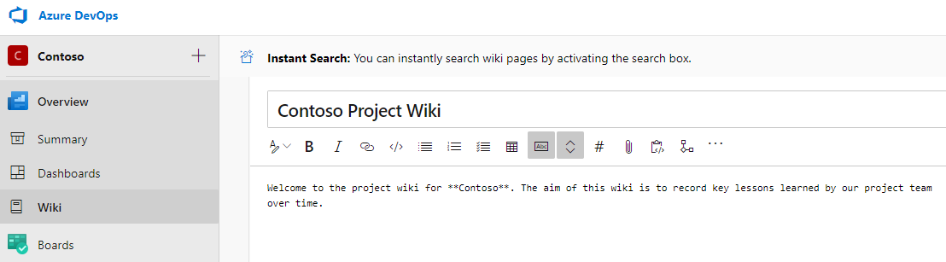
Azure DevOps project wikis
Created in Azure DevOps projects, stored in a repository

Slide 20
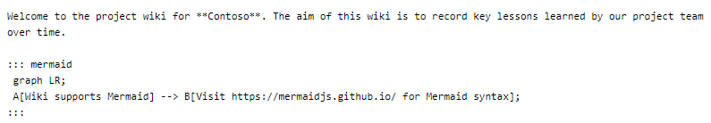
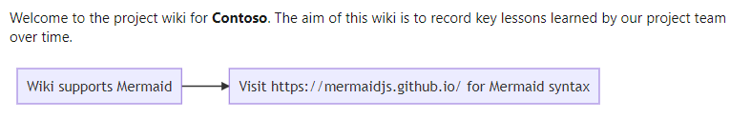
Wiki contents
Written in markdown and can contain file attachments, including videos
Supports insertion of Mermaid diagrams

Slide 21
Lesson 04: Modernizing development environments with GitHub Codespaces

Slide 22
Developing online with GitHub Codespaces
Cloud-based development environment hosted by GitHub
Avoids issues with old hardware/software
Based on Visual Studio Code
Highly portable
Work from PCs, tablets, Chromebooks
Protect against proliferation of intellectual property
Connect to Codespaces from Visual Studio Code

Slide 23
Lesson 05: Lab

Slide 24
Lab: Sharing team knowledge using Azure project wikis
Lab overview:
In this lab, you will create and configure wiki in an Azure DevOps, including managing markdown content and creating a Mermaid diagram.
Objectives:
Create a wiki in an Azure Project
Add and edit markdown
Create a Mermaid diagram
Duration:
Notes:
The labs are updated on a regular basis. For the latest information please visit:
https://microsoftlearning.github.io/AZ400-DesigningandImplementingMicrosoftDevOpsSolutions/

Slide 25
Lesson 06: Module review and takeaways

Slide 26
What did you learn?
Identify technical debt
Build organizational knowledge on code quality

Slide 27
Module review questions
1
What are Mermaid diagrams?
2
What are code smells? Give an example of a code smell.
3
You are using Azure Repos for your application source code repository. You want to create an audit of open-source libraries that you have used. Which tool could you use?
4
Name three attributes of high-quality code
5
You are using Azure Repos for your application source code repository. You want to perform code quality checks. Which tool could you use?
Notes:
Q1 Answer: Mermaid diagrams are code written in markdown to represent diagrams
Q2 Answer: Code smells are characteristics in your code that could possibly be a problem. Code smells hint at deeper problems in the design or implementation of the code. For example, code that works but contains many literal values or duplicated code.
Q3 Answer: WhiteSource Bolt is used to analyze open source library usage. OWASP ZAP is designed to run penetration testing against applications. The two Sonar products are for code quality and code coverage analysis.
Q4 Answer: High quality code should have well-defined interfaces. It should be clear and easy to read so self-documenting is desirable, as is short (not long) method bodies.
Q5 Answer: SonarCloud is the cloud-based version of the original SonarQube, and would be best for working with code in Azure Repos.

