Slide 1
AZ-400.00 Module 4: Working with Git for Enterprise DevOps

Slide 2
Lesson 01: Module overview

Slide 3
Module overview
Lesson 1: Module overview
Lesson 6: Fostering inner source
Lesson 2: How to structure your Git Repo
Lesson 7: Managing Git Repositories
Lesson 3: Git branching workflows
Lesson 8: Lab
Lesson 4: Collaborating with pull requests in Azure Repos
Lesson 9: Module review and takeaways
Lesson 5: Why care about Git Hooks ?

Slide 4
Learning objectives
After completing this module, students will be able to:
Explain how to structure Git Repos
Describe Git branching workflows
Leverage pull requests for collaboration and code reviews
Leverage Git hooks for automation
Use Git to foster inner source across the organization

Slide 5
Lesson 02: How to structure your Git Repo

Slide 6
Monorepo versus multiple repos
A repository is a place where the history of your work is stored.
Azure DevOps projects can contain multiple repositories

Slide 7
Implementing a change log
Track changes to a project over versions.
For each version, record:
New functionality
Changed functionality
Removed functionality
Can be manually created
Can be automatically populated
Can be a combination of both
Auto:
git log
githubchangelog
github_changelog_generator
Preference is to always avoid dumping log entries into a change log.
Logs are "noisy," and so it's easy to generate a mess that is not helpful.

Slide 8
Lesson 03: Git branching workflows

Slide 9
Branching workflow types
Feature branching – All feature development should take place in a dedicated branch instead of the master branch.
GitFlow branching – A strict branching model designed around the project release.
Forking Workflow – Every developer uses a server-side repository.
Evaluate the workflow:
Does this workflow scale with team size?
Is it easy to undo mistakes and errors with this workflow?
Does this workflow impose any new unnecessary cognitive overhead to the team?

Slide 10
Feature branch workflow
Create a branch
Add commits
Open a pull request
Discuss and review your code
Deploy
Merge
All feature development should take place in a dedicated branch instead of the master branch
Encapsulating feature development leverages pull requests, which are a way to initiate discussions around a branch.
Share a feature with others without touching any official code.

Slide 11
Git Branching Model for continuous delivery
DEMO
Notes:
Take a moment to complete the demonstration, as defined in the student manual.

Slide 12
GitFlow branch workflow
Create a Release branch
Merge back
Complete
Master
Create a Develop branch
Issue with the Master?
Hotfix branch
Merge back to Develop and Master
Create a Feature branch
Merge back
Complete
GitFlow is great for a release-based software workflow.
GitFlow offers a dedicated channel for hotfixes to production.

Slide 13

Forking workflow
Forking workflow gives every developer their own server-side repository
Each contributor has not one, but two Git repositories: a private local one and a public server-side one
Most often seen in public open-source projects
Contributions can be integrated without the need for everybody to push to a single central repository
Typically follows a branching model based on the GitFlow workflow
Forked repositories use the standard git clone command

Slide 14
Lesson 04: Collaborating with pull requests

Slide 15
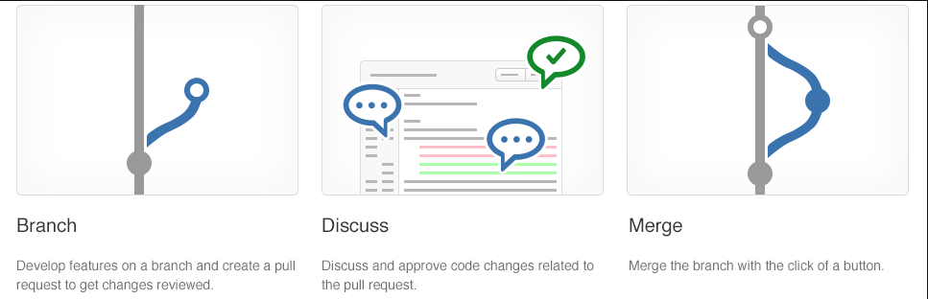
Collaborating with pull requests
Pull requests let you tell others about changes.
Collaboration using the Shared Repository Model
Review and merge your code in a single collaborative process.
Be sure to provide good feedback and protect branches with policies.

Slide 16
Azure Repos collaborating with pull requests
DEMO

Slide 17
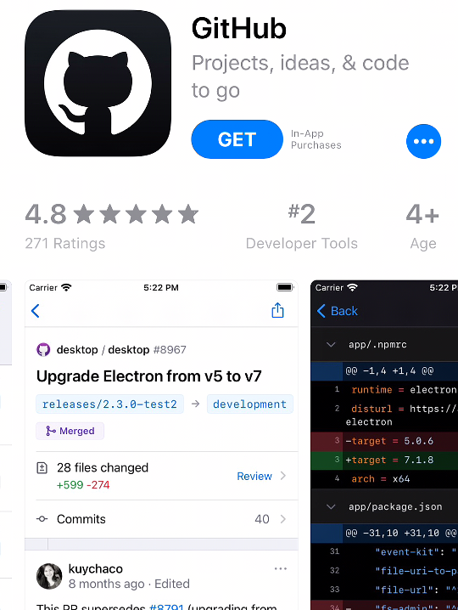
Git Hub mobile for pull request approvals
App can render Markdown, images, PDF files
Manage pull requests directly within the app
Comments can be added (including using emoji short codes)

Slide 18
Lesson 05: Why care about Git hooks ?

Slide 19
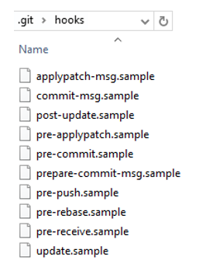
Why care about Git hooks?
A mechanism that allows arbitrary code to be run before, or after, certain Git lifecycle events occur
Use Git hooks to enforce policies, ensure consistency, and control your environment
Can be either client-side or server-side

Slide 20
Git hooks in action
Will my code:
Break other code?
Introduce code quality issues?
Drop the code coverage?
Take on a new dependency?
Will the incoming code:
Break my code?
Introduce code quality issues?
Drop the code coverage?
Take on a new dependency?

Slide 21
Lesson 06: Fostering inner source

Slide 22
Fostering inner source
Fork-based pull request workflows allow anybody to contribute.
Inner source brings all the benefits of open-source software development inside your firewall.
We recommend the forking workflow for large numbers of casual or occasional committers.

Slide 23
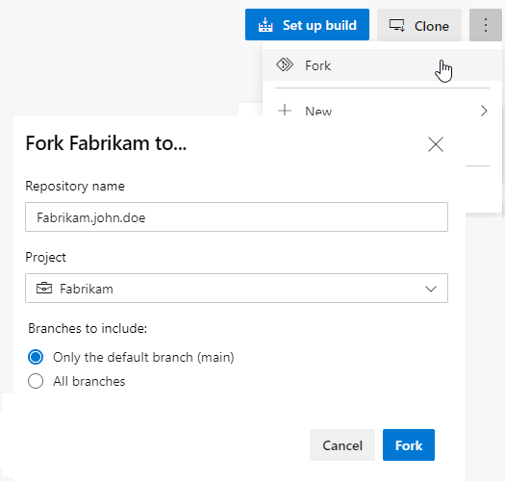
Implementing the fork workflow
What’s in a fork?
Sharing code between forks
Choosing between branches and forks
The forking workflow:
Create a fork
Clone it locally
Make your changes locally and push them to a branch
Create and complete a PR to upstream
Sync your fork to the latest from upstream

Slide 24
Inner source with forks
DEMO
Notes:
Take a moment to complete the demonstration, as defined in the student manual.

Slide 25
Lesson 07: Managing Git Repositories

Slide 26
Working with large repositories
Two common causes: long history and large binary files
Long history: use shallow clones git clone –depth [depth] [clone-url]
Large binary files: use Git Virtual File System (GVFS)

Slide 27
Purging repository data
Might need to delete files from repository:
- Reduce repository size
- Remove accidentally committed large file
- Remove committed file with sensitive data (passwords, keys)
Use:
- filter-branch command
- BFG Repo-Cleaner

Slide 28
Lesson 08: Lab

Slide 29
Version controlling with Git in Azure Repos
Lab overview:
In this lab, you will learn how to work with branches and repositories in Azure DevOps.
Objectives:
Work with branches in Azure Repos
Work with repositories in Azure Repos
Duration:
Notes:
The labs are updated on a regular basis. For the latest information please visit:
https://microsoftlearning.github.io/AZ400-DesigningandImplementingMicrosoftDevOpsSolutions/

Slide 30
Lesson 09: Module review and takeaways

Slide 31
What did you learn?
Explain how to structure Git Repos
Describe Git branching workflows
Leverage pull requests for collaboration and code reviews
Leverage Git hooks for automation
Use Git to foster inner source across the organization

Slide 32
Module 4 review questions
1
What are the three types of branching?
2
What are Git hooks?
3
What are some best practices when working with files in Git? What do you suggest for working with large files?
Notes:
Q1 Answer: Trunk-based development, GitFlow branching, and Forking workflow
Q2 Answer: A mechanism that allows arbitrary code to be run before, or after, certain Git lifecycle events occur. Use Git hooks to enforce policies, ensure consistency, and control your environment. Can be either client-side or server-side.
Q3 Answer: Best practices: use a package management system for DLLs, library files, and other dependent files, don't commit the binaries, logs, tracing output or diagnostic data from your builds, don't commit large, frequently updated binary assets, and use diffable plain text formats, such as JSON, for configuration information. For large files, use Git LFS.

