Slide 1
AZ-400.00 Module 5: Configuring Azure Pipelines

Slide 2
Lesson 01: Module overview

Slide 3
Module overview
Lesson 1: Module overview
Lesson 5: Agent pools
Lesson 2: The concept of pipelines in DevOps
Lesson 6: Pipelines and concurrency
Lesson 3: Azure Pipelines
Lesson 7: Azure DevOps and open-source projects (public projects)
Lesson 4: Evaluate use of hosted versus self-hosted agents
Lesson 8: Azure Pipelines YAML versus Visual Designer

Slide 4
Learning objectives
After completing this module, students will be able to:
Explain the role of Azure Pipelines and its components
Configure agents for use in Azure Pipelines

Slide 5
Lesson 02: The concept of pipelines in DevOps

Slide 6
The concept of pipelines in DevOps
Build automation and continuous integration
Test automation
Deployment automation
A pipeline enables a constant flow of changes into production via an automated software production line
Pipelines create a repeatable, reliable and incrementally improving process for taking software from concept to customer
Pipelines require infrastructure, this infrastructure will have a direct impact on the effectiveness of the pipeline

Slide 7

Lesson 03: Azure Pipelines

Slide 8
Azure Pipelines
Azure Pipelines is a cloud service that you can use to automatically build and test your code project and make it available to other users.
Works great with Continuous Integration and Continuous Delivery:
Work with any language or platform – Python, Java, PHP, Ruby, C#, and Go
Deploy to different types of targets at the same time
Integrate with Azure deployments – Container registries, virtual machines, Azure services, or any on-premises or cloud target (Microsoft Azure, Google Cloud, or AWS)
Build on Windows, Linux, or macOS machines
Integrate with GitHub
Work with open-source projects
Notes:
Review the Azure Pipelines Key terms in the student manual.

Slide 9
Azure Pipelines key terms
Agent
Job
Artifact
Pipeline
Build
Release
Continuous Delivery (CD)
Stage
Continuous Integration (CI)
Task
Deployment target
Trigger

Slide 10

Lesson 04: Evaluate use of Microsoft-hosted vs self-hosted agents

Slide 11
Microsoft-hosted versus self-hosted agents
You generally need at least one agent to build or deploy your project.
An agent is installable software that runs one build or deployment job at a time.
Two types of agents:
Microsoft-hosted agents – Maintenance and upgrades are automatically done. Each time a pipeline is run, a fresh virtual machine (instance) is provided. There are time limits on jobs run on these agents.
Self-hosted agents – You take care of maintenance and upgrades. Give you more control to install dependent software needed. Can be installed on Linux, macOS, Windows machines, or in a Linux Docker container. There are no time limits on these jobs.

Slide 12
Job types
Four types of jobs:
Agent pool jobs – Jobs that run on an agent in an agent pool
Container jobs – Jobs that run in a container on an agent in an agent pool
Deployment group jobs – Jobs that run on systems in a deployment group
Agentless jobs – Jobs that run on the Azure DevOps server (also called Server Jobs)

Slide 13

Lesson 05: Agent pools

Slide 14
Agent pools
Pool A
Pool B
Machine
Machine
Agent
Agent
Agent
Agent
Agent
You can organize agents into agent pools.
An agent pool defines the sharing boundary.
In Azure Pipelines, agent pools are scoped to the Azure DevOps organization; so, you can share an agent pool across projects.
Notes:
Use the student manual for some typical situations where you might want to create agent pools.

Slide 15
Predefined agent pool – Azure pipelines
Hosted VS2019
Hosted VS2017
Hosted Ubuntu 20.04
Hosted Ubuntu 18.04
Hosted Ubuntu 16.04
Hosted macOS X Mojave 10.14
Hosted macOS X Catalina 10.15

Slide 16
Typical situations for agent pools
You’re a member of a project and you want to use a set of machines owned by your team for running build and deployment jobs.
You’re a member of the infrastructure team and would like to set up a pool of agents for use in all projects.
You want to share a set of agent machines with multiple projects but not all of them.
Pool A
Pool B
Machine
Machine
Agent
Agent
Agent
Agent
Agent
Queue 1
Queue 2
Queue 1
Team Project Collection A
Team Project Collection B
Team Project A1
Team Project A2
Team Project B1
Build definition 1
Build definition 3
Build definition 1
Build definition 2
Build definition 4
Build definition 2

Slide 17
Security of agent pools
Roles are defined on each agent pool, and membership in these roles governs what operations you can perform on an agent pool.
Role | Purpose
Reader | Members of this role can view the organization agent pool as well as agents. You typically use this to add operators that are responsible for monitoring the agents and their health.
Service Account | Members of this role can use the organization agent pool to create a project agent pool in a project. If you follow the guidelines above for creating new project agent pools, you typically do not have to add any members here.
Administrator | In addition to all the above permissions, members of this role can register or unregister agents from the organization agent pool. They can also refer to the organization agent pool when creating a project agent pool. Finally, they can also manage membership for all roles of the organization agent pool. The user that created the organization agent pool is automatically added to the Administrator role.

Slide 18
Lesson 06: Pipelines and concurrency

Slide 19
Parallel jobs
FabrikamFiber CI Build 102 (master)
1
FabrikamFiber Release 11
2
5
FabrikamFiber CI Build 101 (feature)
3
4
Queued build waiting for pipeline
Build running
Release waiting for pipeline
Release running
Release waiting for approval
This is a simple example of a Microsoft-hosted parallel job.
Users can collectively run only one build or release job at a time; additional jobs are queued.
A release consumes a parallel job only when it’s being actively deployed to a stage.

Slide 20
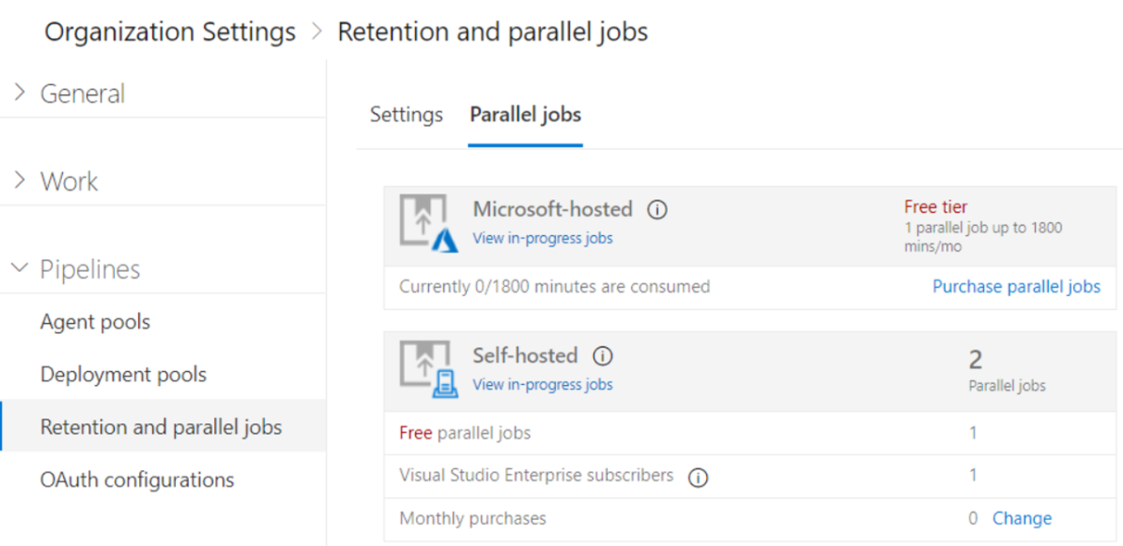
Estimating parallel jobs
Determine how many parallel jobs you need.
Simple estimates vs Detailed estimates
You can display all the builds and releases.
Parallel jobs are purchased at the organization level and are shared by all projects.

Slide 21
Lesson 07: Azure DevOps and open-source projects

Slide 22
Azure DevOps and open-source projects
How do I qualify for the free tier of public projects?
Are there limits on who can use Azure Pipelines?
Are there any limits on the number of builds and release pipelines that I can create?
As a Visual Studio Enterprise subscriber, do I get additional parallel jobs for Azure Pipelines?
What about the option to pay for hosted agents by the minute?

Slide 23
Lesson 08: Azure Pipelines YAML versus Visual Designer

Slide 24
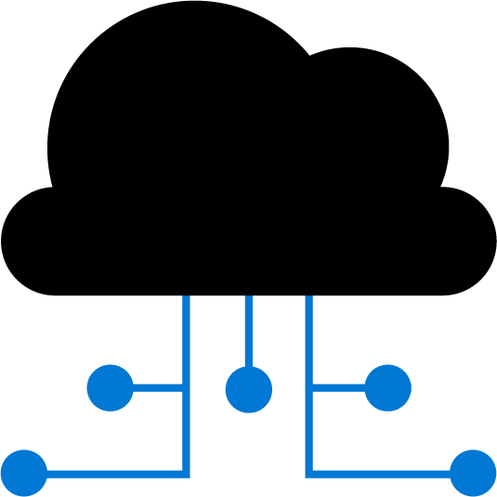

Azure Pipelines and Visual Designer
Configure your pipelines with the Visual Designer
Continuous Integration
Continuous Deployment
Edit Code
Push to code repo
Build tasks
Test tasks
Create artifact
Release tasks
Deploy to target
Create and configure your build and release pipelines.
Push your code to your version control repository.
The build creates an artifact that’s used by the rest of your pipeline.
Your code is now updated, built, tested, and packaged.
Often referred to as "Classic Pipelines"

Slide 25
Azure Pipelines and YAML
Configure your pipelines in a YAML file that exists alongside your code
Edit Code
Edit YAML file
Push to code repo
Azure Pipelines
Deploy to target
Configure Azure Pipelines to use your Git repo.
Edit your azure-pipelines.yml file to define your build.
Push your code to your version control repository.
Your code is now updated, built, tested, and packaged.
While more code-oriented, defining pipelines using YAML is preferred

Slide 26
Lesson 09: Labs

Slide 27
Lab: Configuring Agent Pools and Understanding Pipeline Styles
Lab overview:
In this lab, you will step through the process of converting a classic pipeline into a YAML-based one and running it first by using a Microsoft-hosted agent and then performing the equivalent task by using a self-hosted agent.
Objectives:
Implement YAML-based pipelines
Implement self-hosted agents
Duration:
Notes:
The labs are updated on a regular basis. For the latest information please visit:
https://microsoftlearning.github.io/AZ400-DesigningandImplementingMicrosoftDevOpsSolutions/

Slide 28
Lesson 10: Module review and takeaways

Slide 29
What did you learn?
Explain the role of Azure Pipelines and its components
Configure agents for use in Azure Pipelines

Slide 30
Module review questions
1
What are some advantages of Azure Pipelines?
2
What is a pipeline, and why is it used?
3
What are the two types of agents and how are they different?
4
What is an agent pool, and why would you use it?
5
What are two ways to configure your Azure Pipelines?
Notes:
Q1 Answer: Work with any language or platform - Python, Java, PHP, Ruby, C#, and Go; deploy to different types of targets at the same time; integrate with Azure deployments - container registries, virtual machines, Azure services, or any on-premises or cloud target (Microsoft Azure, Google Cloud, or Amazon cloud services); build on Windows, Linux, or Mac machines; integrate with GitHub; work with open-source projects.
Q2 Answer: A pipeline enables a constant flow of changes into production via an automated software production line. Pipelines create a repeatable, reliable and incrementally improving process for taking software from concept to customer.
Q3 Answer: Microsoft-hosted agents - Automatically take care of maintenance and upgrades. Each time you run a pipeline, you get a fresh virtual machine. The virtual machine is discarded after one use. Self-hosted agents – You take care of maintenance and upgrades. Give you more control to install dependent software needed. You can install the agent on Linux, macOS, Windows machines, or even in a Linux Docker container.
Q4 Answer: You can organize agents into agent pools. An agent pool defines the sharing boundary. In Azure Pipelines, agent pools are scoped to the Azure DevOps organization; so you can share an agent pool across projects.
Q5 Answer: YAML file and Visual Designer

