Slide 1
AZ-400.00 Module 7: Managing Application Configuration and Secrets

Slide 2
Lesson 01: Module overview

Slide 3
Module overview
Lesson 6: Integrating with identity management systems
Lesson 1: Module overview
Lesson 7: Implementing application configuration
Lesson 2: Introduction to security
Lesson 3: Implement a secure development process
Lesson 8: Lab
Lesson 4: Rethinking application configuration data
Lesson 9: Module review and takeaways
Lesson 5: Manage secrets, tokens, and certificates

Slide 4
Learning objectives
After completing this module, students will be able to:
Manage application config and secrets
Integrate Azure Key Vault with a pipeline

Slide 5
Lesson 02: Introduction to security

Slide 6
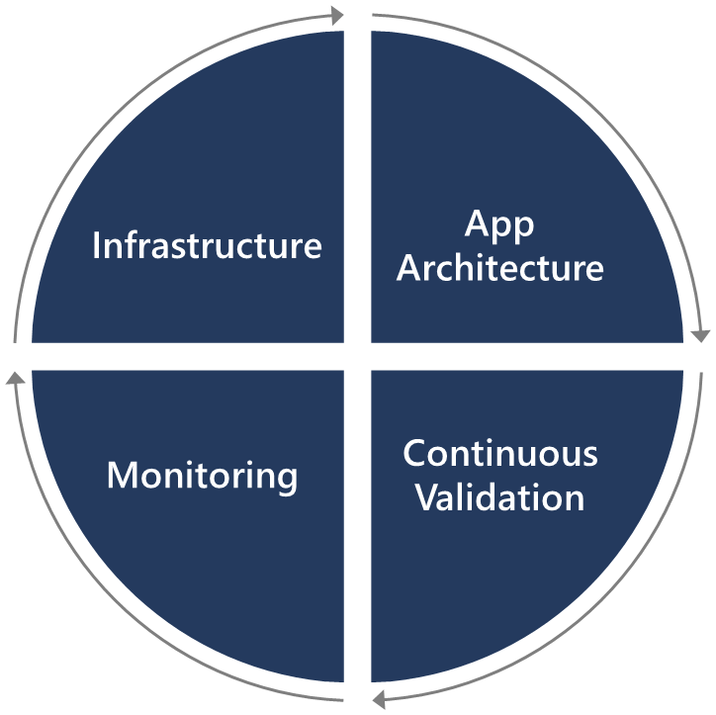
Introduction to security
Security is everyone’s responsibility.
Securing applications is a continuous process that encompasses the following:
Secure infrastructure
Designing an architecture with layered security
Continuous security validation
Monitoring for attacks

Slide 7
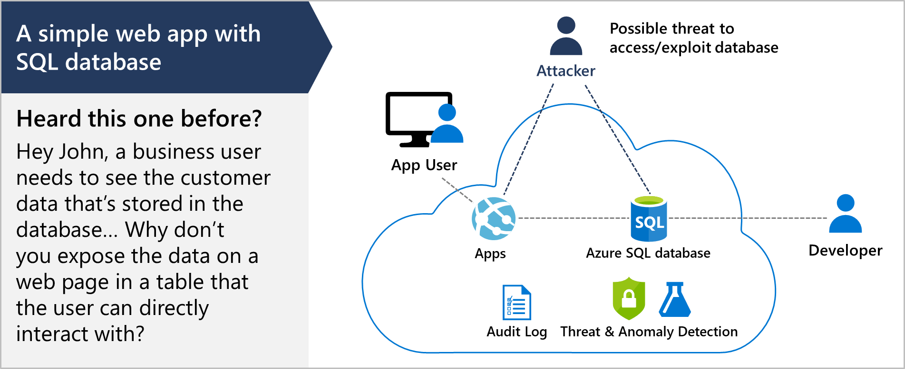
SQL injection attack

Slide 8

Lesson 03: Implement a secure development process

Slide 9
Threat modeling
Define security requirements
2. Diagram
Create an application diagram
1. Define
3. Identify
Identify threats
Threat
modeling
Mitigate threats
5. Validate
4. Mitigate
Validate that threats have been mitigated

Slide 10
Threat modeling
DEMO

Slide 11
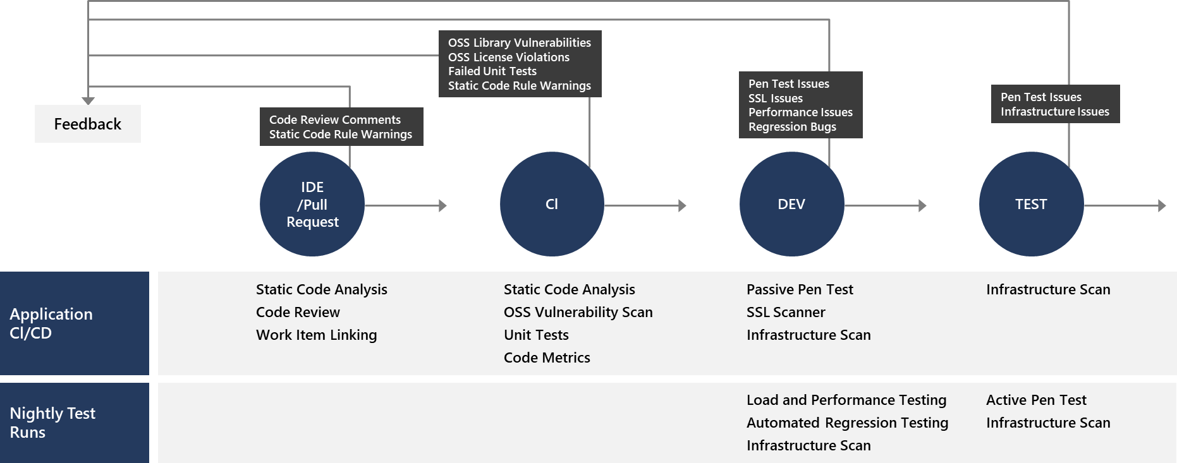
Key validation points
Continuous security validation should be added at each step from development through production

Slide 12
Continuous integration
The CI build should be executed as part of the pull request (PR-CI) process and once the merge is complete
Several tools are available:
SonarQube
Visual Studio Code Analysis and the Roslyn Security Analyzers
Checkmarx – A Static Application Security Testing (SAST) tool
BinSkim – A binary static analysis tool that provides security and correctness results for Windows portable executables
And many more
Notes:
Note: Useful tooling is discussed in a later module

Slide 13
Lesson 04: Rethinking application configuration data

Slide 14
Rethinking application config data
Configuration information is stored in files
Changes can require downtime and administrative overhead
Challenging to manage changes to local configurations across multiple running instances of the application
Discussion: How will you secure this information?

Slide 15
Separation of concerns
Configuration custodian: Responsible for generating and maintaining the life cycle of configuration values
Configuration consumer: Responsible for defining the schema (loose term) for the configuration and then consuming the configuration values in the application or library code
Configuration store: The underlying store that is leveraged to store the configuration
Secret store: A separate store for persisting secrets

Slide 16
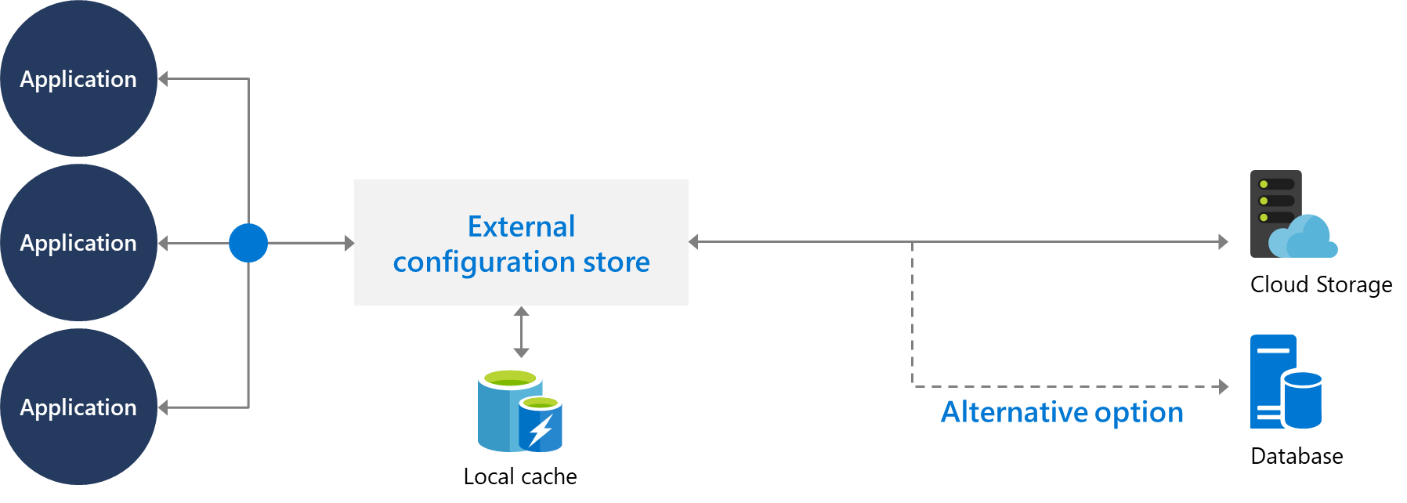
External configuration store patterns
Store the configuration information in external storage.
Provide an interface to quickly and efficiently read and update.

Slide 17
Integrating Azure Key Vault with Azure Pipeline
Azure Key Vault allows you to manage your organization’s secrets and certificates in a centralized repository.
Azure Key Vault stores secrets, keys, and certificates.

Slide 18
Lesson 05: Manage secrets, tokens, and certificates

Slide 19
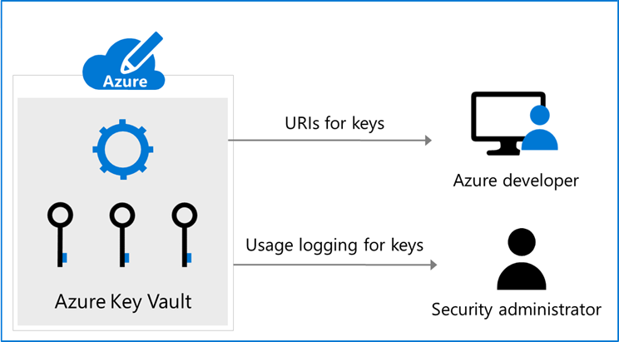
Manage secrets, tokens and certificates
Centralize application secrets
Securely store secrets and keys
Monitor access and use
Simplified administration of application secret
Integrate with other Azure services

Slide 20
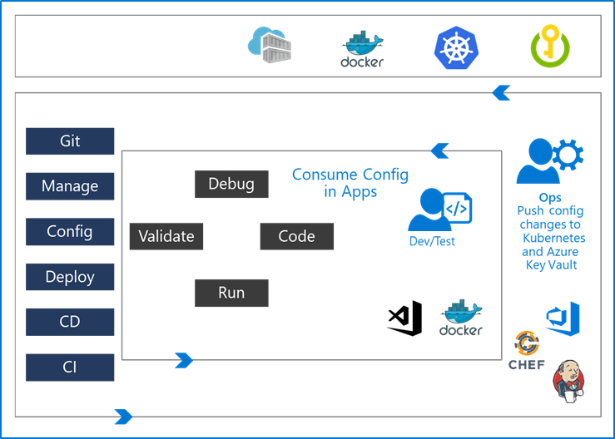
DevOps inner and outer loop
The inner loop is focused on the developer teams iterating over their solution development.
Developer teams consume the configuration published by the outer loop.
The Ops Engineer governs the configuration management and pushes the changes.

Slide 21
Lesson 06: Integrating with identity management systems

Slide 22
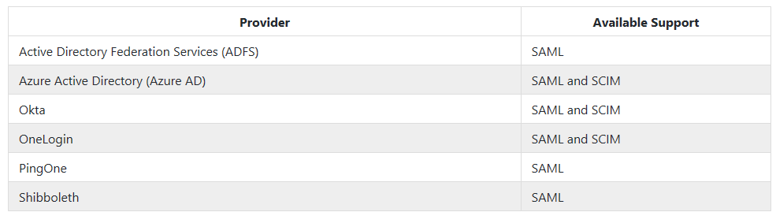
Integrating GitHub with single sign-on (SSO)
Connect identity provider to GitHub at organization level
Both SAML and SCIM support available

Slide 23
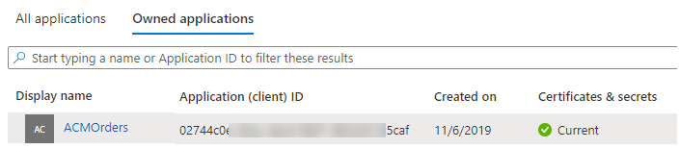
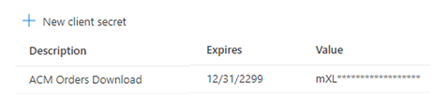
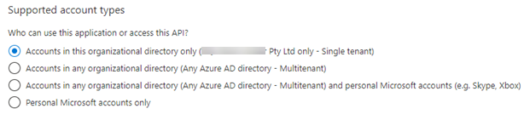
Service principals
Register an AD application
Create a client secret
Grant permissions to the identity
To connect, application presents: -
- TenantID
- Application ID
- Client Secret

Slide 24


Managed service identities
Two types of managed identity:
System-assigned (many services expose these identities)
User-assigned (create a managed identity and assign it to services)
Identity to use?
Managed identities remove the need for the user to provide ongoing management of a credential.

Slide 25
Lesson 07: Implementing application configuration

Slide 26

Azure App configuration service
Useful for most applications but particularly applicable to:
Distributed applications (particularly microservice applications)
Serverless applications
Centralize management and distribution of hierarchical configuration data for different environments and geographies
Dynamically change application settings without the need to redeploy or restart an application
Control feature availability in real-time

Slide 27
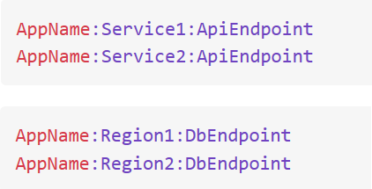
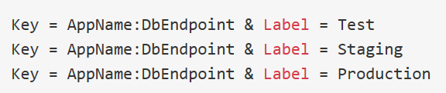
Key-value pairs
Service stores key-value pairs
Keys and values are all Unicode strings
Recommend using hierarchical naming for keys
Labels can be used to store different values for a particular key
Labels can provide a way of versioning keys

Slide 28
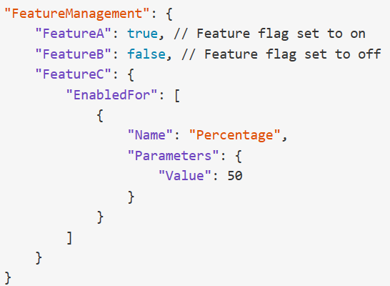
App configuration feature management
Azure App Configuration can also act as a central repository for feature flags.
Feature flags have two parts:
Name
List of one or more filters
Filters are use cases for when an application feature should be enabled
Supports appsettings.json as a configuration source for feature flags
NOTE: Feature flags are discussed later in the course.

Slide 29
Lesson 08: Lab

Slide 30
Integrating Azure Key Vault with Azure DevOps
Lab overview:
In this lab, you will see how you can integrate Azure Key Vault with an Azure DevOps pipeline.
Objectives:
Create an Azure Active Directory (Azure AD) service
principal
Create an Azure key vault
Track pull requests through the Azure DevOps pipeline
Duration:
Notes:
The labs are updated on a regular basis. For the latest information please visit:
https://microsoftlearning.github.io/AZ400-DesigningandImplementingMicrosoftDevOpsSolutions/

Slide 31
Lesson 09: Module review questions

Slide 32
What did you learn?
Manage application config and secrets
Integrate Azure Key Vault with a pipeline

Slide 33
Module review questions
1
What are the five stages of threat modeling?
2
What is the Azure Key Vault and why would you use it?
Notes:
Q1 Answer: Define security requirements. Create an application diagram. Identify threats. Mitigate threats. Validate that threats have been mitigated.
Q2 Answer: Azure Key Vault is a cloud key management service which allows you to create, import, store & maintain keys and secrets used by your cloud applications. The applications have no direct access to the keys, which helps improving the security & control over the stored keys & secrets. Use the Key Vault to centralize application and configuration secrets, securely store secrets and keys, and monitor access and use.

