Slide 1
AZ-400.00 Module 8: Implementing Continuous Integration with GitHub Actions

Slide 2
Lesson 01: Module overview

Slide 3
Module overview
Lesson 4: Securing secrets for GitHub Actions
Lesson 1: Module overview
Lesson 2: GitHub Actions
Lesson 5: Lab
Lesson 3: Continuous integration with GitHub Actions
Lesson 6: Module review and takeaways

Slide 4
Learning objectives
After completing this module, students will be able to:
Create and work with GitHub Actions and workflows
Implement Continuous Integration with GitHub Actions

Slide 5
Lesson 02: GitHub Actions

Slide 6
What are actions?
Automations within the GitHub environment
Often used to build CI/CD implementations
Based on YAML files living within GitHub repositories
Executed on GitHub or self-hosted runners
Large number of existing actions in the GitHub Marketplace

Slide 7
Actions flow
Events
Events trigger workflows:
- Schedule, code, etc.
Workflows contain jobs:
- May contain multiples
Jobs use actions:
- Configured within steps
Trigger
Workflows
Contain
Jobs
Use
Actions

Slide 8
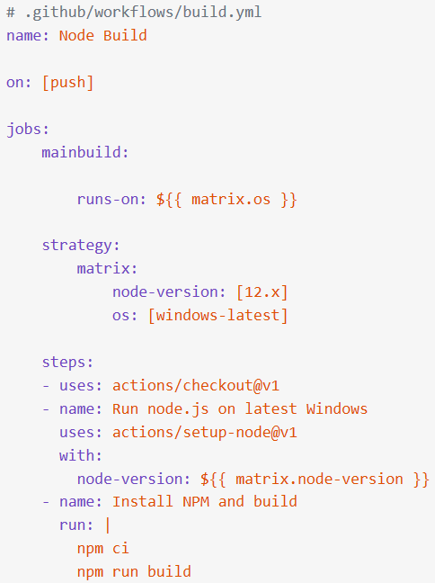
Workflows
Define the required automation:
Events, Jobs
Written in YAML
Stored in .github/workflows
Starter workflows available

Slide 9
Standard workflow syntax elements
Name: the name of the workflow (optional but recommended)
On: the event that triggers the workflow
Jobs: the list of jobs to be executed
Runs-on: the target runner
Steps: the list of steps to execute
Uses: a predefined action to retrieve
Run: tells the job to execute a command on the runner

Slide 10
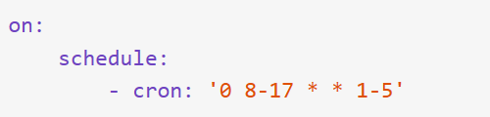


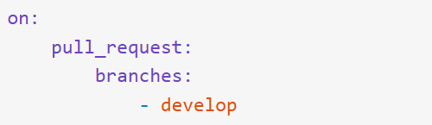

Events
Defined by the on clause
Scheduled events
Code events
Manual events
Webhook events
External events

Slide 11
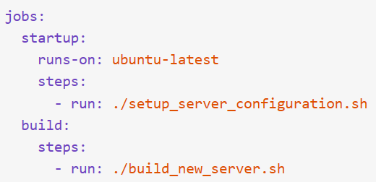
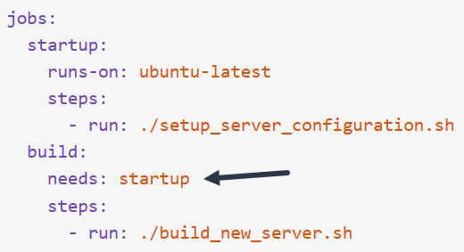
Jobs
Workflows contain one or more jobs. Jobs contain a set of steps to execute in order.
Jobs run in parallel by default but can be configured with dependencies.

Slide 12
Runners
Job steps execute on runners:
Shell scripts
Actions
For JavaScript code, Node.js hosted runners:
Windows
MacOS
Linux
For other languages or options:
Docker containers on Linux
Self-hosted – but do not use for public repos

Slide 13
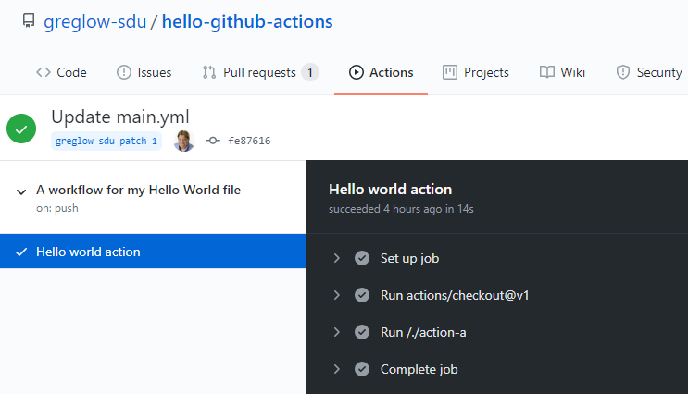
Console output from actions
Console output from actions is available directly in the GitHub UI

Slide 14


Release management for actions
Specific releases of actions can be requested:
Using tags
Using branches
Using SHA hashes

Slide 15
Testing an action
DEMO

Slide 16

Lesson 03: Continuous integration with GitHub Actions

Slide 17
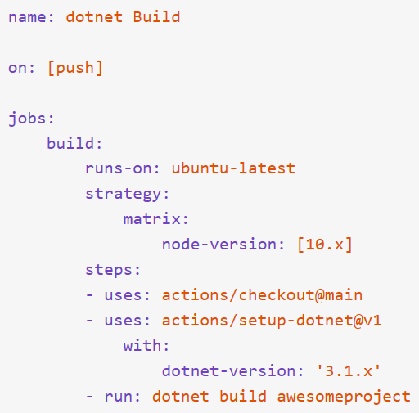
Continuous integration with actions
Example workflow shown:
executes when code is pushed
runs on latest ubuntu
uses Node.js version 10
Steps:
check out the code
set up dotnet
build the project

Slide 18
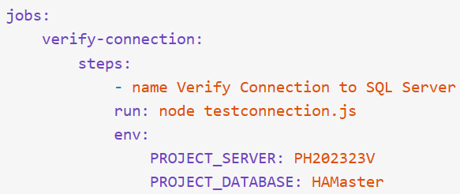
Environment variables
CI workflows usually need environment variables
GitHub default variables (GITHUB_ prefix)
Custom variables

Slide 19
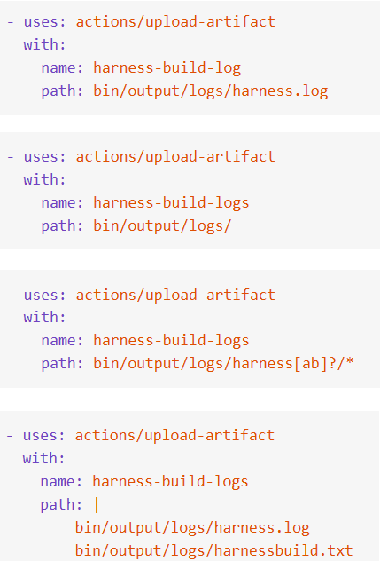
Passing artifacts between jobs
CI workflows need to be able to pass artifacts between jobs. Standard actions:
upload-artifact
download-artifact
Can configure retention

Slide 20


Workflow badges
Show status of a workflow within a repository
Typically added to README.md
Can be branch specific
Added via URLs
https://github.com/accountname/repositoryname/workflows/workflowname/badge.svg
Spaces in names must be encoded as %20

Slide 21
Best practices for creating actions
Create chainable actions – avoid monolithic actions
Version your actions like other code
Provide a latest label
Add appropriate documentation: like README.md
Add detailed action.yml metadata
Consider contributing to the marketplace

Slide 22
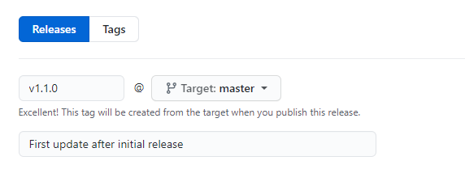
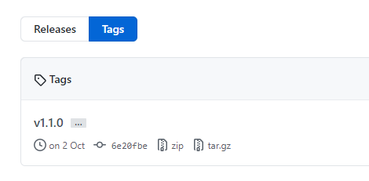
Marking releases with Git tags
Releases are based on Git tags
Mark a specific point in repository history
Tags are viewed in the repository history

Slide 23
Lesson 04: Securing secrets for GitHub Actions

Slide 24
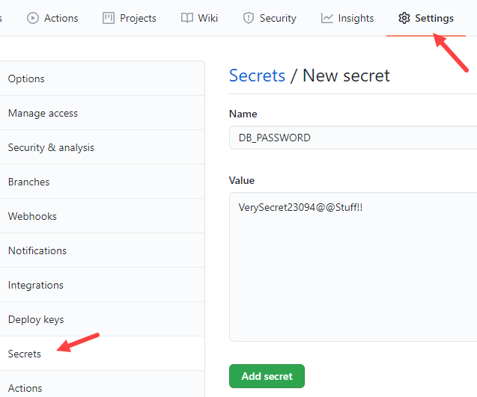
Creating encrypted secrets
Like environment variable but encrypted
Created at repository or organization level
Created/assigned in the GitHub UI

Slide 25
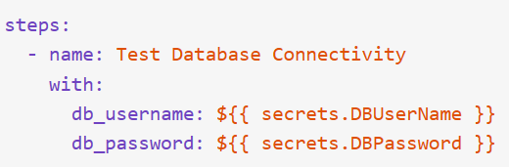
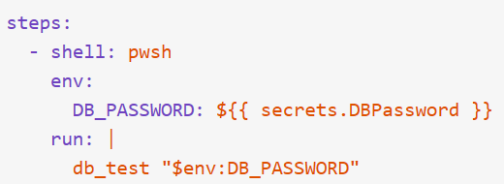
Using secrets in a workflow
Secrets not automatically passed to runners
Can be passed as inputs or as environment variables
Avoid passing secrets in command-line arguments

Slide 26
Lesson 05: Lab

Slide 27
Implementing GitHub Actions by using DevOps Starter
Lab overview:
In this lab, you will learn how to implement a GitHub Action workflow that deploys an Azure web app by using DevOps Starter.
Objectives:
Implement a GitHub Action workflow by using DevOps Starter
Explain the basic characteristics of GitHub Action workflows
Duration:
Notes:
The labs are updated on a regular basis. For the latest information please visit:
https://microsoftlearning.github.io/AZ400-DesigningandImplementingMicrosoftDevOpsSolutions/

Slide 28
Lesson 06: Module review and takeaways

Slide 29
What did you learn?
Create and work with GitHub Actions and workflows
Implement Continuous Integration with GitHub Actions

Slide 30
Module review questions
1
True or False: Self-hosted runners should be used with public repos.
2
Database passwords that are needed in a CI pipeline should be stored where?
3
The metadata for an action is held in which file?
4
How can the status of a workflow be shown in a repository ?
Notes:
Q1 Answer: False – they should never be used with public repos
Q2 Answer: Encrypted Secrets
Q3 Answer: action.yml
Q4 Answer: Using Badges

