Slide 1
AZ-400.00 Module 9: Designing and Implementing a Dependency Management Strategy

Slide 2
Lesson 01: Module overview

Slide 3
Module overview
Lesson 1: Module overview
Lesson 5: Package security
Lesson 2: Packaging dependencies
Lesson 6: Implement a versioning strategy
Lesson 3: Package management
Lesson 7: Lab
Lesson 4: Migrating and consolidating artifacts
Lesson 8: Module review and takeaways

Slide 4
Learning objectives
After completing this module, students will be able to:
Recommend artifact management tools and practices
Abstract common packages to enable sharing and reuse
Migrate and consolidate artifacts
Migrate and integrate source control measures

Slide 5
Lesson 02: Packaging dependencies

Slide 6
What is dependency management?
Modern software is complex
Component based development is common
Not all software is written by a single team
Dependencies on components created by other teams or persons

Slide 7
Elements of a dependency management strategy
Standardization
Package formats and sources
Versioning

Slide 8
Identifying dependencies
Find components and source code that can have independent:
Deployment
Release
Versioning
Things to consider:
Change frequency
Changes should be unrelated to other parts of system
Can package exist by itself
Package should add value for others

Slide 9
Source and package componentization
Source componentization:
Split out components
Related projects in different solutions
Package componentization:
Composing your solution to use packages

Slide 10
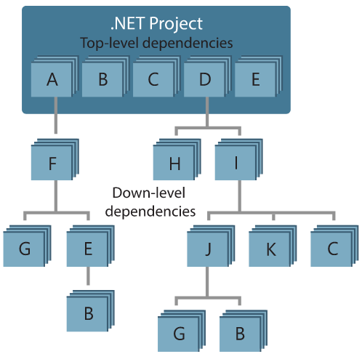
Decompose your system
Approach:
Draw a dependency graph
Group components in sets of related components
Few spanning check-ins across sets
Ideally a single team is responsible
Shared release cadence for single set

Slide 11
Scanning your codebase for dependencies
Duplicate code
High cohesion and low coupling
Individual lifecycle
Stable parts
Independent code and components

Slide 12
Lesson 03: Package management

Slide 13


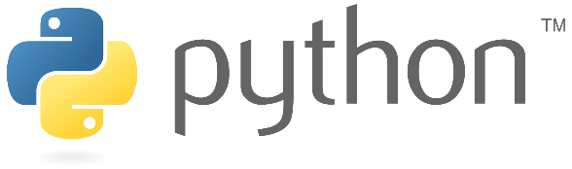
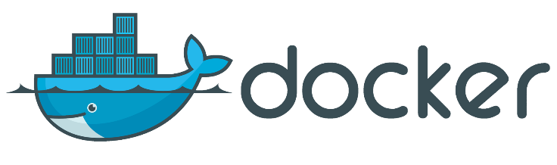

Packages
A package is a formalized way of creating a distributable unit of software artifacts that can be consumed from another software solution.
Microsoft platform and .NET artifacts
Node.js modules
Python scripts
Universal packages
Java packages
Docker images
NuGet Microsoft development platform and .NET artifacts
Npm node.js modules
Maven Java packages
Python Python script
Universal Set of related files
Docker Container images
Symbols Symbol files

Slide 14
Package feeds
Centralized storage of package artifacts:
Public or privately available
Offer secure access for private feeds
Versioned storage of packages
Managed by tooling
Also known as:
Package repositories
Package registry
Package types:
Public: NuGet.org, Npmjs.org, PyPi.org, Docker Hub
Private: MyGet, Azure Container Registry, Azure Artifacts, Self-hosted solutions

Slide 15
Package feed managers
Manage feeds
Maintain local installation cache
Search and list packages from feed
Publish packages
Consume packages
Choose tooling:
Command-line tooling
Integrated in build and release pipelines

Slide 16
Common public package sources
NuGet Gallery
https://nuget.org
NPMjs
https://npmjs.org
Maven
https://search.maven.org
Docker Hub
https://hub.docker.com
Python Package Index
https://pypi.org

Slide 17
Self-hosted and SaaS based package sources
Package type | Self-hosted private feed | SaaS private feed
NuGet | NuGet server | Azure Artifacts, MyGet
NPM | Sinopia, cnpmjs.org, Verdaccio | NPMjs.org, MyGet, Azure Artifacts
Maven | Nexus, Artifactory, Archiva | Azure Artifacts, Bintray, JitPack
Docker | Portus, Quay, Harbor | Docker Hub, Azure Container Registry, Amazon Elastic Container Registry
Python | PyPI Server | Azure Artifacts, Gemfury

Slide 18
Consuming packages
1
Identify a required dependency in your codebase
2
Find a component that satisfies the requirements for the project
3
Search the package sources for a package offering a correct version of the component
4
Install the package into the codebase and development machine
5
Create the software implementation that uses the new components from the package

Slide 19

Azure Artifacts
Azure Artifacts
Create private and public package feeds for package types:
NuGet
NPM
Maven
Universal
Python

Slide 20
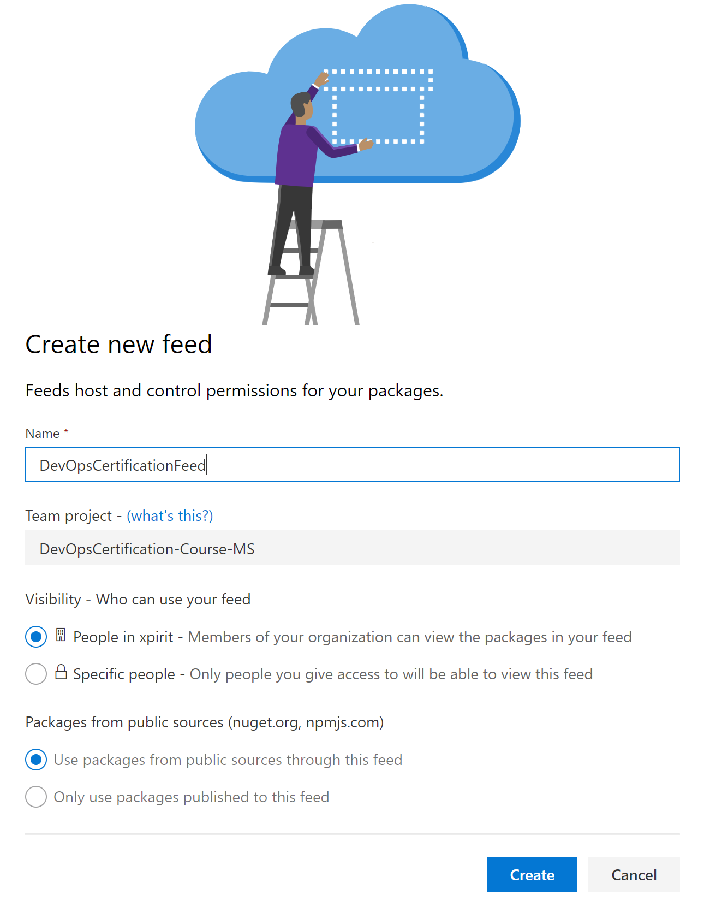
Publishing packages
From Azure DevOps portal
Feeds are centralized
Specify:
Name
Visibility
Public sources as upstream

Slide 21
Demonstration: creating a package feed
DEMO
Notes:
Take a moment to complete the demonstration, as defined in the student manual.

Slide 22
Demonstration: pushing a package
DEMO
Notes:
Take a moment to complete the demonstration, as defined in the student manual.

Slide 23
Lesson 04: Migrating and consolidating artifacts

Slide 24
Identifying existing artifact repositories
An artifact is a deployable component of your application.
Azure Pipelines can work with a wide variety of artifact sources and repositories.
Each release can specify which version of the artifacts are required.
Azure Artifacts can eliminate the need to manage file shares or to host private package servers.
Azure Artifacts provides universal artifact management for Maven, npm and NuGet.

Slide 25
Migrating and integrating artifact repositories
Get started with NuGet packages in Azure DevOps Services and TFS
Use npm to store JavaScript packages in Azure DevOps Services or TFS
Get started with Maven packages in Azure DevOps Services and TFS
Get started with Python packages in Azure Artifacts
Publish and then download a Universal Package

Slide 26
Lesson 05: Package security

Slide 27
Securing access to package feeds
Feeds must be secured:
Private feeds
Not allow access by unauthorized users for publishing
Restricted access for consumption:
Whenever a package feed and its packages should only be consumed by a certain audience, it is required to restrict access to it. Only those allowed access will be able to consume the packages from the feed.
Restricted access for publishing:
Secure access is required to restrict who can publish, so feeds and their packages cannot be modified by unauthorized or untrusted persons and accounts.

Slide 28
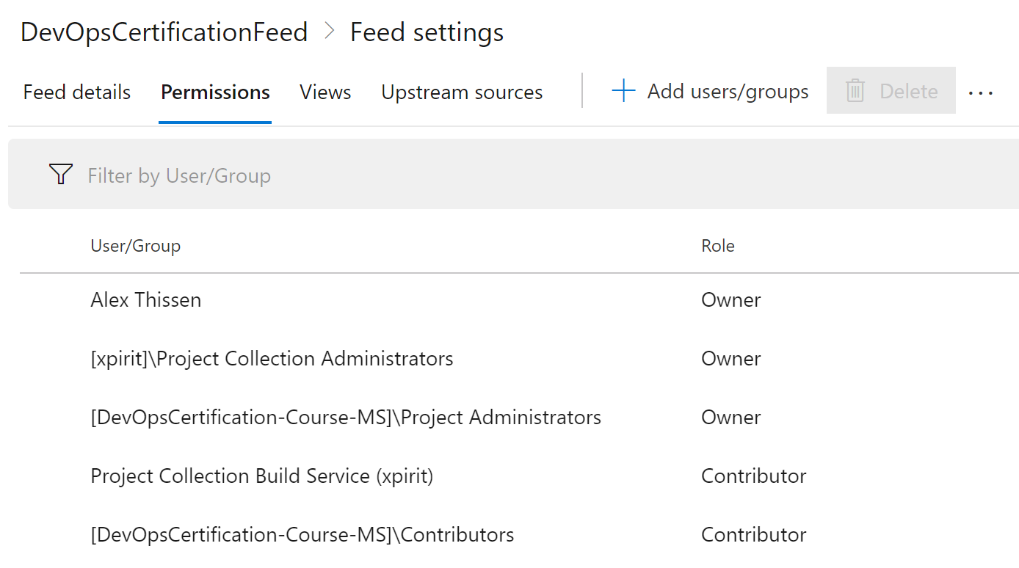
Roles
Available roles in Azure Artifacts:
Reader: Can list and restore (or install) packages from the feed
Collaborator: Is able to save packages from upstream sources
Contributor: Can push and unlist packages in the feed
Owner: Has all available permissions for a package feed
Project Collection Build Service is contributor by default

Slide 29
Permissions
Roles have certain permissions
Permission | Reader | Collaborator | Contributor | Owner
List and restore/install packages | ✓ | ✓ | ✓ | ✓
Save packages from upstream sources |  | ✓ | ✓ | ✓
Push packages |  |  | ✓ | ✓
Unlist/deprecate packages |  |  | ✓ | ✓
Delete/unpublish package |  |  |  | ✓
Edit feed permission |  |  |  | ✓
Rename and delete feed |  |  |  | ✓

Slide 30
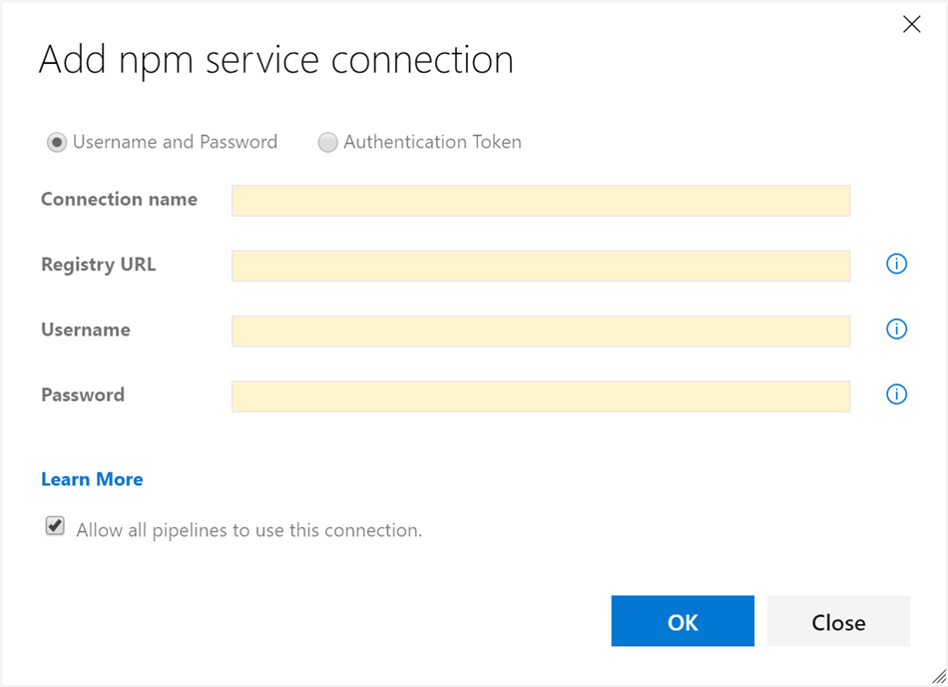
Authentication
-Authentication is required for Azure Artifacts
-Transparently taken care of when logged into portal or in build tasks
External package sources may require credentials:
Create a service connection

Slide 31
Lesson 06: Implement a versioning strategy

Slide 32
Introduction to versioning
Packages need to be versioned
Identification
Maintainability
Each package has its own lifecycle and rate of change
Packages are immutable
Once published a package cannot be changed
Replacing or updating a package is not allowed
Any change requires a new version

Slide 33
Versioning of artifacts
Way to express version technically varies per package type
Versioning requires a scheme
Typical Scheme:
2.1.15
Major
Minor
Patch

Slide 34
Semantic versioning
Express nature and risk of change
1.2.3
-beta2
Nature of change
Quality of change
See also: https://semver.org

Slide 35
Release views
Views help in defining quality without changing version numbers
Three default views:
Local
Release
Prerelease
1
2
3
https://pkgs.dev.azure.com/{yourteamproject}/_packaging/{feedname} @{Viewname}/nuget/v3/index.json

Slide 36
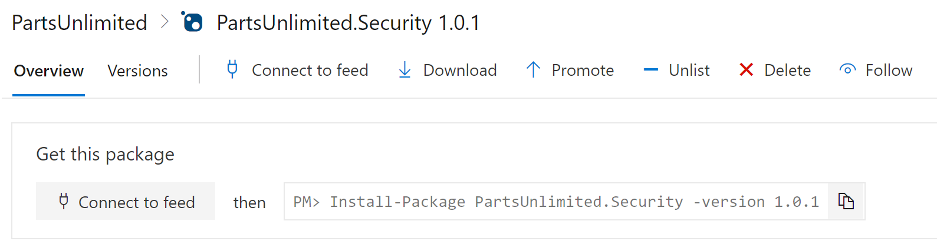
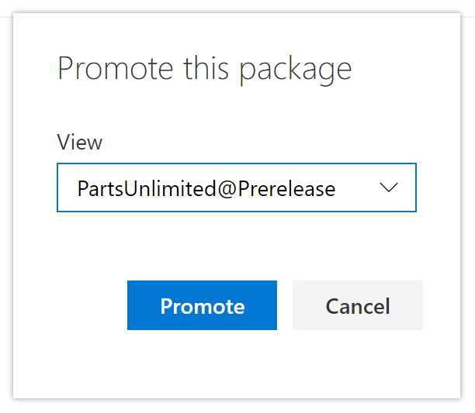
Promoting packages
Promote packages from @local view to other release views.
Upstream sources will only be evaluated from @local view:
Only visible in other release views after being promoted

Slide 37
Demonstration: promoting a package
DEMO

Slide 38
Best Practices for versioning
Have a documented versioning strategy
Adopt SemVer 2.0 for your versioning scheme
Each repository should only reference one feed
On package creation, automatically publish packages back to the feed

Slide 39
Demonstration: pushing from the pipeline
DEMO

Slide 40
Lesson 07: Lab

Slide 41
Package management with Azure Artifacts
Lab overview:
In this lab, you will learn how to work with Azure Artifacts.
Objectives:
Create an Azure Active Directory (Azure AD) service principal
Create an Azure key vault
Track pull requests through the Azure DevOps pipeline
Duration:
Notes:
The labs are updated on a regular basis. For the latest information please visit:
https://microsoftlearning.github.io/AZ400-DesigningandImplementingMicrosoftDevOpsSolutions/

Slide 42
Lesson 08: Module review and takeaways

Slide 43
What did you learn?
Recommend artifact management tools and practices
Abstract common packages to enable sharing and reuse
Migrate and consolidate artifacts
Migrate and integrate source control measures

Slide 44
Module review questions
1
If you are creating a feed that will allow yourself and those that you invite to publish, what visibility should you choose?
2
Can you create a package feed for Maven in Azure Artifacts?
3
What type of package should you use for Machine learning training data & models?
4
If an existing package is found to be broken or buggy, how should it be fixed?
5
What is meant by saying that a package should be immutable?
Notes:
Q1 Answer: Private
Q2 Answer: Yes
Q3 Answer: Universal
Q4 Answer: Publish a new version
Q5 Answer: A published version should never be changed, only replaced by a later version.

