Slide 1
AZ-400.00 Module 12: Implementing an Appropriate Deployment Pattern

Slide 2
Lesson 01: Module overview

Slide 3
Module overview
Lesson 1: Module overview
Lesson 6: Dark launching
Lesson 2: Introduction to deployment patterns
Lesson 7: A/B testing
Lesson 3: Implement blue-green deployment
Lesson 8: Progressive exposure deployment
Lesson 4: Feature toggles
Lesson 9: Lab
Lesson 5: Canary releases
Lesson 10: Module review and takeaways

Slide 4
Learning objectives
After completing this module, students will be able to:
Describe deployment patterns
Implement blue-green deployment
Implement canary release
Implement progressive exposure deployment

Slide 5
Lesson 02: Introduction to deployment patterns

Slide 6
Introduction to continuous delivery and continuous deployment
Continuous delivery is more than release management
Deployment is only one step:
Testing
Safe coding
Architecture
Monoliths are hard to deliver because of all the dependencies:
Break up in smaller pieces
Microservices

Slide 7
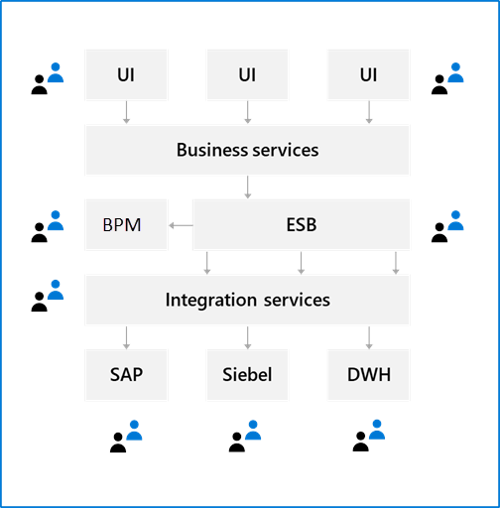
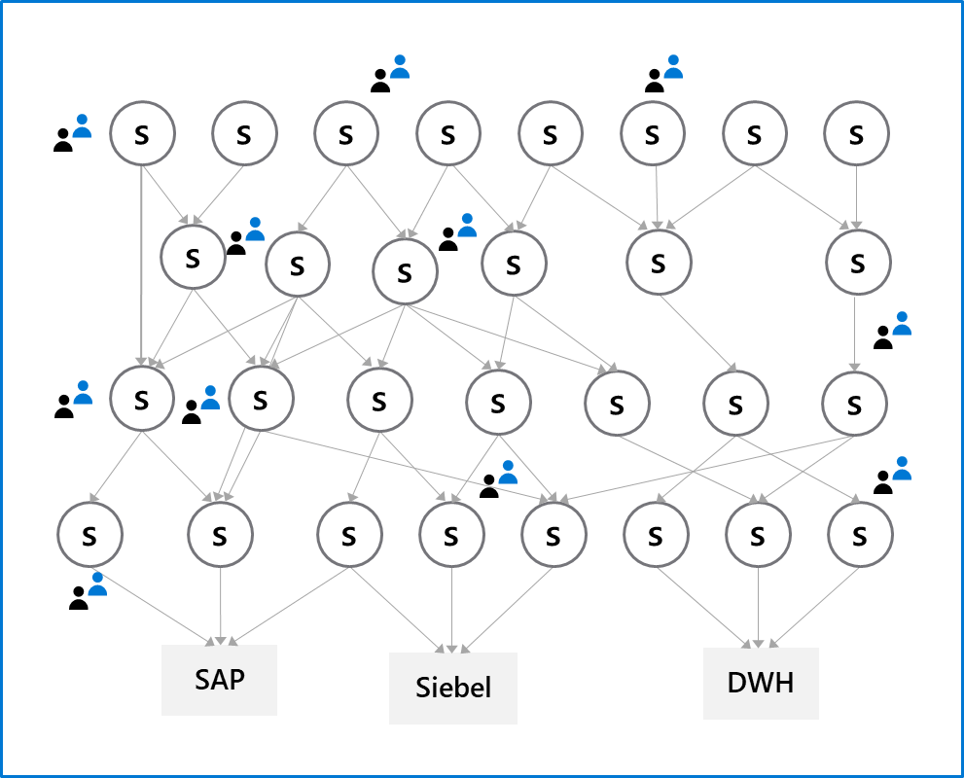
Microservices architecture

Slide 8
Classical deployment patterns
Dev
Test
Staging
Production

Slide 9
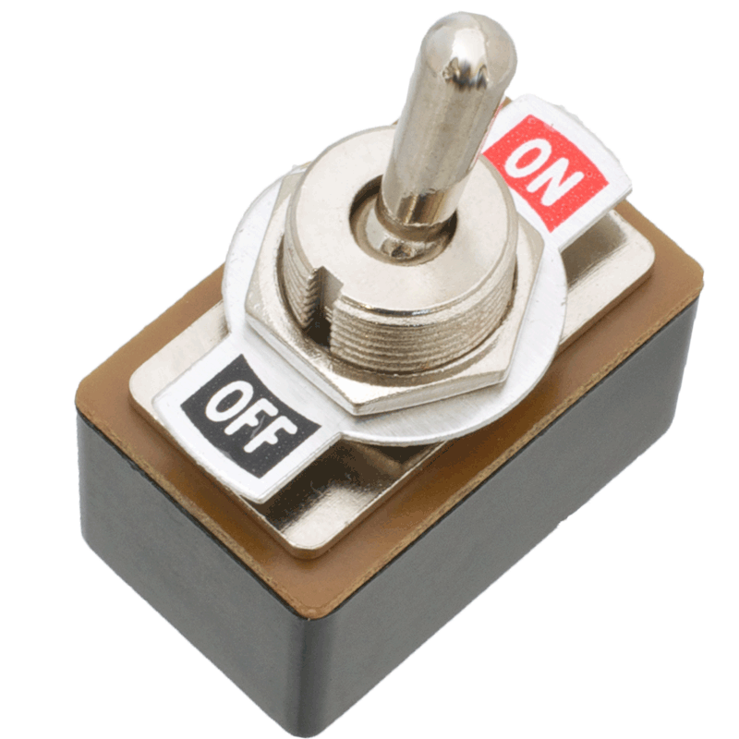
Modern deployment patterns
Blue-green deployments
Canary releases
Dark launching
A/B testing
Progressive exposure deployment/ring-based deployments
Feature toggles

Slide 10
Discussion: A critical look at your architecture
Are your architecture and the current state of your software ready for continuous delivery?
Topics you might want to consider are:
Is your software built as one big monolith or is it divided into multiple components?
Can you deliver parts of your application separately?
Can you guarantee the quality of your software when deploying multiple times a week?
How do you test your software?
Do you run one or multiple versions of your software?
Can you run multiple versions of your software side-by-side?
What do need to improve to implement continuous delivery?

Slide 11
Lesson 03: Implement blue-green deployment

Slide 12
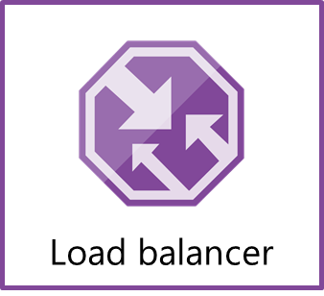
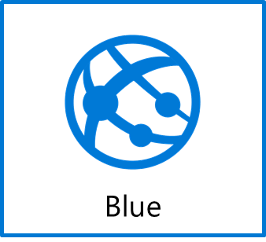

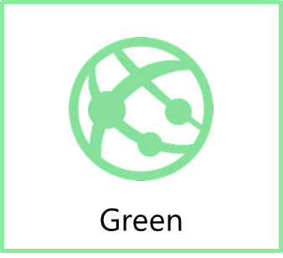
Blue-green deployment
www.production.com
Swap
www.temp.production.com

Slide 13
Deployment slots
What is it?
A way to set up multiple environments and swap between environments
Why do you need it?
When you want to deploy with zero downtime
When you need to test in production
When you want easy rollback

Slide 14
Demonstration: Set up a blue–green deployment
DEMO
Notes:
Take a moment to complete the demonstration, as defined in the student manual.

Slide 15
Lesson 04: Feature toggles

Slide 16
Introduction to feature toggles
What is it?
Mechanism to separate feature deployment from feature exposure
A.k.a. feature flippers, feature flags, feature switch, conditional feature, etc.
Why do you need it?
It enables you to give control back to the business on when to release the feature
Enables A/B testing, canary releases and dark launching
It provides an alternative to keeping multiple branches in version control
Enables change without redeployment

Slide 17
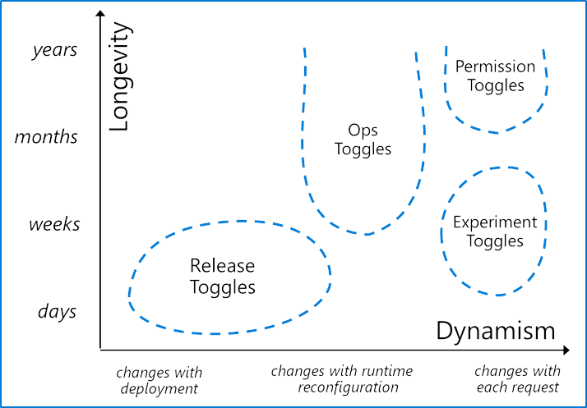
Feature toggle maintenance
Feature toggles need to be maintained
Remove them when you can
It is technical debt if you keep them around
Source: http://martinfowler.com/articles/feature-toggles.html

Slide 18

Lesson 05: Canary releases

Slide 19

Canary releases
What is it?
Releasing a feature to a limited subset of end users
When you want to gradually roll out a feature to ensure success
How to implement it
Use a combination of feature toggles, traffic routing and deployment slots
Route traffic % to a deployment slot with the new feature enabled
Target specific user segment (via feature toggles)

Slide 20
Traffic manager
What is it?
Traffic manager provides the ability to control how requests from web clients are distributed to apps in Azure App Service. Within an app service, it routes traffic between deployment slots
Why do you need it?
It enables failover and load distribution capabilities
It enables you to deploy to a slot and then slowly move traffic over to the other slot
What does it offer?
It provides several options for how to distribute traffic, all based on availability

Slide 21
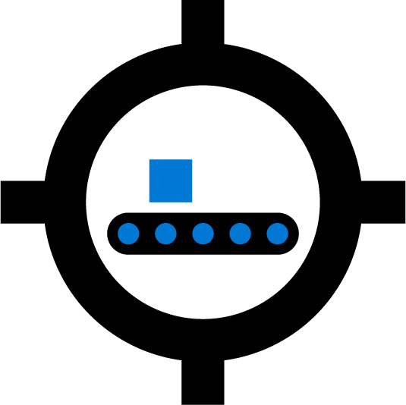
Lesson 06: Dark launching

Slide 22
Dark launching
Like canary releases, but the aim is to assess response of users to new features
Testing of the back end is not the primary aim
Users are often not aware they are being used as guinea pigs for the new feature

Slide 23
Lesson 07: A/B testing

Slide 24
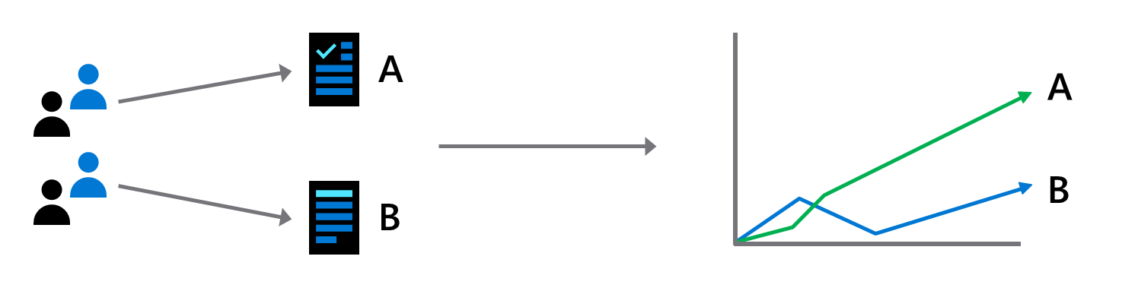
A/B testing
A/B testing is an experiment where two or more variants are shown to users at random, and statistical analysis is used to determine which variation performs better for a given conversion goal

Slide 25

Lesson 08: Progressive exposure deployment

Slide 26
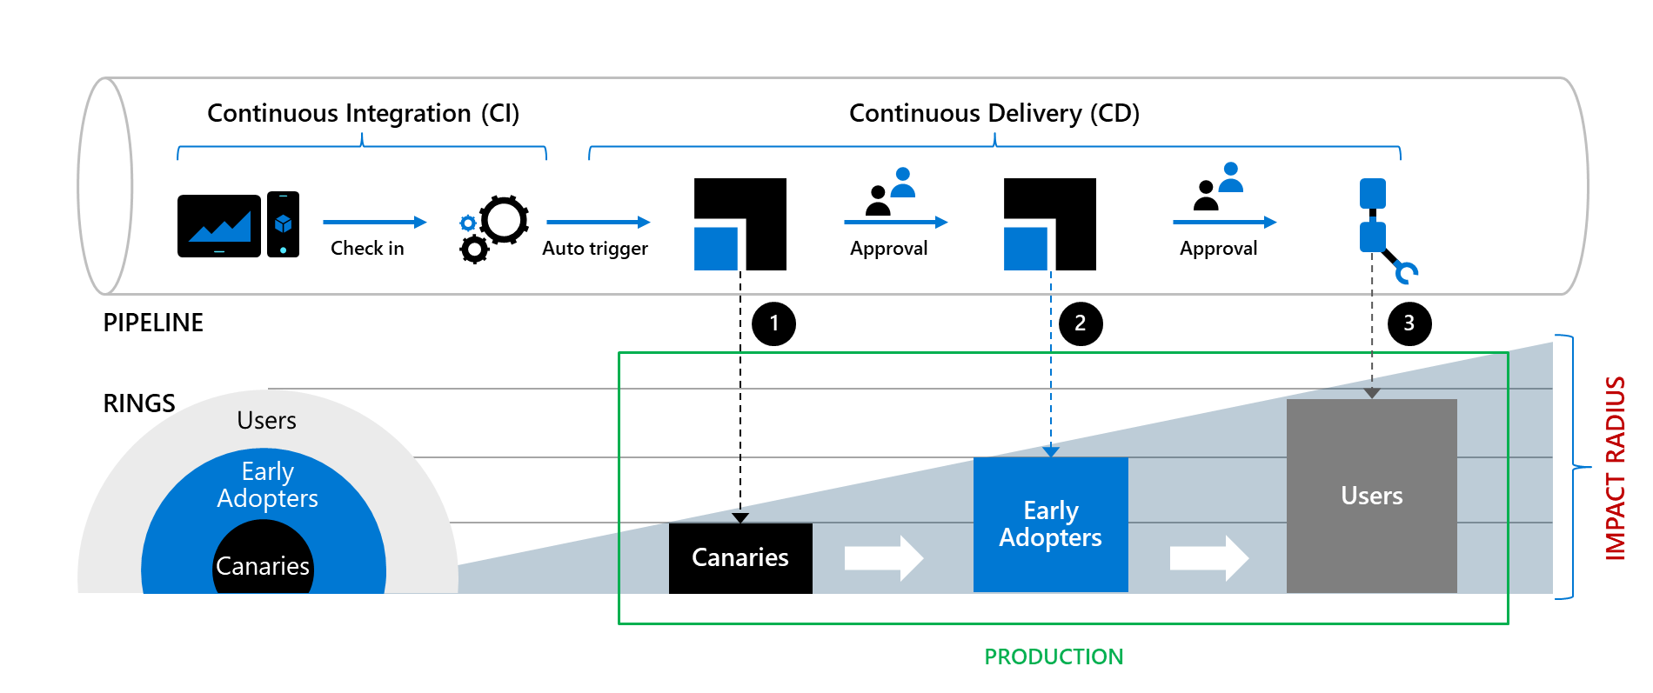
CI/CD with deployment rings

Slide 27
Demonstration: Ring-based deployment
DEMO
Notes:
Take a moment to complete the demonstration, as defined in the student manual.

Slide 28
Lesson 09: Lab

Slide 29
Feature flag management with LaunchDarkly and Azure DevOps
Lab overview:
In this lab, you will create and configure wiki in an Azure DevOps, including managing markdown content and creating a Mermaid diagram.
Objectives:
Create feature flags in LaunchDarkly
Integrate LaunchDarkly with Web applications
Automatically roll-out LaunchDarkly feature flags as part of Azure DevOps release pipelines
Duration:
Notes:
The labs are updated on a regular basis. For the latest information please visit:
https://microsoftlearning.github.io/AZ400-DesigningandImplementingMicrosoftDevOpsSolutions/

Slide 30
Lesson 10: Module review and takeaways

Slide 31
What did you learn?
Describe deployment patterns
Implement blue-green deployment
Implement canary release
Implement progressive exposure deployment

Slide 32
Module review questions
1
What is the easiest way to create a staging environment for an Azure WebApp?
2
What Azure-based tool can you use to divert a percentage of your web traffic to a newer version of an Azure website?
3
What characteristics make users suitable for working with canary deployments?
4
What is a potential disadvantage of using canary deployments?
5
Apart from the traffic routing method, what else does Azure Traffic Manager consider when making routing decisions?
Notes:
Q1 Answer: Create a deployment slot
Q2 Answer: Azure Traffic Manager
Q3 Answer: High tolerance for issues; Like working with bleeding-edge code.
Q4 Answer: Needing to look after multiple versions of code at the same time. Or, the users might not be the right ones to test changes in the particular deployment.
Q5 Answer: Availability of the end point. (It includes built-in endpoint monitoring and automatic endpoint failover)

