Slide 1
AZ-400.00 Module 13: Managing Infrastructure and Configuration using Azure Tools

Slide 2
Lesson 01: Module overview

Slide 3
Module overview
Lesson 1: Module Overview
Lesson 5: Azure Automation with DevOps
Lesson 2: Infrastructure as code and configuration management
Lesson 6: Desired State Configuration (DSC)
Lesson 3: Create Azure resources using ARM templates
Lesson 7: Lab
Lesson 4: Create Azure resources by using Azure CLI
Lesson 8: Module review and takeaways

Slide 4
Learning objectives
After completing this module, students will be able to:
Apply infrastructure and configuration as code principles
Deploy and manage infrastructure using Microsoft automation technologies such as ARM templates, Azure CLI, DSC and Azure Automation

Slide 5
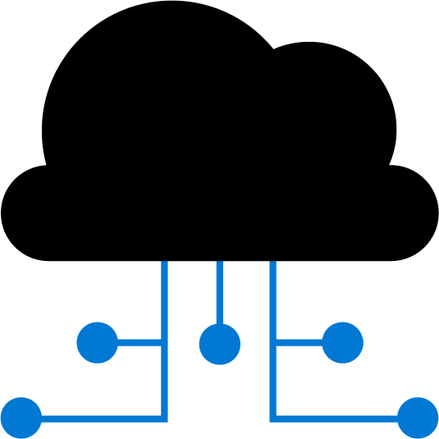
Lesson 02: Infrastructure as code and configuration management

Slide 6
Environment deployment
Manual deployment:
Snowflake servers
Deployment steps vary by environment
More verification steps and more elaborate manual processes
Increased documentation to account for differences
Deployment on weekends to allow time to recover from errors
Slower release cadence to minimize pain and long weekends
Infrastructure as code:
Consistent servers between environments
Environments created or scaled easily
Fully automate creation and updates of environments
Transition to immutable infrastructure
Use blue/green deployments
Treat servers as cattle, not pets
Notes:
Could highlight two items to ensure students understand the meaning:
Immutable means that the service is not updated. If a change is needed to an environment, a new one is deployed and the old one taken down.
blue/green deployments. This is a release methodology to minimize downtime, where two identical environments exist, one is live and the other is not. Updates are applied to the server that is not live, and when testing is verified and complete, it is switched to become the live environment and the previous live environment is no longer the live environment i.e. they are swapped. It can also be referred to as A/B deployment.
Common scenario for Infrastructure as Code: Server failure
Difficulty of reproducing steps for setting up a new machine from memory or disparate sources
Potential for human error when initializing machines
Severe implications if a machine crashes and must be immediately replaced
Solution: treat environments and infrastructure like code
Deployed from a single consistent definition
This is termed Infrastructure as Code
Maintain a consistent environment between development and production

Slide 7
Environment configuration
Manual configuration:
Configuration bugs difficult to Identify
Error prone
More verification steps and more elaborate manual processes
Increased documentation
Deployment on weekends to allow time to recover from errors
Slower release cadence to minimize requirement for long weekends
Configuration as code:
Bugs easily reproducible
Consistent configuration
Increase deployment cadence to reduce amount of incremental change
Treat environment and configuration as executable documentation
Notes:
Could discuss definitions and understanding of Configuration Management such as:
Automated management of configuration via scripts
Scripts define the configuration of an application, and the environment and infrastructure required to support it
Lighter-weight executable configurations
Enable the scripting and automation of environment configuration
Infrastructure as Code can describe both provisioning and configuration of environments
This model scales better across multiple servers than a manual deployment would

Slide 8
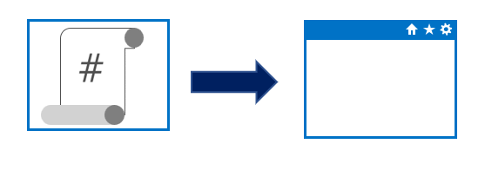
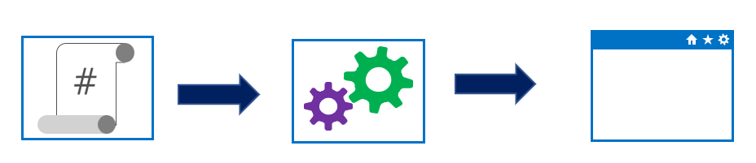
Imperative versus declarative configuration
Approaches to implementing infrastructure and configuration as code
Declarative:
Functional
Defines what the final state should be
Imperative:
Procedural
Defines how to achieve that final state
Notes:
Could mention that Imperative can also be known or called as procedural. And Declarative can sometimes be referred to as functional.
Declarative abstracts away the methodology of how a state is achieved.
A declarative approach would generally be the preferred option where ease of use is the main goal. Azure Resource Manager template files are an example of a declarative automation approach.
An imperative approach may have some advantages where there are complex scenarios where changes in the environment take place relatively frequently, which need to be accounted for in your code.
There is no absolute on which is the best approach to take, and individual tools may be able to be used in either declarative or imperative forms. The best approach for you to take will depend on your particular needs

Slide 9
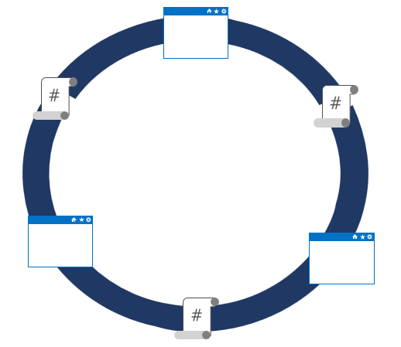
Idempotent configuration
Idempotence – definition:
Mathematical term used in the context of infrastructure and configuration as code
Ability to apply one or more operations against a resource, resulting in the same outcome
To attain idempotence:
Automatically configure and reconfigure an existing set of resources, or
Discard existing resources and spin up a fresh environment
Notes:
Idempotence – mathematical term used in the context of infrastructure and configuration as code, referring to the ability to apply one or more operations against a resource, resulting in the same outcome.
For more information about idempotence in general and in the context of Azure, see - https://www.wintellect.com/idempotency-for-windows-azure-message-queues/

Slide 10
Lesson 03: Create Azure resources using ARM templates

Slide 11
Why use ARM templates?
Make deployments faster and more repeatable
Improve consistency by providing a common language
Enable you to deploy multiple resources in the correct order by mapping out resource dependencies
Reduce manual, error-prone tasks
Templates can be linked together to provide a modular solution (might build on Quickstart Templates)
Notes:
Can discuss some of the benefits of using ARM templates when deploying and configuring resources in Azure.

Slide 12
Template components
JSON data stored as an object in text
Collection of key-value pairs
Templates can contain the following sections:
Parameters
Variables
Functions
Resources
Outputs
Notes:
Go over the examples provided in the student content of each different section in an ARM template.
JSON allows us to express data stored as an object (such as a virtual machine) in text. A JSON document is essentially a collection of key-value pairs.

Slide 13
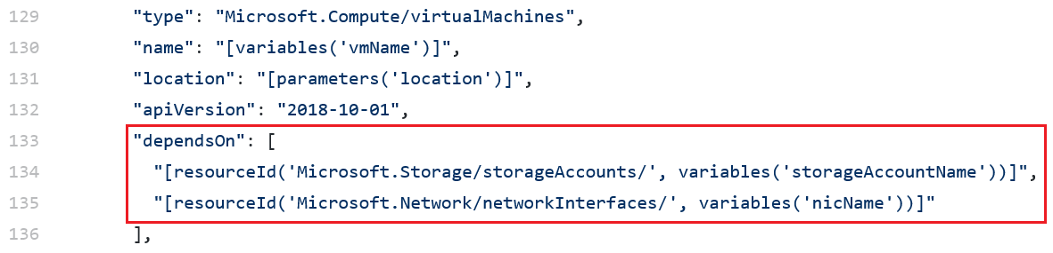
Manage dependencies
Some resources will depend on other resources before you can deploy them
Define this relationship by marking the dependency with the dependsOn element
Notes:
You can define this relationship by marking one resource as dependent on the other resource. You define a dependency with the dependsOn element. You can also use the reference function.
Mention troubleshooting circular reference problems, by either removing a dependency or moving a dependency into a child resource that is deployed after the resources that contained the problem dependency.

Slide 14
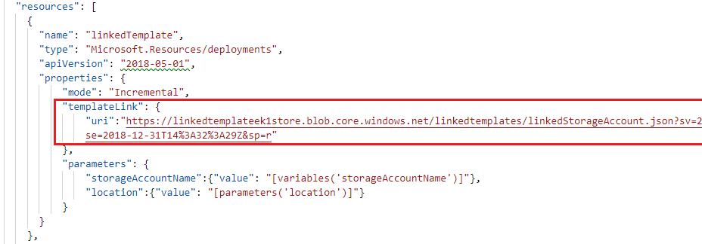
Modularize templates
Best practice: Modularize templates into individual components:
Use linked templates to break the solution into individual pieces
Reuse those elements across different deployments
Notes:
Also discuss using nested templates with the template property and syntax. You can refer students to the examples in the content.
Mention that while there are three deployment options available that incremental mode is the default mode and it doesn’t remove or modify any resources not defined in the template.
Mention that it’s a best practice to use one resource group per deployment.
Also discuss securing an external template by adding the template to a private storage account and providing a SAS token to enable access during deployment.

Slide 15
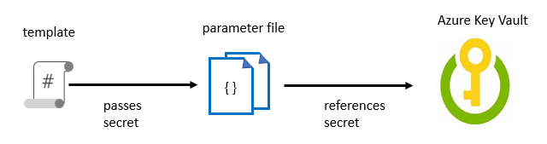
Managing secrets in templates
When passing a secure value (e.g., a password) as a parameter during deployment:
Create a key vault and secret using Azure CLI or PowerShell
Enable Azure Resource Manager access for template deployment
Reference the key pair in the parameter file, not the template
Enable access to the secret. Owner and Contributor roles grant access
Deploy the template and pass in the parameter file
Notes:
For more information about how to use Azure Key Vault to pass secure parameter value during deployment, see: https://docs.microsoft.com/en-us/azure/azure-resource-manager/resource-manager-keyvault-parameter
There also are details available on this page on how to reference a secret with a dynamic ID.
Discuss the example in the student content where a template is used to deploy a SQL database with an admin password. Outline the process of creating the key vault and secret and enabling access to the secret via permissions. Point out that the key vault ID is referenced in the parameter file, not the template, with the actual value never being exposed.
Note: we have not yet defined Azure CLI in the course, so you may need to tell students that it is a command line scripting interface for deployment and configuration of resources in Azure.

Slide 16

Lesson 04: Create Azure resources using Azure CLI

Slide 17
What is Azure CLI?
Command-line program to connect to Azure (Azure Cloud Shell, PowerShell, or Bash)
Execute administrative commands on Azure resources through a terminal, command-line prompt, or script, instead of a web browser:
For example, to restart a VM use the command:
az vm restart -g MyResourceGroup -n MyVm
Can be installed on Linux, macOS, or Windows computers, and added as a module to PowerShell
Can be used interactively or scripted:
Interactive: Issue commands directly at the shell prompt
Scripted: Assemble the CLI commands into a shell script and then execute the script
Notes:
The Azure CLI is a command-line program to connect to Azure and execute administrative commands on Azure resources. It runs on Linux, macOS, and Windows and allows administrators and developers to execute their commands through a terminal or command-line prompt (or script!) instead of a web browser.
Mention the cross-platform command-line tools support for managing Azure resources, as well as the ability to access the CLI from the Cloud Shell.

Slide 18
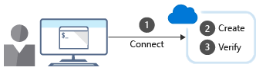
Working with Azure CLI
Commands in the CLI are structured in groups and subgroups:
Use az find to find commands you need az find blob
Use the help argument to get more detail about the command az storage blob --help
Creating a new Azure resource typically involves the following process:
Notes:
Discuss how CLI is organized into groups and subgroups.
Explain how to use the find and - -help arguments to locate commands and their syntax. Use the examples provided in the content to talk about creating a resource group using group create, and viewing resource details using the list sub-command.
Point out the difference between using the shell and PowerShell when running CLI commands in scripts.

Slide 19
Demonstration: Run templates using Azure CLI
Process to deploy and verify a sample Azure deployment template with custom script extension using Azure CLI
1
Create a resource group to deploy your resources to
2
Run curl to download the GitHub template
3
Validate the template
4
Deploy the resource
5
Obtain the IP address
6
Run curl to access your web server and verify the successful deployment and running of the custom script extension
Always remember to delete any resources you deployed when no longer needed to avoid incurring additional costs on them
Notes:
This topic is best presented by either running the template from the Cloud Shell as a demonstration or walking through the syntax. The steps in the process are listed on the slide as a high-level organizer.

Slide 20
Lesson 05: Azure Automation with DevOps

Slide 21
What is Azure Automation?
An Automation service integrated with Microsoft Azure for automating and simplifying the creation, deployment, monitoring and maintenance of Azure resources and resources external to Azure
Azure Automation Capabilities include:
Manage Shared resources
State configuration
Integration with GitHub, Azure DevOps Git/TFVC
Update management
Can automate Windows or Linux environments
Can apply to any system that exposes an API over internet protocols

Slide 22
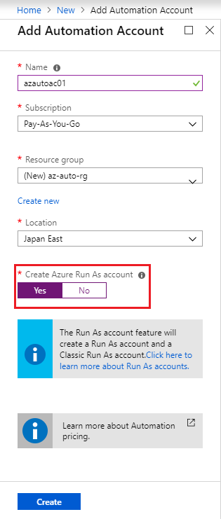
Automation accounts
To use Azure Automation you must create an Automation account
Automation account acts as a container in which you store, manage and use automation artifacts
Provides a way to separate your environments or further organize your Automation workflows and resources.
Requires subscription-owner level access as provides access to all Azure resources via an API
Need at least one automation account but should have multiple for access control
Run As account:
Creates a service principal in Azure AD which allows access to Azure resources when running automation
Notes:
Could create Azure Automation accounts for dev, test, production, security, or other elements in your pipeline for more granular auditing, cost analysis and general management, as well as increased security.
When you create a Run As account, it creates a new service principal user in Azure Active Directory and assigns the Contributor role to this user at the subscription level

Slide 23
What is a runbook?
A runbook is a set of tasks that perform some automated process in Azure Automation
Runbooks serve as repositories for your custom scripts and workflows
Can create your own or import and modify from community via Runbook Gallery
Runbook Types available:
Graphical runbook
PowerShell runbooks
PowerShell Workflow runbooks
Python runbooks
Notes:
They also typically reference Automation shared resources such as credentials, variables, connections, and certificates.
Runbooks can contain other runbooks, thereby allowing you to build more complex workflows. You can invoke and run runbooks either on demand, or according to a schedule by leveraging Automation Schedule assets
All the runbooks from Script Center in the Runbook gallery have been moved to Github. Note : Runbooks from Powershell Gallery will remain as-is without any changes.
Link: https://github.com/MicrosoftDocs/azure-docs/blob/master/articles/automation/automation-runbook-gallery.md

Slide 24
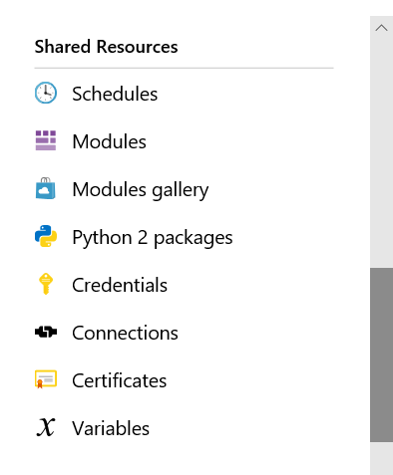
Automation shared resources
Azure Automation contains shared resources that are globally associated available to be used in, or with a runbook
Currently Eight Categories:
Schedules
Modules
Modules gallery
Python 2 packages
Credentials
Connections
Certificates
Variables
Notes:
As a best practice, always try to create global assets so they can be used across your runbooks. This will save time and reduce the number of manual edits within individual runbooks.

Slide 25
Runbook gallery
Can import pre-existing runbooks from the runbook gallery at the Microsoft Script Center
Runbooks provided to help eliminate the time it takes to build custom solutions
Already been built by Microsoft and the Microsoft community
Can be used with or without modification
Can review the code or a visualization of the runbook code on the gallery as well as see source projects, rating, etc.
Considerations:
Python runbooks are also available from the script center gallery. To find them, filter by language and select Python
You cannot use PowerShell to import directly from the Runbook Gallery
Notes:
Could go to Runbook gallery and show students the Microsoft Script Center at the URL below
https://gallery.technet.microsoft.com/scriptcenter/site/search?f[0].Type=RootCategory&f[0].Value=WindowsAzure&f[1].Type=SubCategory&f[1].Value=WindowsAzure_automation&f[1].Text=Automation

Slide 26
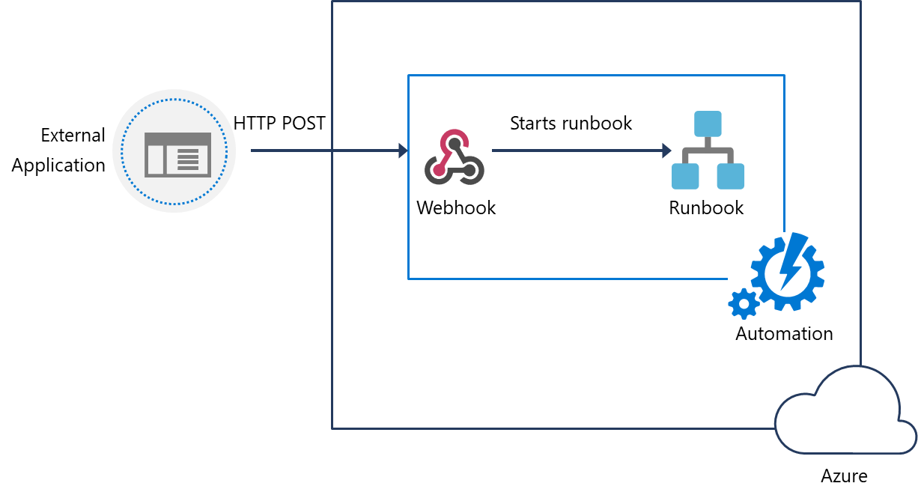
Webhooks
Automate the process of starting a runbook either by scheduling it, or by using a webhook.
Uses a HTTPS request to start a runbook
Reduces complexity and allows external services such as Azure DevOps, GitHub, or custom applications to use webhooks
Webhook Syntax: http://< Webhook Server >/token?=< Token Value >
Notes:
Note: When creating a webhook, make sure you make a copy of the webhook URL when creating it, and then store it in a safe place. After you create the webhook, you cannot retrieve the URL again. This is for security purposes
Also, when creating a webhook if the runbook has mandatory parameters, you will need to provide these mandatory parameters during webhook creation. You are not able to create the webhook unless values are provided.

Slide 27
Source control integration
Azure Automation supports source control integration
Azure Automation supports the following source Control options:
Easier collaboration
GitHub
Increased auditing and traceability
Roll back to earlier versions of your runbooks
Azure DevOps (Git)
Can push code from Azure Automation to source control or pull your runbooks from source control to Azure Automation
Azure DevOps (TFVC)
Notes:
Allows you to sync different branches in source control to your development, test, or production Azure Automation accounts.
Source control sync jobs run under the user's Automation Account and are billed at the same rate as other Automation jobs.

Slide 28
PowerShell workflows
Allows automation and orchestration of multi-environment tasks
Built on PowerShell and based on Windows Workflow Foundation
Characteristics:
Contain Activities – which are core a component of a workflow, are a specific task in a workflow
Tasks can be run in parallel
Can be long-running and repeated over and over (idempotent)
Be interrupted—can be stopped and restarted, suspended and resumed.
Continue after an unexpected interruption, such as a network outage or computer/server restart

Slide 29
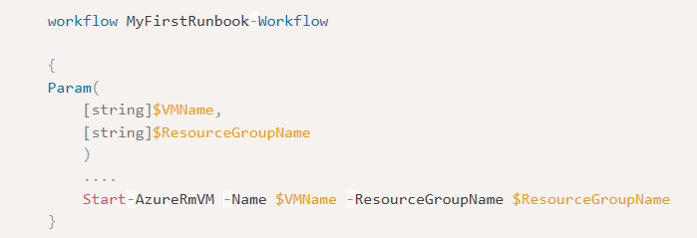
Creating a workflow
There are syntax differences between PowerShell scripts and Workflows
Requires keyword workflow to identify a workflow command
Add parameter values using keyword Param
Notes:
A benefit of using PowerShell ISE is that it automatically compiles your code and allows you to save the artifact. Because the syntactic differences between scripts and workflows are significant, a tool that knows both workflows and scripts will save you significant coding and testing time.

Slide 30
Demonstration: Create and run a workflow runbook
This demonstration will create a new PowerShell workflow runbook, test, publish and then run the runbook
You can complete this walkthrough task by completing the steps outlined below, or you can simply read through them, depending on your available time
Notes:
Students can just read through the tasks and get a feel for how it works or actually step through it like a lab task.
Another option could be to complete the walkthrough at the end of the module, and complete all or some of the walkthroughs in the module together at that stage, like an end of module or even end of course lab.

Slide 31
Checkpoint and parallel processing
Checkpoints:
If a workflow ends in an error or is suspended, it will start from its last checkpoint the next time it runs
You can set a checkpoint in a workflow with the Checkpoint-Workflow activity
A checkpoint is a snapshot of the current state of the workflow
Parallel Processing:
Use the Parallel keyword to create a script block with multiple commands that run concurrently
Tasks within this script block will be run concurrently or in parallel
Can use For Each with Parallel keyword for more granular control on parallelism
Notes:
Can talk through this example of Parallel task and run order.
Parallel
{
Start-AzureRmVM -Name $vm0 -ResourceGroupName $rg
Start-AzureRmVM -Name $vm1 -ResourceGroupName $rg
}
Start-AzureRmVM -Name $vm2 -ResourceGroupName $rg
vm0 and vm1 VMs will be started concurrently, and vm2 will only start after vm0 and vm1 have started.

Slide 32
Lesson 06: Desired State Configuration (DSC)

Slide 33
Configuration drift
Configuration drift:
Process whereby a set of resources change their state over time
Can occur from changes made by people, processes, or programs
Potential security risks introduced by configuration drift: Open ports that should have been closed
Inconsistent patching across environments
Software that doesn’t meet compliance requirements
Solutions that can help:
Windows PowerShell Desired State Configuration
Azure Policy
Many non-Microsoft solutions integrated with Azure

Slide 34
Desired State Configuration (DSC)
Ensures that an environment is maintained in a state that you specify (defined state), to eliminate configuration drift, and no deviation from that defined state
Components:
Configurations: Idempotent declarative PowerShell scripts
Resources: PowerShell scripts compiled into .mof format files to ensure state
Local Configuration Manager (LCM): Client engine to ensure configuration
Methods of Implementing DSC:
Push mode: A user actively pushed put a configuration to environments
Pull mode: Clients get state from remote pull service automatically. Remote service is provided by a pull server, which acts as a central control and manager for the configurations
Notes:
not deviate from that defined state

Slide 35
Azure Automation State Configuration
A cloud-based implementation of PowerShell DSC, available as part of Azure Automation
Characteristics:
Built-in pull server: Built-in pull server in Azure Automation eliminates the need to set up and maintain your own pull server
Management of all DSC artifacts: Manage all DSC configurations, resources, and target nodes in single instance in the Azure portal or PowerShell
Ability to Import Reporting Data directly into Azure Log Analytics: Can send this data to your Log Analytics workspace
Notes:
Could discuss how the general process for how Azure Automation State configuration works, which is as follows:
Create a PowerShell script with the configuration element
Upload the script to Azure Automation and compile the script into a MOF file. The file is transferred to the DSC pull server, which is provided as part of the Azure Automation service. (See Managed Object Format (MOF) file at https://docs.microsoft.com/en-us/windows/desktop/WmiSdk/managed-object-format--mof- for more information on MOF files.)
Define the nodes that will use the configuration, and then apply the configuration.

Slide 36
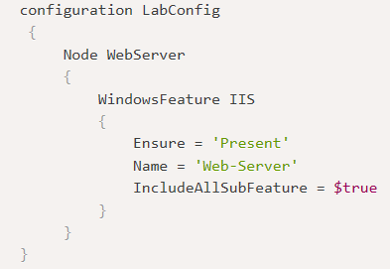
DSC configuration file
DSC configurations are PowerShell scripts that define a special type of function.
Config File Elements:
Configuration block: Name of the configuration
Node block: Define nodes being configured e.g. VMs and servers
Resource blocks: Defines the actual configuration state for the nodes
Notes:
Configuration block. The Configuration block is the outermost script block. In this case, the name of the configuration is LabConfig. Notice the curly brackets to define the block.
Node block. There can be one or more Node blocks. These define the nodes (computers and VMs) that you are configuring. In this example, the node targets a computer called WebServer. You could also call it localhost and use it locally on any server.
Resource blocks. There can be one or more resource blocks. This is where the configuration sets the properties for the resources. In this case, there is one resource block called WindowsFeature. Notice the parameters that are defined. (You can read more about resource blocks at https://docs.microsoft.com/en-us/powershell/dsc/resources/resources)
Within a Configuration block, you can do almost anything that you normally could in a PowerShell function. You can also create the configuration in any editor, such as PowerShell ISE, and then save the file as a PowerShell script with a .ps1 file type extension.

Slide 37
Demonstration: Import and compile
This walkthrough will create a configuration file, will then import that configuration to Azure Automation State configuration (DSC) and then compile the configuration file to create the MOF file
You can complete this walkthrough task by completing the steps outlined below, or you can simply read through them, depending on your available time
Notes:
To do this programmatically you could use the PowerShell Start-AzAutomationDscCompilationJob cmdlet.

Slide 38
Demonstration: Onboarding machines for management
This walkthrough will follow on from the last walkthrough and will on-board virtual machines for management
You can complete this walkthrough task by completing the steps outlined below, or you can simply read through them, depending on your available time
Notes:
Important: Before you can complete this task you need to have provisioned virtual machine to Azure to allow you to onboard them. i.e. you will need to have deployed your VMs to Azure prior to starting:
If you do not have virtual machines available in Azure you can walk through the steps instead.
Note: You can also onboard on-premises virtual machines or virtual machines running in another cloud provider, such as AWS. For more information on onboarding on-premises VMs and non Azure cloud provider VMs, review the page https://docs.microsoft.com/en-us/azure/automation/automation-dsc-onboarding#physicalvirtual-windows-machines-on-premises-or-in-a-cloud-other-than-azureaws

Slide 39
Hybrid management
Hybrid Runbook Worker feature of Azure Automation allows you to run runbooks that manage local resources in your private datacenter, on machines located in your datacenter.
On-Premises
Azure
Hybrid Runbook
Worker group
Azure Automation
Local Server
Runbooks
Windows Hybrid Runbook Worker
TCP 443
Azure Resources
TCP 443
Linux Hybrid Runbook Worker
Local Resources
. . .
Notes:
Hybrid Runbook Worker workflow and characteristics
The following list are characteristics of the Hybrid Runbook Worker workflow:
You can designate one or more computers in your datacenter to act as a Hybrid Runbook Worker, and then run runbooks from Azure Automation.
Each Hybrid Runbook Worker is a member of a Hybrid Runbook Worker group, which you specify when you install the agent.
A group can include a single agent, but you can install multiple agents in a group for high availability.
There are no inbound firewall requirements to support Hybrid Runbook Workers, only Transmission Control Protocol (TCP) 443 is required for outbound internet access.
The agent on the local computer initiates all communication with Azure Automation in the cloud.
When a runbook is started, Azure Automation creates an instruction that is retrieved by the agent. The agent then pulls down the runbook and any parameters prior to running it.

Slide 40
DSC and Linux Automation on Azure
The following Linux operating system versions are currently supported by both PowerShell DSC and Azure Automation DSC:
CentOS 5, 6, and 7 (x86/x64)
Debian GNU/Linux 6, 7 and 8 (x86/x64)
Oracle Linux 5, 6 and 7 (x86/x64)
Red Hat Enterprise Linux Server 5, 6 and 7 (x86/x64)
SUSE Linux Enterprise Server 10, 11 and 12 (x86/x64)
Ubuntu Server 12.04 LTS, 14.04 LTS, 16.04 LTS, 18.04 (x86/x64)

Slide 41
Lesson 07: Lab

Slide 42
Deployments using Azure Resource Manager templates
Lab overview:
In this lab, you will create an Azure Resource Manager template and modularize it by using a linked template. You will then modify the main deployment template to call the linked template and updated dependencies, and finally deploy the templates to Azure.
Objectives:
Create Resource Manager template
Create a Linked template for storage resources
Upload Linked Template to Azure Blob Storage and generate SAS token
Modify the main template to call Linked template
Modify main template to update dependencies
Deploy resources to Azure using linked templates
Duration:
Notes:
The labs are updated on a regular basis. For the latest information please visit:
https://microsoftlearning.github.io/AZ400-DesigningandImplementingMicrosoftDevOpsSolutions/

Slide 43
Lesson 8: Module review and takeaways

Slide 44
What did you learn?
Apply infrastructure and configuration as code principles
Deploy and manage infrastructure using Microsoft automation technologies such as ARM templates, Azure CLI, DSC and Azure Automation

Slide 45
Module review questions
1
What benefits can you achieve by modularizing your infrastructure and configuration resources?
2
Which method of approach for implementing Infrastructure as Code states what the final state of an environment should be without defining how it should be achieved?
3
Which term defines the ability to apply one or more operations against a resource, resulting in the same outcome every time?
4
Which term is the process whereby a set of resources change their state over time from their original state in which they were deployed?
5
Which Resource Manager deployment mode only deploys whatever is defined in the template, and does not remove or modify any other resources not defined in the template?
Notes:
Q1 Answer: Easy to re-use across different environments, Easier to manage and maintain your code, Easier to troubleshoot, Easier to extend and add to your existing infrastructure definitions
Q2 Answer: Declarative
Declarative is the correct answer. The declarative approach states what the final state should be. When run, the script or definition will initialize or configure the machine to have the finished state that was declared, without defining how that final state should be achieved.
All other answers are incorrect. Scripted is not a methodology, and in the imperative approach, the script states the how for the final state of the machine by executing through the steps to get to the finished state. It defines what the final state needs to be, but also includes how to achieve that final state. Object-oriented is a coding methodology but does include methodologies for how states and outcomes are to be achieved.
Q3 Answer: Idempotency is the correct answer. It is a mathematical term that can be used in the context of Infrastructure as Code and Configuration as Code, as the ability to apply one or more operation against a resource, resulting in the same outcome.
Q4 Answer: configuration Drift. Configuration drift is the correct answer. It is the process whereby a set of resources change their state over time from the original state in which they were deployed.
Q5 Answer: Incremental is the correct answer.

