Slide 1
AZ-400.00 Module 16: Creating and Managing Kubernetes Service Infrastructure

Slide 2
Lesson 01: Module overview

Slide 3
Module overview
Lesson 1: Module overview
Lesson 2: Azure Kubernetes Service (AKS)
Lesson 3: Kubernetes tooling
Lesson 4: Integrating AKS with pipelines
Lesson 5: Lab
Lesson 6: Module review and takeaways

Slide 4
Learning objectives
After completing this module, students will be able to:
Deploy and configure Managed Kubernetes Cluster

Slide 5

Lesson 02: Azure Kubernetes Service

Slide 6
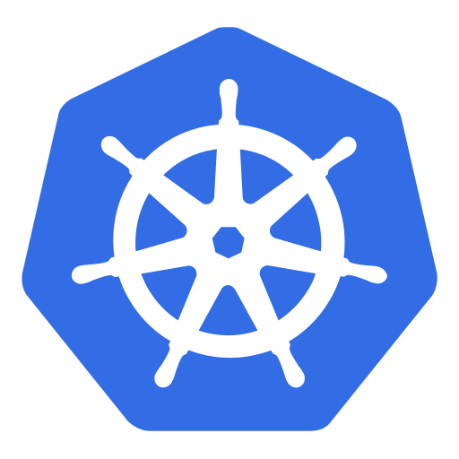
Kubernetes overview
Cluster orchestration technology (originated from Google)
Open-source system for automating deployment, scaling, and management of containerized applications
Kubernetes can be thought of as:
A container platform
A microservices platform
A portable cloud platform (and more)
Several other container cluster orchestration technologies are available, including:
Docker Swarm
Mesosphere DC/OS
Notes:
This is a brief overview of Kubernetes technology, its origins, concepts and purpose, before the specific coverage of Azure’s implementation of Kubernetes later in the lesson (why AKS is not included on this slide). This is a short topic by way of introduction.

Slide 7
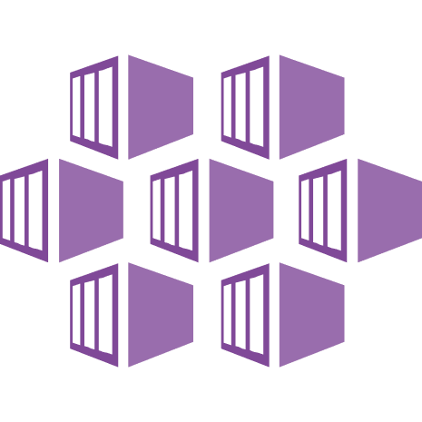
Azure Kubernetes Service
AKS is Microsoft’s implementation of Kubernetes:
Reduces the complexity of managing a Kubernetes Cluster by offloading it to Azure
Easier to deploy and manage container applications without container orchestration expertise
AKS manages the following aspects of a Kubernetes cluster:
Manages health monitoring and maintenance
Performs simple cluster scaling
Enables master nodes to be fully managed by Microsoft
You’re responsible only for managing the agent nodes
Master nodes are free, and you pay only for running agent nodes
Notes:
Like the previous slide, this is a short introduction to the Azure Kubernetes service. Subsequent topics go into the detail around the architecture, networking and deployment, etc.
Examples of the health monitoring and maintenance tasks that AKS performs include Kubernetes version upgrades and patching.

Slide 8
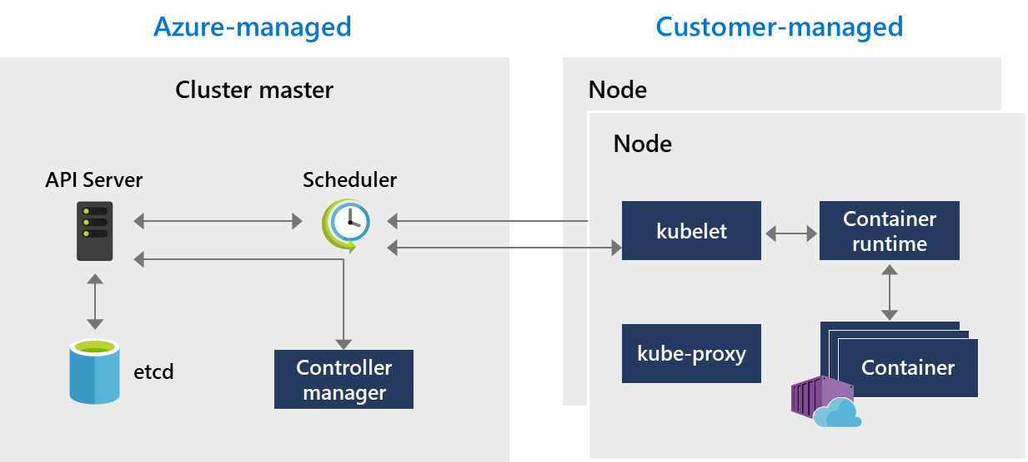
AKS architectural components
Kubernetes cluster is divided into two components:
Cluster master nodes – provide core Kubernetes services and orchestration of application workloads
Nodes that run your application workloads
Notes:
Use the information in the student content to more fully describe the overall architecture and individual components of an AKS cluster, as shown in the diagram.
Discuss the use of pods for running an application instance. The typical usage is a 1:1 mapping with the container but point out that there are more advanced scenarios with multiple containers scheduling pods on the same node, allowing for resource sharing.
A best practice is to define and include resource limits on pods to ensure, for example, a certain amount of memory and CPU is always available. Conversely, you can schedule a maximum amount that prevents an individual pod from consuming too much resources from the underlying node.

Slide 9
Kubernetes networking
Kubernetes uses Services to logically group a set of pods together to provide network connectivity
ClusterIP:
Creates an internal IP address for use within the AKS cluster
NodePort:
Creates a port mapping on the underlying node, so an application can be accessed directly with the node IP address and port
LoadBalancer:
Creates an Azure LB resource, configures an external IP address, and connects the pods to the load balancer backend pool
Customer traffic allowed through load balancing rules on the desired ports
Notes:
In this slide, refer students to the Services diagrams to illustrate the points on the slides.

Slide 10
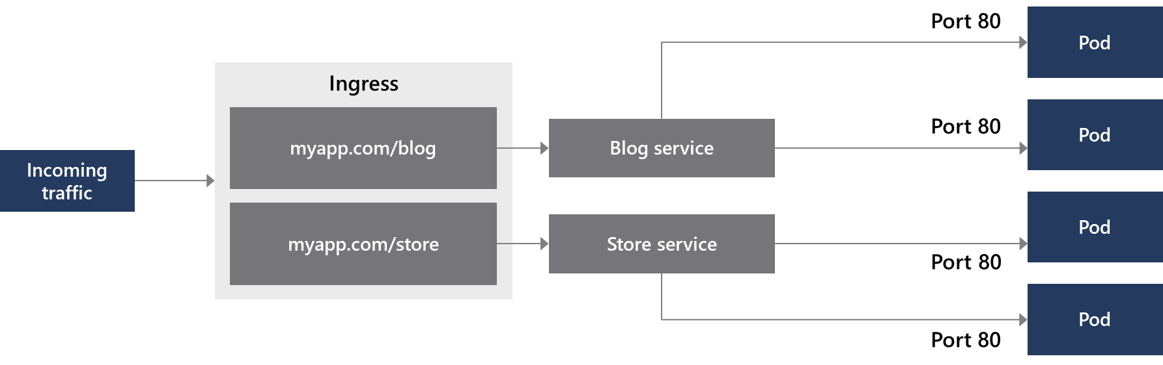
Ingress controllers
Ingress controllers work at Layer 7 so can use more intelligent rules to distribute traffic
For example, route HTTP traffic to different applications based on the inbound URL
Notes:
In this slide, continue the discussion on Service types, focusing on the Ingress controller to work optimally with Services of the Load Balancer type. Use the diagram to help explain the concept.
Creating a Load Balancer–type Service, means that an underlying Azure Load Balancer resource is created. However the Load Balancer only works at Layer 4 of the OSI model and being unaware of the actual applications, cannot make additional routing considerations. With Ingress controllers, because they work at the highest level of the OSI model, you can use more intelligent rules to distribute application traffic, such as routing HTTP traffic to different applications based on the inbound URL.

Slide 11
Deployment units
Pod – deployment unit representing a running process on the cluster:
Used by Kubernetes to package applications
Consists of one or more containers, Configuration, storage resources, and networking support
Can be grouped into services to create microservices
Described using YAML or JSON
Deploy an application to Kubernetes using the kubectl CLI:
Deploy and manage Kubernetes pods from Azure DevOps
Continuous delivery:
Build-and-release pipelines are run for every check-in on the Source repository

Slide 12
Demonstration: Deploying and connecting to an AKS cluster
Part 1: Deploy an AKS cluster using the Azure CLI
1
Open Azure Cloud Shell and choose the Bash environment
2
Create an Azure resource group and an AKS cluster
3
Using az aks get-credentials, connect to the Kubernetes cluster, and verify the connection status
4
Create a YAML file called azure-vote.yaml
5
Deploy the application using the kubectl command. It should result in the below output:
deployment "azure-vote-back" created service "azure-vote-back" created deployment "azure-vote-front" created service "azure-vote-front" created
Notes:
✔ You could have students do this walkthrough, but it may be easier to just demonstrate the procedure. That way if some students don’t already have a subscription, you avoid the issues associated with ensuring all students can meet the prerequisites to do the task.
This walkthrough shows how to deploy an AKS cluster using the Azure CLI. A multi-container application that includes a web front end and a Redis Cache instance is run in the cluster. You then see how to monitor the health of the cluster and pods that run your application
The slide lists the just the high-level steps for the walkthrough, you can use the code provided in the content.

Slide 13
Demonstration: Deploying and connecting to an AKS cluster
Part 2: Monitor the health of cluster and pods running in the application
6
When the application runs, a Kubernetes service exposes the application front end to the internet
7
Initially the EXTERNAL-IP for the azure-vote-front service is shown as pending
8
Eventually changes from pending to an actual public IP address
9
To view the application, open a web browser to the external IP address of your service
10
Monitor health and logs under Monitoring in the Azure portal
11
Examine container logs for the azure-vote-front pod
12
Delete resources when finished to avoid incurring charges
Notes:
✔ You could have students do this walkthrough, but it may be easier to just demonstrate the procedure. That way if some students don’t already have a subscription, you avoid the issues associated with ensuring all students can meet the prerequisites to do the task.
After initial deployment, focus on the monitoring and logging tasks for ascertaining health the of the AKS cluster in the Azure portal.
The slide lists the just the high-level steps for the walkthrough, you can use the code and steps provided in the content.

Slide 14
Continuous deployment
In Kubernetes, you can update a service with a rolling update
Existing traffic to a container is first drained, and the container replaced
Traffic is then rerouted to the container
Syntax for running a rolling update
The apply command works for an initial deployment or an update to an existing deployment
Kubernetes applies a rolling update when the name of the image for a service changes in the YAML file
The cluster will take care of updating the images without downtime (on the assumption the application container is built as stateless)
kubectl apply -f nameofyamlfile

Slide 15
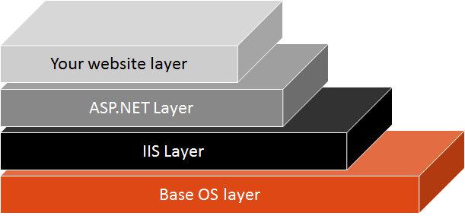
Updating images
Ensure you update images for your container applications regularly
A large part of a container image is the base OS layer
Updating an image’s base OS layer is usually a matter of getting the latest update layer
Create a new image for every change you make in your own code, and ensure that all layers receive regular patching
To patch an image’s OS layer, change the image version number (if using a Docker file to create the image)
Discussion question: What about using the latest tag?
Notes:
You can refer to the graphic in the content and discuss around that
Latest tag:
Don't be tempted to rely on the latest tag. To define repeatable custom images and deployments, you should always be explicit about the base image versions that you are using. Also, just because an image is tagged as the latest doesn't mean that it actually is the latest. The owner of the image needs to ensure this.

Slide 16
Lesson 03: Kubernetes tooling

Slide 17
kubectl
Command-line tool for running commands against Kubernetes clusters. Deploy applications, manage cluster resources.
Common Commands
annotate | Add/update annotations for resources
apply | Apply configuration changes
autoscale | Scale pods managed by a replication controller
certificate | Modify certificate resources
cluster-info | Display endpoint information about master and services
config | Modify kubeconfig files
cp | Copies files to/from containers
describe | Show detailed state about resources
exec | Execute a command against a container
label | Add/update labels for resources
logs | Print the logs for a container
run | Run an image on a cluster

Slide 18
Helm
1
Package manager for Kubernetes
2
Makes it easier to package, configure, and deploy applications and services
3
Command line tool: helm (user interface for Helm functionality)
4
Server component: tiller (ran on k8s cluster and accepted commands from helm – but removed from Helm 3 and later)
5
Helm packages are called charts (implemented as YAML)

Slide 19
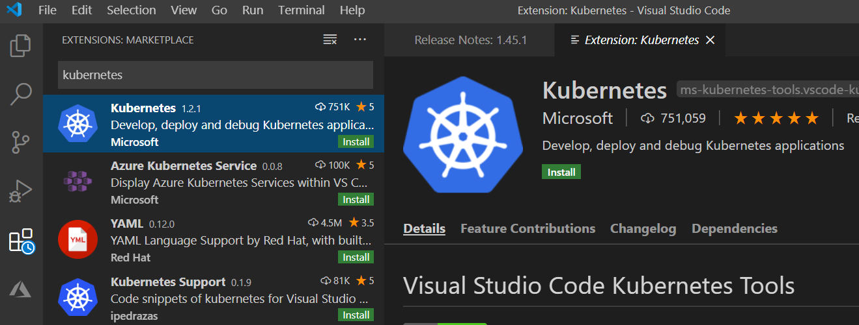
Kubernetes extension for Visual Studio Code
1
Requires existing installation of Docker and kubectl
2
Work with local minikube cluster or AKS cluster
3
Debug containers iteratively
4
Deploy to Azure
5
Helps develop k8s manifests and Helm charts

Slide 20
Lesson 04: Integrating AKS with pipelines

Slide 21
Integrating AKS with pipelines
1
Pipelines can deploy containers from images
2
AKS cluster needs permission to retrieve images from the container registry
3
Task: Create deployments and services in AKS
4
Task: Update image in AKS

Slide 22
Kubernetes and Azure Key Vault
Use Kubernetes and Azure Key Vault together to get the best security benefits:
Azure Key Vault Secret store
Kubernetes ConfigMaps
Kubernetes Secrets

Slide 23
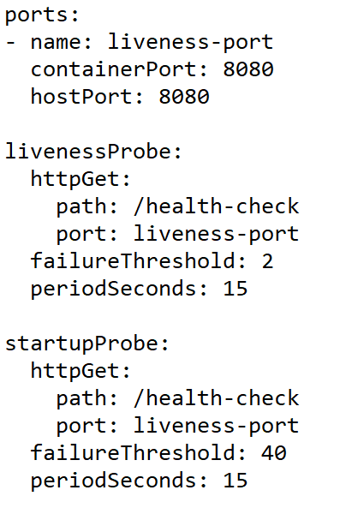
Readiness, startup and liveness probes
Check container health
Detect unresponsive containers (e.g. deadlocks)
Wait for containers to start up

Slide 24
Lesson 05: Lab

Slide 25
Deploying a multi-container application to Azure Kubernetes Services
Lab overview:
In this lab, you will use Azure DevOps to deploy a containerized ASP.NET Core web application MyHealthClinic (MHC) to an AKS cluster.
Objectives:
Create an Azure DevOps team project with a .NET
Core application using the Azure DevOps Demo Generator tool.
Use Azure CLI to create an Azure Container registry (ACR), an AKS cluster and an Azure SQL database
Configure containerized application and database deployment by using Azure DevOps
Use Azure DevOps pipelines to build to automatically deploy containerized applications
Duration:
Notes:
The labs are updated on a regular basis. For the latest information please visit:
https://microsoftlearning.github.io/AZ400-DesigningandImplementingMicrosoftDevOpsSolutions/

Slide 26
Lesson 06: Module review and takeaways

Slide 27
What did you learn?
Deploy and configure Managed Kubernetes Cluster

Slide 28
Module review questions
1
True or False: Azure Policy natively integrates with AKS, allowing you to enforce rules across multiple AKS clusters. Track, validate and configure nodes, pods and container images for compliance
2
Kubernetes CLI is called?
3
For workloads running in AKS Kubernetes Web Dashboard allows you to view _______________________ .
4
Pods can be described using which of the following languages? Select all that apply
Notes:
Q1 Answer: True
Q2 Answer: KUBECTL
Q3 Answer: Config Map & Secrets, Logs, Storage
Q4 Answer: JSON and YAML

