Slide 1
AZ-400.00 Module 18: Implementing System Feedback Mechanisms

Slide 2
Lesson 01: Module overview

Slide 3
Module overview
Lesson 1: Module overview
Lesson 6: Managing alerts
Lesson 2: Site reliability engineering
Lesson 7: Blameless retrospectives and a just culture
Lesson 3: Design practices to measure end-user satisfaction
Lesson 8: Lab
Lesson 4: Design processes to capture and analyze user feedback
Lesson 9: Module review and takeaways
Lesson 5: Design processes to automate application analytics

Slide 4
Learning objectives
After completing this module, students will be able to:
Define site reliability engineering
Design processes to measure end-user satisfaction and analyze user feedback
Design processes to automate application analytics
Manage alerts and reduce meaningless and non-actionable alerts
Carry out blameless retrospectives and create a just culture

Slide 5
Lesson 02: Site reliability engineering

Slide 6
What is site reliability engineering?
Site reliability engineering (SRE) empowers software developers to own the ongoing daily operation of their applications in production

Slide 7
Lesson 03: Design practices to measure end-user satisfaction

Slide 8
Capturing end-user satisfaction
1
Outline your goals and plan
2
Create a customer satisfaction survey (CSAT, CES, NPS)
3
Choose your survey’s trigger and timing
4
Analyze the survey data
5
Adjust and repeat

Slide 9
Capturing feedback in product
Benefits | Weaknesses
Context-sensitive feedback | Not enough detail
Always on | Always on
High response rates | Too much feedback
 | Limited future follow up

Slide 10
Feedback from product roadmap
Pros | Cons
Customers feel that they’re an active part of building your product roadmap | Likely biased towards your highest-intent customers
Builds a sense of community and heightened loyalty | Low volume
Provides a channel through which you can make users feel appreciated

Slide 11
Lesson 04: Design processes to capture and analyze user feedback

Slide 12
For every customer who bothers to complain, 20 other customers remain silent

Slide 13
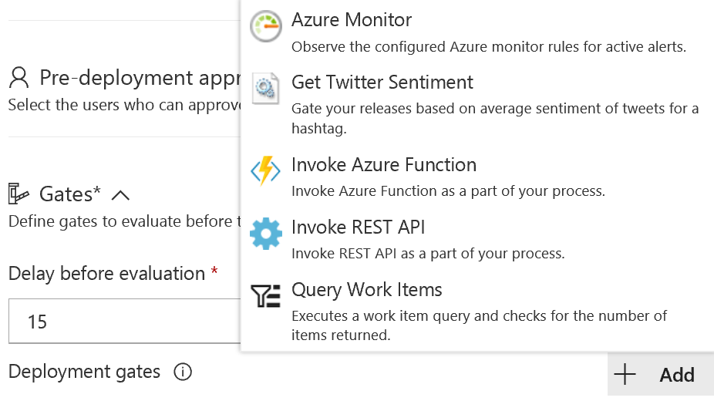
Twitter sentiment release gate

Slide 14
Demonstration: Deploy with release management green light capabilities
DEMO
Notes:
Take a moment to complete the demonstration, as defined in the student manual.

Slide 15
Lesson 05: Design processes to automate application analytics

Slide 16
Rapid responses and augmented search
1
In Agile teams, issues that "slip through the cracks" directly impact end-users
2
Speedy resolution required – even if root cause determined later
3
Large volume of infrastructure and application logs to search
4
Augmented search uses semantic processing, statistical models, and ML

Slide 17
Integrating telemetry
Benefits:
Provides detailed accurate insights on usage
Monitors an object while physically far removed from it
Challenges:
Do end users want it enabled?
Users might not be comfortable with being monitored

Slide 18
Recommending monitoring tools and technologies
Synthetic monitoring
Alert management
Deployment automation
Analytics

Slide 19
Lesson 06: Managing alerts

Slide 20
When would I get a notification?
Application Insights automatically analyzes the performance of your web application and can warn you about potential problems

Slide 21
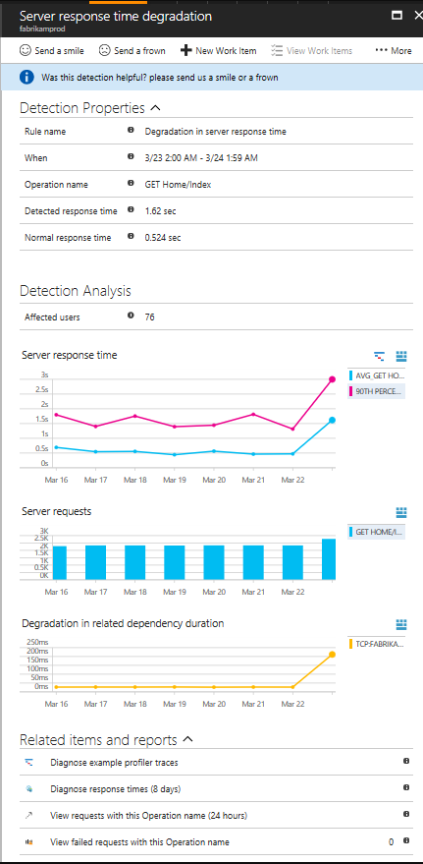
How do I fix it?
Triage (how many users/ops are affected?)
Scope (all traffic or some pages?)
Diagnose (often will suggest the issue)

Slide 22
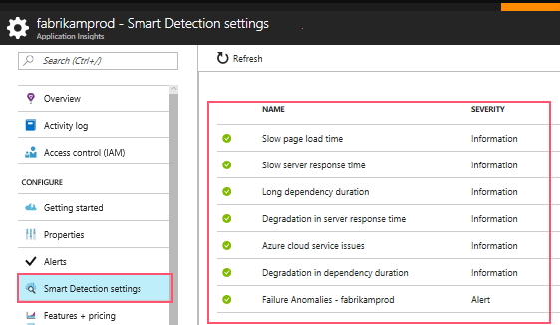
Smart detection notifications

Slide 23
How can I improve performance?
1
Triage
2
Diagnose slow page loads
3
Improve slow pages

Slide 24
Example: Server response time degradation
Response time compared to normal response time
Number of affected users
Average response time
Count of this operation requests on the day of detection and 7 days before
Correlation between degradation in this operation and degradations in related dependencies
Links to help diagnose the problem

Slide 25
Reducing meaningless and non-actionable alerts
Monitoring and alerting enables a system to tell us when it’s broken, or, potentially, what’s about to break
Alerts requesting immediate action should be urgent, important, actionable, and real

Slide 26
Lesson 07: Blameless retrospectives and a just culture

Slide 27
Discussion: Blameless retrospective
What does it mean to have a blameless retrospective?

Slide 28
Developing a just culture
When engineers feel safe to discuss mistakes, they are usually keen to help fix the issues
Encourage learning by using blameless post-mortems
Understand how an issue happened
Gain multiple perspectives
Enable and encourage mistake-makers
Work hard to eliminate hindsight bias

Slide 29
Lesson 08: Lab

Slide 30
Integration between Azure DevOps and Microsoft Teams
Lab overview:
In this lab, you will implement integration scenarios between Azure DevOps services and Microsoft Teams.
Objectives:
Integrate Microsoft Teams with Azure DevOps
Integrate Azure DevOps Kanban boards and Dashboards in Teams
Integrate Azure Pipelines with Microsoft Teams
Install the Azure Pipelines app in Microsoft Teams
Subscribe for Azure Pipelines notifications
Duration:
Notes:
The labs are updated on a regular basis. For the latest information please visit:
https://microsoftlearning.github.io/AZ400-DesigningandImplementingMicrosoftDevOpsSolutions/

Slide 31
Lesson 09: Module review and takeaways

Slide 32
What did you learn?
Define site reliability engineering
Design processes to measure end-user satisfaction and analyze user feedback
Design processes to automate application analytics
Manage alerts and reduce meaningless and non-actionable alerts
Carry out blameless retrospectives and create a just culture

Slide 33
Module review questions
1
What are some of the ways to measure end user satisfaction for your product?
2
True or False: Azure DevOps has a feature request board.
3
True or False: Application Insights analyses the traffic from your website against historic trends and sends you smart detection notifications on degradation.
Notes:
Q1 Answer: CSAT, CES, NPS
Q2 Answer: True
Q3 Answer: True

