Slide 1
AZ-400.00 Module 20: Validating Code Bases for Compliance

Slide 2
Lesson 01: Module overview

Slide 3
Module overview
Lesson 4: Integrating license and vulnerability scans
Lesson 1: Module overview
Lesson 2: Open-source software
Lesson 5: Lab
Lesson 3: Managing security and compliance policies
Lesson 6: Module review and takeaways

Slide 4
Learning objectives
After completing this module, students will be able to:
Describe the potential challenges with integrating open-source software
Inspect open-source software packages for security and license compliance
Manage organizational security and compliance policies
Integrate license and vulnerability scans into build and deployment pipelines
Configure build pipeline to access package security and license ratings

Slide 5
Lesson 02: Open-source software

Slide 6
How software is built
Software based 80% on components:
Internal teams
Commercial 3rd party
Open-source community
Almost all software nowadays uses open-source software in some way, shape, or form

Slide 7
What is open-source software?
Open-source software is a type of computer software in which source code is released under a license in which the copyright holder grants users the rights to study, change, and distribute the software to anyone and for any purpose
https://en.wikipedia.org/wiki/Open-source_software

Slide 8
Corporate concerns with open-source software components
Are of low quality:
This would impact maintainability, reliability, and performance of the overall solution
Have no active maintenance:
The code would not evolve over time or be alterable without making a copy of the source code, effectively forking away from the origin
Contain malicious code:
The entire system that includes and uses the code will be compromised. Potentially the entire company’s IT and infrastructure is affected
Have security vulnerabilities:
The security of a software system is as good as its weakest part. Using source code with vulnerabilities makes the entire system susceptible to attack by hackers and misuse
Have unfavorable licensing restrictions:
The effect of a license can affect the entire solution that uses the open-source software

Slide 9
Open-source licenses
According to the open-source definition of OpenSource.org a license should not:
Discriminate against persons or groups
Discriminate against fields of endeavor
Be specific to a product
Restrict other software

Slide 10
Common open-source licenses
Restrictive
ATTRIBUTION
BSD
MIT
Apache
DOWNSTREAM
MPL
EPL
MS-RL
COPYLEFT
GPL
LGPL
AGPL
Permissive

Slide 11
License implications and ratings
Using a package implies following license requirements:
The license type may have a high, medium or low impact on distributed software including it
License rating indicates impact of use of packages:
Compliancy
Intellectual property
Exclusive rights

Slide 12
Lesson 03: Managing security and compliance policies

Slide 13
Inspecting and validating code bases for compliance
There are many aspects to building and deploying secure applications
General knowledge problem
Code is created correctly and securely implements the required features, and we need to make sure that the features were designed with security in mind in the first place
Complies with the rules and regulations that it is required to meet

Slide 14
Planning to implement OWASP Secure Coding Practices
Start with secure coding practices
Open Web Application Security Project (OWASP) – A global charitable organization focused on improving the security of software
OWASP regularly publish a set of Secure Coding Practices
Notes:
See http://owasp.org

Slide 15
Inspecting and validating code bases for compliance
BinSkim is a static analysis tool that scans binary files
OWASP Zed Attack Proxy Scan is an open-source web app scanner for professional penetration testers
Notes:
For more information, you can see:
Fortify - https://marketplace.visualstudio.com/items?itemName=fortifyvsts.hpe-security-fortify-vsts
Checkmarx CxSAST - https://marketplace.visualstudio.com/items?itemName=checkmarx.cxsast
OWASP Zed Attack Proxy Scan - https://marketplace.visualstudio.com/items?itemName=kasunkodagoda.owasp-zap-scan
BinSkim - https://blogs.msdn.microsoft.com/secdevblog/2016/08/17/introducing-binskim/

Slide 16
Discussion: Security policy tooling
Azure DevOps can be integrated with a wide range of existing tooling that is used for checking security policy during builds
Which security policy tools do you currently use?
What do you like or don’t like about the tools?

Slide 17
Lesson 04: Integrating license and vulnerability scans

Slide 18
Implement continuous security validation
Coding
Build
QA & security
Production
$80/defect
$240/defect
$960/defect
$7,600/defect
Source: Ponemon Institute Research
Reduce cost by moving DevSecOps to the left
Use automated tooling and processes to identify problems

Slide 19
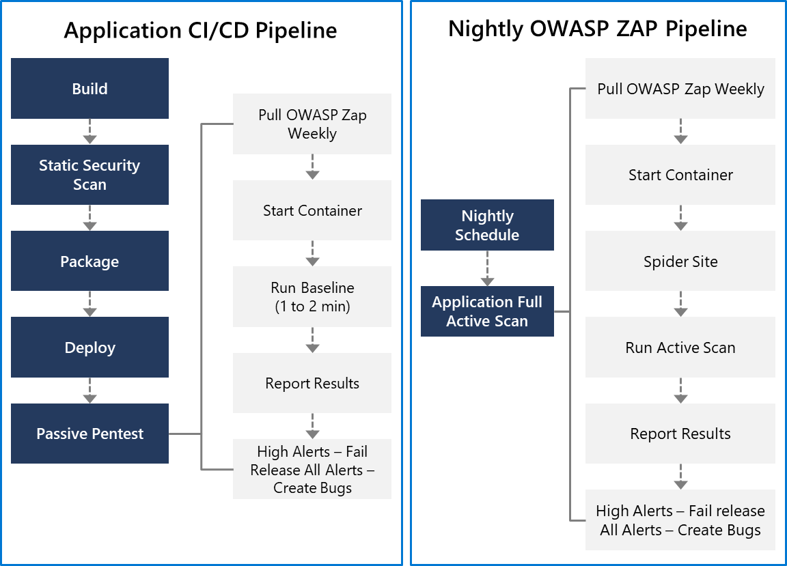
OWASP ZAP penetration testing
OWASP ZAP can be used for penetration testing
Testing can be active or passive
Conduct a quick baseline scan to identify vulnerabilities
Conduct nightly more intensive scans

Slide 20
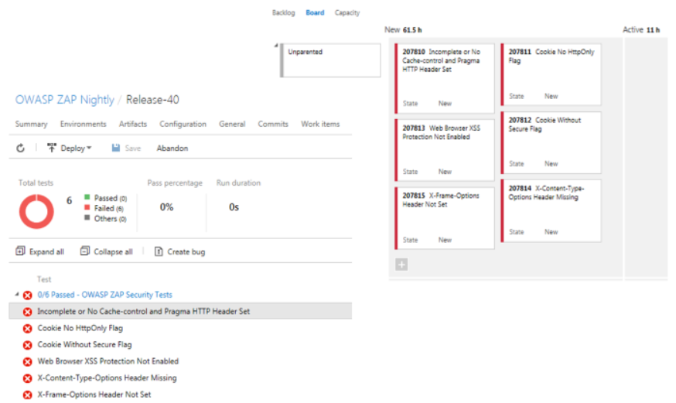
OWASP ZAP results and bugs
OWASP ZAP provides a report with results
and bugs
Use a holistic and layered approach to security

Slide 21
Tools for assessing package security and license rating
Approach 1: Scan centralized artifact repository
Approach 2: Tooling during build in pipeline
Tool | Type
Artifactory | Artifact repository
SonarQube | Static code analysis tool
White Source(Bolt) | Build scanning

Slide 22
SonarCloud
SonarQube:
- Open platform for managing code quality
- Joint investments with Microsoft
- Wide range of programming languages supported
Cloud-hosted version: SonarCloud

Slide 23
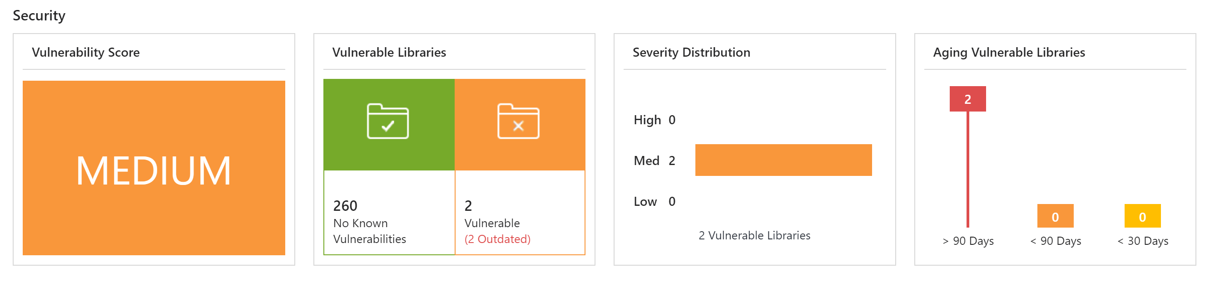
Interpret alerts from scanning tools
Report Contains:
Security vulnerabilities
License risks and compliancy
Outdated libraries
Aspects to keep in mind:
False positives
Security bug bar

Slide 24
CodeQL in GitHub
Action:
Steps:
Treats code like queryable data
Standard or custom analysis queries
Create a CodeQL database (based upon the code)
Run CodeQL queries against the database
Interpret the results
CodeQL CLI or CodeQL for Visual Studio Code

Slide 25
GitHub Dependabot alerts and security updates
Check for updates
Alerts
Automated pull requests
Review and triage

Slide 26
Lesson 05: Lab

Slide 27
Managing technical debt with SonarQube and Azure DevOps
Lab overview:
In this lab, you will learn how to setup SonarQube on Azure and integrate it with Azure DevOps.
Objectives:
Provision SonarQube server as an Azure Container Instance from the SonarQube Docker image
Set up a SonarQube project
Provision an Azure DevOps Project and configure CI pipeline to integrate with SonarQube
Analyze SonarQube reports
Duration:
Notes:
The labs are updated on a regular basis. For the latest information please visit:
https://microsoftlearning.github.io/AZ400-DesigningandImplementingMicrosoftDevOpsSolutions/

Slide 28
Lesson 06: Module review and takeaways

Slide 29
What did you learn ?
Describe the potential challenges with integrating open-source software
Inspect open-source software packages for security and license compliance to align with corporate standards
Manage organizational security and compliance policies
Integrate license and vulnerability scans into build and deployment pipelines
Configure build pipeline to access package security and license ratings

Slide 30
Module review questions:
1
What issues are often associated with the use of open-source libraries?
2
How can an open-source library cause licensing issues if it is free to download?
3
What is open-source software?
Notes:
Q1 Answer: Bugs, security vulnerabilities, and licensing issues
Q2 Answer: Each library has usage restrictions as part of the licensing. These restrictions might not be compatible with your intended application use.
Q3 Answer: A type of software where users of code are permitted to study, change, and distribute the software. The open-source license type can limit the actions (such as sale provisions) that can be taken.

