Slide 1
Inside Docker Client
Ravindra Kudache

Slide 2
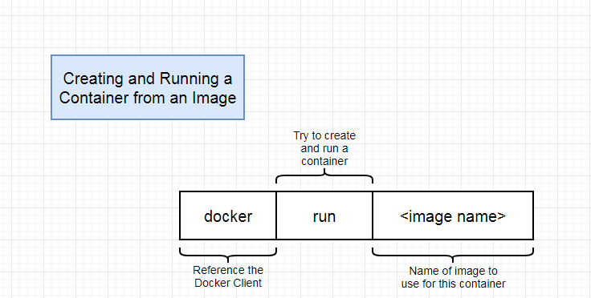
Docker Run in Details
Notes:
https://app.diagrams.net/#Hrkudache31%2Fk8s%2Fmaster%2Fk8s%2Fdiagrams%2F02%2Fdiagrams.xml

Slide 3
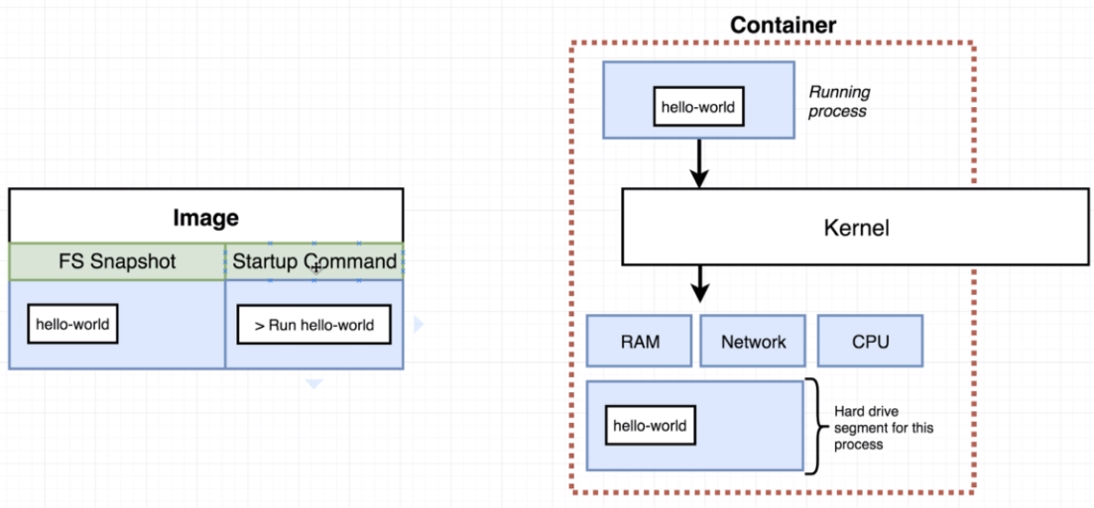
Docker Run in Details
Notes:
https://app.diagrams.net/#Hrkudache31%2Fk8s%2Fmaster%2Fk8s%2Fdiagrams%2F03%2Fdiagrams.xml

Slide 4
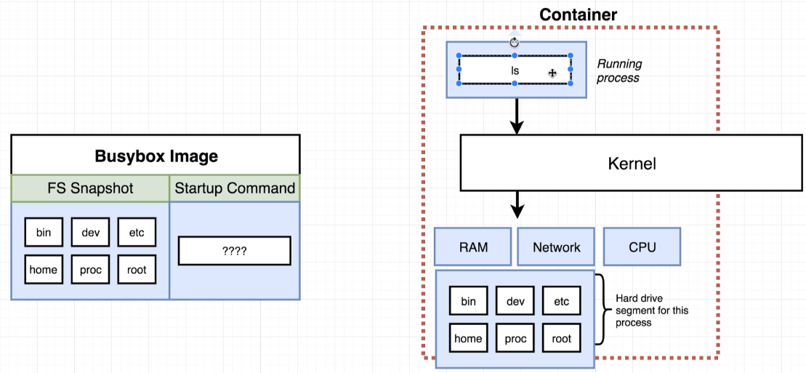
Docker Run in Details
Notes:
https://app.diagrams.net/#Hrkudache31%2Fk8s%2Fmaster%2Fk8s%2Fdiagrams%2F03%2Fdiagrams.xml

Slide 5
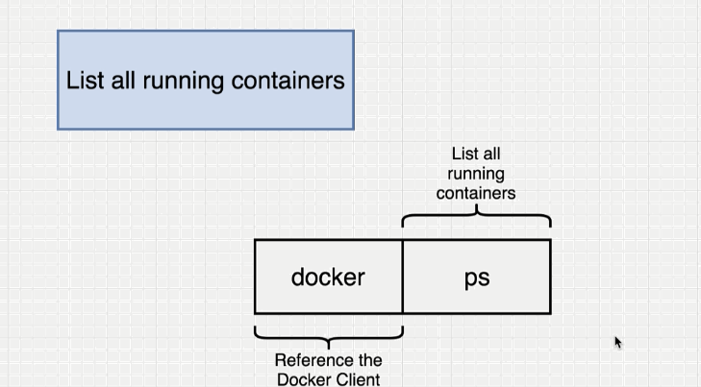
Listening Running container

Slide 6
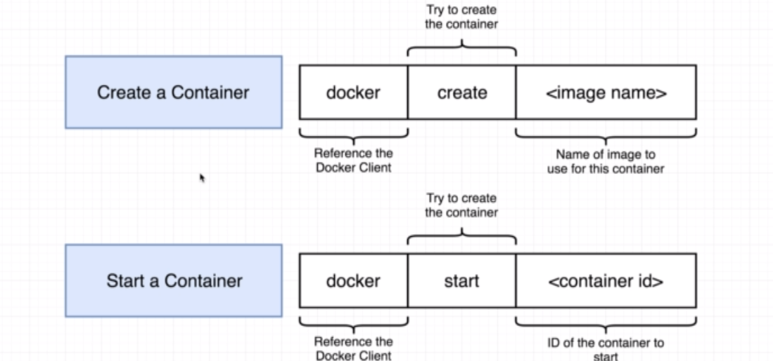
Container Lifecycle

Slide 7
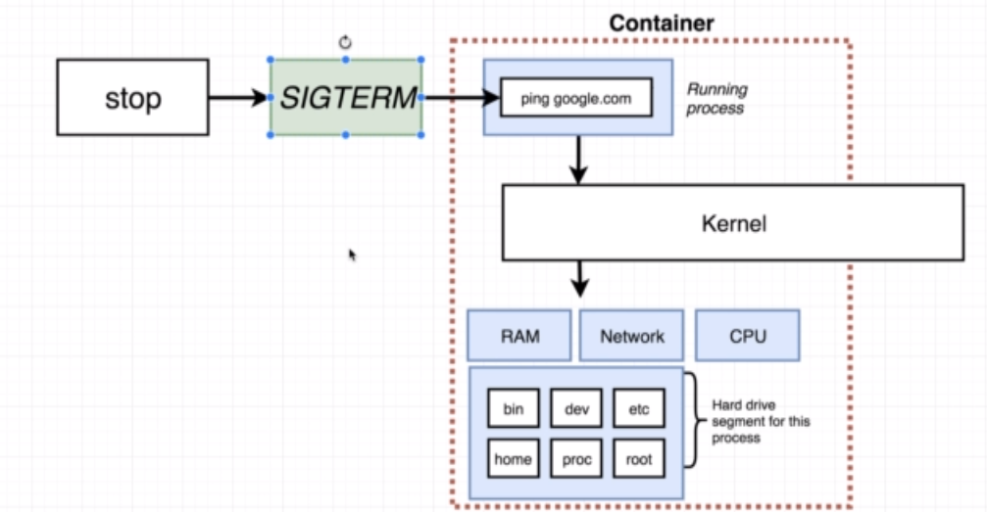
Stopping container

Slide 8
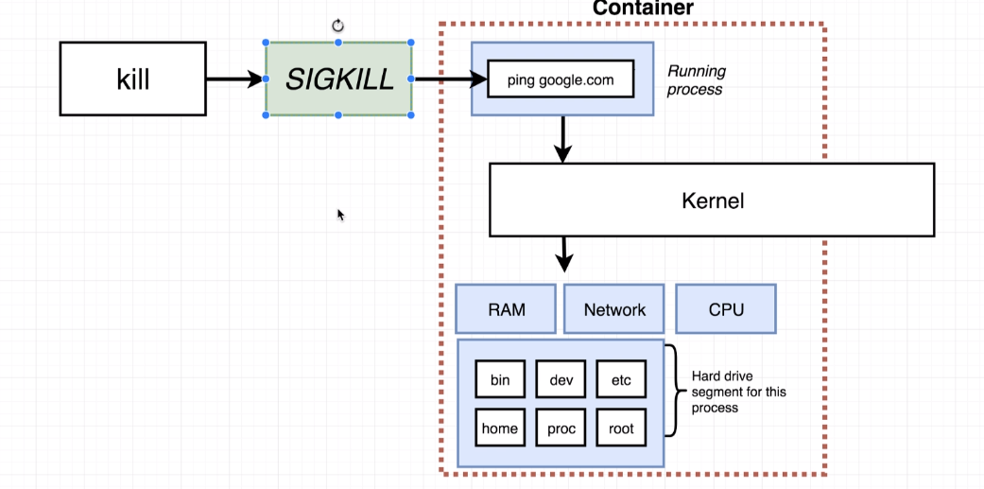
Stopping container

Slide 9
Removing stop container
Docker system prune

Slide 10
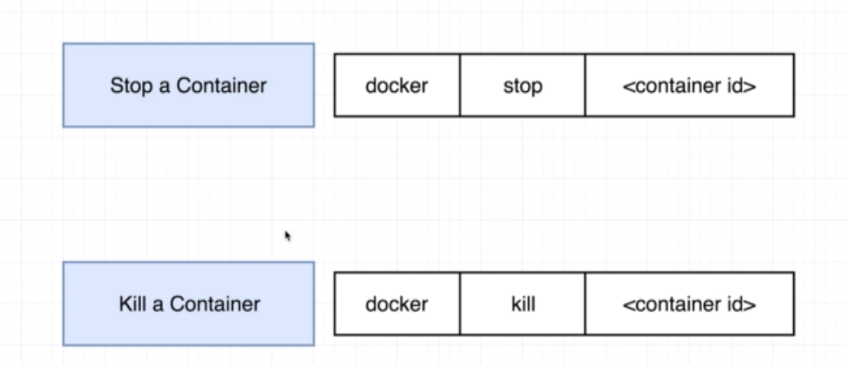
Stopping container

Slide 11
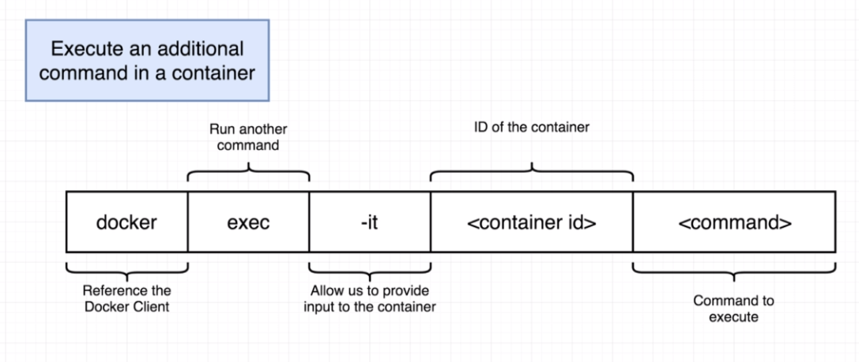
Interactive Terminal

Slide 12
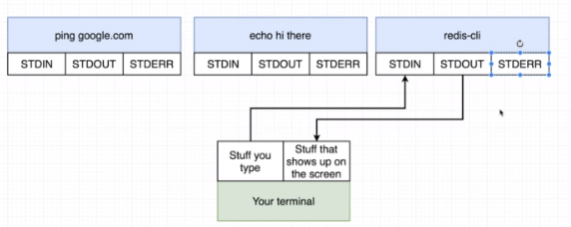
Interactive Terminal

Slide 13
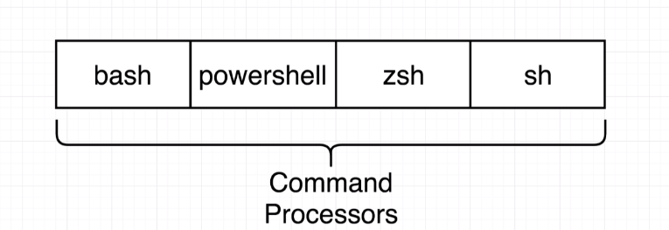
Shell

Slide 14
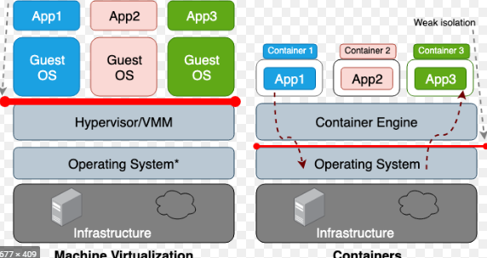
Container Isolation

Slide 15
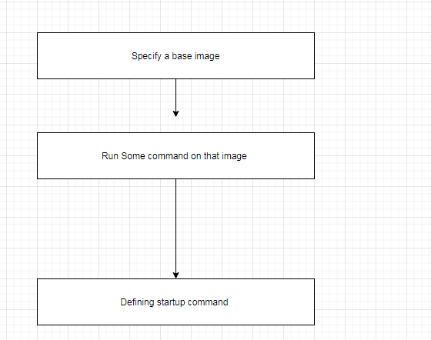
Container Isolation

Slide 16
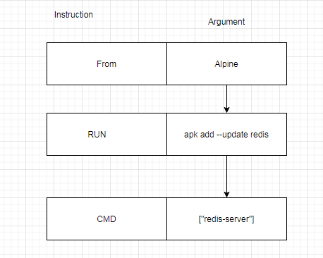
Container Isolation

Slide 17
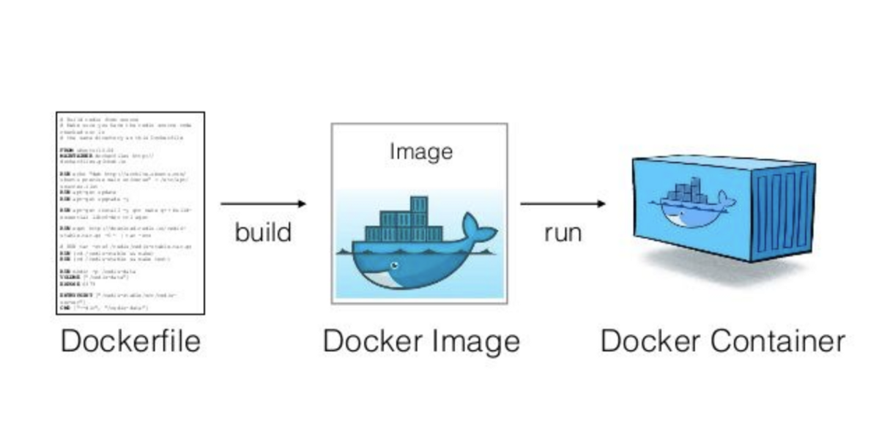
Building Images

Slide 18
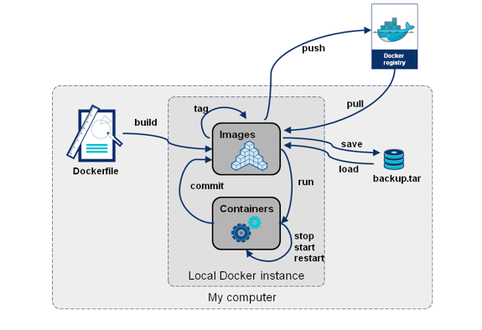
Docker Build

Slide 19
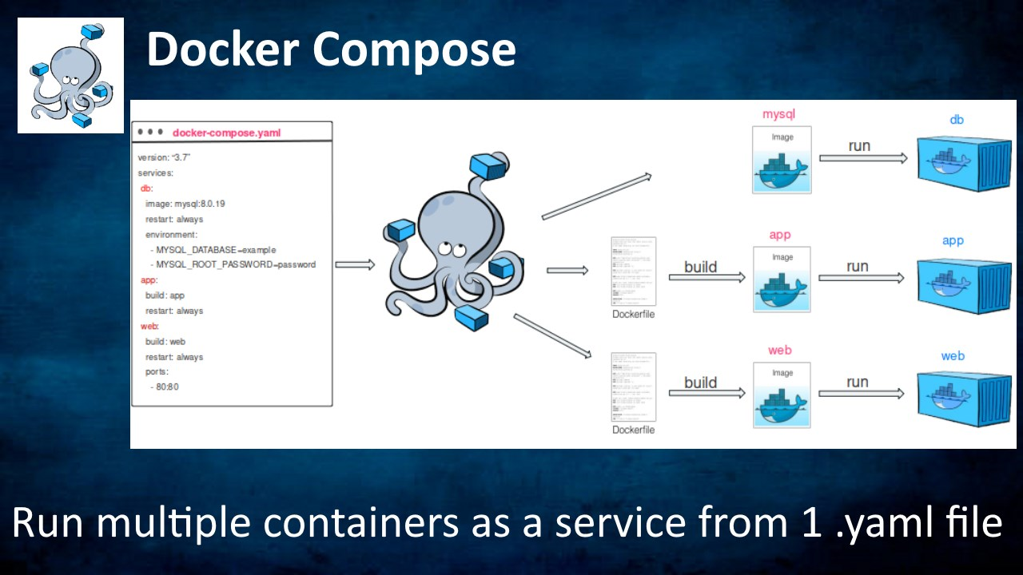
Docker Compose

Slide 20
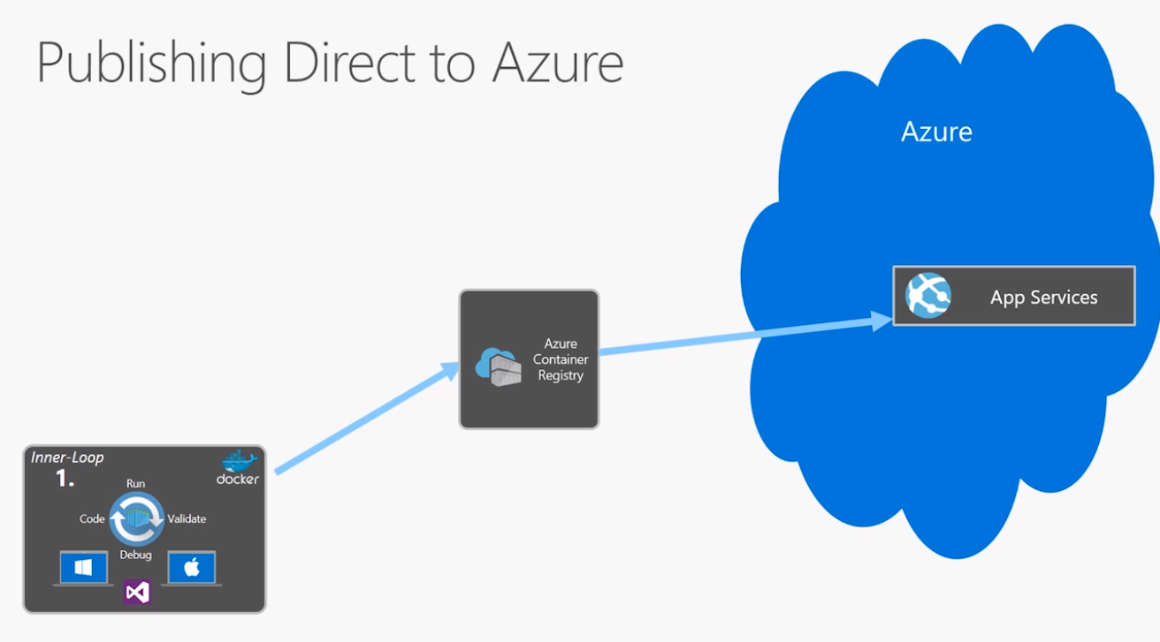
Docker image and web app

Slide 21
The End

