Slide 1
D1.5 Sunbursts
Robert Kulesza

Slide 2
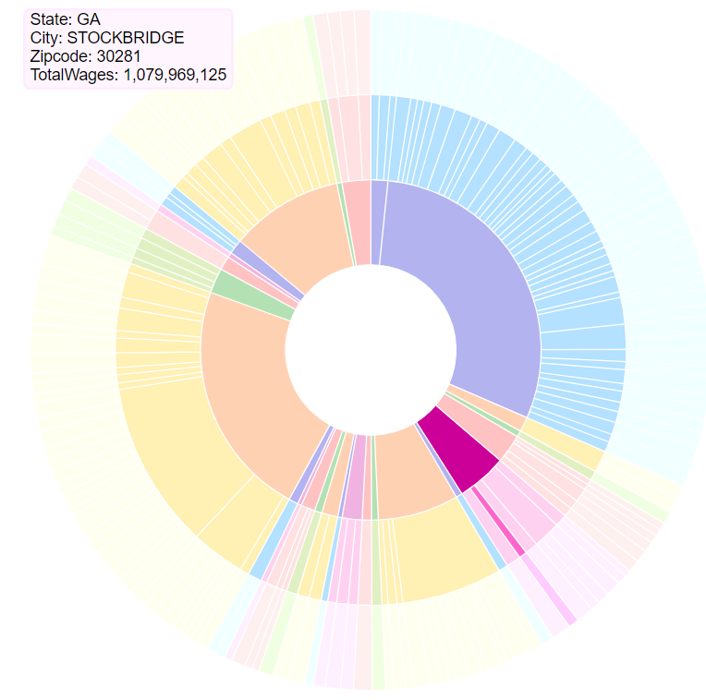
What is a Sunburst Chart?
A circular chart that expands outward.
Each segment of the chart corresponds to some data point, its size reflecting the magnitude.
The depth (the number of segments going outward from the center) display hierarchical data.

Slide 3
Data
I used the data from view vDV_Data1
State, City, Zipcode
Lets you choose specific states. Lets you choose total Wages / tax returns / est. population
The Structure:
[headers, data]
Group – the path through the depth of the sunburst chart
Count – the magnitude
[["State","City","Zipcode"],[{"group":["AZ","CHANDLER","85225"],"current":{"count":1162951792}},{"group":["AZ","GLENDALE","85308"],"current":{"count":1410661734}},{"group":["AZ","YUMA","85364"],"current":{"count":858899638}}]]

Slide 4
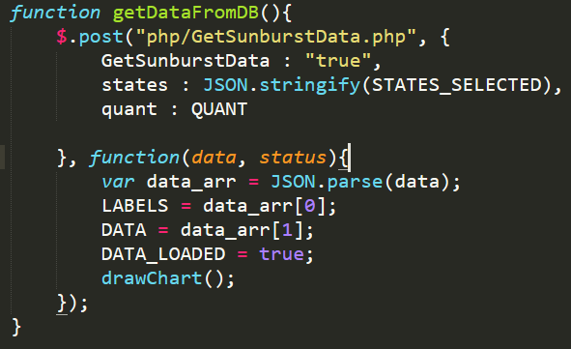
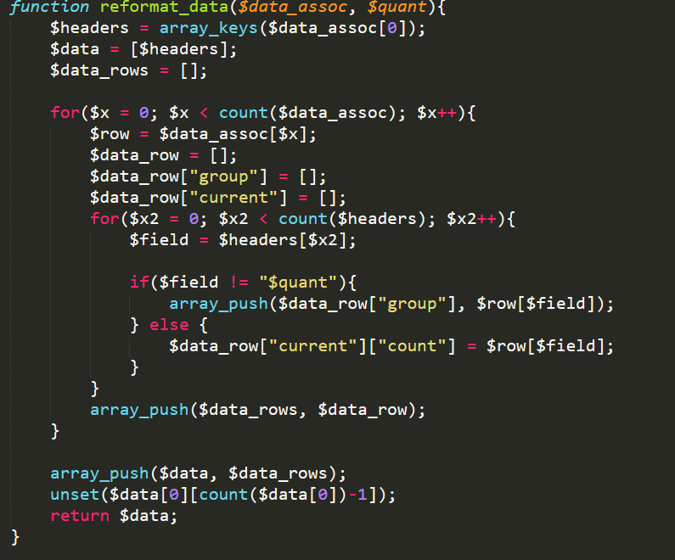
Reformatting Data From DB to JS
../php/getSunburstData.php
Ajax request made with user paramaters
Gets data from DB as associative array
Reformats associative array into sunburst json data format

Slide 5
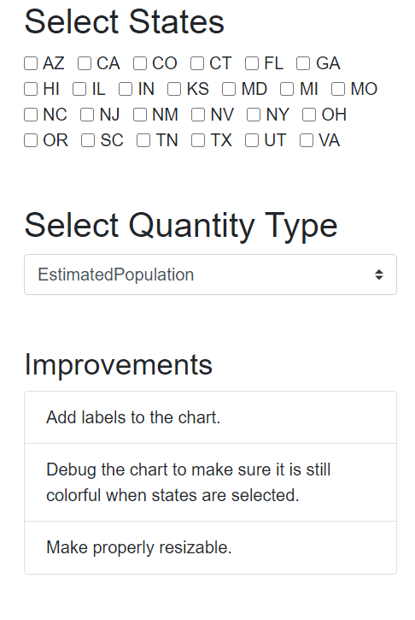
User Interaction
Select States Menu
If no states are clicked > all states are shown
Click states to view only particular states on the sunburst chart
Select Quantity Type
You can select between TaxReturnsFiled, EstimatedPopulation, AvgWages, and TotalWages
Improvements
Things I would add to make it better if I had more time.

Slide 6
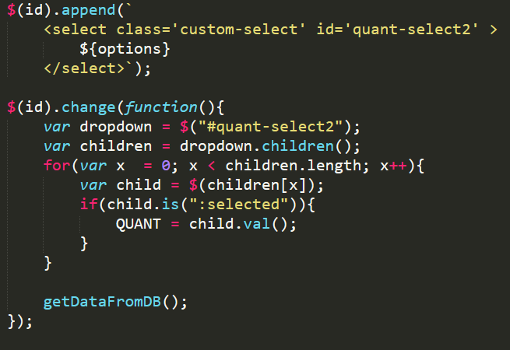
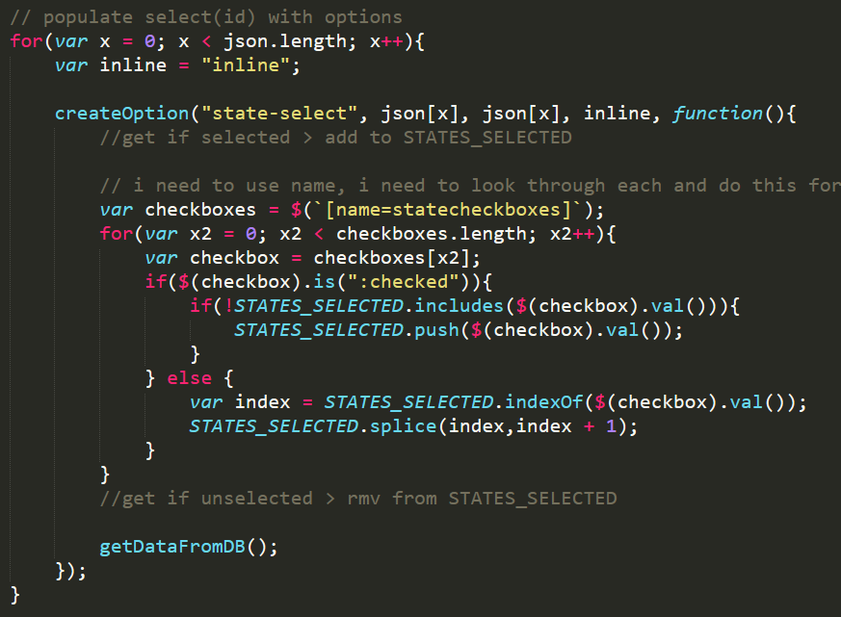
User Interaction (under the hood 1)
Checkbox / select are populated from ajax calls to php scripts
The checkboxes have onChange listeners which will update an array of states and get updated data for the chart (STATES)
The select has an onChange listener that updates the setting in the ajax call to reflect the new selected column (QUANT)

Slide 7
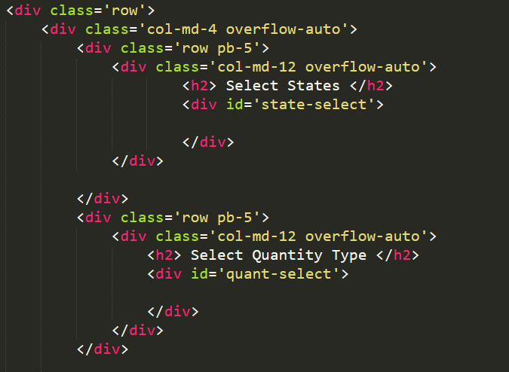
User Interaction (Under The Hood 2)
I use div tags with IDs
I use javascript to dynamically create the input elements based on what is in the table on the DB (ajax call)

Slide 8
Question
How does the number of options for hierarchial data (e.g. 50 states, 100 countries, categorical data, etc.) effect a sunburst chart?

