Slide 1
SQL (Structured Query Language)
Data Query Language (DQL)
Query DB
Data Definition Language (DDL)
Define DB Schema
Data Control Language (DCL)
User Permission
Data Manipulation Language (DML)
Insert, Update & Delete Data

Slide 2
DATA TYPE
TINYINT | CHAR | VARCHAR(LENGTH)
SMALLINT | BINARY | VARBINARY
MEDIUMINT | BLOB | TEXT
INT | ENUM | SET
BIGINT | JSON | FLOAT
DOUBLE | BIT | DATE
DATETIME | TIMESTAMP | TIME
YEAR | DECIMAL(M,N)

Slide 3
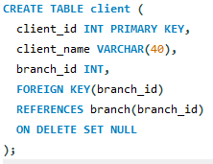
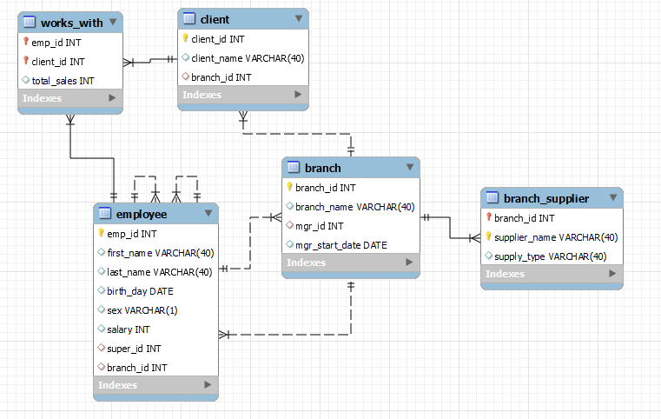
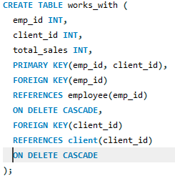
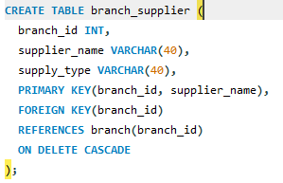
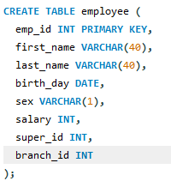
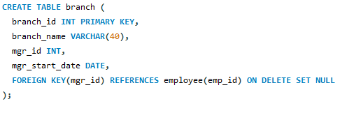

Slide 4






Query

Slide 5





Functions

Slide 6



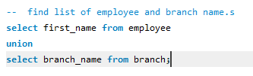
Wild Cards & Unions

Slide 7
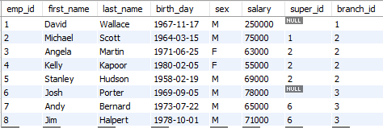

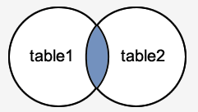

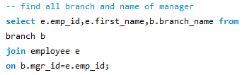
INNER JOIN (simple join) (Intersection)
Records matching both tables

Slide 8
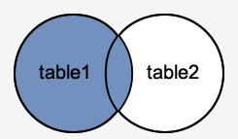
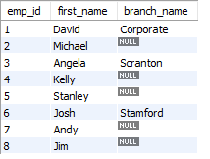

LEFT OUTER JOIN
All employee records and only records
From branch with matching criteria

Slide 9
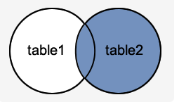


RIGHT OUTER JOIN
All branch records and only records
From employee with matching criteria

Slide 10
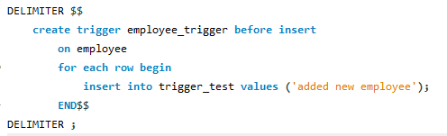
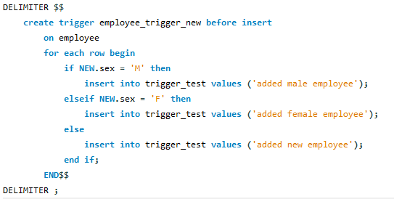
TRIGGER

