Slide 1

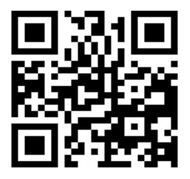


Consumer
Supplier
Affliates
Ticket Booking
Application
Theatre Partners

Slide 2
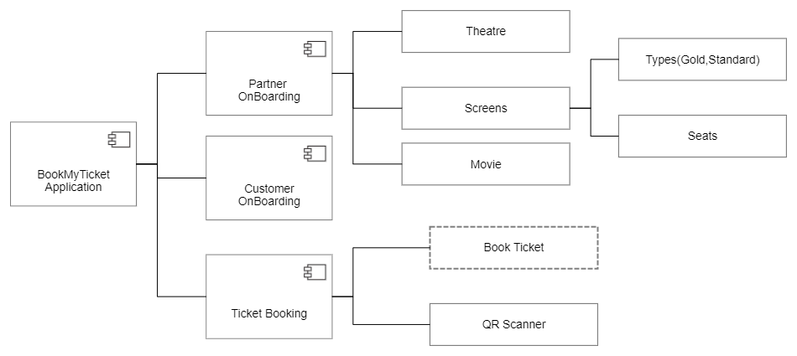

Slide 3
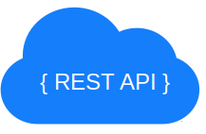
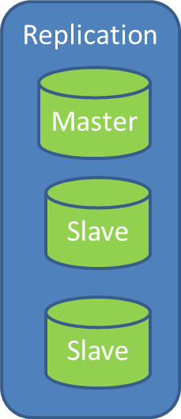
Payment Gateway(Razor Pay/Etc)
Sharding
Replication
Ticket
Booking
Master
Partner
Onboarding
Search
Slave
Customer Onboarding
Notification
Slave
CDN(CloudFront/Etc.)
GitHub JWT
JPA
WebFlux
Spring Boot Embedded Server( Tomcat/Jetty/Netty)
Elastic
Search

Slide 4
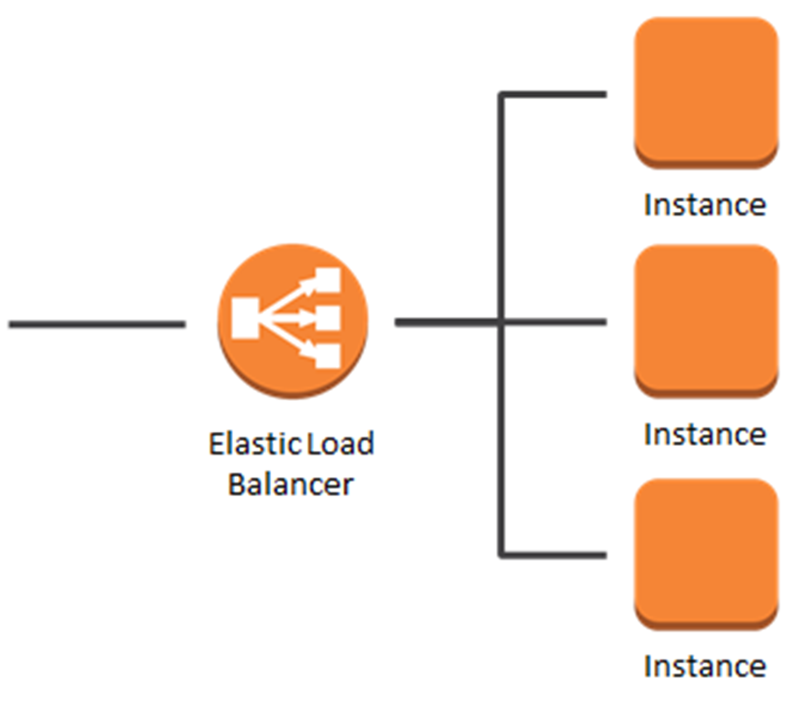
AWS Compute
BookMyTicket
Java
Application
AWS Compute
BookMyTicket
Java
Application
AWS Compute
BookMyTicket
Java
Application

Slide 5
AWS Compute
Dockerize
BookMyTicket
Application
AWS Compute
Dockerize
BookMyTicket
Application
AWS Compute
Dockerize
BookMyTicket
Application

