Slide 1
The Neuron

Slide 2
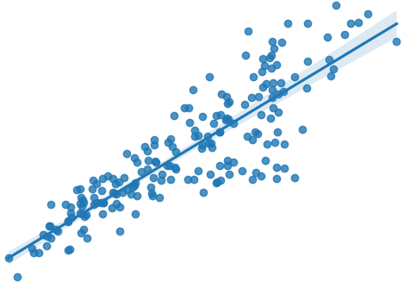
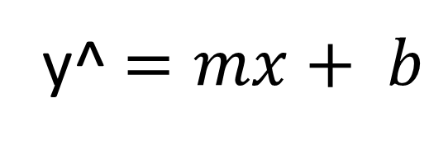
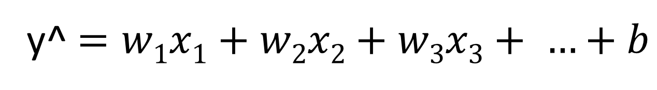
The Neuron
Linear Regression for regression - Line of Best Fit
Logistic Regression for classification
y^ $=mx+ b$
y^ $=w1x1+w2x2+w3x3+ …+b$
For multiple input features

Slide 3
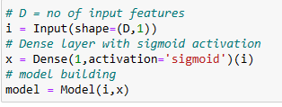
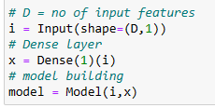
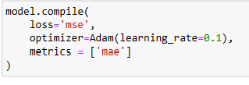
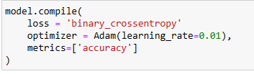


Classification vs. Regression
Classification
Regression
Dense with sigmoid
$sigmoid=σ(wTx+b)$
$dense=wTx+b$

Slide 4
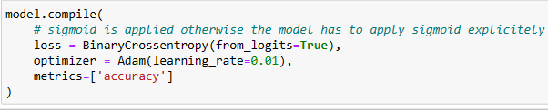
Classification vs. Regression (Preferred)
Classification
Regression
Dense with sigmoid
$sigmoid=σ(wTx+b)$
$dense=wTx+b$

