Slide 1
Feed Forward Network (FFN)
ANN’s – Artificial Neural Network

Slide 2




Artificial Neural Network
Forms the basis for other kinds of neural network
Convolutional Neural Network aka. CNN
Recurrent Neural Network aka RNN
$$x_{1}$$
$$x_{2}$$
$$y^{^}$$
$$x_{3}$$

Slide 3















From Logistic Regression to Neural Network
$$x_{1}$$
$$x_{1}$$
$$x_{1}$$
$$x_{2}$$
$$x_{2}$$
$$x_{2}$$
$$x_{3}$$
$$x_{3}$$
$$x_{3}$$
$$one neuron$$
$$two neuron$$
$$three neuron$$
$$x_{1}$$
Because the signal goes from left to
Right we call it a feed forward network.
$$x_{2}$$
$$x_{3}$$

Slide 4







Forward Propagation
Neural Network output is a prediction
Each neuron is identifying a unique feature from inputs
$$x_{1}$$
$$x_{2}$$
$$x_{3}$$
$$input layer$$
$$hidden layer$$
$$hidden layer$$
$$output layer$$

Slide 5













Deep and Wide Networks
Add more neurons to make a wide network
Add more layers to make the network deep.
$$x_{1}$$
$$x_{1}$$
$$x_{2}$$
$$x_{2}$$
$$output layer$$
$$x_{3}$$
$$x_{3}$$
$$hidden layer$$
$$output layer$$
$$input layer$$
$$hidden layer$$
$$input layer$$
$$hidden layer$$

Slide 6
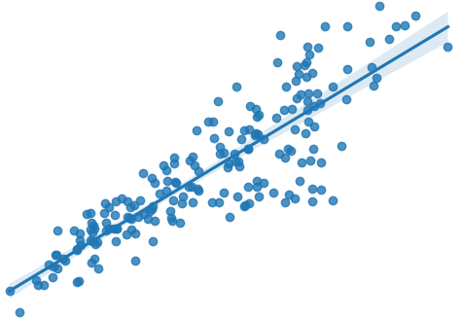





Lines to Neurons
Line
Neuron
$y^=mx+b$
$y=σ(wTx+b)$
$$x_{1}$$
$$x_{2}$$
$$x_{3}$$

Slide 7


Feature Transformation
$$regression$$
Dense
Layer
Dense
Layer
Dense
Layer
Linear
Regression
$$classification$$
Dense
Layer
Dense
Layer
Dense
Layer
Logistic
Regression

Slide 8






Model Variations
$$linear regression$$
$$binary logistic regression$$
$$Multiclass logistic regression$$
Dense
Layer
Dense
Layer
Sigmoid
Dense
Layer
SoftMax
$$ann regression$$
$$ann binary classification$$
Dense
Layer
Dense
Layer
Dense
Layer
Dense
Layer
Sigmoid
$$ann multiclass classification$$
Dense
Layer
Dense
Layer
SoftMax

Slide 9










CBOW vs. Skip Gram
CBOW
Skip Gram
Use surrounding words to predict middle word
Use a single word to predict contextual word
$$w(t−2)$$
$$w(t−2)$$
Embedding
$$w(t−1)$$
$$w(t−1)$$
Embedding
Average
Dense
$$w(t)$$
$$w(t)$$
$$w(t+1)$$
$$w(t+1)$$
Embedding
$$w(t+2)$$
$$w(t+2)$$
Embedding

Slide 10
CBOW vs. Skip Gram

