Slide 1
Convolution

Slide 2



Convolution in 2D Images
$$Image of Size 8∗8 pixels$$
1. | 0.9960733 | 0.9947644 | 0.87565445 | 0.86256545 | 0.97382199 | 0.96727749 | 0.9960733
0.98560209 | 0.9947644 | 0.7421466 | 0.48691099 | 0.51963351 | 0.51963351 | 0.9947644 | 0.9947644
0.9908377 | 0.9895288 | 0.67408377 | 0.68455497 | 0.65706806 | 0.45287958 | 0.98167539 | 0.9921466
0.98429319 | 0.97774869 | 0.81020942 | 0.67015707 | 0.66623037 | 0.62434555 | 0.98298429 | 0.98167539
0.98036649 | 0.9882199 | 0.86256545 | 0.67670157 | 0.61910995 | 0.77094241 | 0.98560209 | 0.98560209
0.9973822 | 0.79973822 | 0.45418848 | 0.64136126 | 0.59293194 | 0.48298429 | 0.66361257 | 0.90314136
0.34162304 | 0.21989529 | 0.19502618 | 0.65575916 | 0.82984293 | 0.19371728 | 0.13874346 | 0.17408377
0.18717277 | 0.17539267 | 0.19109948 | 0.5013089 | 0.7447644 | 0.20942408 | 0.16099476 | 0.14790576
$$Kernal Of Size 3 ∗3$$
1 | 1 | 1
-1 | -1 | -1
0 | 0 | 0
*
=
Dot Product Of input features and Kernel

Slide 3


Convolution in 2D Images
$$Image of Size 6∗6 pixels$$
1. | 0.9960733 | 0.9947644 | 0.87565445 | 0.86256545 | 0.97382199
0.98560209 | 0.9947644 | 0.7421466 | 0.48691099 | 0.51963351 | 0.51963351
0.9908377 | 0.9895288 | 0.67408377 | 0.68455497 | 0.65706806 | 0.45287958
0.98429319 | 0.97774869 | 0.81020942 | 0.67015707 | 0.66623037 | 0.62434555
0.98036649 | 0.9882199 | 0.86256545 | 0.67670157 | 0.61910995 | 0.77094241
0.9973822 | 0.79973822 | 0.45418848 | 0.64136126 | 0.59293194 | 0.48298429
$$Kernal Of Size 3 ∗3$$
1 | 1 | 1
-1 | -1 | -1
0 | 0 | 0
*
=?
Dot Product Of input features and Kernel

Slide 4
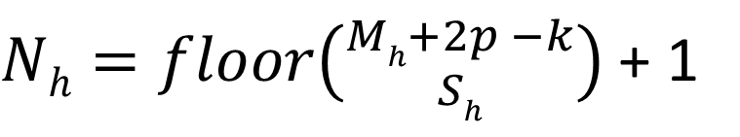



Convolution in 2D Images Output
$$Output=input_pixels∗kernal$$
0.9947644 | 0.7421466 | 0.48691099 | 0.51963351
0.9895288 | 0.67408377 | 0.68455497 | 0.65706806
0.97774869 | 0.81020942 | 0.67015707 | 0.66623037
0.9882199 | 0.86256545 | 0.67670157 | 0.61910995
$Nh=floor\left({Mh+2p −k \atop Sh}\right)$ + 1
$Previous Example Output Size=floor\left({6h+2∗0 −3 \atop 1h}\right)$ + 1
$Previous Example Output Size=floor\left({6+0 −3 \atop 1}\right)$ + 1
$Previous Example Output Size=floor\left({3 \atop 1}\right)$ + 1
Dot Product Of input features and Kernel
Kernels are filters that extract features from Image
Kernels are generally small 3 * 3, 5 * 5 or 7 * 7
Kernel's starts with random values, however it learns through
gradient descent, After learning kernel's are same all images.
Pretrained kernels is called transfer learning
$Previous Example Output Size=3$ + 1 = 4
N_{h} → Size Of Input Matrix in Current Layer M_{h} → Size Of Matrix in previous Layer
P → Padding
S → Stride
K → Size Of Kernel Matrix

Slide 5
Padding in Convolution
In the previous example input matrix Of size 413x413 with a kernel size of 3x3 , output matrix was of size 4 11x411
If we need to retain the output size as input size, then we need to use padding.
Based on the formula if we add a padding of 1, then the output matrix size will match with the input matrix.
The padded values are generally 0.
$Output Size=floor\left({413h+2∗1 −3 \atop 1h}\right)$ + 1
$Output Size=floor\left({413+2 −3 \atop 1}\right)$ + 1
$Output Size=floor\left({412 \atop 1}\right)$ + 1
$Output Size=$412 + 1 = 413

Slide 6

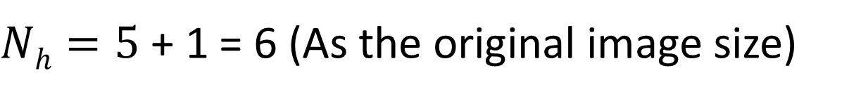
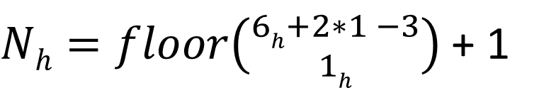
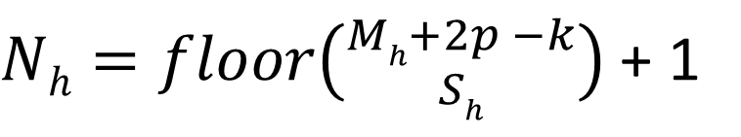
Convolution With Padding
$$Image of Size 6∗6 pixels with padding of 1$$
0 | 0 | 0 | 0 | 0 | 0 | 0 | 0
0 | 1. | 0.9960733 | 0.9947644 | 0.87565445 | 0.86256545 | 0.97382199 | 0
0 | 0.98560209 | 0.9947644 | 0.7421466 | 0.48691099 | 0.51963351 | 0.51963351 | 0
0 | 0.9908377 | 0.9895288 | 0.67408377 | 0.68455497 | 0.65706806 | 0.45287958 | 0
0 | 0.98429319 | 0.97774869 | 0.81020942 | 0.67015707 | 0.66623037 | 0.62434555 | 0
0 | 0.98036649 | 0.9882199 | 0.86256545 | 0.67670157 | 0.61910995 | 0.77094241 | 0
0 | 0.9973822 | 0.79973822 | 0.45418848 | 0.64136126 | 0.59293194 | 0.48298429 | 0
0 | 0 | 0 | 0 | 0 | 0 | 0 | 0
$$Kernal Of Size 3 ∗3$$
1 | 1 | 1
-1 | -1 | -1
0 | 0 | 0
*
$Nh=floor\left({Mh+2p −k \atop Sh}\right)$ + 1
$Nh=floor\left({6h+2∗1 −3 \atop 1h}\right)$ + 1
$Nh=5$ + 1 = 6 (As the original image size)

Slide 7
Padding Summary
Padding is used to increase the result of the convolution and match the previous layer.
Padding involves adding 1+ row and column
Padding numbers are generally 0

Slide 8
Convolution with Stride
$$Image of Size 6∗6 pixels$$
1. | 0.9960733 | 0.9947644 | 0.87565445 | 0.86256545 | 0.97382199
0.98560209 | 0.9947644 | 0.7421466 | 0.48691099 | 0.51963351 | 0.51963351
0.9908377 | 0.9895288 | 0.67408377 | 0.68455497 | 0.65706806 | 0.45287958
0.98429319 | 0.97774869 | 0.81020942 | 0.67015707 | 0.66623037 | 0.62434555
0.98036649 | 0.9882199 | 0.86256545 | 0.67670157 | 0.61910995 | 0.77094241
0.9973822 | 0.79973822 | 0.45418848 | 0.64136126 | 0.59293194 | 0.48298429
$$Kernal Of Size 3 ∗3$$
1 | 1 | 1
-1 | -1 | -1
0 | 0 | 0
*
=
Stride is shift or skip row and column to get smaller matrix output.
0.9947644 | 0.48691099 | 0.51963351
0.97774869 | 0.67015707 | 0.62434555
0.79973822 | 0.64136126 | 0.48298429

Slide 9
Stride Summary
Stride is used to decrease the size of the result of convolution, it is mechanism of down sampling and reduces the number of params in CNN
Stride is usually the same for rows and columns.

Slide 10

Transpose Convolution
Output
1. | 0.9960733 | 0.9947644 | 0.87565445 | 0.86256545 | 0.97382199
0.98560209 | 0.9947644 | 0.7421466 | 0.48691099 | 0.51963351 | 0.51963351
0.9908377 | 0.9895288 | 0.67408377 | 0.68455497 | 0.65706806 | 0.45287958
0.98429319 | 0.97774869 | 0.81020942 | 0.67015707 | 0.66623037 | 0.62434555
0.98036649 | 0.9882199 | 0.86256545 | 0.67670157 | 0.61910995 | 0.77094241
0.9973822 | 0.79973822 | 0.45418848 | 0.64136126 | 0.59293194 | 0.48298429
0 | 0 | 0 | 0 | 0 | 0
Input
0.9908377 | 0.9895288 | 0.67408377 | 0.68455497
0.98429319 | 0.97774869 | 0.81020942 | 0.67015707
0.98036649 | 0.9882199 | 0.86256545 | 0.67670157
0.9973822 | 0.79973822 | 0.45418848 | 0.64136126
$$Kernal Of Size 3 ∗3$$
1 | 1 | 1
-1 | -1 | -1
0 | 0 | 0
Transpose Convolution is Opposite to normal Convolution
It starts with each pixel in image and convolve with kernel and creates a larger output matrix.

Slide 11
Transpose Convolution
Transpose Convolution is scaler multiply a kernel with each pixel.
As long as kernel is > 1, then the output is higher resolution than original image.
Transpose convolution is used for higher resolution CNN
Formula for transpose convolution size.
$$Nh=Sh\left(Mh −1\right)+k −2p$$
N_{h} → Size Of Input Matrix in Current Layer M_{h} → Size Of Matrix in previous Layer
P → Padding
S → Stride
K → Size Of Kernel Matrix

Slide 12



Pooling
100 | 50 | 20 | 30
25 | 25 | 50 | 80
20 | 30 | 0.67408377 | 0.68455497
50 | 80 | 0.81020942 | 0.67015707
$Avg Kernal Of Size$2 * 2
50
45
.25 | .25
.25 | .25
100 | 50 | 20 | 30
25 | 25 | 50 | 80
20 | 30 | 0.67408377 | 0.68455497
50 | 80 | 0.81020942 | 0.67015707
$$Max Pooling$$
100
80
$$Min Pooling$$
25
20

Slide 13
Max v/s Mean Pooling
Max
Mean
Highlight sharp features
Contrast
Smooth images

Slide 14
Receptive Fields
Each Pixel is a separate feature as input to FFN.
With Pooling we group pixel matrix as input feature for CNN.
This increases the receptive field of input, example when we transform the image (rotate or otherwise.)
That is the reason CNN performance improves over FFN.
1. | 0.9960733 | 0.9947644 | 0.87565445 | 0.86256545 | 0.97382199 | 0.96727749 | 0.9960733
0.98560209 | 0.9947644 | 0.7421466 | 0.48691099 | 0.51963351 | 0.51963351 | 0.9947644 | 0.9947644
0.9908377 | 0.9895288 | 0.67408377 | 0.68455497 | 0.65706806 | 0.45287958 | 0.98167539 | 0.9921466
0.98429319 | 0.97774869 | 0.81020942 | 0.67015707 | 0.66623037 | 0.62434555 | 0.98298429 | 0.98167539
0.98036649 | 0.9882199 | 0.86256545 | 0.67670157 | 0.61910995 | 0.77094241 | 0.98560209 | 0.98560209
0.9973822 | 0.79973822 | 0.45418848 | 0.64136126 | 0.59293194 | 0.48298429 | 0.66361257 | 0.90314136
0.34162304 | 0.21989529 | 0.19502618 | 0.65575916 | 0.82984293 | 0.19371728 | 0.13874346 | 0.17408377
0.18717277 | 0.17539267 | 0.19109948 | 0.5013089 | 0.7447644 | 0.20942408 | 0.16099476 | 0.14790576

Slide 15
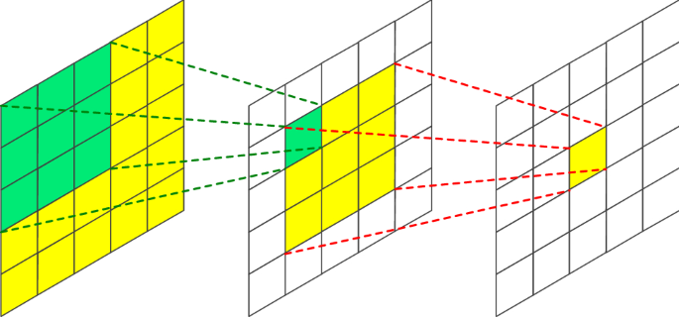
Receptive Field CNN with Pooling
Each Layer sees more of image.
Covers a larger space and converts to smaller feature set each layer in CNN, this helps the CNN model to learn
Larger feature space even when the input data gets transformed

Slide 16
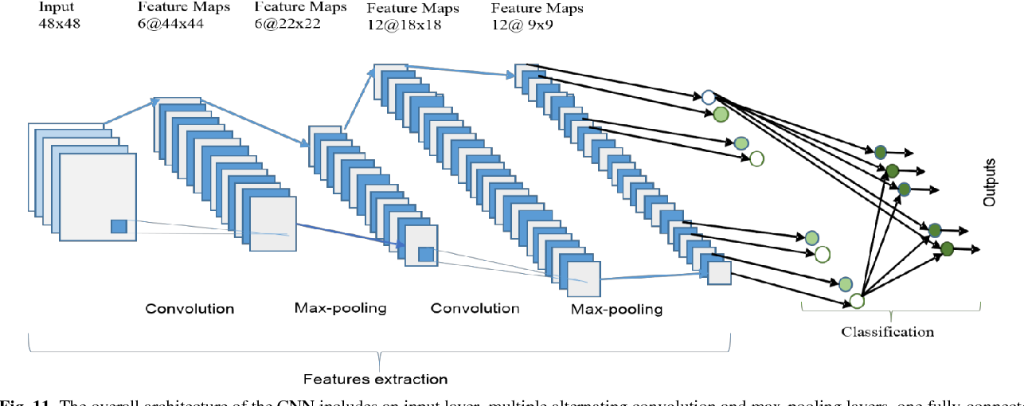
Where does pooling happens

Slide 17
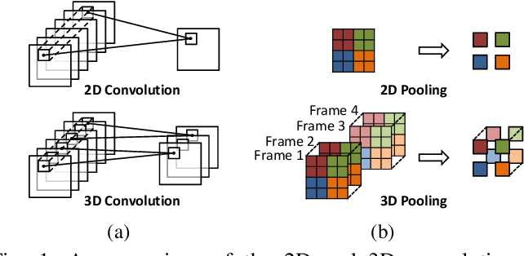
2D and 3D Pooling
2D Pooling – Each Layer in the input combined as singe pooled layer in output
3D Pooling – Each Later is pooled separately and there will same number of pooled layer in the output.

Slide 18

Convolution Stride Or Pooling
There are 2 approaches of down sampling in convolution.
Convolution Stride
Pooling
When we do pooling we take non overlapping matrix from input matrix.
When we do stride the input matrix gets overlapped to get the output matrix.
Stride
1. | 0.9960733 | 0.9947644 | 0.87565445 | 0.86256545 | 0.97382199
0.98560209 | 0.9947644 | 0.7421466 | 0.48691099 | 0.51963351 | 0.51963351
0.9908377 | 0.9895288 | 0.67408377 | 0.68455497 | 0.65706806 | 0.45287958
0.98429319 | 0.97774869 | 0.81020942 | 0.67015707 | 0.66623037 | 0.62434555
0.98036649 | 0.9882199 | 0.86256545 | 0.67670157 | 0.61910995 | 0.77094241
0.9973822 | 0.79973822 | 0.45418848 | 0.64136126 | 0.59293194 | 0.48298429
100 | 50 | 20 | 30
25 | 25 | 50 | 80
20 | 30 | 0.67408377 | 0.68455497
50 | 80 | 0.81020942 | 0.67015707
$$Max Pooling$$
100
80
1 | 1 | 1
-1 | -1 | -1
0 | 0 | 0
0.9947644 | 0.48691099 | 0.51963351
0.97774869 | 0.67015707 | 0.62434555
0.79973822 | 0.64136126 | 0.48298429

Slide 19
Stride v/s Max Pool v/s Min Pool
Even the output feature map is of the same dimension, they represent separate feature map for next layer.

Slide 20
Convolution Stride v/s Convolution + Pool
Convolution Stride
Convolution + Pooling
Slower
Learned Parameters
Kernel spans a larger area(Large receptive field)
Computationally Fast
No Params
Kernel spans a smaller area(Smaller receptive field)

