Slide 1
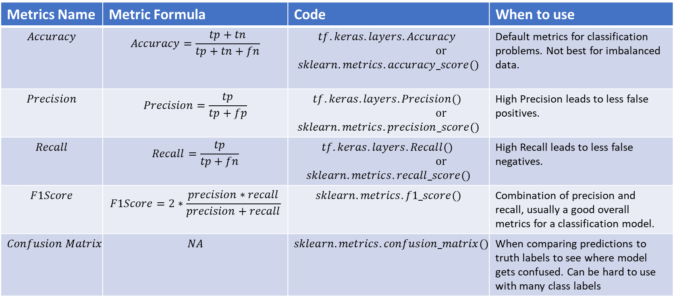
Metrics Name | Metric Formula | Code | When to use
$$Accuracy$$ | $$Accuracy=\frac{tp+tn}{tp+tn+fn}$$ | $$tf.keras.layers.Accuracy$$ $or$ $$sklearn.metrics.accuracy_score()$$ | Default metrics for classification problems. Not best for imbalanced data.
$$Precision$$ | $$Precision=\frac{tp}{tp+fp}$$ | $$tf.keras.layers.Precision()$$ $or$ $$sklearn.metrics.precision_score()$$ | High Precision leads to less false positives.
$$Recall$$ | $$Recall=\frac{tp}{tp+fn}$$ | $$tf.keras.layers.Recall()$$ $or$ $$sklearn.metrics.recall_score()$$ | High Recall leads to less false negatives.
$$F1Score$$ | $$F1Score=2∗\frac{precision∗recall}{precision+recall}$$ | $$sklearn.metrics.f1_score()$$ | Combination of precision and recall, usually a good overall metrics for a classification model.
$$Confusion Matrix$$ | $$NA$$ | $$sklearn.metrics.confusion_matrix()$$ | When comparing predictions to truth labels to see where model gets confused. Can be hard to use with many class labels

Slide 2
RNN Architecture
…
Text Vectorization
Embedding Layer
Recurrent Neural Network
(LSTM/GRU/Bidirectional)
Dense Layer
Output Layer

Slide 3
CNN Architecture (Text Sequence)
…
Input Text
Text Vectorization
Embedding Layer
Conv1D Layer (s)
Pooling
Layer
Dense Layer
Output Layer

Slide 4
USE* Feature Extractor (Text Sequence)
…
Input Text
Embedding Layer
(USE From TensorFlow Hub)
Dense Layer
Output Layer

