Slide 1
Meta- Parameters
Loss Function

Slide 2
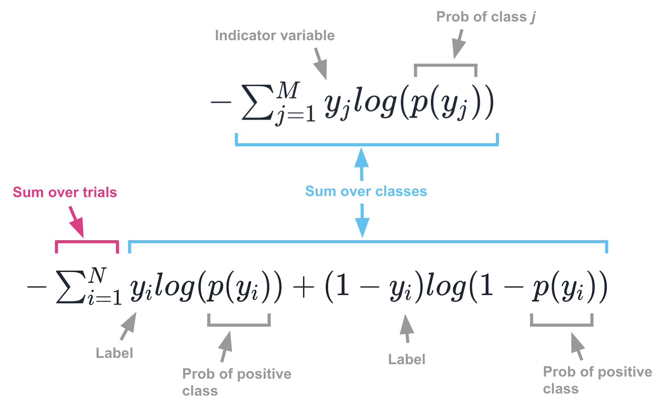
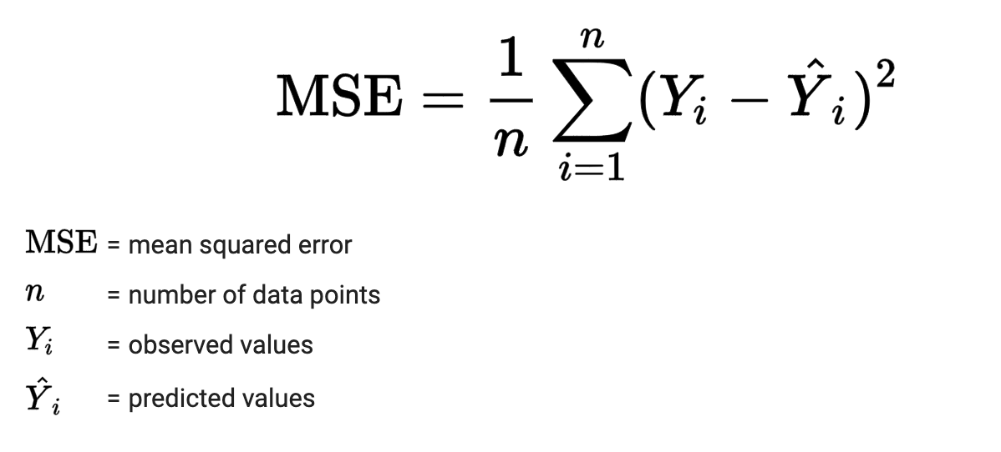
Loss Function
Mean Squared Error (MSE)
Cross Entropy (Logistic)
Use for continuous data when output is a numerical prediction
Use for categorical data when the output is probability

Slide 3
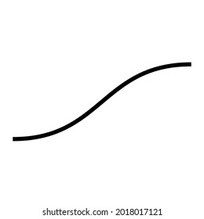










Loss Function – Output Layer Architecture
$$x_{1}$$
Continuous Data
Output layer has 1 unit with linear
activation function
MSE Loss Function
Binary Classification
Output layer has 1 unit with
sigmoid activation function
Cross Entropy(BCE) Loss function
Multiclass N Classification
Output layer has N units with
SoftMax activation function
Classification Cross Entropy(CCE)
$$x_{2}$$
$$y^{^}$$
$$x_{3}$$
$$x_{1}$$
$$x_{2}$$
$$y^{^}$$
$$x_{3}$$
$$x_{1}$$
σ
$$y^{^}$$
$$x_{2}$$
$$x_{3}$$
σ
$$y^{^}$$

Slide 4
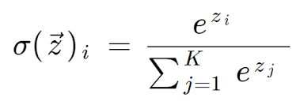
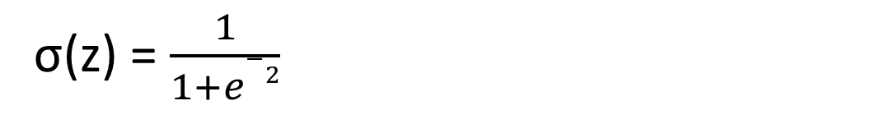
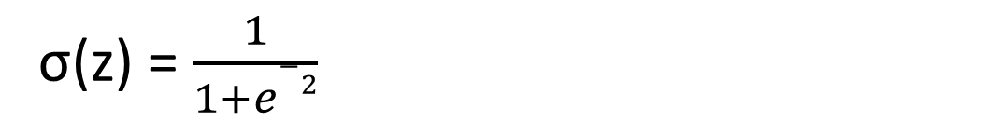
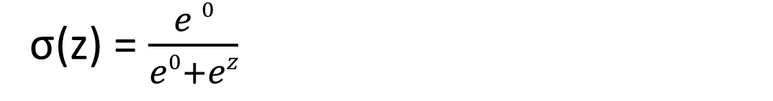
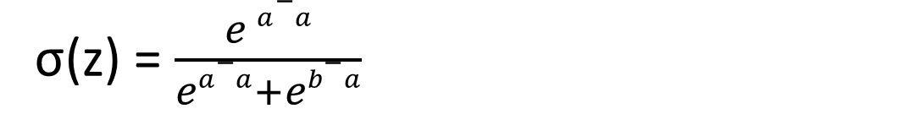
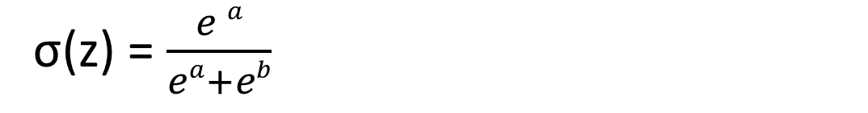
SoftMax v/s Sigmoid
SoftMax for 2 categories is equal to sigmoid
σ(z) = $\frac{1}{1+e−2}$
σ(z) = $\frac{e a}{ea+eb}$
σ(z) = $\frac{e a−a}{ea−a+eb−a}$
σ(z) = $\frac{e 0}{e0+ez}$
σ(z) = $\frac{1}{1+e−2}$

