Slide 1
Latent Dirichlet Allocation
LDA has also an acronym for “Linear Discriminant Analysis”

Slide 2
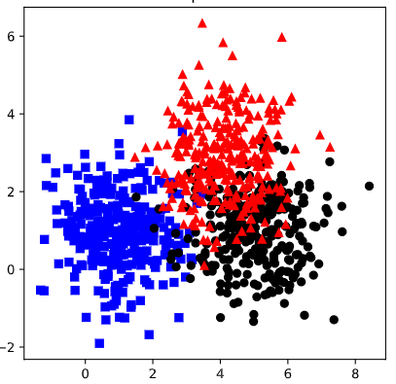
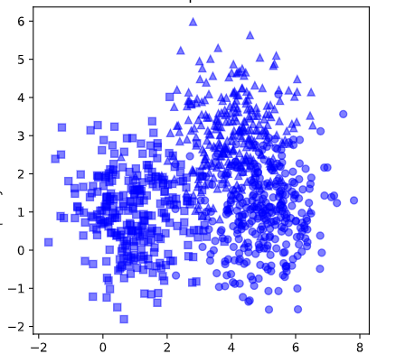
Supervised vs. Unsupervised Learning
Supervised Learning
Unsupervised Learning
Each Document has labels to predict. Example either the document is red, blue or black.
With supervised learning given a input we predict the output label for the document.
There is no label defined, input is only documents.
With Unsupervised learning we predict no of categories of documents.

Slide 3
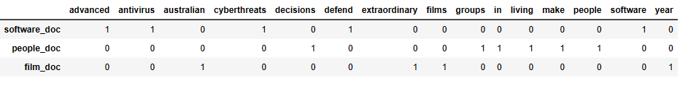
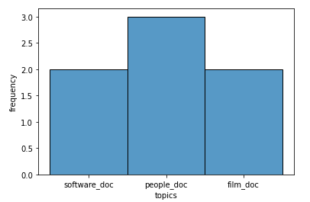
Latent Dirichlet Allocation – API Perspective
Inputs → Count Vector (Bag Of Words)
Ordering is not taken care of…
Use sklearn.feature_extraction.text.CountVectorizer
Outputs →
topics x words
document x topics

Slide 4
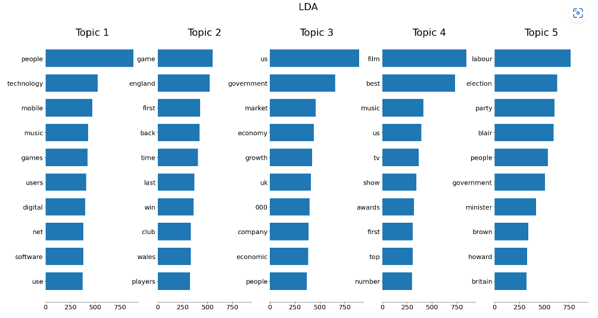
Latent Dirichlet Allocation – Topics vs. Words

Slide 5

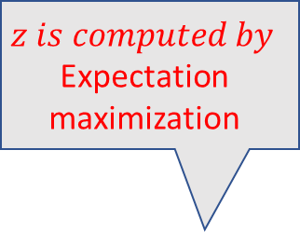

Clustering vs. Classification
Clustering / Mixture Model
Bayes Classifier
Z = Cluster Identity
y = Class Label
Z
Unknown Data
y
Known Data
In both cases we use Bayes rule to find posterior
$$z is computed by$$
Expectation maximization
X
X
$$p(z|x)=\frac{p\left(x | z\right)p(z)}{p(x)}$$
$$p(y|x)=\frac{p\left(x | y\right)p(y)}{p(x)}$$

Slide 6

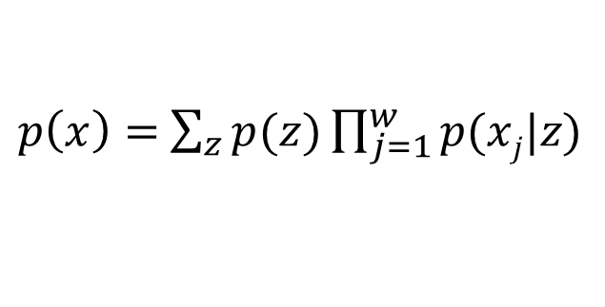


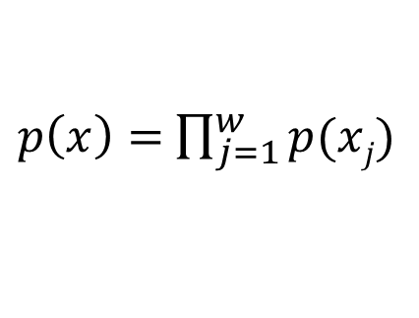




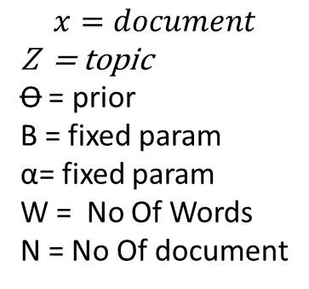







Unsupervised Models
$$x=document$$
Z = topic
Ꝋ = prior
Β = fixed param
α= fixed param
W = No Of Words
N = No Of document
prior
β
$$Unigram$$
$$Mixure Model$$
$$Latent Dirichlet Allocation(LDA)$$
$$x$$
$$z$$
$$x$$
α
Ꝋ
$$z$$
$$x$$
$$W$$
$$W$$
$$W$$
$$N$$
$$N$$
$$N$$
$p\left(x\right)=$ $\prod_{j=1}^{w}{p(xj)}$
$p\left(x\right)=$ $\sum_{z}{p(z)}\prod_{j=1}^{w}{p(xj|z)}$
With LDA we sample new topic for every word
Only 1 topic
One word per topic

Slide 7


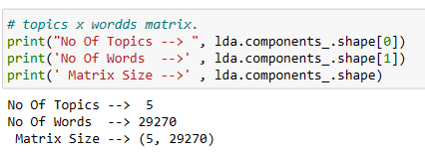

Actual API Reference

Slide 8
Non Negative Matrix Factorization {NMF}
Recommender System is how Matrix factorization best known for.
How NMF is related to topic modelling
Recommender System Movie Rating Matrix
Most user may provide ratings for few movies and based on this matrix find the movie to be recommended to users.
M Users (rows) and N movies (columns) → M x N matrix
User ID/Movie Name | Movie 1 | Movie 2 | Movie 3 | Movie 4 | Movie 5
00121 | 6 |  | 4 |  | 9
00312 |  | 6 |  | 8
00432 | 7 |  | 9

Slide 9
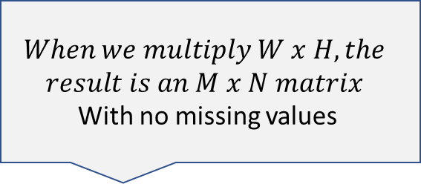
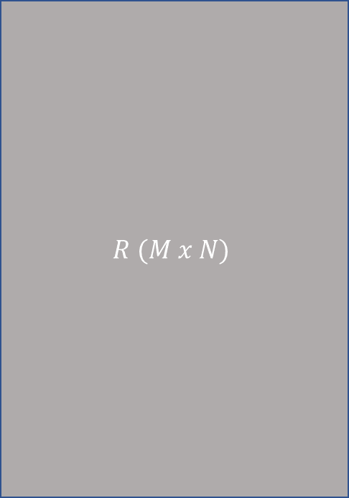
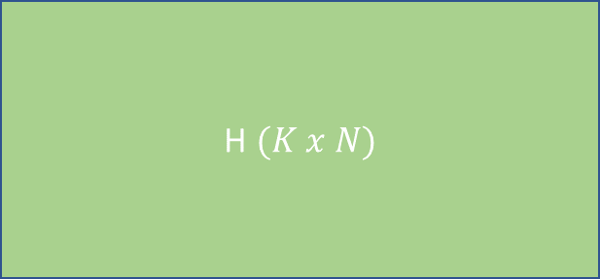


Matrix Factorization
$$R=W x H$$
$$R (M x N)$$
W$(M x K)$
H$(K x N)$
$$==$$
$$When we multiply W x H, the$$
$$result is an M x N matrix$$
With no missing values
Identify W and H to minimize
The loss in loss function…

Slide 10
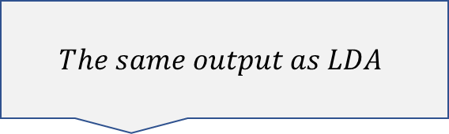
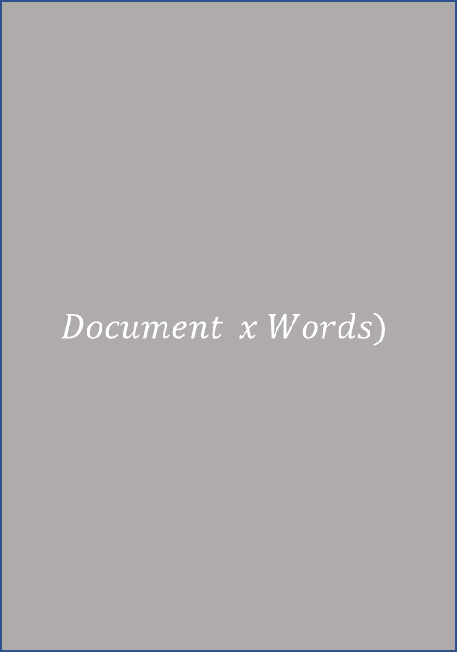



NMF for Topic Modelling
$$Document x Words)$$
W$(M x K)$
H$(K x N)$
$$Documents$$
$$Words$$
$$==$$
$$The same output as LDA$$
$$Topics$$

Slide 11
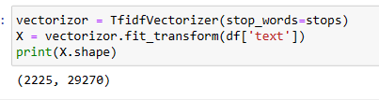
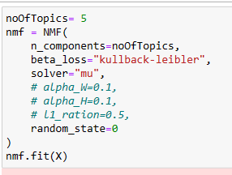
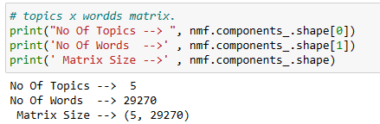

Actual API Reference

Slide 12
Topic Modeling Summary
Topic Modelling is unsupervised learning and similar to clustering.
For LDA, a new topic is sampled for every word, but for mixture models(i.e. clustering) only one topic per document.
NMF can be applied to topic modelling since the outputs are the same.

Slide 13
Appendix – topic x words
from sklearn.feature_extraction.text import CountVectorizer
import pandas as pd
text = ['Advanced antivirus software defend cyberthreats ',
'people living in groups make decisions',
'extraordinary year australian films']
coun_vect = CountVectorizer()
count_matrix = coun_vect.fit_transform(text)
count_array = count_matrix.toarray()
df = pd.DataFrame(data=count_array,columns = coun_vect.get_feature_names(),index=['software_doc','people_doc','film_doc'])
df.head()

Slide 14
Appendix – Document x topics
columns = ['a','b','c','d']
y = [[1,1,1,'software_doc'],
[1,1,1,'people_doc'],
[1,1,1,'film_doc'],
[1,1,1,'software_doc'],
[1,1,1,'people_doc'],
[1,1,1,'people_doc'],
[1,1,1,'film_doc']]
df = pd.DataFrame(data=y,columns=columns)
df
import seaborn as sns
import matplotlib.pyplot as plt
sns.histplot(data=df,x='d')
plt.xlabel('topics')
plt.ylabel('frequency')

