Slide 1
Meta- Parameters

Slide 2
(Meta) Parameters
Parameters are features of the model.
Mainly the weights between the nodes.
Meta parameters are features of the model set in the application.

Slide 3
(Meta Parameters)
Model architecture
Hidden Layers
Units per layer
Cross Validation Size
Mini batch size
Activation Function
Optimization Function
Learning rate.
Dropouts
Loss Function
Data Normalization
Weight normalization

Slide 4
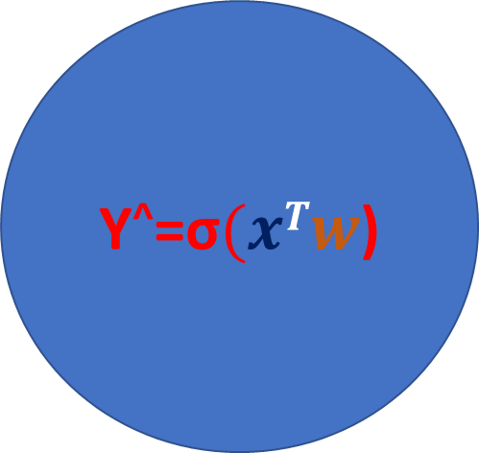


Data Normalization
Y^ - Output Of ANN Node
σ - Activation Function
$x$ – input
$w$ – weight
$xTw$ – input transpose weights
$ո$ - learning rate
$ԀՀ$ – derivative/gradient
Y^=σ$(xTw$)
$$w w −ոԀՀ$$

Slide 5

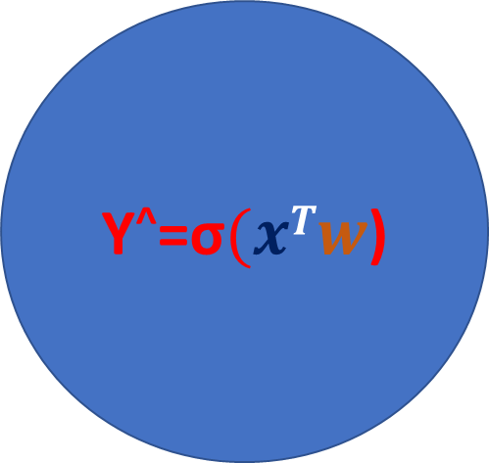
Data Normalization – Non normalized data
W | X1 | X2
.2 | 10 | .3
.4 | 20 | .4
.7 | 10 | .7
.1 | 40 | .5
Y^=σ$(xTw$)
If data is not normalized higher order feature data will incur huge loss.
All feature data should be in same numerical range.
$$w w −ոԀՀ$$

Slide 6

Data Normalization – Z Transform
Mean Centred – Subtract the average from each individual value.
Variance Normalized – Divide by standard deviation
The units are standard deviation away from the mean of the distribution.
-
z_{i} $=\frac{xi −x}{σx}$
import scipy.stats as stats
data[cols] = data[cols].apply(stats.zscore)

Slide 7


Data Normalization – Min Max Scaling
Transform the data such that smallest number if 0 and highest number is 1.
-
x $=\frac{x −min x}{\max{x −\min{x}}}$
$$scale to 0 −1$$
$x$* $=$ $a+ x(b −a)$
$$scale to a −b$$
>>> from sklearn.preprocessing import MinMaxScaler
>>> data = [[-1, 2], [-0.5, 6], [0, 10], [1, 18]]
>>> scaler = MinMaxScaler()
>>>
(scaler.fit(data))

Slide 8
Data Normalization
Min Max scaling for data which is of fixed heights, example pixels in images vary from 0 – 255
Z scoring is common for data which is normally distributed.
Data normalization improves the test accuracy by approx. 10%

Slide 9


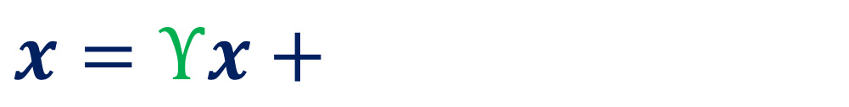
Batch Normalization
Batch normalization refers to the fact that why normalize only the input layer and on the hidden layers.
In batch normalization input to each layer is normalized.
Batch normalization helps avoid vanishing or exploding gradients.
$ϒ$ = gamma scaling parameter
$β$ = standard deviation scaling
$x$ = normalized input
Y=σ$(xTw$)
~
~
~
$x=ϒx+β$

Slide 10
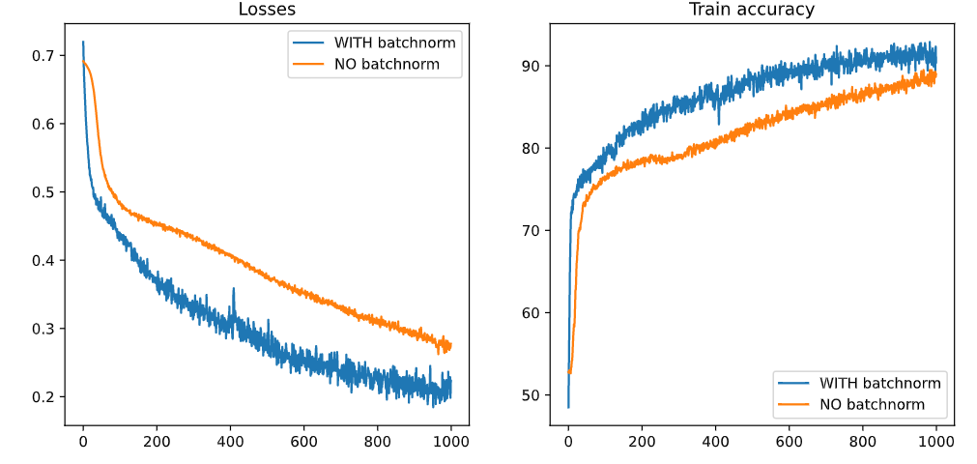
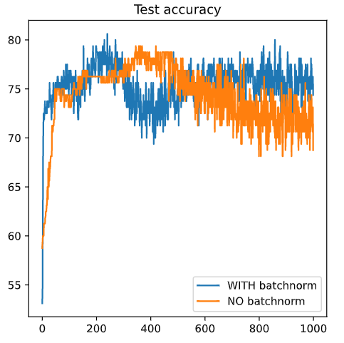
Batch Normalization - Effect

Slide 11
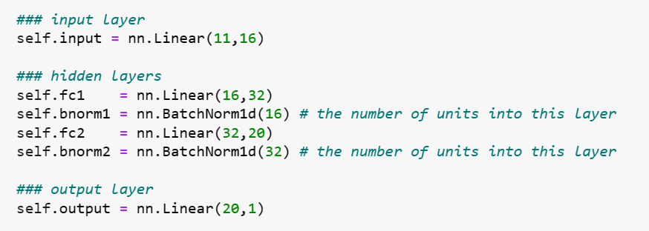
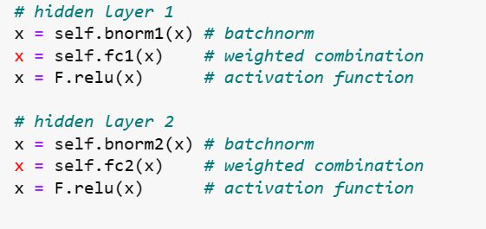
Batch Normalization - Code

Slide 12
Activation Function
Sigmoid
RELU – Rectified Linear Unit
TanH
Softmax Function
Log SoftMax – Log of SoftMax – stronger penalty for errors
Leaky Relu
ELU – Exponential Linear Unit
Swish
Gaussian Error Linear Unit (GELU)
Scaled Exponent Linear Unit(SELU)

Slide 13
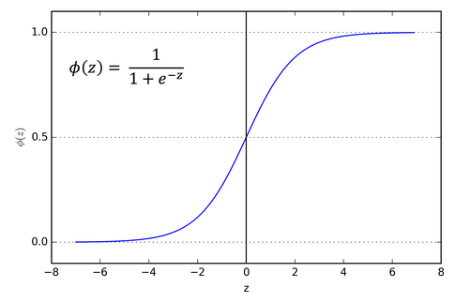
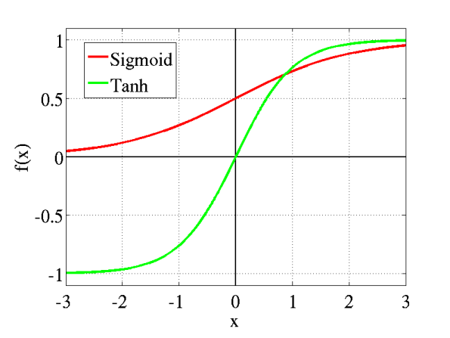
Activation Function

Slide 14
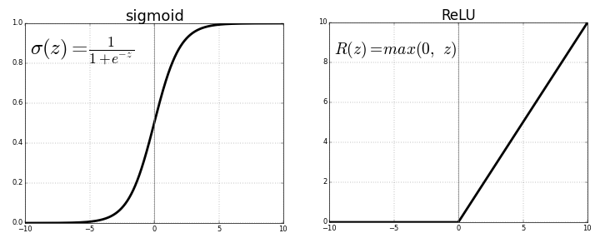
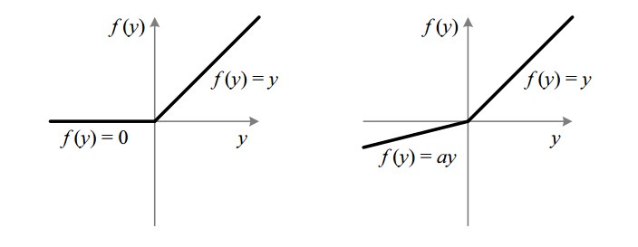
Activation Function
Fig : ReLU v/s Leaky ReLU

Slide 15
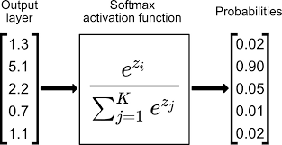
Activation Function

Slide 16
Choose the Activation Function
Regression - Linear Activation Function
Binary Classification—Sigmoid/Logistic Activation Function
Multiclass Classification—Softmax
Multilabel Classification—Sigmoid

Slide 17
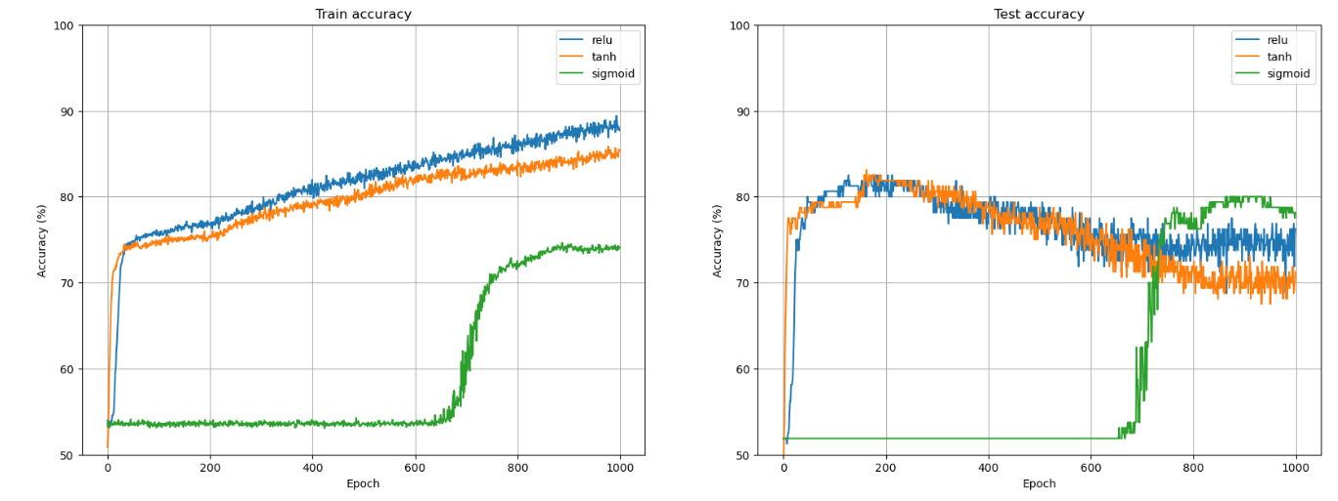
Activation Function - Comparison
For data with binary classification and sigmoid function is applied with BCEWithLogitsLoss

Slide 18
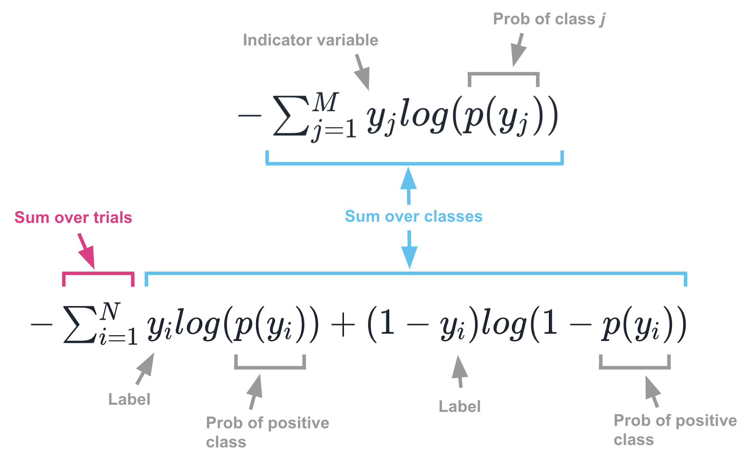
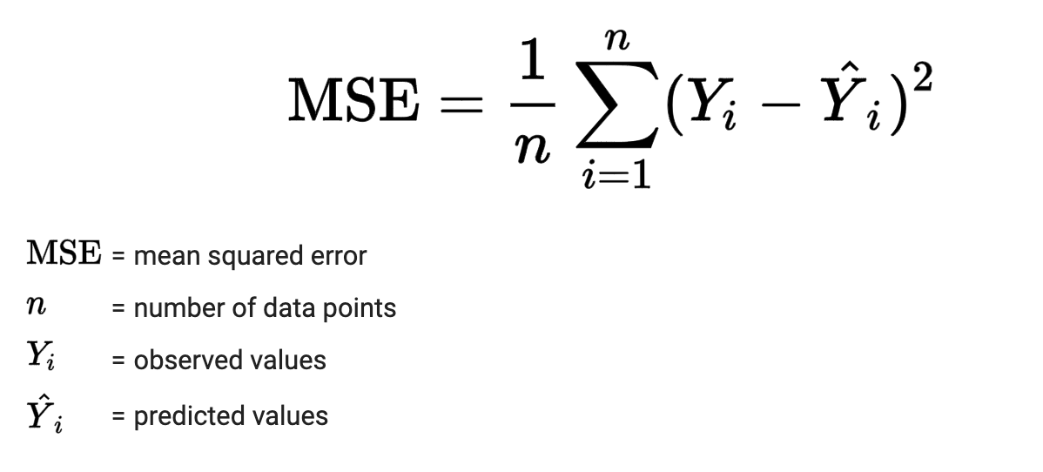
Loss Function
Mean Squared Error (MSE)
Cross Entropy (Logistic)
Use for continuous data when output is a numerical prediction
Use for categorical data when the output is probability

Slide 19
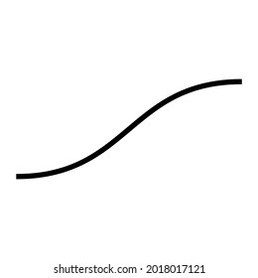










Loss Function – Output Layer Architecture
$$x_{1}$$
Continuous Data
Output layer has 1 unit with linear
activation function
MSE Loss Function
Binary Classification
Output layer has 1 unit with
sigmoid activation function
Cross Entropy(BCE) Loss function
Multiclass N Classification
Output layer has N units with
SoftMax activation function
Classification Cross Entropy(CCE)
$$x_{2}$$
$$y^{^}$$
$$x_{3}$$
$$x_{1}$$
$$x_{2}$$
$$y^{^}$$
$$x_{3}$$
$$x_{1}$$
σ
$$y^{^}$$
$$x_{2}$$
$$x_{3}$$
σ
$$y^{^}$$

Slide 20
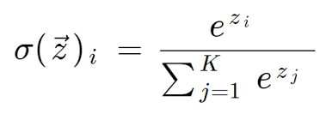
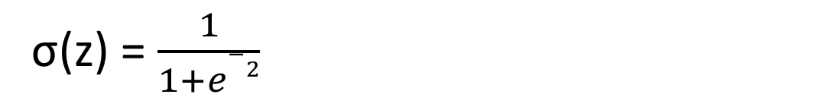
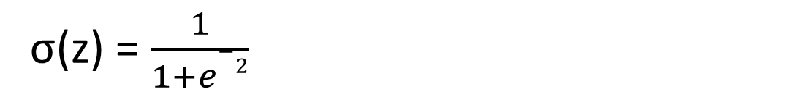
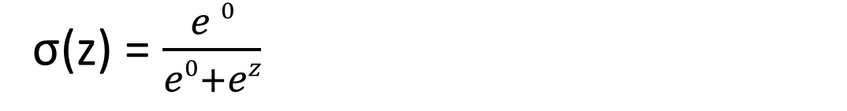
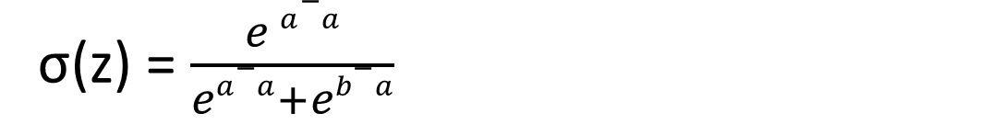
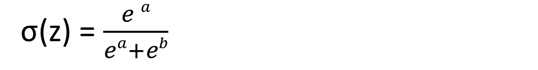
SoftMax v/s Sigmoid
SoftMax for 2 categories is equal to sigmoid
σ(z) = $\frac{1}{1+e−2}$
σ(z) = $\frac{e a}{ea+eb}$
σ(z) = $\frac{e a−a}{ea−a+eb−a}$
σ(z) = $\frac{e 0}{e0+ez}$
σ(z) = $\frac{1}{1+e−2}$

Slide 21

Optimizer – Stochastic Gradient Descent(SGD)
Find the minimum of loss function…
Optimizers refers to the algorithm that adjust weights during back propagation…
The goal of other optimizer is modification of SGD with the goal of smoothing the descent…
$$w w −ոԀՀ$$
SGD changes the weights after each sample…

Slide 22
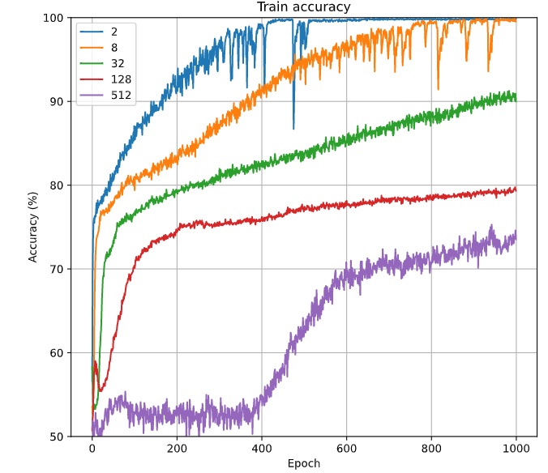
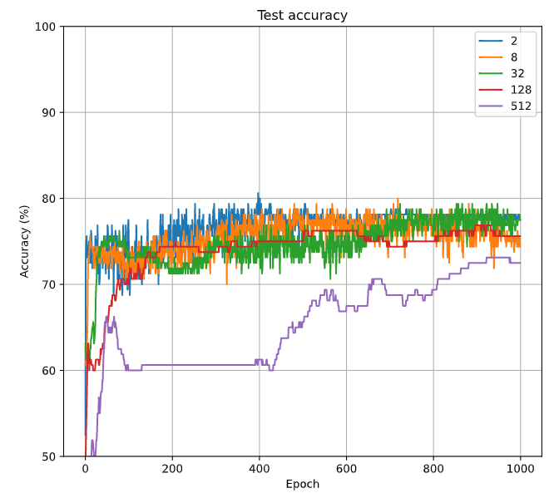

Mini Batch SGD
$$w w −ոԀՀ$$
Changes the weights after N Samples
Computes average loss for N samples.

Slide 23
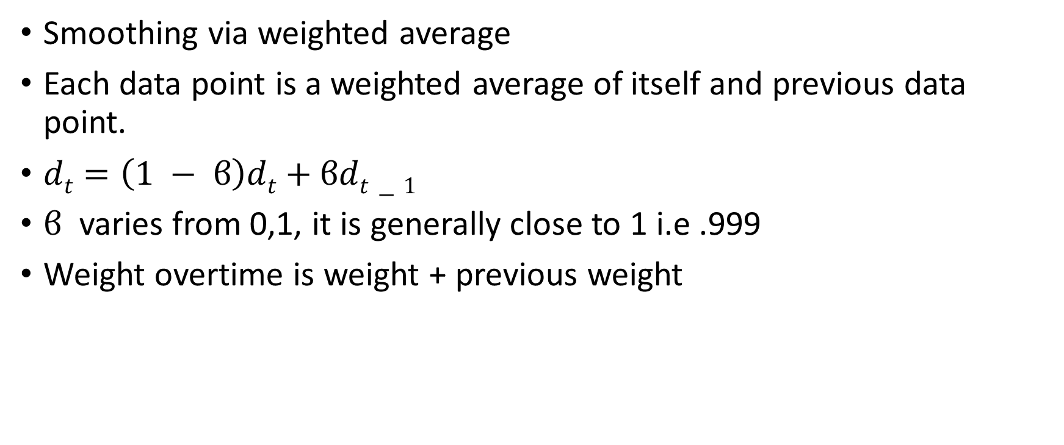
Momentum
Smoothing via weighted average
Each data point is a weighted average of itself and previous data point.
$dt=\left(1 − ϐ\right)dt+ϐdt−1$
$ϐ$ varies from 0,1, it is generally close to 1 i.e .999
Weight overtime is weight + previous weight

Slide 24
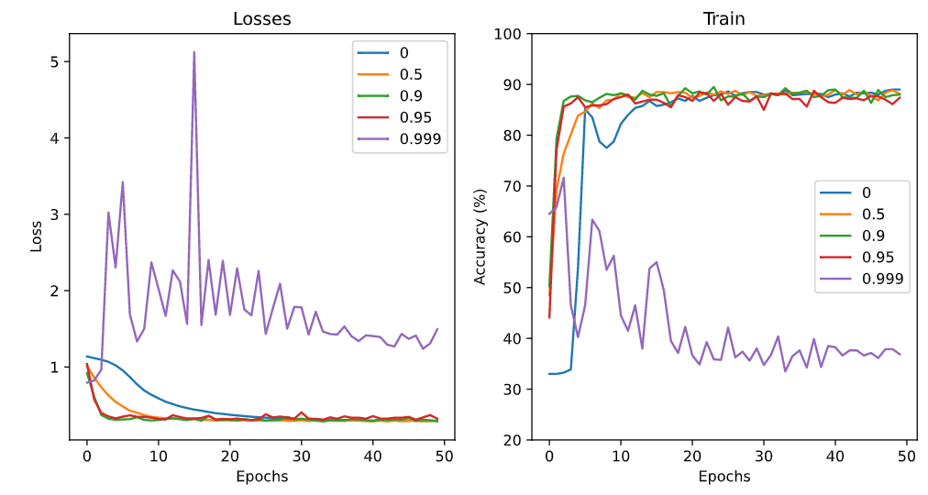
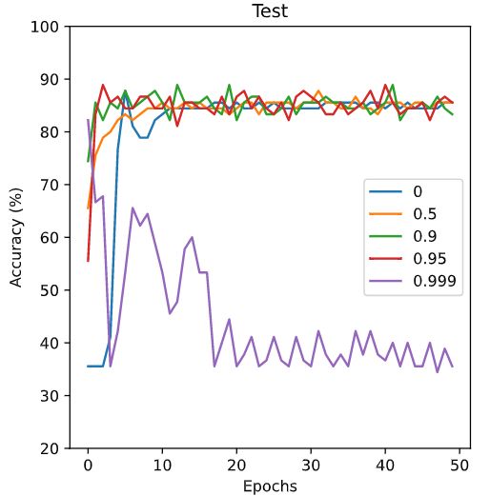
Momentum Effect

Slide 25
Optimizers (RMSProp & Adam)
RMS Prop & Adam is an extension on SGD
RMSProp is similar as momentum, bias the weight changes using dampened previous gradients
RMSProp instead of biasing the gradient bias the learning rate according to the magnitude of gradient.
Instead of changing the gradient change the learning rate based on the gradient, take smaller steps
When gradient is high and take larger steps when gradient is low, this avoid exploding and
Diminishing gradient as well.

Slide 26
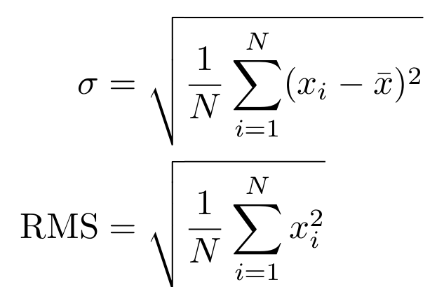
RMS and Variance

Slide 27
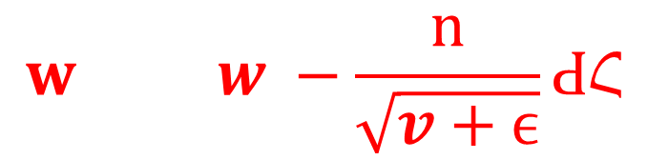

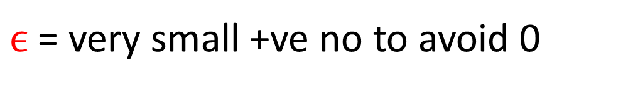
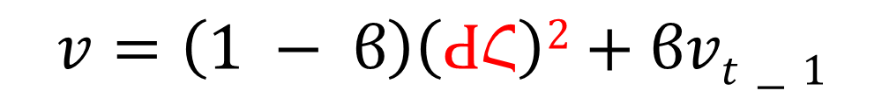
RMS Prop
$$w w −ոԀՀ$$
$$w w −\frac{ո}{\sqrt{v+ϵ}}ԀՀ$$
$$v=\left(1 − ϐ\right)\left(ԀՀ\right)2+ϐvt−1$$
$ϵ$ = very small +ve no to avoid 0

Slide 28
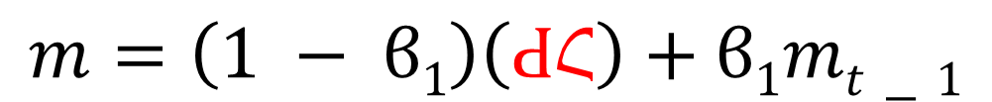
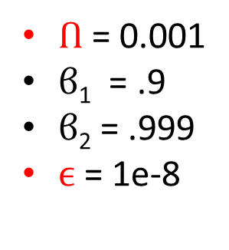
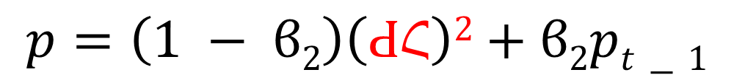
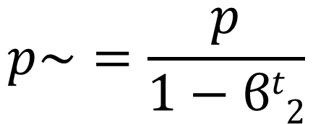
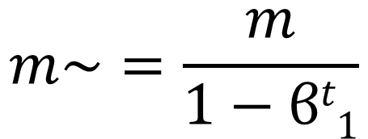
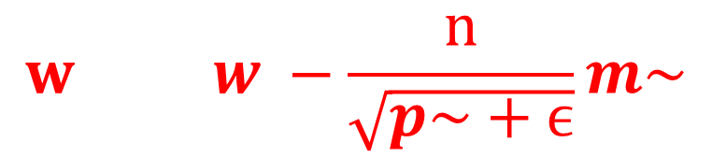
Adam
$$m=\left(1 − ϐ1\right)\left(ԀՀ\right)+ϐ1mt−1$$
Adam is adaptive momentum
Combines momentum and RMSProp
Best Of Both Worlds
$$p=\left(1 − ϐ2\right)\left(ԀՀ\right)2+ϐ2pt−1$$
$$m\sim =\frac{m}{1−ϐt1}$$
$$w w −\frac{ո}{\sqrt{p\sim +ϵ}}m\sim$$
$Ո$ = 0.001
$ϐ$₁ = .9
$ϐ$₂ = .999
$ϵ$ = 1e-8
$$p\sim =\frac{p}{1−ϐt2}$$

Slide 29
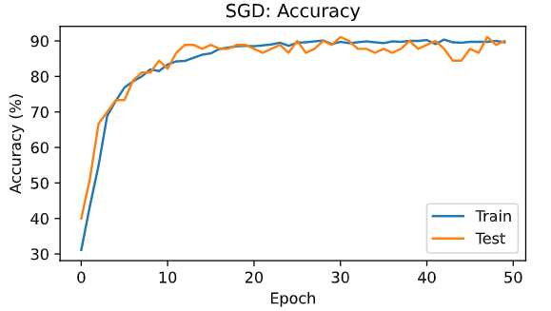
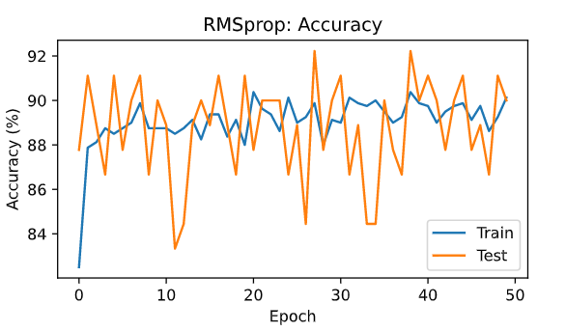
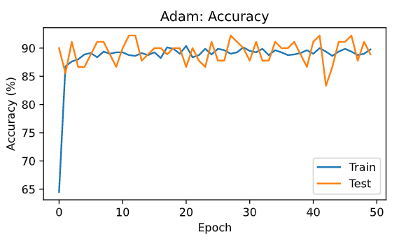
Optimizer Comparisons

Slide 30
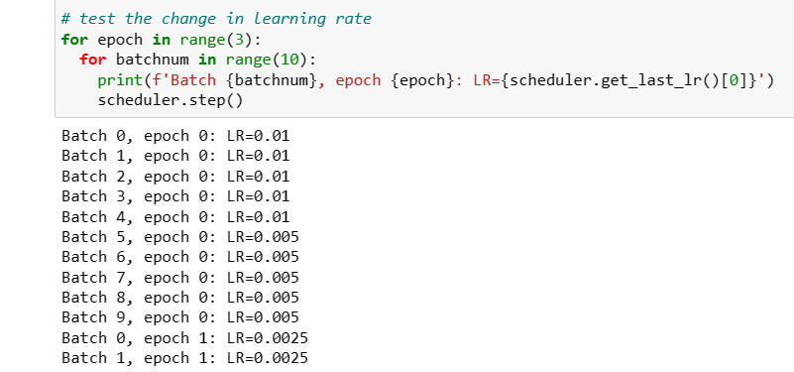
Learning Rate Decay

