Slide 1
Bias & Variance

Slide 2
Bias & Variance
Bias is how far off the mean value of the predicted value from real value.
Variance is how scattered is the predicted value from real value.
Use validation curve for training and validation data set to identify bias and variance. If the validation curve is similar in nature for training set and validation set then it is a perfect model with low bias and low variance.

Slide 3

Bias & Variance
High variance low bias
High bias low variance
.
.
.
.
.
.
.
.
.
.
.
.
.
.
.
High variance High bias
Low bias low variance
.
.
.
.
.
.
.
.
.
.
.
.
.
.
.
.

Slide 4
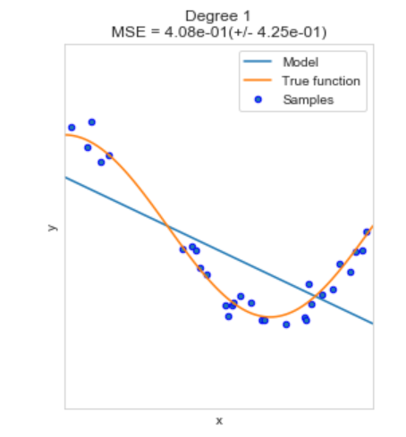
High Bias Low Variance - Underfitting
.
.
.
.
.
.
.
.
.
.
.
.
.
.

Slide 5
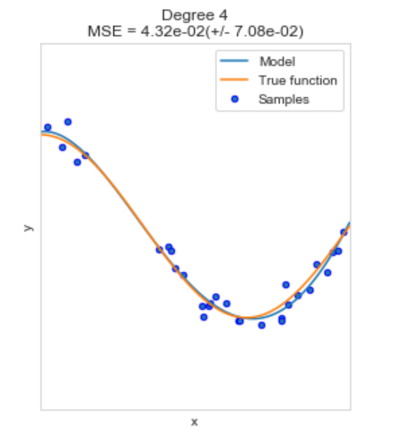
Low Bias Low Variance
.
.
.
.
.
.
.

Slide 6
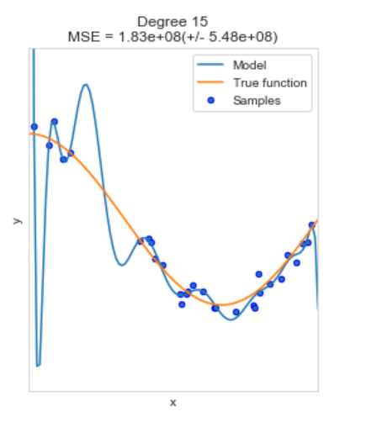
Low Bias High Variance - Overfitting
.
.
.
.
.
.
.

