Slide 1
Gradient Descent
Minimize Cost Function

Slide 2
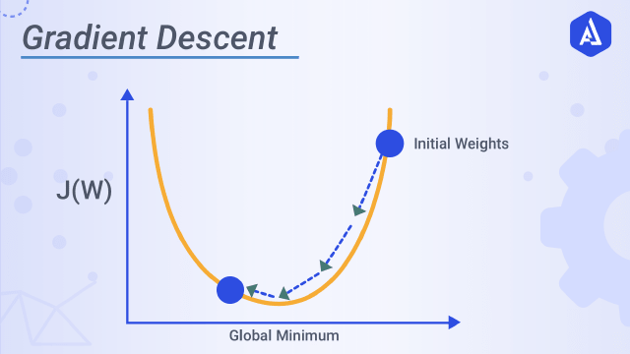
Gradient Descent
Find minimum value of a cost function.

Slide 3
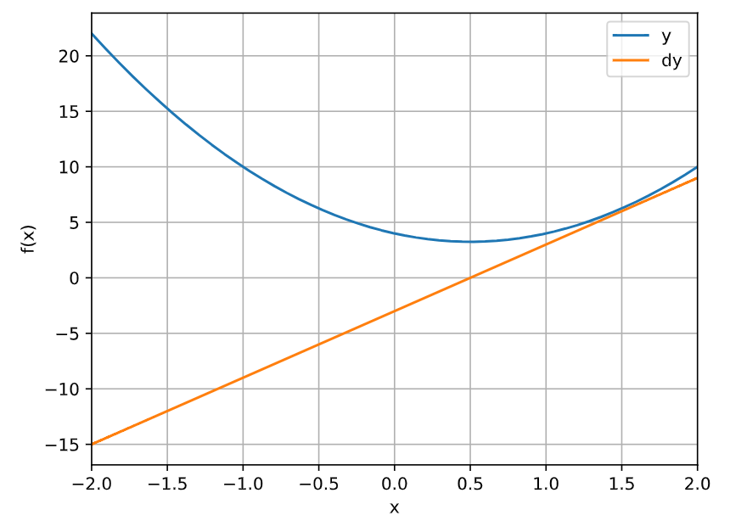



Gradient Descent
Cost Function
Derivative of $f\left(x\right)$
Goal of gradient descent in machine learning is to find the minimum of a function, in this case minimum of a function is when derivative is 0.
When derivative is 0, then find x, $6x −3=0 and hence x= \frac{3}{2}$, $x$ = 0.5
$$f\left(x\right)=3x2−3x+4$$
$\frac{df}{dx}$ = $6x −3$

Slide 4
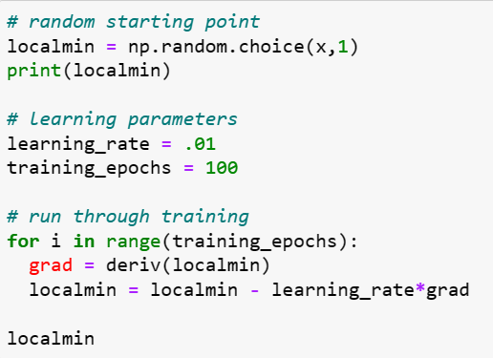
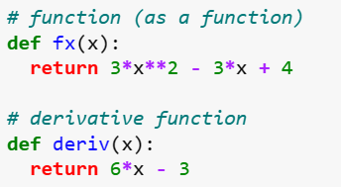
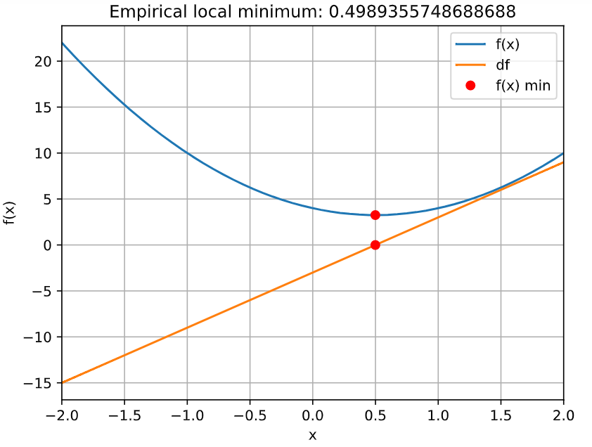

Gradient Descent Goal
We know mathematically the minimum
of cost function is 0.5$, however with 100 epochs we got 0.4989,$
Experiment with more epochs and see if that changes.

Slide 5







Yj = true value
Y^ = predicted value
Jβ) = Cost function
$\frac{1}{2}$ = Additional convenience for derivative
(
Linear Regression Cost Function
$$Residual Error={ y}^{j}\text{ − }{y^}^{j}$$
$Squared Error={ (y}^{j}\text{ − }{y^}^{j}$)²
$$Sum Of Squared Error={ \sum_{j=0}^{n}{{(y}^{j}\text{ − }{y^}^{j}\text{)}\text{2}}}^{}$$
$$Average Squared Error= \frac{1}{n}{ \sum_{j=1}^{n}{{(y}^{j}\text{ − }{y^}^{j}\text{)}\text{2}}}^{}$$
$Cost Function$ = J(β) = $\frac{1}{2n}{ \sum_{j=1}^{n}{{(y}^{j}\text{ − }{y^}^{j}\text{)}\text{2}}}^{}$
$Cost Function$ = J(β) = $\frac{1}{2n}{ \sum_{j=1}^{n}{{(y}^{j}\text{ −}\sum_{i=0}^{n}{βi}xi\text{)}\text{2}}}^{}$
$y hat$= $y$^ = $\sum_{i=0}^{n}{βi}xi$

Slide 6
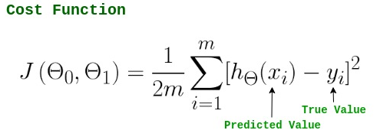
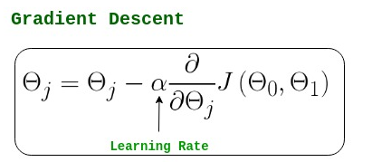
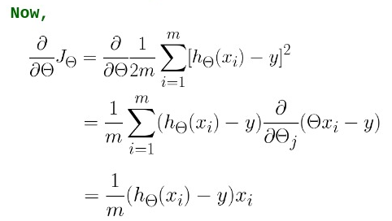
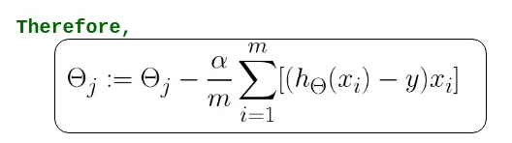
Linear Regression Cost Function

Slide 7
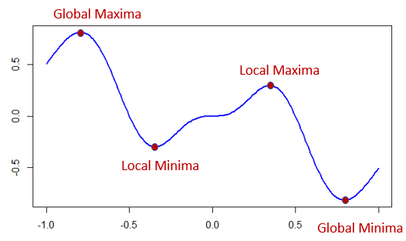
Gradient Descent
Local minima v/s global minima

Slide 8
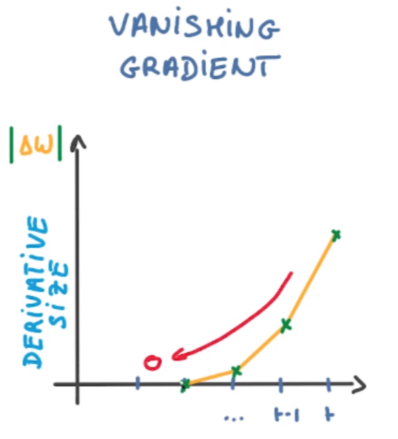
Gradient Descent – Vanishing Gradient
Vanishing is when as backpropagation occurs, the gradients normally get smaller and smaller, gradually approaching zero

Slide 9
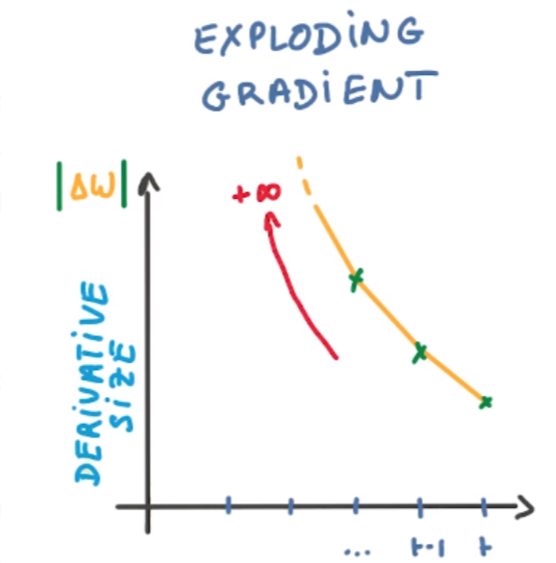
Gradient Descent – Exploding Gradient
Exploding is the opposite of Vanishing and is when the gradient continues to get larger which causes a large weight update and results in the Gradient Descent to diverge.

Slide 10
Gradient Descent – Summary
Use models with few hidden layer.
Use activation function that do not saturate. Ex:- ReLU
Apply weight normalization
Use encoders
Use regularization
Use networks like residual network. Ex:- resnet

Slide 11
OLS – Ordinary Least Squares
Minimize ∑(yi – ŷi)^2
OLS method finds the best-fit line for the data by minimizing the sum of squared errors or residuals between the actual and predicted values.
∂/∂m (SSE) = ∑-2Xi(yi – ŷi)
∑-2Xi(yi – ŷi) = 0
∑-(yi – ŷi) = 0
∑yi*xi = m∑xi*xi + b*∑xi
∑yi = m∑xi + b*n

