Slide 1
Page Object Model Design Patten with Visual Studio C# & Selenium WebDriver
Rameshkumar madhavakurup

Slide 2
Implementation details
POM Design pattern
PageFatory Implementation to Optimize page elements
Generic Web Driver class (ManageWebDriver)
Generic Library class for WebDriver Interaction (SelenseSync)
Page Object Classes (LoginPage, AccountOverviewPage, CartPage)
Test Cases - LoginTest, CartTest
App.config

Slide 3
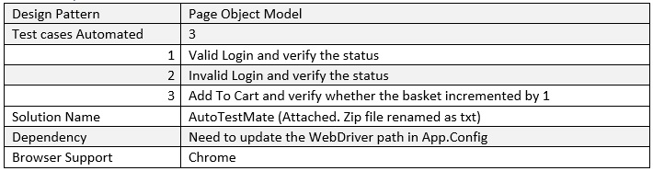
Test cases

Slide 4
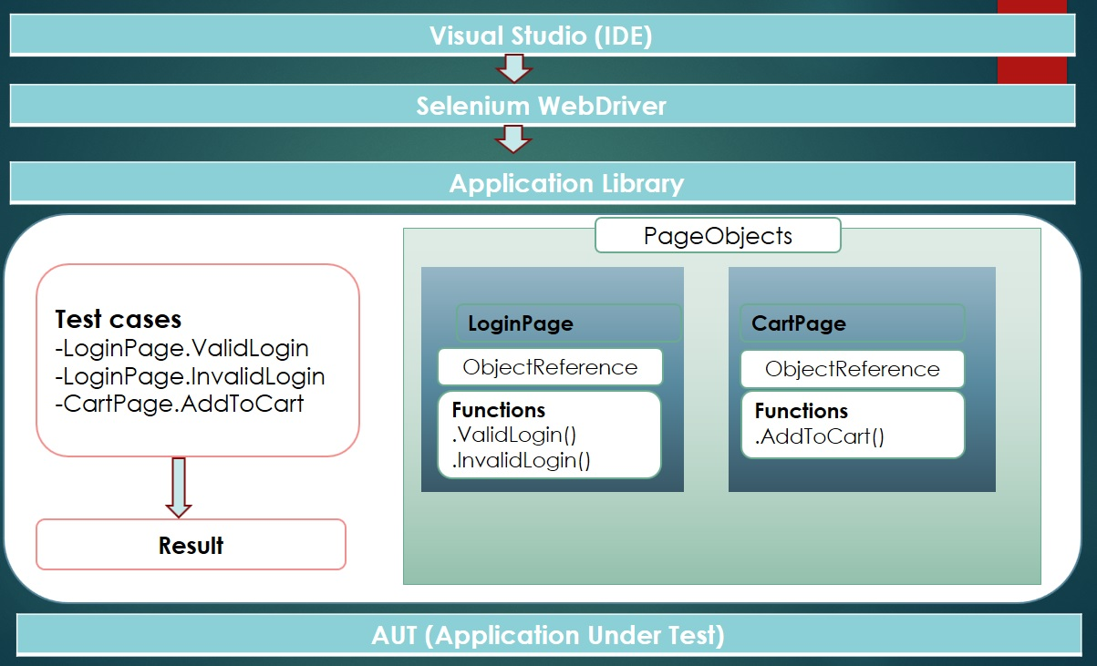
Test Flow

Slide 5
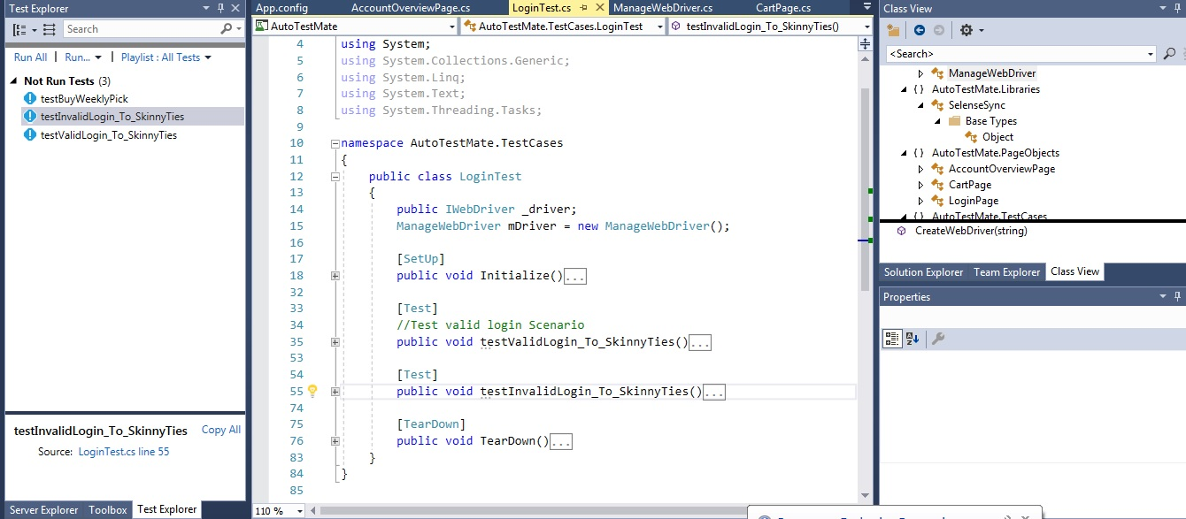
Test Script

Slide 6
Demo

Slide 7
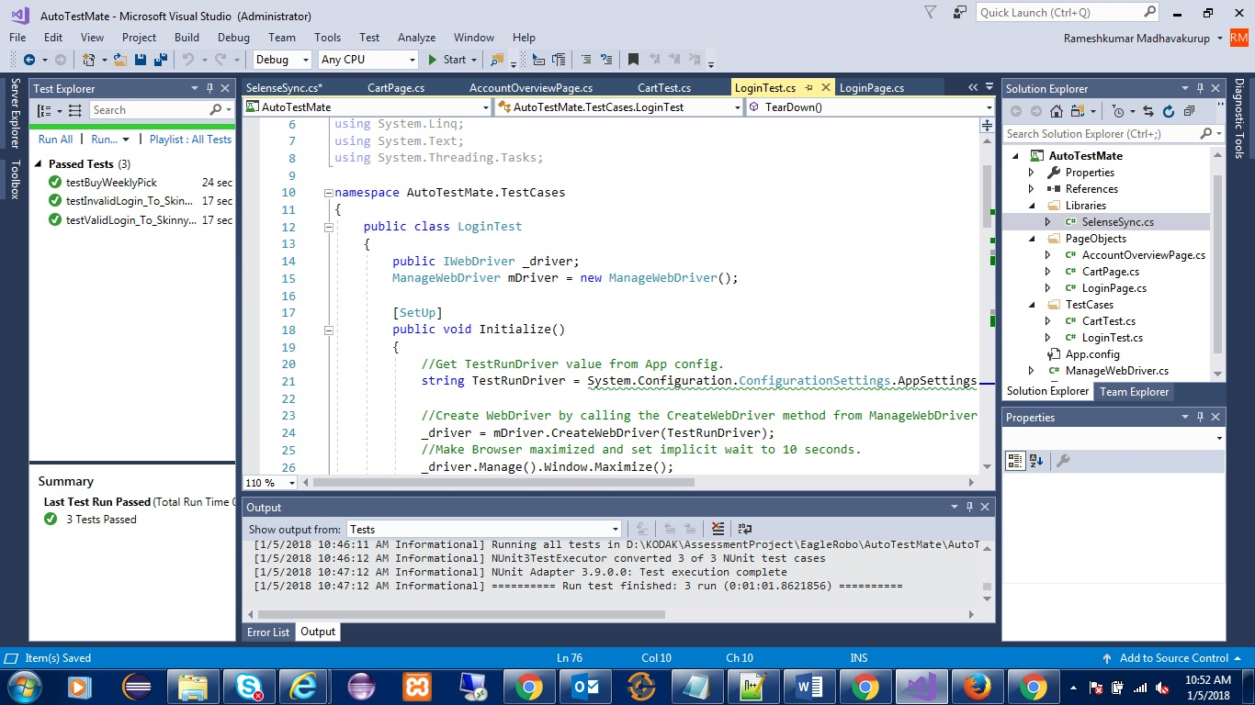
Test Result

Slide 8
Thank You

