Slide 1
AI Powered Cloud Operations Platform
RamaKrishna Vaka
Chakra Yel
Amit Biswas
Pratik Shah
Rajesh Kumar

Slide 2
THE VISION
COMPANY NAME
AGENDA
01
Problem Statement
02
The Solution
03
Architecture
04
Demo
05
Next Steps
06
Q and A

Slide 3
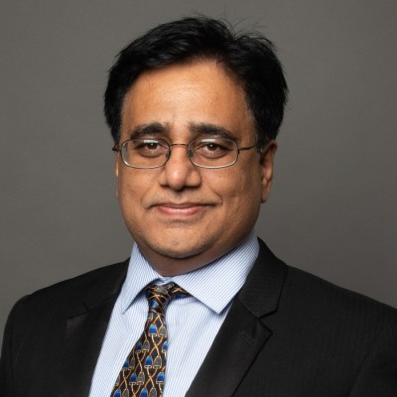
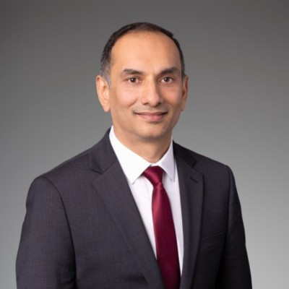


THE TEAM
COMPANY NAME
THE TEAM
Ramakrishna Vaka
Chakra Yel
Amit Biswas
:Pratik Shah
Rajesh Kumar
Infrastructure Solutions Architect, State of Michigan

Slide 4
THE VISION
COMPANY NAME
Cloud environments generate thousands of operational alerts daily:
High CPU alerts
Lambda failures
Security violations
Cost spikes
Infrastructure drift
Most organizations still rely on manual triage by DevOps/SRE teams, which causes:
Slow incident resolution
Alert fatigue
Human errors
👉 We need autonomous cloud operations that can detect, analyze, and remediate issues automatically.
Problem Statement

Slide 5
THE VISION
COMPANY NAME
Problem
Cloud environments generate 1,000s of alerts daily (CPU spikes, failures, security, cost anomalies)
Current State
Manual DevOps/SRE triage →
MTTR in hours (delayed resolution) → $100k per incident (due to prolonged outages)
80% alerts are noise (alert fatigue) → $1M+ per year (due to wasted engineering time)
High risk of human errors → non-compliance exposure / security breach
Problem Statement - v2

Slide 6
THE VISION
COMPANY NAME
The Solution
Build an AI-powered Cloud Operations Platform that can:
Detect operational events in real-time/near real-time
Analyze root cause using AI reasoning
Decide remediation action
Execute automated fix
Notify engineers
Reduce MTTR by 50–80%
This creates a self-healing cloud system and generic solution which can be used across all organizations.
https://github.com/rkumarus040599/sa-bcamp-hackathon-2026

Slide 7
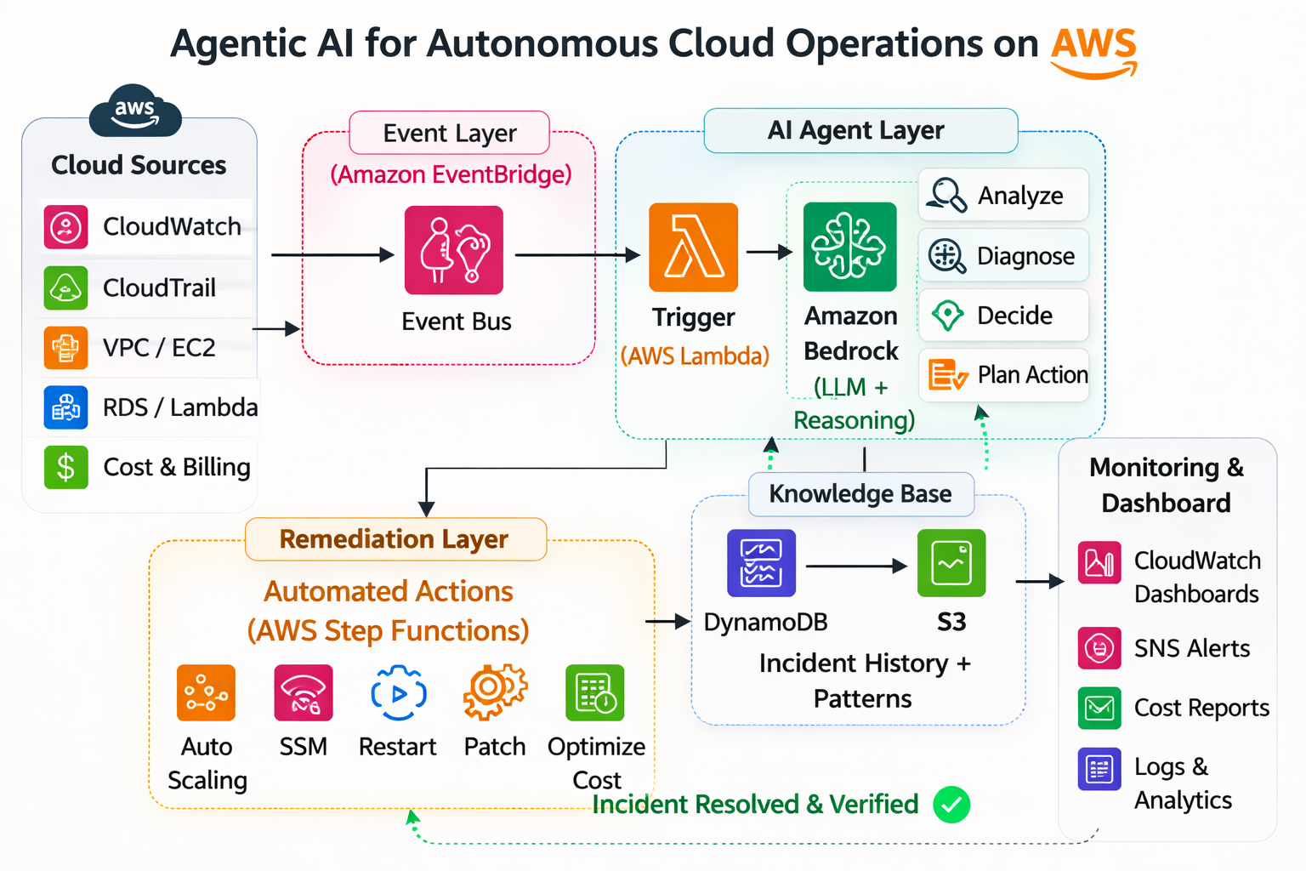
Architecture

Slide 8
Demo
CloudWatch Alarm
↓
EventBridge
↓
Event Router Lambda
↓
AI Agent Layer(Amazon Bedrock RAG)
↓
AWS Step Functions (Remediation Layer)
↓
Knowledge Base
↓
Monitoring & Dashboard
https://github.com/rkumarus040599/sa-bcamp-hackathon-2026

Slide 9
CONCLUSION
COMPANY NAME
THANK YOU
Any questions?

