Slide 1
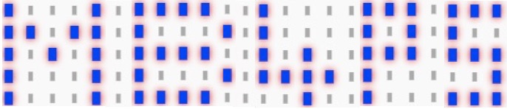

micro:bit for primary schools – mb4ps.co.uk
Session 3 – PXT Editor update
Animations and brightness
Written by Neil Rickus. Licensed under CC BY-NC-SA 4.0

Slide 2
Objectives
Make an animation
Alter the brightness of the LEDs

Slide 3
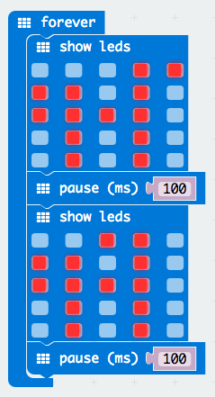
Making animations
Last time we displayed images
We’re now going to animate an image
This code will make a dog sprite wag
its tail!
Can you make a person / animal /
object move on the screen?

Slide 4


Challenges
Make a message scroll after your animation
Program button A to reduce the brightness of the LEDs (255 is maximum brightness)
Set brightness can be found in the Led block,
then clicking More
Program button B to increase the brightness of the LEDs
Program A and B to turn off the LEDs

