Slide 1
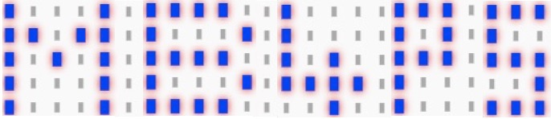

micro:bit for primary schools – mb4ps.co.uk
Independent project
Step counter
Written by Neil Rickus. Licensed under CC BY-NC-SA 4.0

Slide 2
Objectives
Develop a micro:bit based Step counter

Slide 3
Features
The NHS recommends you take 10,000 steps each day -> default target for FitBit
What features do step counters have?
What features are:
Essential?
Desirable?

Slide 4
Features
Essential:
Count number of steps
Display number of steps
Desirable:
Show number of steps to target
Set target number of steps
Display motivational messages

Slide 5
Implementation
For the essential features, discuss how you might implement them
Focus on the functionality, rather than the specific blocks you’ll need
Use a whiteboard and pen if you need it
Essential:
Count number of steps
Display number of steps

Slide 6
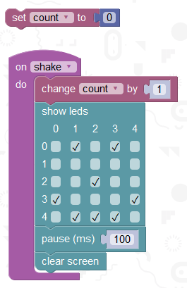
Counting steps
We need a variable to
record the number of steps
We then increase the steps
each time we shake the
micro:bit
We can display an image to
show we took a step

Slide 7
Counting steps
We need a variable to
record the number of steps
We then increase the steps
each time we shake the
micro:bit
We can display an image to
show we took a step

Slide 8
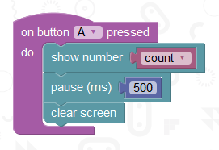
Displaying steps
When button A is pressed,
we show the number of steps
for a short amount of time,
then clear the screen

Slide 9
Displaying steps
When button A is pressed,
we show the number of steps
for a short amount of time,
then clear the screen

Slide 10
Desirable features
Desirable:
Show number of steps to target
Set target number of steps
Display motivational messages
Could you record whether a step
is taken more accurately?

Slide 11
Desirable features
Desirable:
Show number of steps to target
Set target number of steps
Display motivational messages
Could you record whether a step
is taken more accurately?

Slide 12
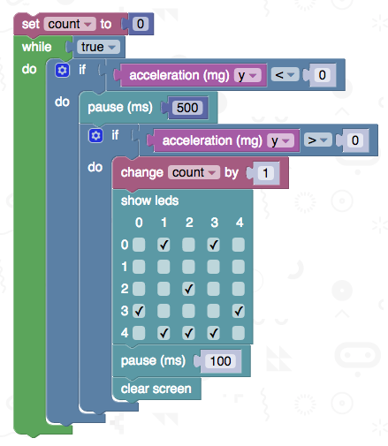
Accurate Step Recording
We can record the number of steps taken more accurately by looking for changes in values recorded by the accelerometer

