Slide 1
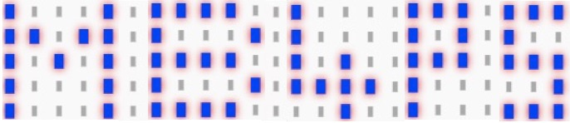

micro:bit for primary schools – mb4ps.co.uk
Radio – PXT Editor update
Introduction
Written by Neil Rickus. Licensed under CC BY-NC-SA 4.0

Slide 2
Objectives
Send and receive messages using the micro:bit radio
You’ll need at least two micro:bits for this session!

Slide 3

Using the micro:bit radio
The micro:bit has an in built radio, which can be used to send and receive data between micro:bits
A radio that can both send and receive is called a transceiver
We could send text, numbers, or even information from the micro:bit’s sensors
We first need to ensure the micro:bits send and receive data using the same channel, or group. We can use any number between 0 and 255 for the group

Slide 4
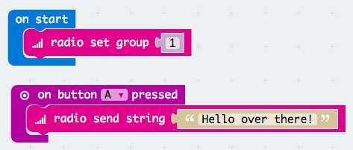
Sending text
We can send messages using the radio send string block
Download these instructions on to your first micro:bit

Slide 5
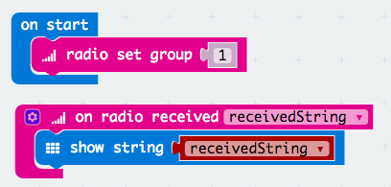
Receiving text
We can display the messages received using the on radio received block with a show string block (receivedString is a variable)
Download these instructions on to your second micro:bit
Try pressing button A on your first micro:bit. The message should display on the second micro:bit

Slide 6
Challenges
Make the first micro:bit also able to receive messages
Make the second micro:bit also able to send messages
Send different text depending on the button pressed
Send (and receive) numerical values, rather than text (Hint: use radio send number and on radio received receivedNumber)
Program Button A to select and display a random number, then Button B to send the selected number to the other micro:bit
When shaken, program the last two numbers received to be added together and displayed on the screen
When a button is pressed on either micro:bit, make both micro:bits display a countdown (from 5 -> 0) then show rock, paper or scissors

