Slide 1

Sustain Earth
A visualization and enablement tool for saving earth
Saviours : Kacey Gambill, Catalin Dragu, Ramesh Kuruba

Slide 2
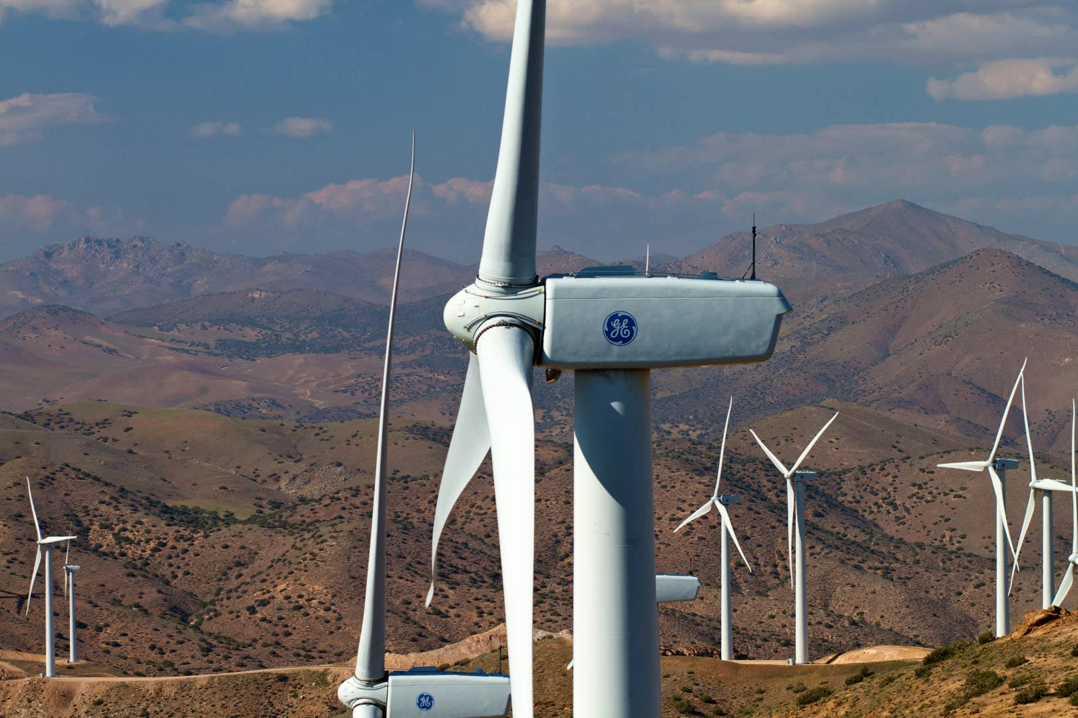
“This tool can be used to save water in the households based on the precipitation in the past three days”

Slide 3





Demo
AWS Services & Data
Amazon API Gateway
AWS Lambda
Amazon S3
bucket
Amazon Athena
AWS Glue
ASDI Data

Slide 4
Demo
“Who is the center of the earth?”

